Slide 1
The Generator Effect

Slide 2
Information
Developing and Using Models
Planning and Carrying Out Investigations
Constructing Explanations and Designing Solutions
2. Cause and Effect
5. Energy and Matter
6. Structure and Function

Slide 3
Inducing current in a wire
Notes:
Teacher notes
This virtual experiment can be used as an introduction to electromagnetic induction or as a summary exercise.
This presentation is accompanied by the worksheet The Generator Effect.

Slide 4
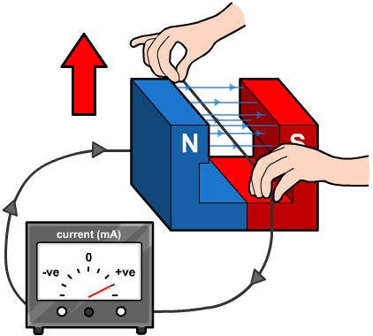
What is electromagnetic induction?
When current flows through a wire held in a magnetic field, a force is created that moves the wire. This is the motor effect.
The opposite is also possible: if a wire is moved through a magnetic field, a potential difference is induced across the ends of the wire.
If the wire is part of a complete circuit, a current is produced. This is electromagnetic induction, or the generator effect.
The induced current generates a second magnetic field. The generated magnetic field opposes the movement of the wire or a change in the original magnetic field.
Notes:
Teacher notes
For more information about how a current generates a magnetic field, please refer to the Electromagnetism and Motors presentations.

Slide 5
Inducing current in a coil
Notes:
Teacher notes
This virtual experiment can be used as an alternative introduction to electromagnetic induction or as a summary exercise.
This slide covers the Science and Engineering Practice:
Planning and Carrying Out Investigations: Plan an investigation or test a design individually and collaboratively to produce data to serve as the basis for evidence as part of building and revising models, supporting explanations for phenomena, or testing solutions to problems. Consider possible variables or effects and evaluate the confounding investigation’s design to ensure variables are controlled.

Slide 6
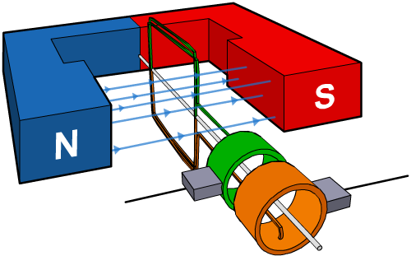
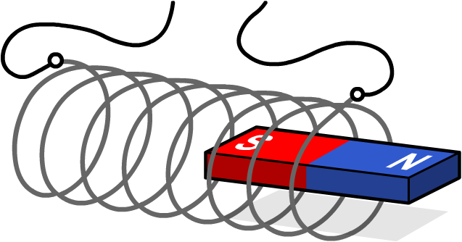
Magnet and coil: relative movement
Electromagnetic induction depends on relative movement between the magnet and the coil.
It does not matter whether it is the coil (top) or the magnet (bottom) that is moving.
If there is no movement, then there will be no electromagnetic induction and no potential difference produced across the ends of the coil.
A current is induced when the wire and magnetic field move perpendicular to each other. If they move parallel to each other, no current is induced.

Slide 7
Varying the size of the induced current
Notes:
This slide covers the Science and Engineering Practice:
Planning and Carrying Out Investigations: Plan an investigation or test a design individually and collaboratively to produce data to serve as the basis for evidence as part of building and revising models, supporting explanations for phenomena, or testing solutions to problems. Consider possible variables or effects and evaluate the confounding investigation’s design to ensure variables are controlled.

Slide 8
Factors affecting induced current
Notes:
Teacher notes
Appropriately colored voting cards could be used with this classification activity to increase class participation.

Slide 9
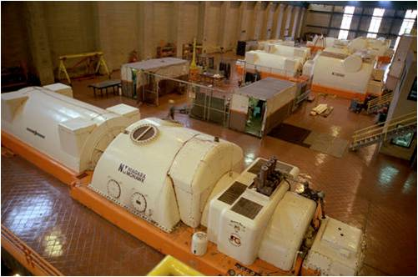
Increasing the size of the induced current
How can the size of an induced current be increased?
increase the speed at which the coil rotates
increase the strength of the magnetic field
increase the number of turns in the coil
increase the total area of the coil.
An electromagnet is often used in a power station generator. This can provide a stronger magnetic field than a permanent magnet.
Notes:
Photo credit: © David Parsons / National Renewable Energy Laboratory
The generator of Niagara Mohawk’s Dunkirk steam station in New York. This coal-fired power plant produces 600,000 kilowatts of 60 cycle power.

Slide 10
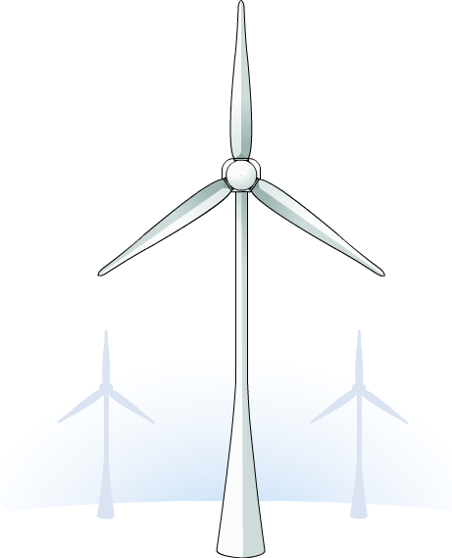
What are generators?
An electric current is created by moving a coil of wire in a magnetic field, or moving a magnet through a coil of wire.
A generator is a device that converts kinetic energy into electrical energy. It is the opposite of an electric motor.
The kinetic energy is provided by primary energy sources. For example, wind turbines use kinetic energy from the wind to provide rotational motion in a generator.

Slide 11
How do AC generators work?
Notes:
Teacher notes
Press on the labels to learn more about slip rings, brushes and the coil. The induced current changes direction with every half turn of the coil in the magnetic field. This is alternating current.
This slide covers the Science and Engineering Practices:
Developing and Using Models: Develop, revise, and/or use a model based on evidence to illustrate and/or predict the relationships between systems or between components of a system.
Constructing Explanations and Designing Solutions: Apply scientific ideas, principles, and/or evidence to provide an explanation of phenomena and solve design problems, taking into account possible unanticipated effects.

Slide 12
AC generator simulation
Notes:
Teacher notes
This simulation takes the concepts from the previous slide to create an animated generator simulation. The current, forces and magnetic field can be toggled on and off to aid visualization and understanding.

Slide 13
Another way of generating AC
Notes:
This slide covers the Science and Engineering Practice:
Constructing Explanations and Designing Solutions: Apply scientific ideas, principles, and/or evidence to provide an explanation of phenomena and solve design problems, taking into account possible unanticipated effects.

Slide 14
Electromagnets in generators
Electromagnets are often used in power station generators. They provide stronger magnetic fields, and thus larger currents in a coil and more electricity, than permanent magnets.
How can the size of the induced current be increased?
increase the speed at which the electromagnet rotates
the size of the induced current depends on how quickly the magnetic field is changing, so a magnet moving faster creates a larger current.
increase the number of turns in the electromagnetic coil
more turns in the coil generates a stronger magnetic field, which induces a larger current in a nearby coil when moved.

Slide 15
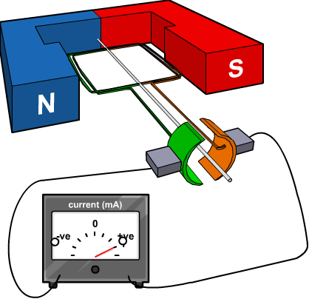
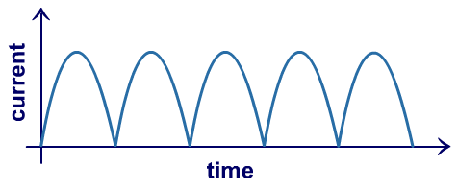
Generating DC
An alternator is used to generate AC (alternating current).
The generator effect can also be used to generate DC (direct current). A dynamo is used to generate DC.
A dynamo works in a similar way to an alternator, but contains a commutator instead of slip rings.
The commutator reverses the connection to the coils every half turn, so the current is always produced in one direction.

Slide 16
Comparing AC and DC
Notes:
Teacher notes
This virtual experiment uses an oscilloscope connected to a power supply to enable students’ to compare AC and DC. It could be used to remind students about alternating and direct current. The current can be switched between alternating current and direct current. The dials can be used to alter the voltage and frequency. It should be highlighted that altering the frequency has no effect on the DC current. The static/dynamic button allows the wave to appear stationary (static) or move across the oscilloscope screen (dynamic).

Slide 17
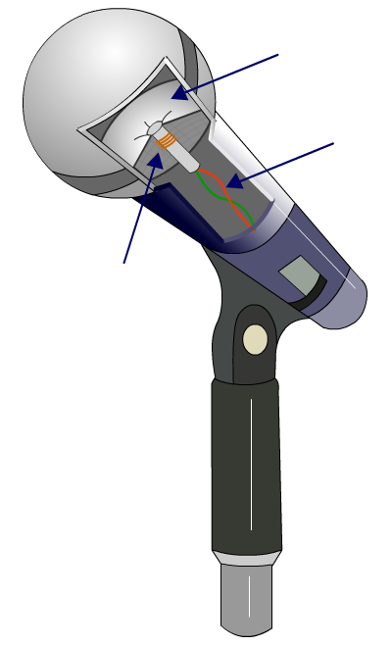
Moving-coil microphones
Sound waves can be used move a coil in a magnetic field.
This is how a moving-coil microphone converts sound into electrical signals.
A moving-coil microphone contains a diaphragm that vibrates in response to the pressure variations in sound waves.
diaphragm that vibrates
The diaphragm is attached to a coil, which moves in a magnetic field as the diaphragm vibrates, inducing a current in the coil.
wires carry electrical signal
coil attached to diaphragm
The frequency and amplitude of the current induced depend on the frequency and amplitude of the sound wave.
Notes:
This slide covers the Science and Engineering Practice:
Constructing Explanations and Designing Solutions: Apply scientific ideas, principles, and/or evidence to provide an explanation of phenomena and solve design problems, taking into account possible unanticipated effects.

Slide 18
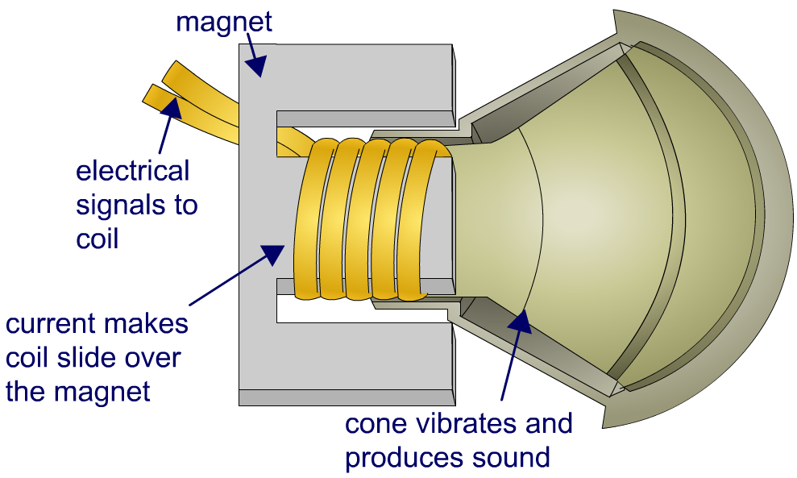
Loudspeakers and headphones
A moving-coil loudspeaker is the reverse of a moving-coil microphone. It uses the motor effect to convert electrical signals into sound waves.
A current is passed through a coil in a magnetic field. This causes the coil to move.
The coil is attached to a cone, which vibrates as the coil moves. The vibrations of the cone produce sound waves.
Headphones convert variations in current into the pressure variations in sound waves in the same way.
Notes:
This slide covers the Science and Engineering Practice:
Constructing Explanations and Designing Solutions: Apply scientific ideas, principles, and/or evidence to provide an explanation of phenomena and solve design problems, taking into account possible unanticipated effects.

Slide 19
Multiple-choice quiz
Notes:
Teacher notes
This multiple-choice quiz could be used as a summary activity to assess students’ understanding of generators. The questions can be skipped through without answering by pressing “next.”

