Slide 1
Static Electricity

Slide 2
Information
Developing and Using Models
Planning and Carrying Out Investigations
Constructing Explanations and Designing Solutions
1. Patterns
2. Cause and Effect
6. Structure and Function

Slide 3
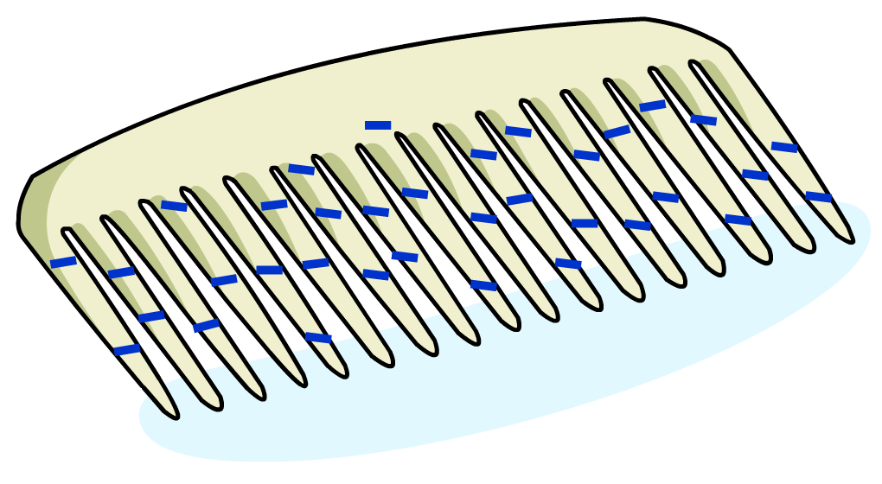
What causes static electricity?
Static electricity is due to electric charge that builds up on the surface of an insulator, such as a plastic comb.
The charge that has built up cannot easily flow away from the insulator, which is why it is called static electricity.
Notes:
This presentation is accompanied by the worksheet Static Electricity.

Slide 4
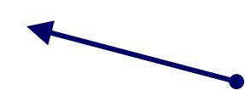
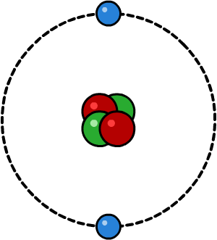
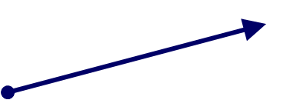
Where does static charge come from?
All materials are made of atoms, which contain electric charges.
Around the nucleus of an atom there are electrons, which have a negative charge.
The nucleus at the center of an atom contains protons, which have a positive charge.
An atom has equal numbers of electrons and protons and so has no overall charge.
Electrons do not always stay attached to atoms and can sometimes be removed by rubbing.
Atoms that have lost or gained electrons are called ions.
Notes:
Teacher notes
It might be worthwhile pointing out that the nucleus also contains neutrons, which have no charge.

Slide 5
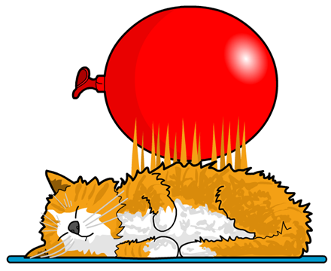
Charging up
In insulating materials, charge can build up on the surface of an object. The charge gets stuck there because it cannot flow through the insulating material.
This happens due to a transfer of electrons.
If there are more electrons than protons on the surface of an object, the surface will be negatively charged.
If there are fewer electrons than protons, the surface will be positively charged.
Electron transfer can happen when two different insulating materials are rubbed together. Rubbing a balloon against your hair is an example of this.
Notes:
This slide covers the Science and Engineering Practice:
Constructing Explanations and Designing Solutions: Apply scientific ideas, principles, and/or evidence to provide an explanation of phenomena and solve design problems, taking into account possible unanticipated effects.

Slide 6
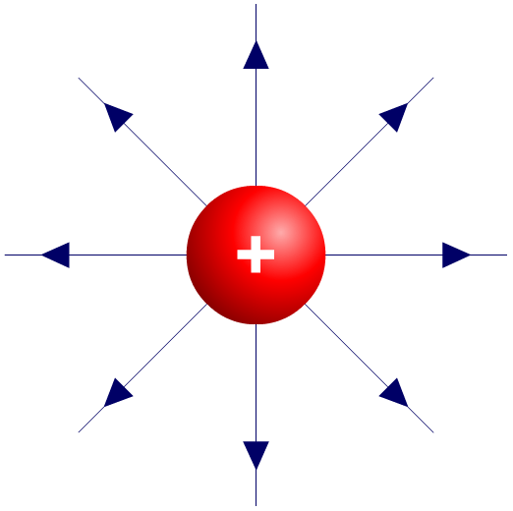
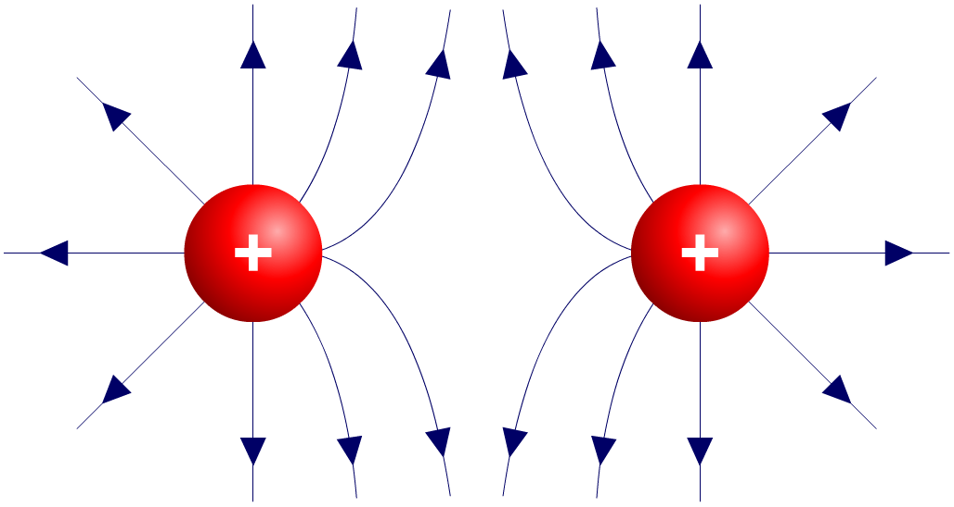
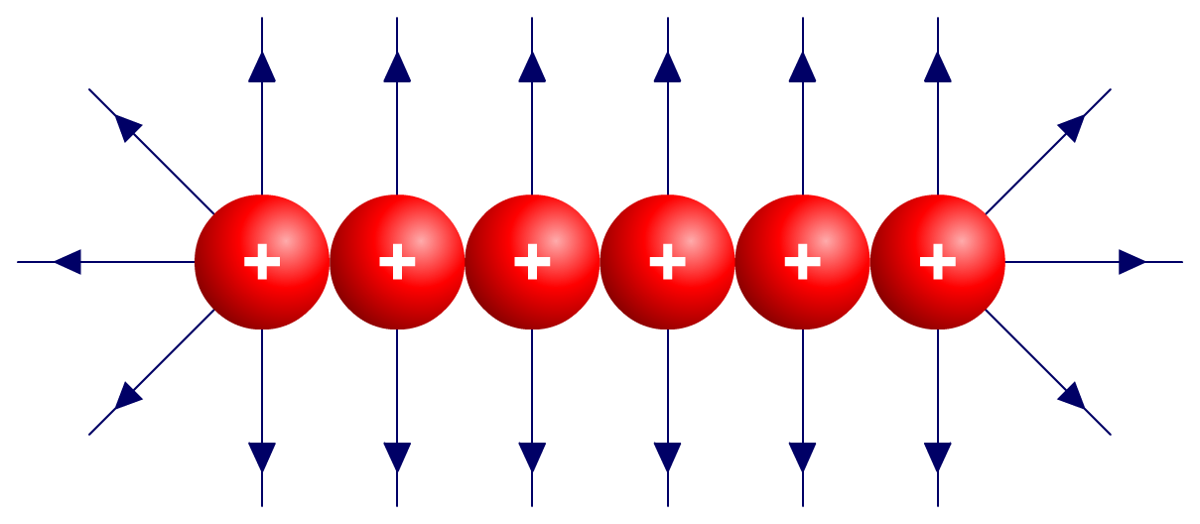
Adding fields
When charges are close to each other, their fields interfere.
+
When two particles with the same charge are next to each other, there are no field lines between the particles.
If several positive charges are lined up, then only straight field lines at right angles to the line of particles will be seen (except at the edges).
Notes:
Teacher notes
For more information about the fields around charges, please refer to the Electric Fields presentation.
This slide covers the Science and Engineering Practice:
Developing and Using Models: Use a model to provide mechanistic accounts of phenomena.

Slide 7
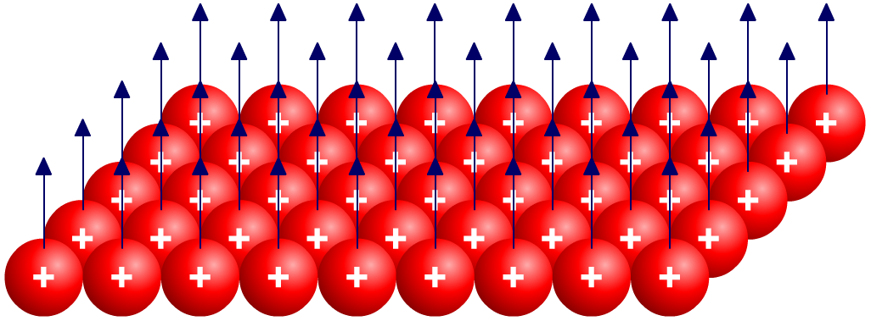
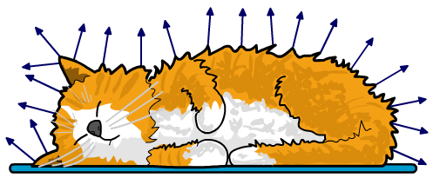
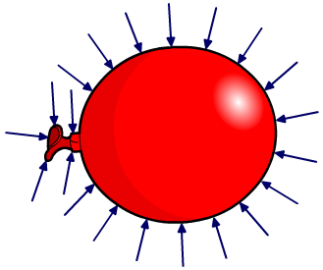
Charged surfaces
A positively-charged surface will only have field lines pointing outwards from the surface.
So the field lines of a charged object simply point outwards or inwards from the surface of the object. The direction of the field lines depends on the object’s charge.
positively charged object
negatively charged object
Notes:
This slide covers the Science and Engineering Practice:
Developing and Using Models: Use a model to provide mechanistic accounts of phenomena.

Slide 8
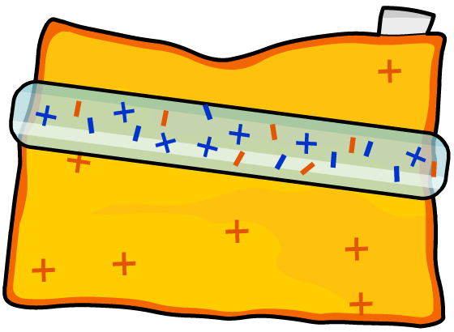
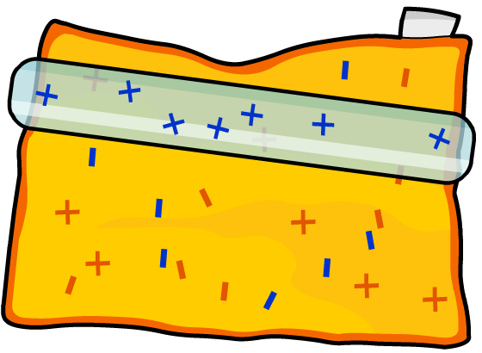
How can static charge be created?
Friction can be used to create a static charge.
If an insulator is rubbed with a cloth, it can become charged in one of two ways:
Electrons move from
the cloth to the insulator.
Electrons move from
the insulator to the cloth.
OR
The insulator ends up with an overall negative charge.
The insulator ends up with an overall positive charge.

Slide 9
Charging materials
Notes:
Teacher notes
This animated activity could be used to introduce the topic of charging materials and could be used as a precursor to work in the lab. It should be highlighted that it is the movement of electrons that causes materials to become charged and not the movement of protons. Students should be aware that the materials that can be charged are insulators. Unlike metals, these materials do no conduct electricity and so charge is able to build up.
This slide covers the Science and Engineering Practice:
Constructing Explanations and Designing Solutions: Apply scientific ideas, principles, and/or evidence to provide an explanation of phenomena and solve design problems, taking into account possible unanticipated effects.

Slide 10
Static charge – true or false?
Notes:
Teacher notes
This true-or-false activity could be used as an introductory or summary exercise on static charge, or at the start of a lesson to gauge students’ existing knowledge of the subject matter. Colored traffic light cards (red = false, yellow = don’t know, green = true) could be used to make this a whole class exercise.

Slide 11
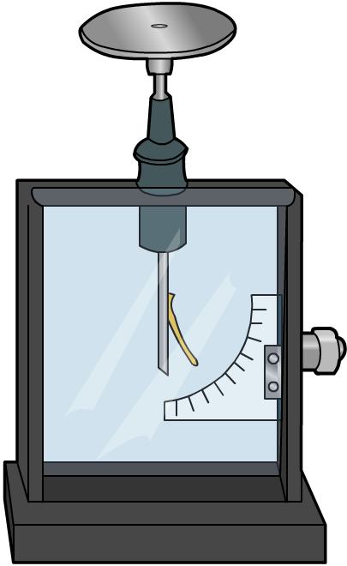
How can static charge be detected?
A gold leaf electroscope can be used to detect charge.
An electroscope consists of an earthed metal case, inside which a metal rod is connected to a metal plate.
A piece of gold leaf is attached to the other end of the metal rod.
When the metal plate becomes charged, the charge spreads out through the metal rod and the gold leaf.
The metal rod and the gold leaf gain the same charge, so the thin gold leaf is repelled from the rod and sticks out.

Slide 12
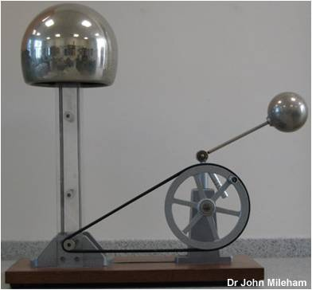
What is a Van de Graaff generator?
A Van de Graaff generator is a machine used to build up static charge.
It was invented in 1931 by Robert Jemison Van de Graaff, an American physicist.
This machine uses the simple principle of rubbing insulating materials together to build up a supply of charged particles.
The generator can produce very high voltages and was first used to help scientists study the behavior of subatomic particles.
Notes:
Photo credit: Dr John Mileham

Slide 13
Van de Graaff generator
Notes:
Teacher notes
This three-part animation could be used to introduce work on Van de Graaff generators. It could be highlighted to students that the generator uses the basic principle of rubbing insulators together to produce charge. In stage 3, it is important to note that the boy would be standing on an insulator, such as a rubber coated step.
This slide covers the Science and Engineering Practice:
Constructing Explanations and Designing Solutions: Apply scientific ideas, principles, and/or evidence to provide an explanation of phenomena and solve design problems, taking into account possible unanticipated effects.

Slide 14
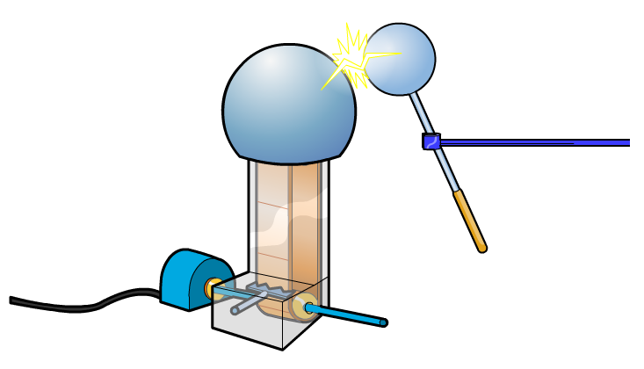
Sparking
Static charge builds up in insulating materials. If a charged insulating material is brought into contact with a conductor, the charge can transfer from the insulator to the conductor.
If a conductor touches a positively-charged insulator, electrons will move from the conductor to the insulator, and the conductor will become positively charged. The reverse happens if the insulator is negatively charged.
If a charged conductor is brought near another conductor, electrons can jump through the air from one conductor to the other, creating a spark.
Notes:
This slide covers the Science and Engineering Practice:
Constructing Explanations and Designing Solutions: Apply scientific ideas, principles, and/or evidence to provide an explanation of phenomena and solve design problems, taking into account possible unanticipated effects.

Slide 15
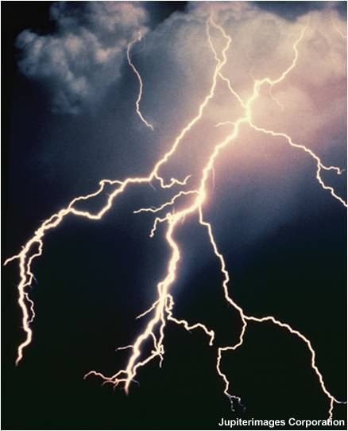
Is lightning caused by electric charge?
Lightning is an electric discharge that occurs when charge builds up in clouds.
The physical properties of water enable regions of a cloud to become positively or negatively charged.
When enough charge has built up, it will follow a path to Earth.
This movement produces lightning, which is simply a big spark!
Notes:
Photo credit: © Jupiterimages Corporation 2018

Slide 16
What did Benjamin Franklin do?
Notes:
Teacher notes
This historical sequence could be used to introduce the concept of lightning as form of electricity.
Suitable prompts include: Stage 1: What do the terms “positive” and “negative” refer to? It could also be highlighted that the illustration contains spectacles and a pair of swimming flippers, both of which were invented by Franklin.
Stage 2: Why did Franklin add a metal key to the string of the kite?
Stage 3: Why did Franklin get a shock?
Stage 4: How does a lightning conductor prevent damage to buildings? It should be highlighted to students that a lightning conductor does not stop lightning but controls the path of a lightning strike.

Slide 17
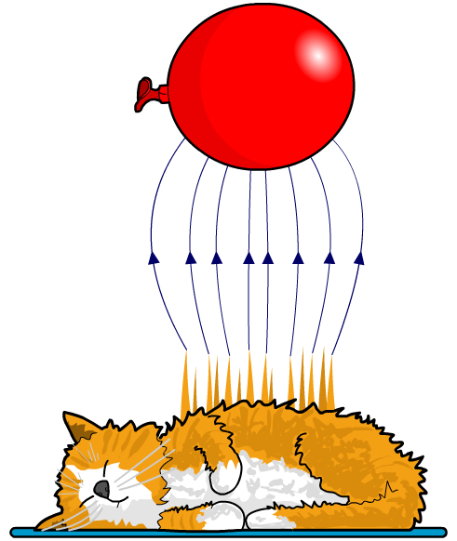
Electric fields and static electricity
When a charged object is placed in the electric field of another charged object, it experiences a force, just like charged particles do.
This means that electrostatically charged objects can exert a force on one another without touching. The electrostatic force is a non-contact force.
If a neutral object is placed in the electric field of a charged object, electrons on its surface will move either toward or away from the charged object, creating a charged surface that is attracted to the charged object. This is how a charged balloon can cause hair to stand on end.

Slide 18
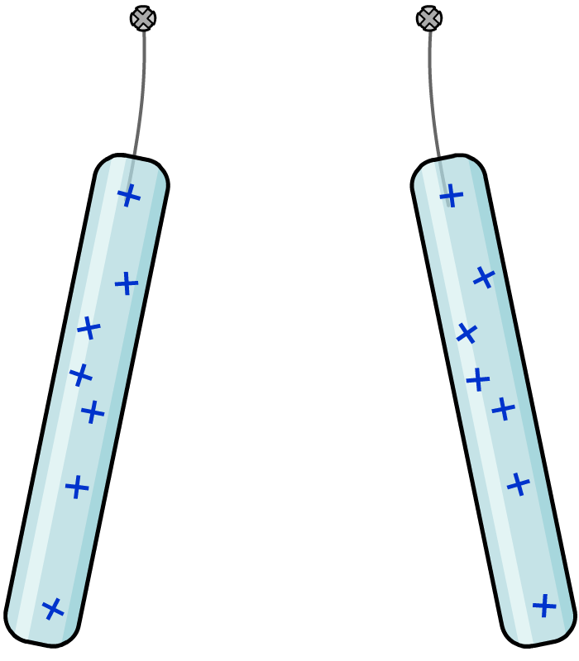
What are the forces between charges?
The forces between charges can be investigated using rods made of insulating materials.
What happens when two positively-charged acetate rods are placed near each other?
The rods repel each other because they have the same overall charge.
acetate rods
The force between charged objects is a non-contact force. The objects can exert a force on each other without touching.
rods repel
each other
What will happen if one rod is replaced with a charged polyethylene rod?
Notes:
This slide covers the Science and Engineering Practice:
Developing and Using Models: Use a model to provide mechanistic accounts of phenomena.

Slide 19
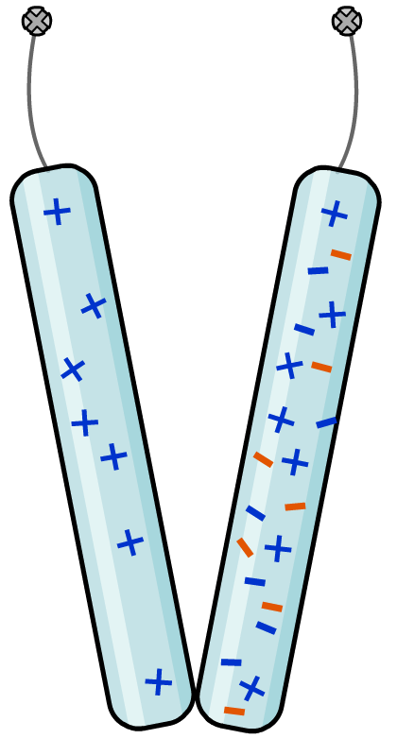
How do opposite charges behave?
When a charged acetate rod is placed near a charged polyethylene rod, the rods attract each other.
acetate rod
polyethylene rod
Why does this happen?
The polyethylene rod has an overall negative charge and the acetate rod has an overall positive charge.
The overall charges of these rods are opposite and so they attract each other.
rods attract
each other
Notes:
This slide covers the Science and Engineering Practice:
Developing and Using Models: Use a model to provide mechanistic accounts of phenomena.

Slide 20
Investigating pairs of charges
Notes:
This slide covers the Science and Engineering Practice:
Planning and Carrying Out Investigations: Plan and conduct an investigation individually and collaboratively to produce data to serve as the basis for evidence, and in the design: decide on types, how much, and accuracy of data needed to produce reliable measurements and consider limitations on the precision of the data (e.g., number of trials, cost, risk, time), and refine the design accordingly.

Slide 21
Experimenting with static charge
Notes:
Teacher notes
This simulation activity allows students to explore the effects of a charged balloon on a range of items. It could be used as a precursor to running the practical in the lab or for summary purposes.
Please note that each experiment contains a section showing the behavior of charges in the materials, which can be viewed by pressing “zoom” after the interactive stage.
This slide covers the Science and Engineering Practice:
Planning and Carrying Out Investigations: Plan and conduct an investigation individually and collaboratively to produce data to serve as the basis for evidence, and in the design: decide on types, how much, and accuracy of data needed to produce reliable measurements and consider limitations on the precision of the data (e.g., number of trials, cost, risk, time), and refine the design accordingly.

Slide 22
Designing an experiment
Notes:
Teacher notes
This non-marking activity can be used to encourage students to think about aspects of experimental design that will allow them to obtain valid results.
This slide covers the Science and Engineering Practice:
Planning and Carrying Out Investigations: Plan and conduct an investigation individually and collaboratively to produce data to serve as the basis for evidence, and in the design: decide on types, how much, and accuracy of data needed to produce reliable measurements and consider limitations on the precision of the data (e.g., number of trials, cost, risk, time), and refine the design accordingly.

Slide 23
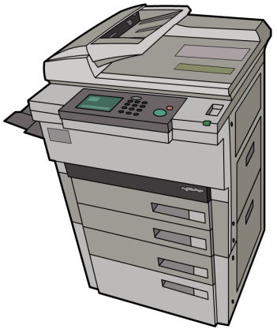
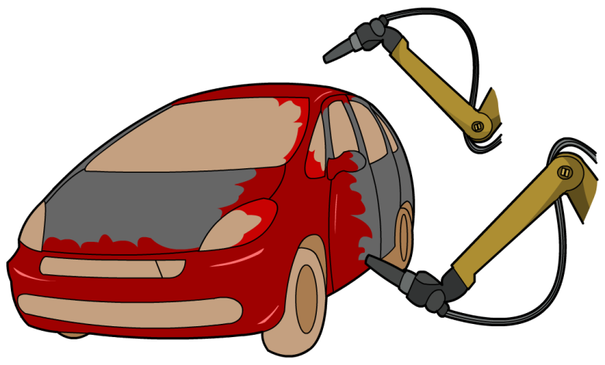
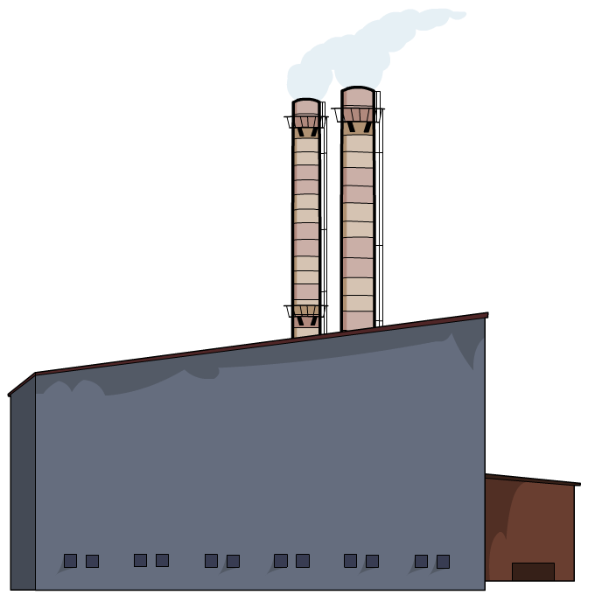
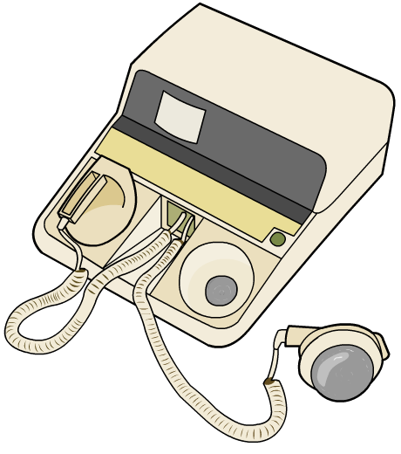
How can static electricity be used?
Static electricity has many uses, including:
photocopiers and laser printers
spray painting cars
filtering factory smoke
heart defibrillators

Slide 24
How does a photocopier work?
Notes:
Teacher notes
This five-stage animation could be used to introduce the practical applications of static electricity. It should highlighted to students that it is the drum that becomes charged and not the paper.

Slide 25
How does spray painting cars work?
Notes:
Teacher notes
This three-stage animation illustrates how static electricity is used to spray paint a car.
Suitable prompts include:
Stage 1: What instrument is used to spray paint a car?
Stage 2: Do the spray gun and the car body have the same overall charge?
Stage 3: Why is it important to reduce waste in factories?

Slide 26
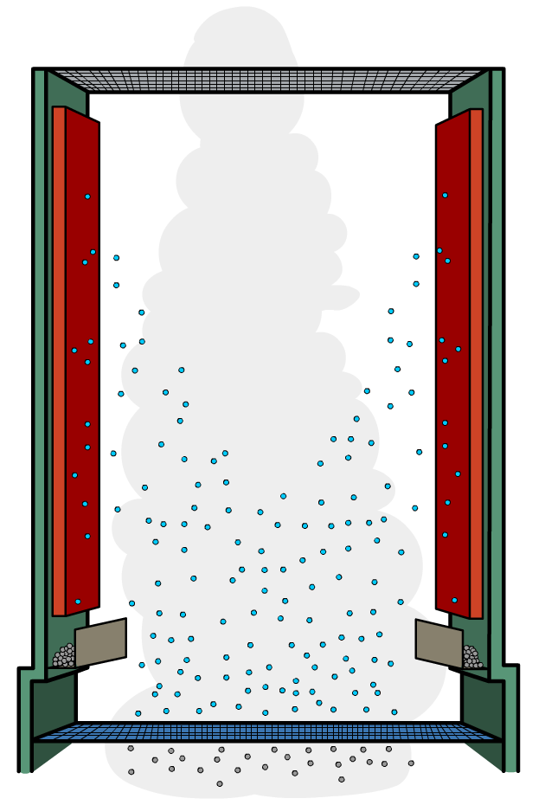
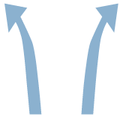
How does static charge reduce pollution?
A precipitator in the chimney of a power station uses static electricity to filter smoke particles from waste gases.
The smoke particles pass through a charged grid and pick up a negative charge.
positively- charged metal plates
They are then attracted
to the positively-charged collecting plates.
smoke particles
The smoke particles lose their charge and fall back down the chimney, so the waste gases emitted are free of polluting smoke.
metal grid at a high voltage
Notes:
Teacher notes
Students should understand that the smoke particles gain electrons (a negative charge) at the charged grid, and then lose electrons at the collecting plates.

Slide 27
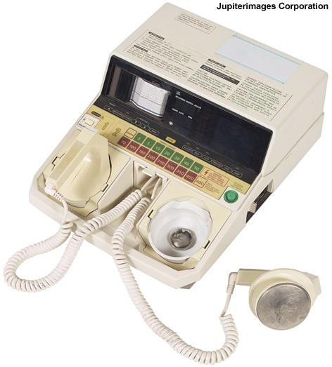
How does a defibrillator work?
A defibrillator is a machine that uses electricity to correct faulty heart rhythms.
Fibrillation is an irregular heart rhythm, often brought on by a heart attack.
The metal pads of the defibrillator are placed on the patient’s chest and then charged.
This sends a controlled shock to the patient, which corrects the heart rhythm.
Notes:
Photo credit: © Jupiterimages Corporation 2018

Slide 28
What are the dangers of static electricity?
Charge builds up when two insulators are rubbed together. This can occur when non-conducting fuel flows through pipes, when paper is rolled in paper mills, and when grain flows through chutes in grain stores.
When static electricity is discharged, it creates a spark.
One spark is enough to cause a major explosion if it occurs near flammable materials like fuel or grain dust.
Metal paper rollers and grain chutes are used to prevent charge building up.
Notes:
Photo credit: © Jupiterimages Corporation 2018

Slide 29
Refueling aircraft

Slide 30
Preventing electric shocks
Notes:
Photo credits: grounding mat © Equilibria (www.equilibrauk.com) 2018, shoes © (chungking), fuel nozzle © (Tony Mathews), both at shutterstock 2018

Slide 31
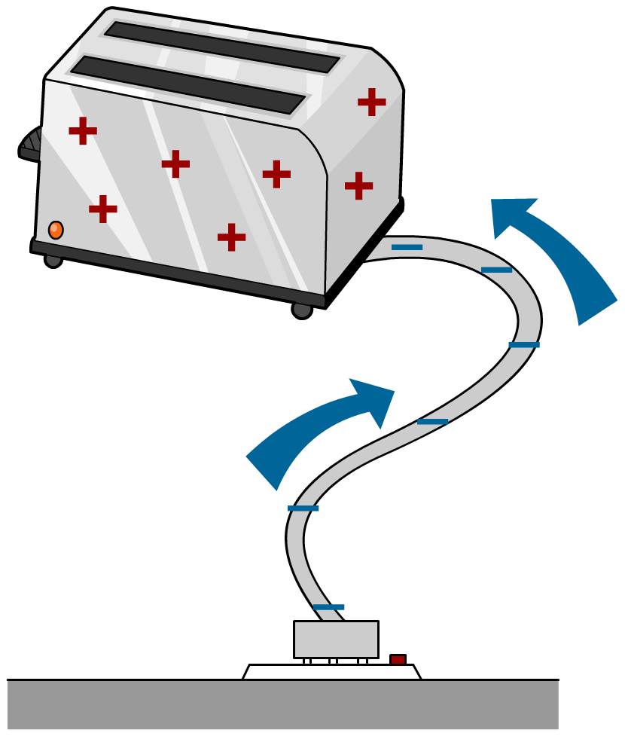
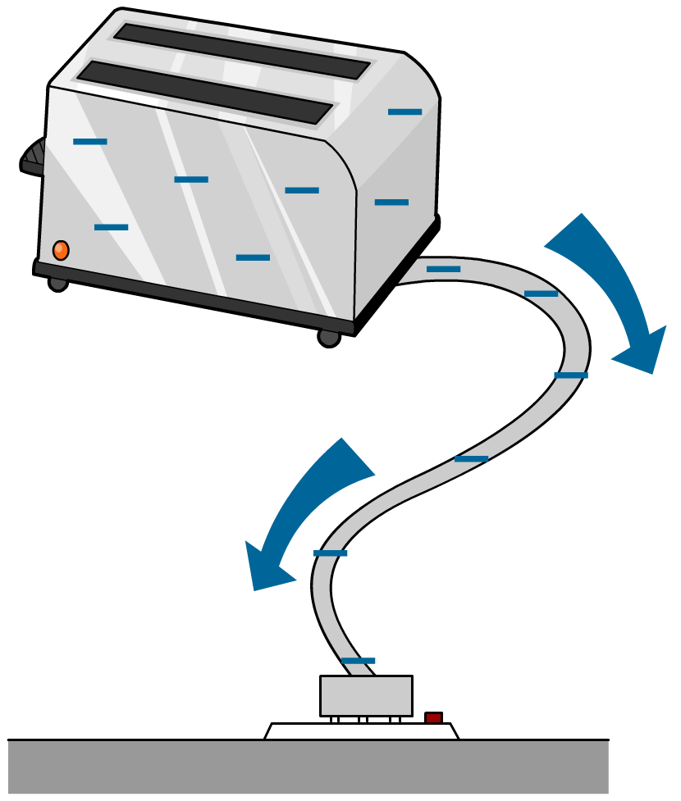
Grounding
A charged object can be negatively or positively charged.
Negatively-charged objects have gained electrons.
Positively-charged objects have lost electrons.
When an object is connected to the Earth, electrons flow between the object and the ground, evening out the charges.
Electrons will flow into a positively-charged object…
…and out of a negatively-charged object.

