Slide 1
Resistors

Slide 2
Information
Developing and Using Models
Planning and Carrying Out Investigations
Analyzing and Interpreting Data
Constructing Explanations and Designing Solutions
1. Patterns
2. Cause and Effect
5. Energy and Matter
6. Structure and Function

Slide 3
Resistors
Some resistors have a constant value of resistance, R. They are called fixed resistors. For other resistors, the value of R varies with the current.
Components that have a constant value of R are known as ohmic conductors. This means that they obey Ohm’s law: the current through the component is proportional to the potential difference across it (at a constant temperature).
fixed resistor symbol
For ohmic conductors, the relationship between current and potential difference is linear. A graph of current against potential difference for an ohmic conductor, such as a fixed resistor, is a straight line.
Notes:
This presentation is accompanied by the worksheet Resistors.

Slide 4
Current–voltage graphs
Notes:
Teacher notes
This animated graph could be used to introduce the topic of current–voltage graphs and Ohm’s law.
Suitable prompts include:
Stage 1: What is the shape of the line?
Stage 2: What will happen to the size of the current if voltage is multiplied by a factor of four?
Stage 3: This stage introduces Ohm’s law, which states that voltage = current × resistance (V = I × R). Students could be asked to consider which factors control the size of the current.
Students may need reminding that “voltage” is often used interchangeably with “potential difference.”

Slide 5
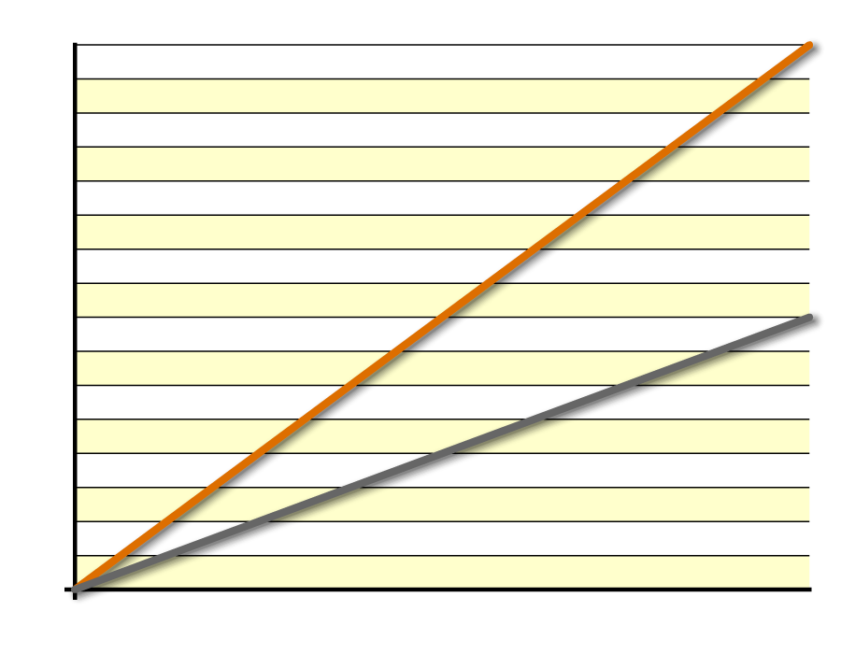
Is resistance the same in all wires?
Plotting current–voltage results for nichrome and copper wires on the same graph gives straight lines with different gradients.
copper
At the same voltage, a copper wire allows a larger current than a nichrome wire of the same size.
nichrome
voltage (V)
This means that the copper wire has a lower resistance than the nichrome wire. What does the gradient tell you about resistance?
The steeper the gradient of a current–voltage graph, the lower the resistance of the wire.
Notes:
Teacher notes
Only the gradient of a linear current–voltage graph gives the resistance. Not all materials have a straight line graph for their current–voltage graphs, and their resistance is not given by the gradient.
This slide covers the Science and Engineering Practice:
Analyzing and Interpreting Data: Apply concepts of statistics and probability (including determining function fits to data, slope, intercept, and correlation coefficient for linear fits) to scientific and engineering questions and problems, using digital tools when feasible.

Slide 6
Current–voltage graphs for wires
Notes:
Teacher notes
This identifying activity could be used as a introductory or summary exercise on the current–voltage graphs.
This slide covers the Science and Engineering Practice:
Analyzing and Interpreting Data: Apply concepts of statistics and probability (including determining function fits to data, slope, intercept, and correlation coefficient for linear fits) to scientific and engineering questions and problems, using digital tools when feasible.

Slide 7
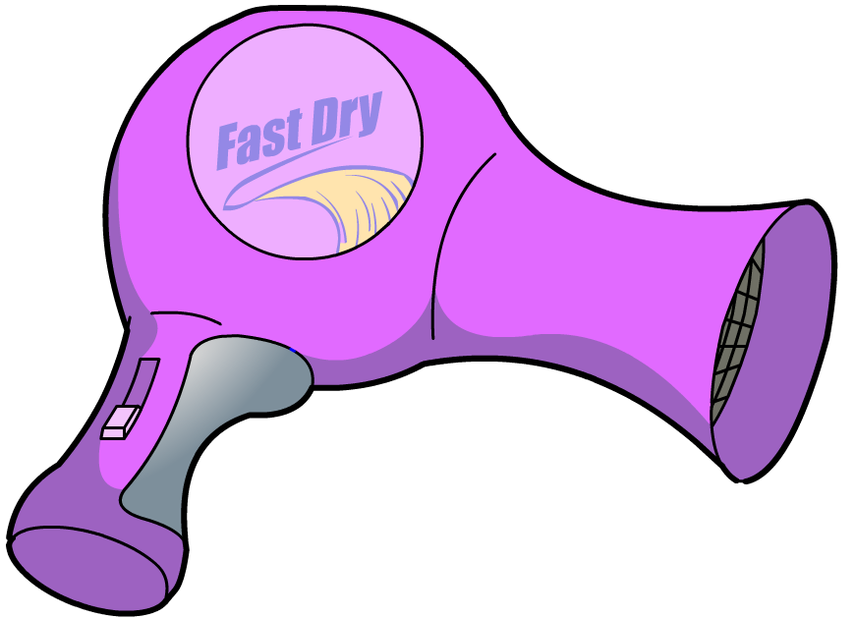
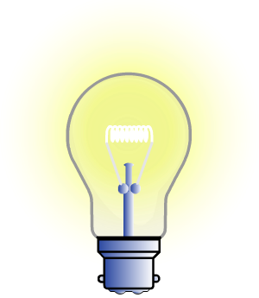
How can resistance be used?
When a material resists current, some of the electrical energy is transferred to heat or light. This property of resistance is used in many electrical appliances.
Hairdryers and electric heaters contain coils of nichrome wire.
Nichrome, an alloy of nickel and chromium, resists current and gets very hot.
Filament light bulbs contain tungsten.
Tungsten resists current and gets so hot that it glows. This is why bulbs waste energy as heat.
Notes:
Teacher notes
For more information about energy transfers, please refer to the Energy Transfers presentation.

Slide 8
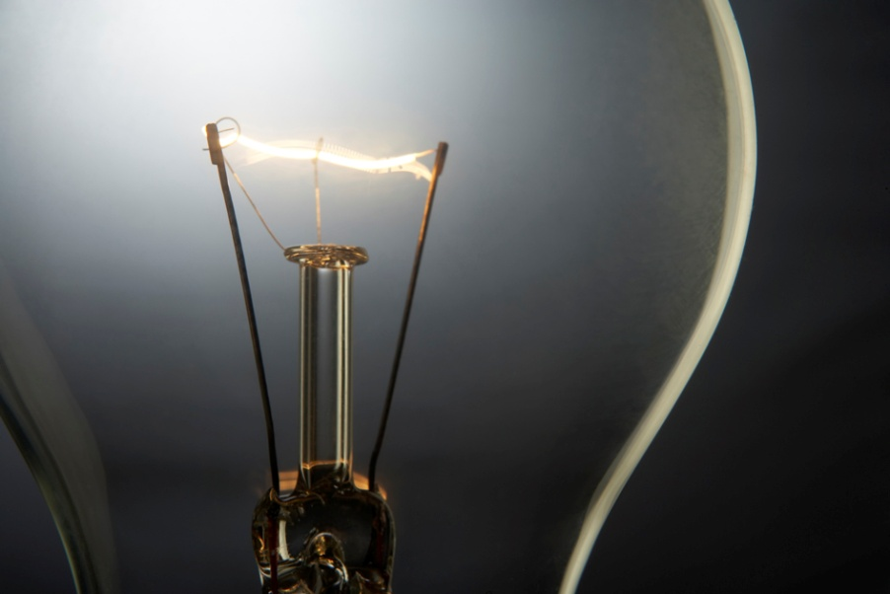
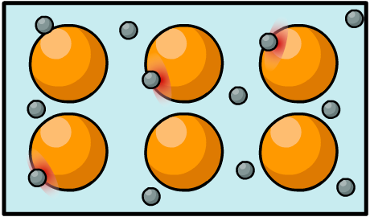
Why do resistors get hot?
When an electric current passes through a resistor, the resistor gets hotter.
This is why the filament in a light bulb gets hot and glows.
This heating effect is caused by collisions between moving electrons and stationary ions in the wire.
This transfers energy from the moving electrons to the metal.
electron movement through wire
Notes:
This slide covers the Science and Engineering Practices:
Developing and Using Models: Use a model to provide mechanistic accounts of phenomena.
Constructing Explanations and Designing Solutions: Apply scientific ideas, principles, and/or evidence to provide an explanation of phenomena and solve design problems, taking into account possible unanticipated effects.
Photo credit: © photos.com 2018

Slide 9
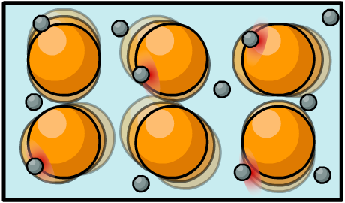
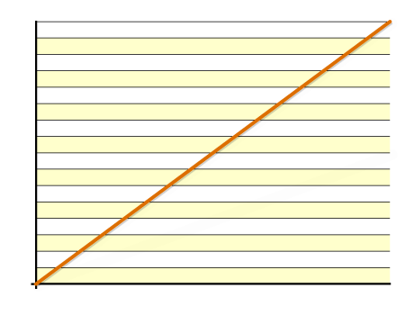
How does temperature affect resistance?
Increasing the temperature of a material increases its resistance.
This is because the positively charged metal ions vibrate faster when they are hot, making it more difficult for the electrons to flow through the metal.
Ohm’s law (V = IR) means that if resistance is constant in a circuit, voltage and current are directly proportional.
What will happen if resistance increases as more current raises the temperature of the resistor?
voltage (V)
Notes:
This slide covers the Science and Engineering Practices:
Developing and Using Models: Use a model to provide mechanistic accounts of phenomena.
Constructing Explanations and Designing Solutions: Apply scientific ideas, principles, and/or evidence to provide an explanation of phenomena and solve design problems, taking into account possible unanticipated effects.

Slide 10
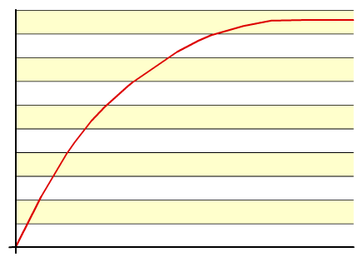
Non-ohmic conductors
The resistance of some electrical components is not constant: it changes as the current through the component changes. These components are non-ohmic conductors.
Filament bulbs, diodes, thermistors and LDRs are examples of non-ohmic conductors.
For non-ohmic conductors, the relationship between current and potential difference is non-linear. A graph of current against potential difference for a non-ohmic conductor is not a straight line.
voltage (V)

Slide 11
Current–voltage graph for a bulb
Notes:
Teacher notes
This animated graph could be used to introduce work on the current–voltage graphs for a bulb. While using this activity, it should be highlighted to students that a filament light bulb is a non-ohmic conductor.
Stage 3: If the voltage becomes too high, the filament will get too hot and melt. This will break the circuit, and the light will go out.

Slide 12
Advantages and disadvantages of heating

Slide 13
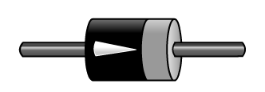
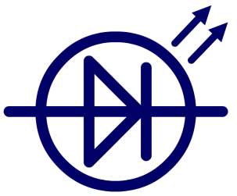
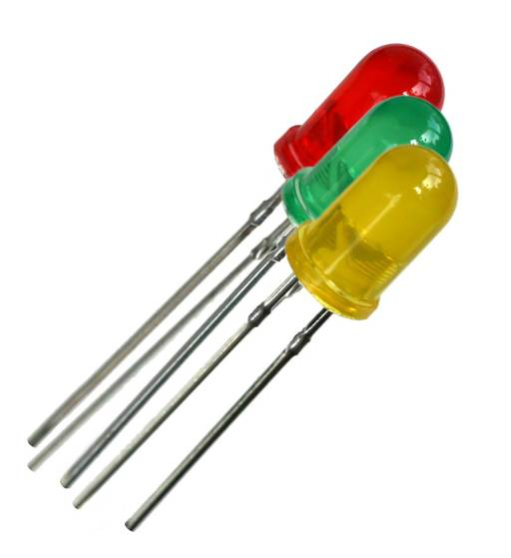
What is a diode?
A diode is a component made from a semiconducting material such as silicon.
Diodes have the unique property of only allowing current to pass through them in one direction. This is because it has a very high resistance in the reverse direction.
diode and its symbol
The arrowhead on the symbol shows the direction of current flow.
Some diodes emit light when they conduct electricity. These are called Light Emitting Diodes (LEDs).
Notes:
Teacher notes
Students might be interested to know that diodes have a variety of uses, including logic gates and providing protection from back emf.
Photo credit: © Kevin H Knuth, shutterstock.com 2018

Slide 14
Current–voltage graph for a diode
Notes:
Teacher notes
This animated graph could be used to introduce work on the current­–voltage graph for a diode.

Slide 15
Uses of resistors
Notes:
Teacher notes
This activity provides illustrated information about components that are specifically designed to resist current. It could be used as an introduction to the topic or for summary purposes.

Slide 16
Resistor circuit diagram symbols
Notes:
Teacher notes
This matching activity could be used as a introductory exercise on resistors’ circuit symbols.

Slide 17
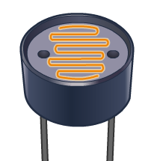
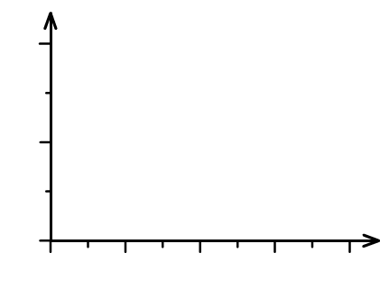
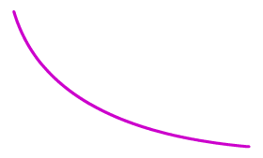
LDRs: light and resistance
The resistance of a light dependent resistor (LDR) is not fixed. It is dependent on the intensity of incident light.
An LDR has a high resistance in the dark but a low resistance in the light.
LDR symbol
The graph shows how the resistance of an LDR decreases as the light intensity increases.
This means that LDRs can be used in light sensing circuits, such as circuits that switch on lights when it gets dark.
light intensity

Slide 18
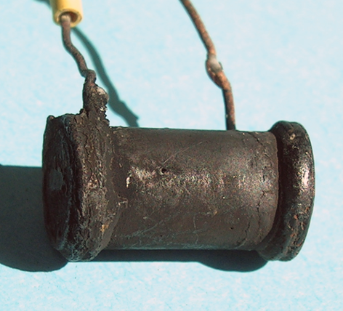
Thermistors: temperature and resistance
The resistance of a thermistor varies with temperature.
Most thermistors have a high resistance when cold but a low resistance when hot.
thermistor
symbol
This is unusual, as resistance normally increases with increasing temperature.
Thermistors are useful in the sensor circuits of a thermostat, as their output varies with temperature fluctuations.
temperature (°C)

Slide 19
Resistor quiz
Notes:
Teacher notes
This true-or-false quiz could be used as a introductory exercise to work on resistors. Students could be given colored traffic light cards (red = false, green = true) to vote on the statements shown. To stretch students, they could be asked to explain their voting.

Slide 20
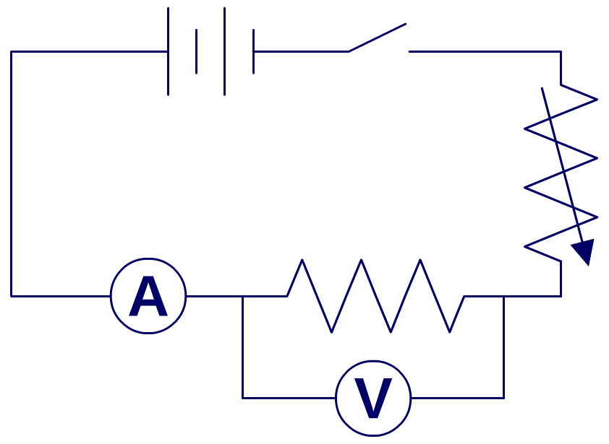
How can resistance be investigated?
Set up this circuit with a resistor and a variable resistor.
voltage (V)
current (A)
0.0
0.0
0.5
0.6
1.0
1.1
1.5
1.8
2.0
2.5
Slowly adjust the variable resistor, increasing the voltage by 0.5 V at a time and record the current for each setting.
2.5
3.0
3.0
3.5
3.5
4.2
Plot a current–voltage graph of the results.
Notes:
This slide covers the Science and Engineering Practice:
Planning and Carrying Out Investigations: Plan an investigation or test a design individually and collaboratively to produce data to serve as the basis for evidence as part of building and revising models, supporting explanations for phenomena, or testing solutions to problems. Consider possible variables or effects and evaluate the confounding investigation’s design to ensure variables are controlled.

Slide 21
Investigating current and voltage
Notes:
Teacher notes
This virtual experiment can be used to investigate how resistance changes in a variety of components and also how voltage and current change.
It should be highlighted to students that the voltmeter is wired in parallel and the ammeter is wired in series.
Students could write down the readings on the ammeter and voltmeter and use these to plot I­V graphs for each component. These graphs could then be compared with the graphs shown for each component in this presentation.
Please note, this virtual experiment is designed to demonstrate the principle of Ohm's Law and so has some simplified features:
A single cell has been used as the power source but more sophisticated apparatus would be needed if setting up this experiment in the laboratory.
The resistance values have been chosen to show the general behavior of each component so that comparisons can be made with other components. This is why an ordinary piece of copper wire has a measurable resistance.
This slide covers the Science and Engineering Practice:
Planning and Carrying Out Investigations: Plan an investigation or test a design individually and collaboratively to produce data to serve as the basis for evidence as part of building and revising models, supporting explanations for phenomena, or testing solutions to problems. Consider possible variables or effects and evaluate the confounding investigation’s design to ensure variables are controlled.

