Slide 1
Reflection and Refraction of Waves

Slide 2
Information
Developing and Using Models
Planning and Carrying Out Investigations
Using Mathematics and Computational Thinking
Constructing Explanations and Designing Solutions
2. Cause and Effect
3. Scale, Proportion, and Quantity

Slide 3
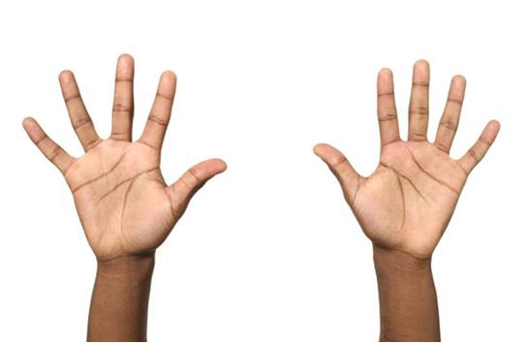
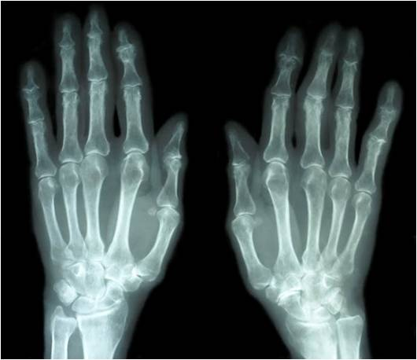

What happens when waves hit a surface?
When waves hit a surface, they can be reflected, absorbed or transmitted.
How a wave behaves depends on the type of wave, its energy and the type of material it interacts with.
For example, light waves are reflected by skin, but X-rays
are transmitted through skin.
If waves are absorbed by a material, some of their energy
is transferred to the material.
This usually increases the temperature of the material.
Notes:
Photo credits: hands © photobank.ch, x-ray hands © dusan964, both at shutterstock.com 2018

Slide 4

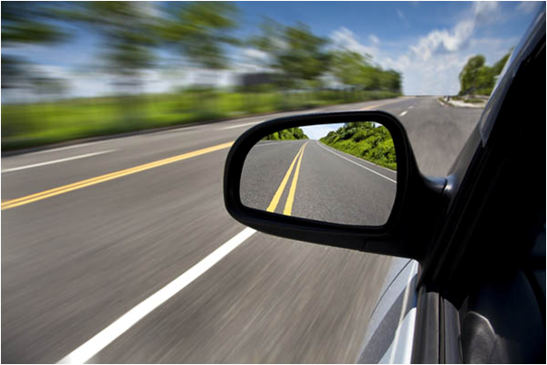
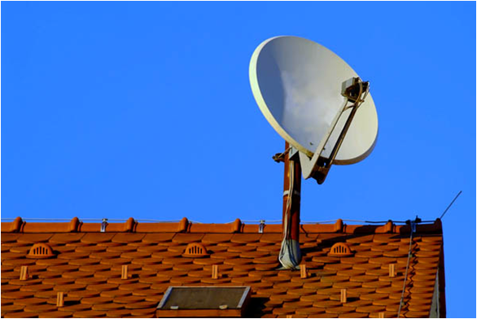
What happens when waves are reflected?
Some surfaces can reflect waves. Shiny surfaces are good reflectors of light waves.
When waves are reflected, some of their energy may also be absorbed by the material because surfaces do not reflect perfectly.
A mirror reflects most of the light waves that hit it.
A curved satellite dish reflects microwaves from a satellite to the receiver.
How does reflection allow us to see?
Notes:
Teacher notes
Reflection allows organisms to see because eyes sense light from the Sun or artificial sources of light that is reflected off of surfaces.
For more information about how the eye works, please refer to the Life Sciences: The Eye presentation.
Photo credits: wing mirror © Tom Wang, satellite dish © foto.fritz, both at shutterstock.com 2018

Slide 5


Light moves in straight lines
Notes:
Teacher notes
This is an introductory slide to enforce the idea that light travels in straight lines.
In order to further explain the concept of the umbra and penumbra, the shadow formation exercise could be linked to eclipses. If we see a total eclipse of the Sun then we are in the umbra of the Moon’s shadow. If we see a partial eclipse, only part of the Sun’s light can reach us and we are in the penumbra.

Slide 6


Investigating reflection
Notes:
This slide covers the Science and Engineering Practice:
Planning and Carrying Out Investigations: Plan an investigation or test a design individually and collaboratively to produce data to serve as the basis for evidence as part of building and revising models, supporting explanations for phenomena, or testing solutions to problems. Consider possible variables or effects and evaluate the confounding investigation’s design to ensure variables are controlled.

Slide 7

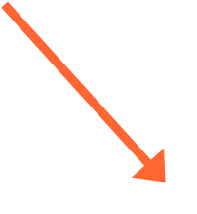
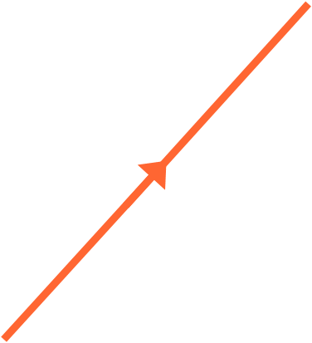
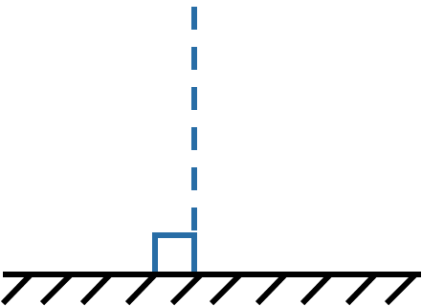


The law of reflection
When a light ray hits a mirror it changes direction: the ray is reflected.
angle of incidence (i) = angle of reflection (r)
normal
incident ray
reflected ray
i
r
point of incidence
plane mirror
This is called the law of reflection and is true for any type of wave being reflected from a surface.
Notes:
This slide is accompanied by the worksheet Reflection and Refraction of Waves.
This slide covers the Science and Engineering Practice:
Using Mathematics and Computational Thinking: Use mathematical, computational, and/or algorithmic representations of phenomena or design solutions to describe and/or support claims and/or explanations.

Slide 8
Images in plane mirrors
If we look into a mirror, we see an image.
What kind of image is formed in the plane mirror?
laterally inverted
same size as the object
virtual.
Notes:
Teacher notes
Students could be asked to create their own ray diagrams before the illustration is fully revealed.

Slide 9
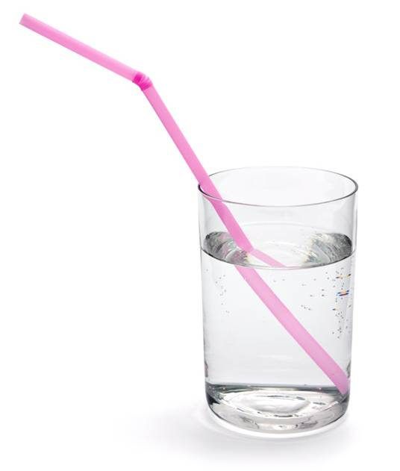
What happens when waves are transmitted?
If a wave is not reflected or absorbed at a surface, it is transmitted – it passes through the material.
Sometimes the wave passes through the material in a straight line; sometimes the wave changes direction as it crosses the boundary between
two materials. This is known
as refraction.
Refraction causes the straw in
this image to appear to be bent
in the liquid. As the light crosses
the boundary between fluid and
glass, it is bent, producing a distorted image.
Notes:
Photo credit: © MilanB, shutterstock.com 2018

Slide 10
Refraction in a glass block
Notes:
Teacher notes
By activating the angle measurements in stages, students are given a chance to identify the various elements of the experiment. Initially they should try to define the normal, name the rays and angles shown and describe the relative angle size. Revealing the angles at the air to glass boundary will act to clarify these points to students. Students can then be challenged to identify i₂ and r₂, before revealing them to the class.
This slide covers the Science and Engineering Practice:
Planning and Carrying Out Investigations: Plan an investigation or test a design individually and collaboratively to produce data to serve as the basis for evidence as part of building and revising models, supporting explanations for phenomena, or testing solutions to problems. Consider possible variables or effects and evaluate the confounding investigation’s design to ensure variables are controlled.

Slide 11

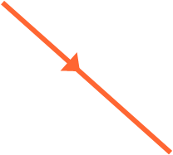
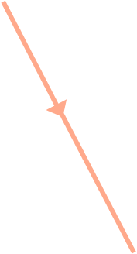



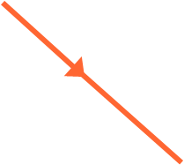
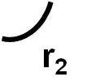
Refraction – labeling diagrams
If an incident ray enters glass at an angle, then it will be refracted, bending towards the normal.
incident
ray
normal
air
The angle of incidence (i)
is greater than the angle of refraction (r).
glass
When the light leaves the glass, the opposite happens: it bends away from the normal.
normal
A material which light passes through,
such as glass or air, is known as a medium.
refracted
ray
Notes:
This slide is accompanied by the worksheet Reflection and Refraction of Waves.

Slide 12
Refraction summary
Notes:
Teacher notes
This activity could be used as an introductory or summary activity to check students’ understanding of refraction, and to test their ability to extract valuable information from a table.

Slide 13
Understanding why light refracts
Notes:
This slide covers the Science and Engineering Practices:
Developing and Using Models: Use a model to provide mechanistic accounts of phenomena.
Constructing Explanations and Designing Solutions: Apply scientific ideas, principles, and/or evidence to provide an explanation of phenomena and solve design problems, taking into account possible unanticipated effects.

Slide 14
Speed of light
Refraction occurs because the speed of light changes depending on the density of the medium.
Light reaches 300,000,000 m/s in a vacuum, and is marginally slower in air. It moves more slowly in more dense media.
In other materials the speed of light varies significantly:
material
speed of light (m/s)
water
225,000,000
acrylic glass
200,000,000
glass
200,000,000
diamond
120,000,000
As the speed of light varies depending on the medium, different materials refract light by different amounts.
Notes:
Teacher notes
Students could be asked to research the speed of light in each material themselves. The idea of light taking time to reach its destination may also be discussed. The concept of light years could be introduced, and the students should realize that the light we see from the stars in the sky was actually emitted thousands of years ago.
This slide covers the Science and Engineering Practice:
Constructing Explanations and Designing Solutions: Apply scientific ideas, principles, and/or evidence to provide an explanation of phenomena and solve design problems, taking into account possible unanticipated effects.

Slide 15
Understanding refraction
The change in the speed of light as it moves from one medium to another can be explained using a wave
front diagram.
The wave fronts are at right angles to the direction of
the wave.
If the wave fronts are at an angle to the surface of a different medium, one end of the wave front will reach the surface first.
The part of the wave front in the second medium will travel at a different speed to the part that is still in the first, causing the wave to bend.
Notes:
This slide covers the Science and Engineering Practices:
Developing and Using Models: Use a model to provide mechanistic accounts of phenomena.
Constructing Explanations and Designing Solutions: Apply scientific ideas, principles, and/or evidence to provide an explanation of phenomena and solve design problems, taking into account possible unanticipated effects.

Slide 16
Refractive index
Refractive index is a measure of how much a substance slows down light. The higher its value, the slower light travels in that medium.
The refractive index of a medium is calculated by comparing the speed of light in a vacuum to the speed in that medium:
speed of light in vacuum
speed of light in medium
refractive index =
The refractive index of air is 1 because light travels at nearly the same speed in air as it does in a vacuum.
Does any substance have a refractive index less than 1?
Notes:
Teacher notes
Refractive index can never be less than 1 (light cannot travel faster than it travels in a vacuum).
There are no units for refractive index.
This slide is accompanied by the worksheet Reflection and Refraction of Waves.

Slide 17
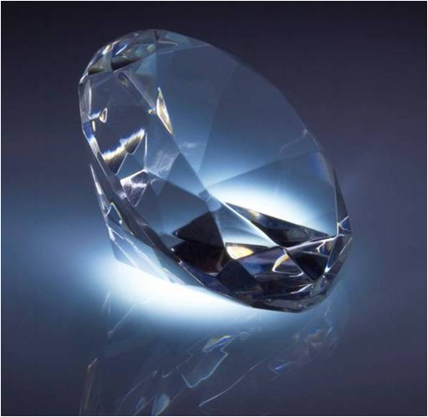
Predicting refraction
The refractive index of air is 1 and that of diamond is 2.4. What happens when light goes from diamond into air?
Diamond has a higher refractive index than air.
higher refractive index
light travels more slowly
This means light speeds up when it leaves the diamond.
The light will bend away from the normal. The angle of incidence is less than or equal to the angle of refraction.
Notes:
This slide covers the Science and Engineering Practice:
Developing and Using Models: Develop, revise, and/or use a model based on evidence to illustrate and/or predict the relationships between systems or between components of a system.
Photo credit: © Volodymyr Krasyuk, shutterstock.com 2018

Slide 18
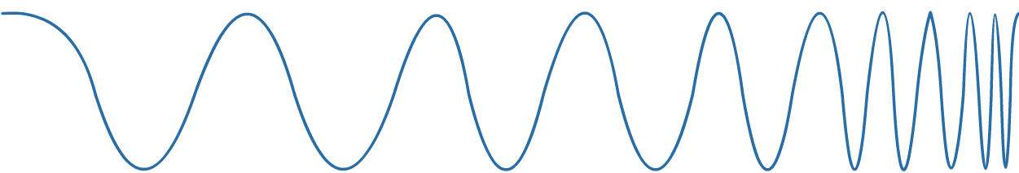
Refraction of electromagnetic waves
The electromagnetic spectrum is a continuous series of waves with varying wavelength and frequency.
radio waves
microwaves
infrared
visible light
UV
X-rays
gamma rays
10 cm
1 mm
0.01 mm
100 nm
1 nm
0.01 nm
All wavelengths of electromagnetic radiation travel at the same speed in a vacuum, but different wavelengths travel at different speeds in a medium.
This means that different wavelengths of electromagnetic radiation are refracted by different amounts.

