Slide 1
Radioactive Decay

Slide 2
Information
Developing and Using Models
Planning and Carrying Out Investigations
Using Mathematics and Computational Thinking
1. Patterns
2. Cause and Effect
5. Energy and Matter
7. Stability and Change

Slide 3
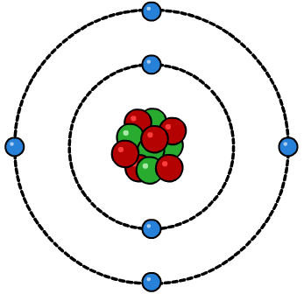
What is radiation?
The term radiation (also known as nuclear radiation) refers to the particles or waves emitted by radioactive substances.
An atom has a central nucleus, which is made up of protons and neutrons. Electrons surround the nucleus in shells.
electron
neutron
proton
Nuclear radiation comes from the nucleus of a radioactive atom. In a radioactive atom, the nucleus is unstable and so it emits particles or waves to lose excess energy and form a more stable atom.
This process is called radioactivity or radioactive decay. It is a natural and completely random process.
Notes:
This presentation is accompanied by the worksheet Radioactive Decay.

Slide 4
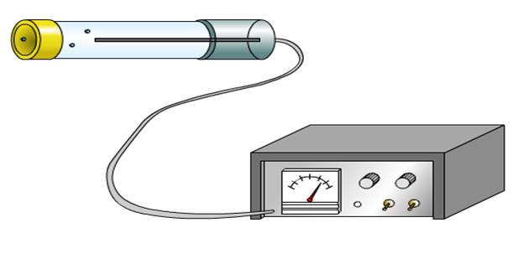
Activity of an isotope
Although atoms of the same element always have the same number of protons, they can have different numbers of neutrons. Atoms that differ in this way are called isotopes. In a radioactive isotope, its nuclei are unstable and so it emits particles or waves to form a more stable atom.
The activity of a radioactive isotope is the rate at which the isotope decays. Activity is measured in becquerel (Bq).
The number of decays recorded each second by a detector, such as a Geiger counter, is called the count-rate.

Slide 5
Types of radiation
Notes:
Teacher notes
This activity, summarizing the different types of radiation, could be used to introduce the topic of radiation, as an introductory or summary activity.
This slide covers the Science and Engineering Practice:
Developing and Using Models: Use a model to provide mechanistic accounts of phenomena.

Slide 6
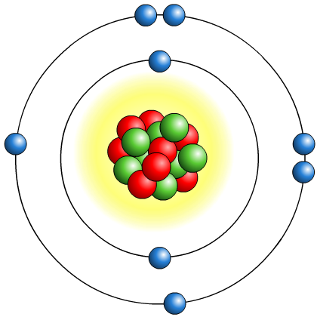
Ionizing radiation
Substances that give out radiation all of the time are known as radioactive substances. Their behavior cannot be changed by chemical or physical processes.
As they decay, radioactive substances give out nuclear radiation in the form of alpha particles (α), beta particles (β), and gamma rays (γ).
When this nuclear radiation interacts with other atoms or molecules, they may break them up into ions. This is known as ionization.

Slide 7
What is an ion?
Atoms with incomplete outer electron shells are unstable. By either gaining or losing electrons, atoms can obtain full outer electron shells and become stable.
When this happens, atoms have an unequal number of protons and electrons and therefore have an overall charge. This is how atoms become ions.
Ions can take part in chemical reactions in living cells. This can be dangerous to health, causing cells to die or become cancerous.
An ion is an atom or group of atoms that has an electrical charge, either positive or negative.
Notes:
Teacher notes
For more information about ions, please refer to the Ionic Bonding presentation.

Slide 8
Investigating penetrating power
Notes:
Teacher notes
This virtual experiment illustrates the penetrating power of the three different types of radiation.
It could be highlighted that the GM tube, when switched on, is not at zero when the radiation from the source is blocked. This is because it is reading a small amount of background radiation.
It should also be made clear to the students that they should not put their hands in front of any known radiation source, and that the hand in the experiment is only for illustrative purposes.
This slide covers the Science and Engineering Practice:
Planning and Carrying Out Investigations: Plan an investigation or test a design individually and collaboratively to produce data to serve as the basis for evidence as part of building and revising models, supporting explanations for phenomena, or testing solutions to problems. Consider possible variables or effects and evaluate the confounding investigation’s design to ensure variables are controlled.

Slide 9
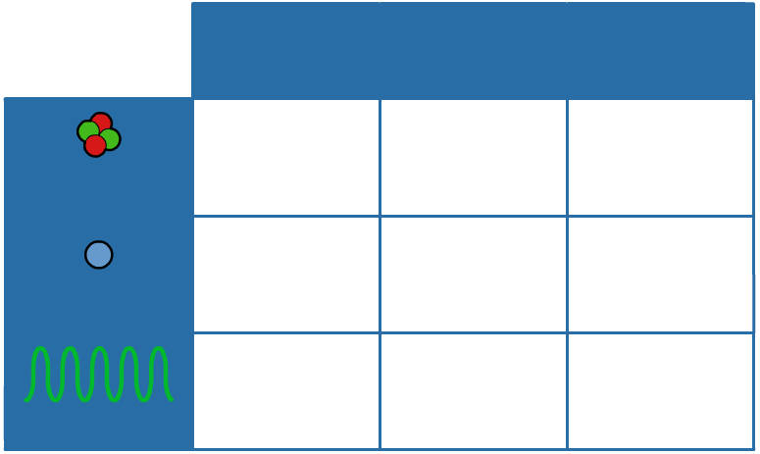
Alpha, beta, gamma
Alpha, beta and gamma radiation have different properties in terms of how able they are to ionize atoms, their penetrating power and how far they can travel in air.
ionizing power
penetrating power
range
in air
strongly ionizing
weakly penetrating
a few centimeters
alpha
weakly ionizing
averagely penetrating
a few meters
beta
very weakly ionizing
strongly penetrating
many meters
gamma
Notes:
Teacher notes
Alpha particles have a very short range in air because they have a relatively high atomic mass of 4. This causes them to travel in straight lines and deposit their energy quickly. Beta particles are negatively- or positively-charged electrons, and as such are relatively light. They travel in a random path through air and materials, making their range difficult to measure. Gamma rays are very short electromagnetic waves. Because they have no charge, they have a long range through air.

Slide 10
Alpha, beta or gamma?
Notes:
Teacher notes
This sorting activity could be used as an introductory or summary activity on alpha, beta and gamma radiation.

Slide 11
Types of radioactive decay – summary
Notes:
Teacher notes
This activity, summarizing the three types of radiation, could be used to introduce the topic of radiation, or as a summary activity.

Slide 12
Nuclear equations
Radioactive decay can be represented by nuclear equations.
In a nuclear equation, an alpha particle is represented by the symbol .
4
He
2
4
He
2
A beta particle is represented
by the symbol .
0
e
–1
0
e
A gamma ray is represented
by the symbol γ.
–1
Nuclear equations should be balanced. This means that the total atomic number and total mass number should be the same on each side of the equation.
γ
Notes:
Teacher notes
For more information about atomic numbers and mass numbers, please refer to the Subatomic Particles presentation.
This slide covers the Science and Engineering Practice:
Developing and Using Models: Develop, revise, and/or use a model based on evidence to illustrate and/or predict the relationships between systems or between components of a system.

Slide 13
Alpha decay equations
An alpha particle consists of two protons and two neutrons. It is the same as a helium nucleus.
When an atom’s nucleus decays and releases an alpha particle, it loses two protons and two neutrons.
mass number decreases by 4
238
234
4
U
Th
+
He
92
90
2
atomic number decreases by 2
The number of protons has changed, so the decayed atom has changed into a new element.
Notes:
This slide covers the Science and Engineering Practice:
Developing and Using Models: Develop, revise, and/or use a model based on evidence to illustrate and/or predict the relationships between systems or between components of a system.

Slide 14
Beta decay equations
A beta particle consists of a high energy electron, which is emitted by the nucleus of the decaying atom.
When an atom’s nucleus decays and releases a beta particle, a neutron turns into a proton, which stays in the nucleus, and a high energy electron, which is emitted.
mass number remains the same
14
14
0
C
N
+
e
6
7
–1
atomic number increases by 1
The decayed atom has gained a proton and so has changed into a new element.
Notes:
Teacher notes
Students may find it helpful to consider the idea of a “neutron number,” which can only be seen as the difference between the mass and atomic numbers in these equations. This number would decrease by one as it changed to a proton, which is why the mass number remains at 17.
This slide covers the Science and Engineering Practice:
Developing and Using Models: Develop, revise, and/or use a model based on evidence to illustrate and/or predict the relationships between systems or between components of a system.

Slide 15
Gamma decay equations
Gamma radiation is a form of electromagnetic radiation, not a type of particle.
When an atom’s nucleus decays and emits gamma radiation, there is no change to the make-up of the nucleus and so a new element is not formed.
Gamma rays are usually emitted with alpha or beta particles. For example, cobalt-60 decays releasing a beta particle. The nickel formed is not stable and so emits gamma radiation.
mass number remains the same
60
60
60
γ
Co
Ni*
+
β⁺
Ni
+
+
β⁺
27
28
28
atomic number remains the same
The nickel does not change into a new element.
Notes:
Teacher notes
The “*” symbol next to the nickel in the middle of the equation indicates that the nickel is still unstable and needs to release more radioactivity to become stable.
This slide covers the Science and Engineering Practice:
Developing and Using Models: Develop, revise, and/or use a model based on evidence to illustrate and/or predict the relationships between systems or between components of a system.

Slide 16
Nuclear equations examples
Notes:
This slide covers the Science and Engineering Practices:
Developing and Using Models: Develop, revise, and/or use a model based on evidence to illustrate and/or predict the relationships between systems or between components of a system.
Using Mathematics and Computational Thinking: Apply techniques of algebra and functions to represent and solve scientific and engineering problems.

