Slide 1
Nuclear
Fusion

Slide 2
Information
Asking Questions and Defining Problems
Developing and Using Models
Constructing Explanations and Designing Solutions
2. Cause and Effect
4. Systems and System Models
5. Energy and Matter
7. Stability and Change

Slide 3


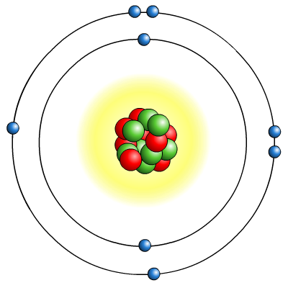

How do we get energy from atoms?
Energy is produced from atoms in power stations using the process of nuclear fission.
nucleus
Fission involves splitting atomic nuclei, releasing some of the enormous energy they contain.
Energy can also be released by joining two small nuclei together to form a larger one in a process called nuclear fusion.
electrons
The energy released by a fusion process
can be emitted as radiation.
Notes:
Teacher notes
For more information about nuclear fission, please refer to the Nuclear Fission presentation.
This presentation is accompanied by the worksheet Nuclear Fusion.

Slide 4

What is nuclear fusion?
Nuclear fusion is the process that powers the Sun and other stars.
In this process, small nuclei join together to form larger nuclei and energy is released.
In the Sun’s core, at temperatures of 15 million °C, hydrogen nuclei fuse to form helium nuclei and release vast amounts of energy.
A worldwide research programme is being carried out
to find ways in which nuclear fusion could be harnessed on Earth as a clean and plentiful source of energy.

Slide 5



What happens in nuclear fusion?
Notes:
Teacher notes
This two-stage animated sequence explains how nuclear fusion occurs in a fusion reactor.
This slide covers the Science and Engineering Practices:
Developing and Using Models: Develop, revise, and/or use a model based on evidence to illustrate and/or predict the relationships between systems or between components of a system.
Developing and Using Models: Use a model to provide mechanistic accounts of phenomena.

Slide 6

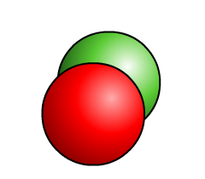
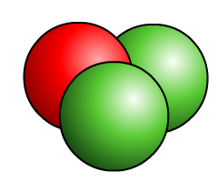

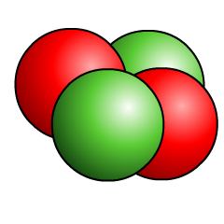

What are the conditions for fusion?
In nuclear fusion, small nuclei join together to form
larger nuclei.
+
+
deuterium
+
tritium
fusion
helium
+
neutron
3
2
H
H
4
H
1
+
+
n
1
1
2
0
Nuclear fusion requires very high pressures and temperatures. These conditions overcome repulsive forces between the positive nuclei and force them together.
Scientists have found it difficult to create the extreme conditions needed to carry out nuclear fusion on Earth.
Notes:
This slide covers the Science and Engineering Practices:
Asking Questions and Defining Problems: Analyze complex real-world problems by specifying criteria and constraints for successful solutions.
Developing and Using Models: Develop, revise, and/or use a model based on evidence to illustrate and/or predict the relationships between systems or between components of a system.
Constructing Explanations and Designing Solutions: Apply scientific ideas, principles, and/or evidence to provide an explanation of phenomena and solve design problems, taking into account possible unanticipated effects.

Slide 7
Why is fusion so difficult?

Slide 8



Fusion in stars
In a star like our Sun, fusion reactions happen easily.
Because the Sun is very large, its gravity is very powerful and provides the pressure and temperature required for sustained fusion.
On Earth, scientists need to recreate the pressure and temperature required in other ways, e.g. using magnetic fields.
gravity
pressure
Creating and safely containing such high temperature and pressure environments is very difficult, and also very expensive.
Notes:
This slide covers the Science and Engineering Practice:
Constructing Explanations and Designing Solutions: Apply scientific ideas, principles, and/or evidence to provide an explanation of phenomena and solve design problems, taking into account possible unanticipated effects.

Slide 9
Fusion – true or false?

Slide 10
Comparing nuclear fission and fusion
Notes:
Teacher notes
Appropriately colored voting cards could be used with this classification activity to increase class participation.

