Slide 1
Momentum

Slide 2
Information
Asking Questions and Defining Problems
Developing and Using Models
Planning and Carrying Out Investigations
Using Mathematics and Computational Thinking
Constructing Explanations and Designing Solutions
3. Scale, Proportion, and Quantity
4. Systems and System Models

Slide 3
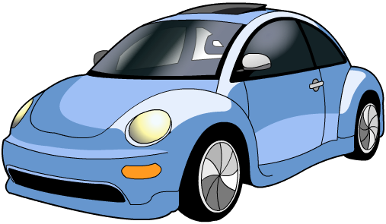
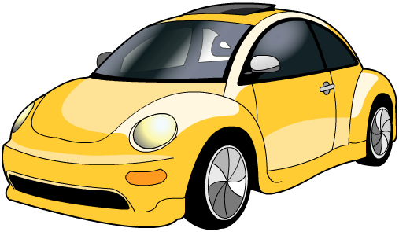
What is momentum?
All moving objects have momentum. This is a measure of how difficult it is to stop a moving object.
If these two cars have the same mass but one is quicker than the other, which has more momentum?
The faster car has more momentum.
If both cars travel at the same velocity, but one is filled with luggage and the other is empty, which has more momentum?
The heavier car has more momentum.
The heavier an object is and the faster it moves, the more momentum it will have and the more difficult it will be to stop.

Slide 4
How is momentum calculated?
The momentum of an object can be calculated using this equation:
momentum = mass × velocity
or:
p = m v
Mass (m) is measured in kilograms (kg).
Velocity (v) is measured in meters per second (m/s).
Momentum (p) is measured in kilogram meters per second (kg m/s).
Notes:
Teacher notes
It may be worth pointing out to students that the force needed to lift an object is the same as the weight of the object. For example, the force needed to lift a 100 N box is 100 N.
This slide covers the Science and Engineering Practice:
Developing and Using Models: Develop and/or use a model (including mathematical and computational) to generate data to support explanations, predict phenomena, analyze systems, and/or solve problems.

Slide 5
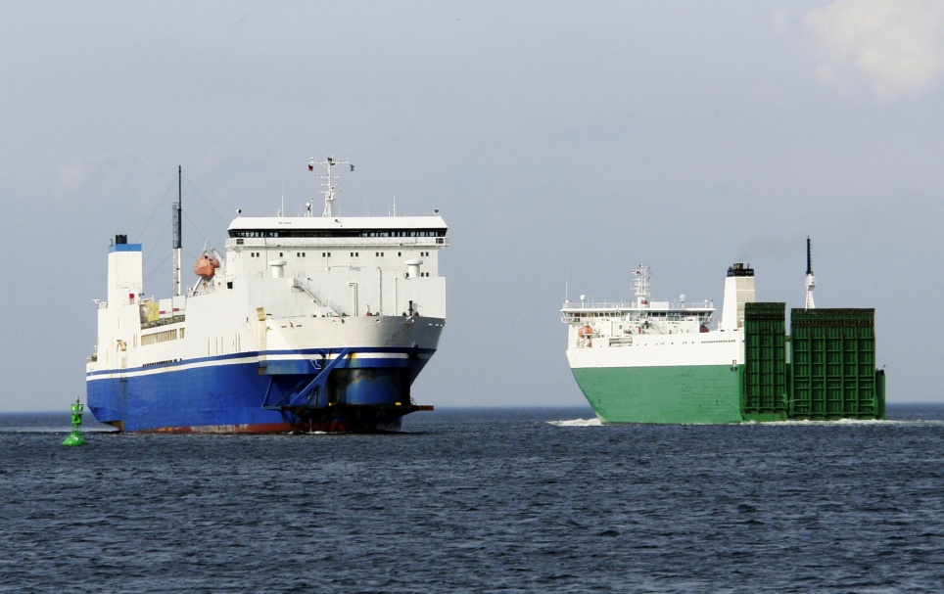
Scalar or vector?
Velocity is a vector quantity – this means it has magnitude (size) and direction. Scalar quantities, such as speed, only have magnitude.
As velocity is needed to calculate momentum, momentum must also be a vector quantity and it therefore has a direction.
If two objects of the same mass are moving in opposite directions but at the same speed (i.e. their velocities are different), the momentum of each object will be different.
A “+” and a “–” are often used to indicate the opposite directions of momentum.
Notes:
Photo credit: © photos.com 2018

Slide 6
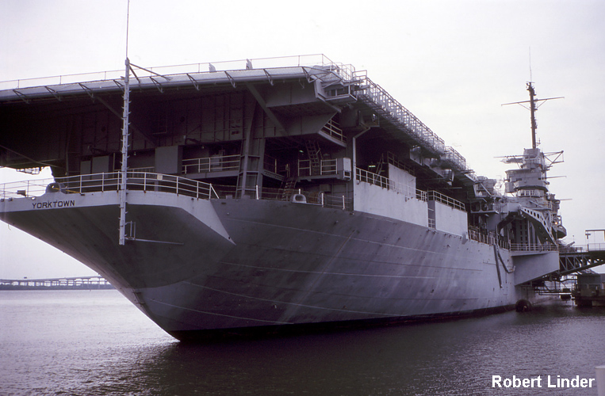
Calculating momentum question
An aircraft carrier has a mass of 1,000,000 kg and a velocity of 15 m/s. What is its momentum?
momentum = mass × velocity
= 1,000,000 × 15
= 15,000,000 kg m/s
Notes:
This slide covers the Science and Engineering Practice:
Using Mathematics and Computational Thinking: Apply techniques of algebra and functions to represent and solve scientific and engineering problems.
Photo credit: © Robert Linder, 2018

Slide 7
Momentum calculations
Notes:
This slide is accompanied by the worksheet Momentum.
This slide covers the Science and Engineering Practice:
Using Mathematics and Computational Thinking: Apply techniques of algebra and functions to represent and solve scientific and engineering problems.

Slide 8
Momentum and collisions
Notes:
Teacher notes
This simulation of a Newton’s cradle can be used to get students thinking about what happens to momentum in collisions, and to introduce the principle of conservation of momentum.
This slide covers the Science and Engineering Practices:
Asking Questions and Defining Problems: Ask questions that arise from careful observation of phenomena, or unexpected results, to clarify and/or seek additional information.
Constructing Explanations and Designing Solutions: Apply scientific ideas, principles, and/or evidence to provide an explanation of phenomena and solve design problems, taking into account possible unanticipated effects.

Slide 9
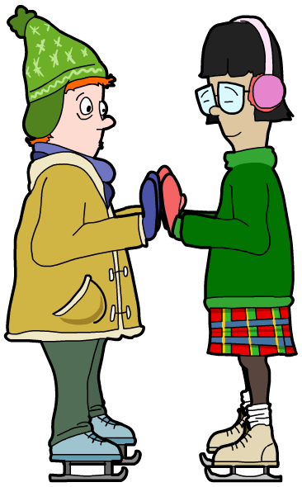
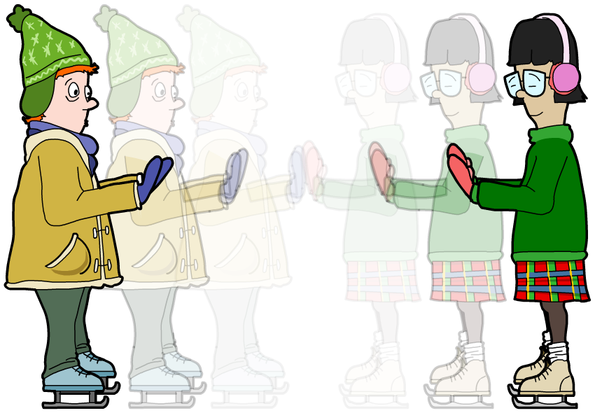
What is conservation of momentum?
If two objects collide or interact, the forces acting on each one will be the same size but in opposite directions. The same is true for the change in momentum of each object.
This means that the momentum lost by one of the objects will be gained by the other object. Therefore, whenever two objects collide or interact, momentum is conserved.
Notes:
Teacher notes
It could be worth refreshing the students’ understanding of Newton’s third law of motion at this point.
Momentum is only conserved in a closed system, i.e. a system that is not affected by external forces.
This slide is accompanied by the worksheet Momentum.

Slide 10
Using conservation of momentum
Notes:
Teacher notes
This five-stage animation shows how the principle of conservation of momentum can be used to calculate the velocity of an object.
This slide covers the Science and Engineering Practices:
Using Mathematics and Computational Thinking: Use mathematical, computational, and/or algorithmic representations of phenomena or design solutions to describe and/or support claims and/or explanations.
Using Mathematics and Computational Thinking: Apply techniques of algebra and functions to represent and solve scientific and engineering problems.

Slide 11
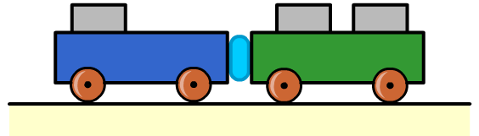
Conservation of momentum example
Two trolleys collide and stick together. From the data below, calculate the velocity of the trolleys after the collision.
trolley A
trolley B
mass = 3 kg
mass = 5 kg
velocity = 8 m/s
velocity = –4 m/s
momentum = 24 kg m/s
momentum = –20 kg m/s
total momentum before collision = 4 kg m/s (24 + –20)
mass after collision = 8 kg (3 + 5)
momentum after collision = 4 kg m/s
velocity after collision = momentum / mass = 0.5 m/s
Notes:
This slide covers the Science and Engineering Practice:
Using Mathematics and Computational Thinking: Apply techniques of algebra and functions to represent and solve scientific and engineering problems.

Slide 12
Investigating momentum
Notes:
Teacher notes
This virtual experiment enables students to explore how mass and velocity affect the momentum of an object, and how momentum is conserved in a collision.
Select a mass and velocity for each trolley, then click the momentum box to reveal the momentum of each trolley, or ask students to calculate the value first. Once the trolleys have collided, students could be encouraged to calculate the total momentum and velocity of the combined trolleys, before revealing the final values and the working for the calculations.
This slide covers the Science and Engineering Practices:
Planning and Carrying Out Investigations: Plan an investigation or test a design individually and collaboratively to produce data to serve as the basis for evidence as part of building and revising models, supporting explanations for phenomena, or testing solutions to problems. Consider possible variables or effects and evaluate the confounding investigation’s design to ensure variables are controlled.
Using Mathematics and Computational Thinking: Use mathematical, computational, and/or algorithmic representations of phenomena or design solutions to describe and/or support claims and/or explanations.
Using Mathematics and Computational Thinking: Apply techniques of algebra and functions to represent and solve scientific and engineering problems.

Slide 13
Momentum in explosions
Notes:
Teacher notes
This five-stage animation shows momentum during an explosion.

