Slide 1
Internal Energy and Specific Heat Capacity

Slide 2
Information
Developing and Using Models
Planning and Carrying Out Investigations
Analyzing and Interpreting Data
Using Mathematics and Computational Thinking
4. Systems and System Models
5. Energy and Matter

Slide 3
Internal energy
The particles in any system each have some kinetic and potential energy.
This means that energy is stored inside a system. This is called internal energy.
The internal energy of a system is the total kinetic and potential energy of all the atoms and molecules that make up the system.

Slide 4
Temperature and kinetic energy
Notes:
This slide covers the Science and Engineering Practice:
Developing and Using Models: Use a model to provide mechanistic accounts of phenomena.

Slide 5
Heat and internal energy
Heating a system gives energy to the particles in the system, so increases the internal energy of the system.
Increasing the energy stored in a system will either:
raise the temperature of the system, by increasing the kinetic energy of the particles that make up the system
change the state of the system, by breaking the bonds between the particles that make up the system.
Notes:
Teacher notes
For more information about changing the state of a system, please refer to the Specific Latent Heat presentation.

Slide 6
Investigating temperature change
Notes:
Teacher notes
The purpose of each piece of equipment should first be explained:
The yellow power pack supplies power.
The joulemeter measure the amount of energy supplied.
The thermocouple measure the temperature.
This slide covers the Science and Engineering Practice:
Planning and Carrying Out Investigations: Plan and conduct an investigation individually and collaboratively to produce data to serve as the basis for evidence, and in the design: decide on types, how much, and accuracy of data needed to produce reliable measurements and consider limitations on the precision of the data (e.g., number of trials, cost, risk, time), and refine the design accordingly.

Slide 7
What factors affect temperature change?
Notes:
Teacher notes
The purpose of each piece of equipment should first be explained:
The yellow power pack supplies power.
The joulemeter measure the amount of energy supplied.
The thermocouple measure the temperature.
Pupils could be asked which are the dependent and independent variables in each experiment to clarify which factors affect temperature change.
This slide covers the Science and Engineering Practice:
Planning and Carrying Out Investigations: Plan and conduct an investigation individually and collaboratively to produce data to serve as the basis for evidence, and in the design: decide on types, how much, and accuracy of data needed to produce reliable measurements and consider limitations on the precision of the data (e.g., number of trials, cost, risk, time), and refine the design accordingly.

Slide 8
Factors affecting temperature change
Notes:
Teacher notes
This quiz could be used as an introductory activity to discover what factors affect temperature change as a material is heated. Students could be given colored traffic light cards (red = no, green = yes) to vote on the statements shown. To stretch students, they could be asked to explain their voting.

Slide 9
How does energy affect materials?
Do different materials need the same amount of energy to increase their temperature by the same amount?
Increasing the temperature of 1 kg of water by 1 °C requires 4,200 J.
Increasing the temperature of 1 kg of copper by 1 °C requires 390 J.
Water and copper require different amounts of energy because they have different values for a property called specific heat capacity (SHC). SHC is the amount of energy required to increase the temperature of 1 kg of a material by 1 °C.
So, the specific heat capacity for water is 4,200 J/kg°C and for copper is 390 J/kg°C.
Notes:
Teacher notes
It should be stressed that the specific heat capacity is the amount of energy required to produce a 1 °C temperature rise in 1 kg of material.

Slide 10
What is specific heat capacity?
The specific heat capacity of a material is the amount of energy required to raise 1 kg of the material by 1 °C.
It can be used to work out how much energy is needed to raise the temperature of a material by a certain amount:
energy
=
mass
×
specific heat
capacity
×
temperature
change
Energy is measured in joules (J).
Mass is measured in kilograms (kg).
Temperature change is measured in degrees Celsius (°C).
Specific heat capacity is measured in joules per kilogram per degree Celsius (J/kg°C).
Notes:
This slide covers the Science and Engineering Practice:
Developing and Using Models: Develop and/or use a model (including mathematical and computational) to generate data to support explanations, predict phenomena, analyze systems, and/or solve problems.

Slide 11
Specific heat capacity example
How much energy is needed to increase the temperature of 600 g of water by 80 °C in a kettle?
Note: mass = 600 g = 0.6 kg and the specific heat capacity
of water is 4,200 J/kg°C.
energy
specific heat
capacity
temperature
change
=
mass
×
×
energy = 0.6 kg × 4,200 J/kg°C × 80 °C
= 201,600 J
Notes:
This slide covers the Science and Engineering Practice:
Using Mathematics and Computational Thinking: Apply techniques of algebra and functions to represent and solve scientific and engineering problems.

Slide 12
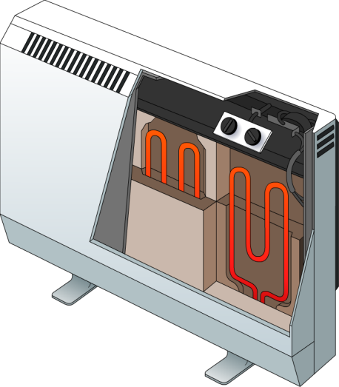
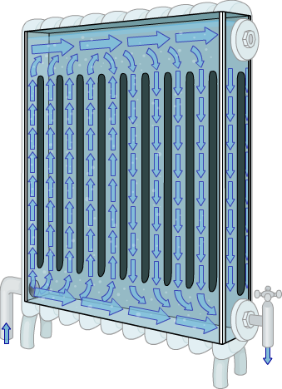
Choosing suitable materials
Different materials have different specific heat capacity values. A high value means that the material can store a large amount of heat energy for a minimal temperature change.
For example, concrete is used in night storage heaters. Concrete has an SHC of 880 J/kg°C. This is high compared with other suitable materials such as granite (SHC = 790 J/kg°C).
Radiators use closed liquid systems. Water is used because it has an extremely high SHC of 4,200 J/kg°C. This is much higher than oil, for example, with a typical SHC of 1,800 J/kg°C.
Notes:
This slide is accompanied by the worksheet Internal Energy and Specific Heat Capacity.

Slide 13
Specific heat capacity of metals
Notes:
This slide covers the Science and Engineering Practices:
Analyzing and Interpreting Data: Consider limitations of data analysis (e.g., measurement error, sample selection) when analyzing and interpreting data.
Using Mathematics and Computational Thinking: Apply techniques of algebra and functions to represent and solve scientific and engineering problems.

Slide 14
The specific heat capacity equation
Notes:
Teacher notes
This slide could be used to emphasize the need to show work in the calculation and demonstrate the most suitable layout.
This slide covers the Science and Engineering Practice:
Using Mathematics and Computational Thinking: Apply techniques of algebra and functions to represent and solve scientific and engineering problems.

Slide 15
Specific heat capacity calculations
Notes:
Teacher notes
For this set of practice questions, students could be asked to find the answer before it is revealed on the slide. Students should be encouraged to lay out their work as on the previous slide.
This slide covers the Science and Engineering Practice:
Using Mathematics and Computational Thinking: Apply techniques of algebra and functions to represent and solve scientific and engineering problems.

