Slide 1
Interference

Slide 2
Information
Developing and Using Models
Planning and Carrying Out Investigations
Constructing Explanations and Designing Solutions
1. Patterns
2. Cause and Effect
4. Systems and System Models

Slide 3
What is interference?
Notes:
This slide covers the Science and Engineering Practice:
Planning and Carrying Out Investigations: Plan an investigation or test a design individually and collaboratively to produce data to serve as the basis for evidence as part of building and revising models, supporting explanations for phenomena, or testing solutions to problems. Consider possible variables or effects and evaluate the confounding investigation’s design to ensure variables are controlled.

Slide 4
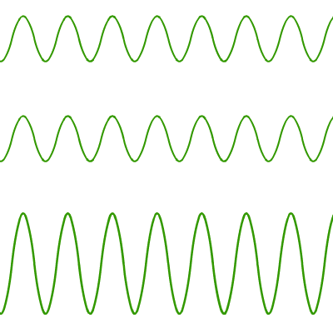
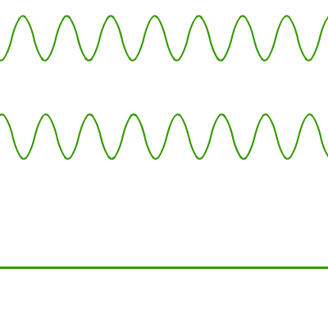
Interference of sound
What caused the pattern of loud and quiet spots?
Both speakers produce identical sounds. When the sound from one speaker meets the sound from the other, the two waves interact with each other. This is known as interference.
If the waves are in phase, they reinforce each other.
If the waves are out of phase, they cancel each other out.
+
+
=
=
This is constructive interference.
This is destructive interference.
Notes:
This slide covers the Science and Engineering Practice:
Developing and Using Models: Use a model to provide mechanistic accounts of phenomena.

Slide 5
Interference patterns
When waves or ripples in water overlap, the interference is seen clearly.
Someone walking in the sea parallel to a beach might find that they walk through areas with big waves and areas where the water is smooth.
This happens when waves from different sides of the bay overlap and reinforce or cancel each other out.
Notes:
Photo credit: © Mellimage, shutterstock.com 2018

Slide 6
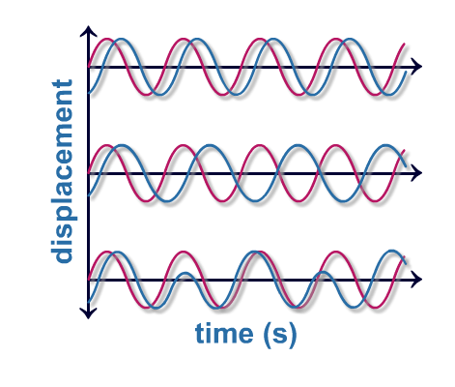
Coherence
To make a stable interference pattern, the wave sources need to be coherent:
1. waves from both sources have the same frequency
2. waves have a constant phase difference (in phase)
3. peaks and troughs have the same or comparable amplitudes.
For light, a coherent light source is monochromatic.
It must emit only one color light.
Notes:
Teacher notes
To investigate interference of light, coherent sources are created by using monochromatic light from only one source. The light is then shone through a screen containing two slits that act as a two point sources of light. This ensures that the light from both slits is coherent. A laser can also be used, as laser light is coherent.

Slide 7
Investigating interference
Notes:
Teacher notes
It may be helpful to point out to students that, after interfering, the waves emerge from each other unaffected.
This slide covers the Science and Engineering Practice:
Developing and Using Models: Use a model to provide mechanistic accounts of phenomena.

Slide 8
Using interference
Interference in sound can be used for noise cancellation.
Some car manufacturers put microphones into the engine bay, delay the sound by half a wave, and play it back to the passengers. The effect of this is that the noise of the engine is cancelled out, and the journey is much quieter.
The same idea is used on helicopters to cancel out the incredibly loud rotor noise and allow the pilot to communicate more effectively.
Notes:
This slide covers the Science and Engineering Practice:
Constructing Explanations and Designing Solutions: Apply scientific ideas, principles, and/or evidence to provide an explanation of phenomena and solve design problems, taking into account possible unanticipated effects.
Photo credit: © 2018 Photos.com

Slide 9
Interference in light
Notes:
This slide covers the Science and Engineering Practice:
Constructing Explanations and Designing Solutions: Apply scientific ideas, principles, and/or evidence to provide an explanation of phenomena and solve design problems, taking into account possible unanticipated effects.

Slide 10
Understanding interference
Notes:
Teacher notes
This completing sentences activity could be used as an introductory or summary activity on wave interference.

