Slide 1
Braking Distance

Slide 2
Information
Analyzing and Interpreting Data
Using Mathematics and Computational Thinking
Constructing Explanations and Designing Solutions
2. Cause and Effect
3. Scale, Proportion, and Quantity
5. Energy and Matter

Slide 3
What is braking distance?
Stopping distance is the overall distance that a vehicle takes to stop. It is made up of two parts: thinking distance and braking distance.
stopping distance = thinking distance + braking distance
Thinking distance is how far the vehicle travels whilst the driver is making the decision to stop.
The braking distance is how far the vehicle travels after the driver has applied the brakes.
The faster a vehicle is going, the longer it will take to stop.
Notes:
This slide covers the Science and Engineering Practice:
Using Mathematics and Computational Thinking: Use mathematical, computational, and/or algorithmic representations of phenomena or design solutions to describe and/or support claims and/or explanations.

Slide 4
Braking forces
When a vehicle is traveling at a constant velocity, the thrust produced by the engine is balanced by resistive forces. The net force is zero.
braking force
resistive forces
thrust
In order to stop the vehicle, the brakes must apply an additional force. When this happens, the forces on the vehicle are no longer balanced and the car decelerates.

Slide 5
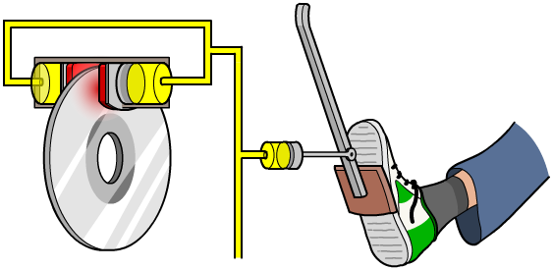
How do brakes work?
Brakes work through friction. Friction is a resistive force that occurs whenever two surfaces try to move past each other.
When brakes are applied, the brake pads are squeezed together and come into contact with the brake discs.
Large frictional forces are generated between the brake pads and the brake discs. These oppose the movement of the wheel and the wheel stops spinning.
Notes:
This slide covers the Science and Engineering Practice:
Constructing Explanations and Designing Solutions: Apply scientific ideas, principles, and/or evidence to provide an explanation of phenomena and solve design problems, taking into account possible unanticipated effects.

Slide 6
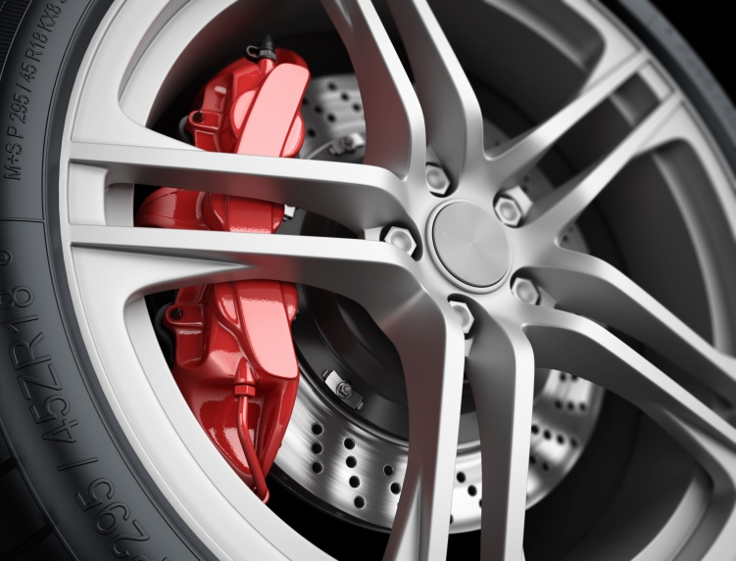
Work done by frictional forces
Because the vehicle has kinetic energy, it takes work to stop it.
work done = energy transferred
The work done by the brakes to stop the car is equal to the kinetic energy the car had before the brakes were applied.
Energy cannot be destroyed, only transformed from one form to another. In this case, the kinetic energy is converted into heat energy. The brake pads and brake discs become hot.
Notes:
Teacher notes
For more information about work and energy transfer, please refer to the Work Done presentation.
Photo credit: © You can more, shutterstock.com 2018

Slide 7
What affects the kinetic energy?
The kinetic energy of an object can be calculated using the equation:
As mass and velocity increase, the kinetic energy of the object also increases.
Therefore, for the same braking force, the stopping distance of a vehicle increases with its mass and velocity.
Which do you think has the greater effect: mass or velocity?
Notes:
Teacher notes
Students should be able to see from the formula for kinetic energy that a change in velocity will have a greater effect on kinetic energy, because velocity is squared. To prove this, you could investigate the effects of doubling the mass compared to doubling the velocity for a given example. For more information about kinetic energy, please refer to the Potential and Kinetic Energy presentation.
It should be noted that this scenario imagines an unchanged braking force. While a heavier car would have increased kinetic energy, it would also have increased friction with the road, since friction is also approximately proportional to mass. Therefore the stopping distance would be approximately unchanged.
This slide covers the Science and Engineering Practice:
Using Mathematics and Computational Thinking: Use mathematical, computational, and/or algorithmic representations of phenomena or design solutions to describe and/or support claims and/or explanations.

Slide 8
Speed and braking distance
Notes:
Teacher notes
This flash activity explicitly investigates how braking distance varies with velocity. The connection between the relationship illustrated by the graph, distance ∝ speed² , and the equation for kinetic energy on the previous slide may already be clear to some students.
This slide covers the Science and Engineering Practice:
Analyzing and Interpreting Data: Analyze data using tools, technologies, and/or models (e.g., computational, mathematical) in order to make valid and reliable scientific claims or determine an optimal design solution.

Slide 9
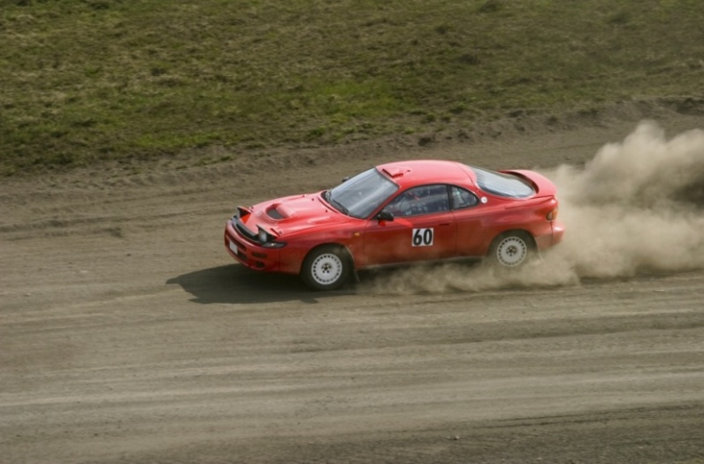
Kinetic energy calculation
How much work is done by the brakes to bring a 1,750 kg car traveling at 30 m/s to a stop?
work done = energy transferred
All of the car’s kinetic energy is transferred to heat.
KE = ½ × mass × velocity²
work done = kinetic energy = ½ m v²
= ½ × 1,750 × 30²
= 787,500 J or 787.5 kJ
Notes:
This slide covers the Science and Engineering Practice:
Using Mathematics and Computational Thinking: Apply techniques of algebra and functions to represent and solve scientific and engineering problems.
Photo credit: © TTPhoto, shutterstock.com 2018

Slide 10
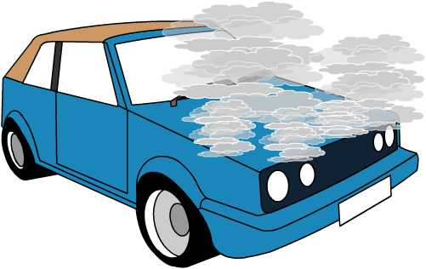
Braking and deceleration
Remember: the faster the vehicle, the more kinetic energy it has. The more kinetic energy it has, the more work needs to be done to bring it to a stop.
To do more work over the same braking distance, the force applied by the brakes has to be larger.
The more force applied, the faster the car will decelerate. However, large decelerations are dangerous. Brakes can overheat and be damaged if applied too heavily or for too long.
Notes:
This slide covers the Science and Engineering Practice:
Constructing Explanations and Designing Solutions: Design, evaluate, and/or refine a solution to a complex real-world problem, based on scientific knowledge, student-generated sources of evidence, prioritized criteria, and trade-off considerations.

Slide 11
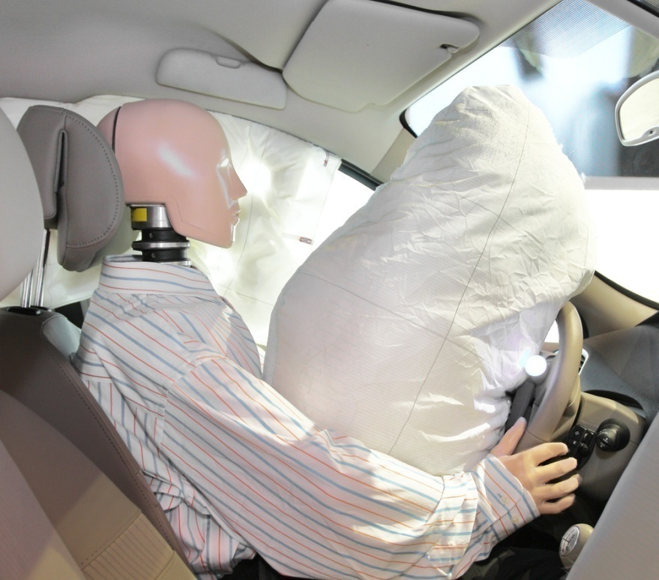
Braking safely
Large or sudden decelerations can also injure the people in the vehicle.
A large force acting briefly is more of a risk than a moderate force acting over a longer period of time.
For this reason, many vehicles have safety features designed to increase the stopping time or stopping distance for the passengers.
Notes:
Teacher notes
The force expended in a collision is equivalent to the change in momentum over the time for which the force is acting. For more information about momentum, please refer to the Momentum presentation.
This slide covers the Science and Engineering Practice:
Constructing Explanations and Designing Solutions: Design, evaluate, and/or refine a solution to a complex real-world problem, based on scientific knowledge, student-generated sources of evidence, prioritized criteria, and trade-off considerations.
Photo credit: © Vereshchagin Dmitry, shutterstock.com 2018

Slide 12
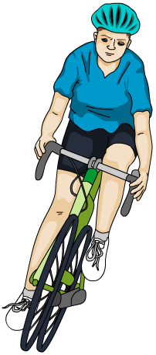
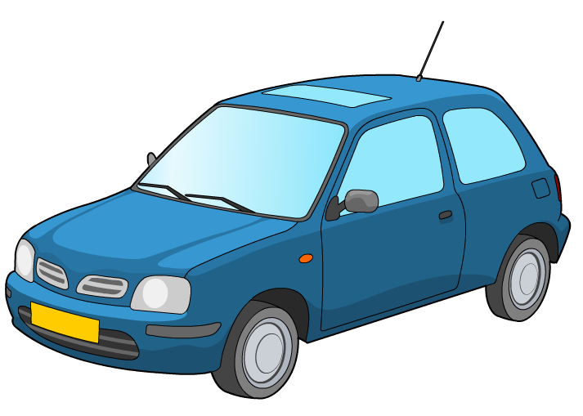
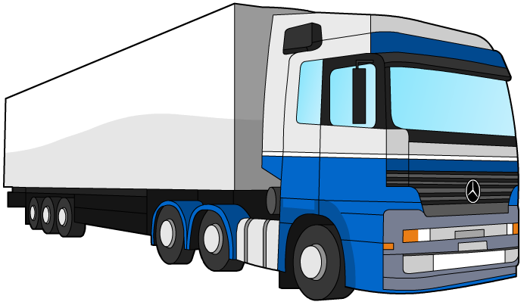
Estimating braking forces
Estimate the force needed to safely stop…
…a small car.
…a bicycle.
… a heavy truck.
about 5 kN
around 200 N
roughly 15 kN
Notes:
Teacher notes
Ask students to suggest estimates for these vehicles, based on suitable estimates of mass, speed and stopping distance.
Answers given are based on:
a 800 kg car traveling at 25 m/s and stopping in 50 m
a 20 kg bicycle traveling at 5.5 m/s and stopping in 1.5 m
a 3,500 kg truck traveling at 20 m/s and stopping in 50 m.
This slide covers the Science and Engineering Practices:
Using Mathematics and Computational Thinking: Apply techniques of algebra and functions to represent and solve scientific and engineering problems.
Using Mathematics and Computational Thinking: Apply ratios, rates, percentages, and unit conversions in the context of complicated measurement problems involving quantities with derived or compound units (such as mg/mL, kg/m3, acre-feet, etc.).

Slide 13
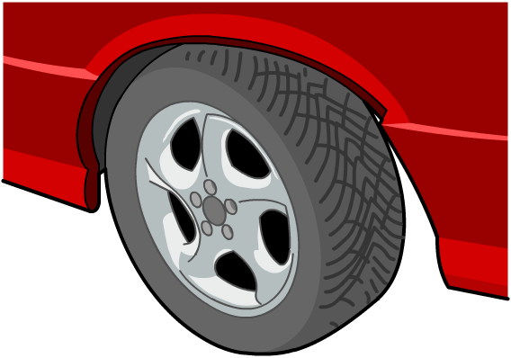
What affects braking distance?
What factors other than speed affect braking distance?
adverse road conditions
poor condition of the vehicle
wet or icy weather
condition of tires or brakes
condition of road

Slide 14
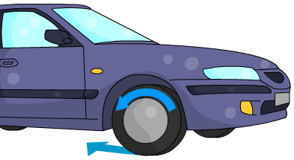
Braking distance and friction
When braking, the wheels of the car are in contact with the brakes and the road.
If the brakes are worn, this will reduce the amount of friction between the brake pad and the brake disc. The car will take longer to stop.
friction from brakes
friction from road
If the road is slippery, this will reduce the friction between the tire and the road. The car will take longer to stop and be more likely to skid.
Notes:
This slide covers the Science and Engineering Practice:
Constructing Explanations and Designing Solutions: Apply scientific ideas, principles, and/or evidence to provide an explanation of phenomena and solve design problems, taking into account possible unanticipated effects.

Slide 15
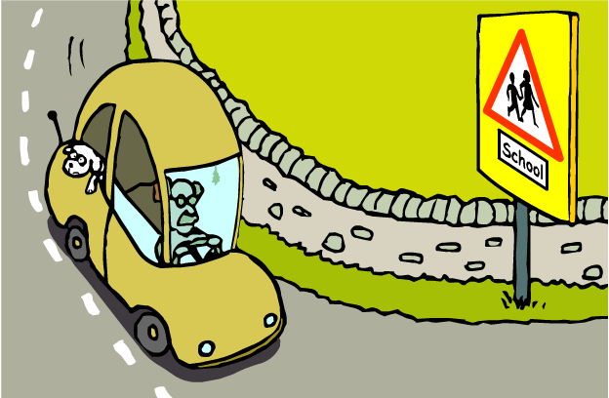
Braking quickly
In an emergency, drivers need to be able to minimize their braking distance in order to stop quickly.
Because of the squared relationship between velocity and braking distance, a small decrease in velocity produces a bigger decrease in braking distance.
Drivers are advised to reduce their speed in wet or icy weather. Different speed limits are used on different roads and in different situations. Compare the speed limit on a highway to a street outside a school.
Notes:
Teacher notes
Ask students to come up with other road safety measures, and explain the reasoning behind them. For example:
Why are roads gritted in bad weather?
Why are cars required to have regular tests?
This slide covers the Science and Engineering Practice:
Constructing Explanations and Designing Solutions: Apply scientific ideas, principles, and/or evidence to provide an explanation of phenomena and solve design problems, taking into account possible unanticipated effects.

Slide 16
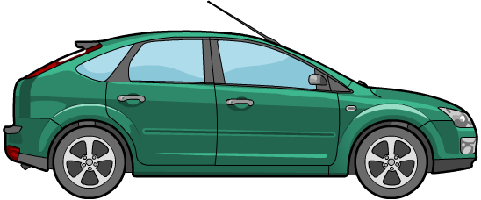
Estimating braking distance
Estimate the braking distance for a car traveling at…
… 25 mph.
… 50 mph.
…100 mph.
around 10 m
around 40 m
around 160 m
How would these estimates change if the road was wet?
Notes:
Teacher notes
Ask students to suggest estimates for these vehicles. Answers given are based on a coefficient of friction of approximately 0.7. You should ensure that students recognize that whilst the velocity doubles, the distance quadruples.
If the road was wet, friction would be reduced and braking distance would increase.
This slide covers the Science and Engineering Practices:
Using Mathematics and Computational Thinking: Apply techniques of algebra and functions to represent and solve scientific and engineering problems.
Using Mathematics and Computational Thinking: Apply ratios, rates, percentages, and unit conversions in the context of complicated measurement problems involving quantities with derived or compound units (such as mg/mL, kg/m3, acre-feet, etc.).

