Slide 1
The Haber Process

Slide 2
Information
Asking Questions and Defining Problems
Analyzing and Interpreting Data
Constructing Explanations and Designing Solutions
7. Stability and Change

Slide 3
What is the Haber process?
Ammonia is an important compound in the manufacture of artificial fertilizers and other chemicals, such as cleaning fluids and floor waxes.
It is made industrially by reacting nitrogen with hydrogen in the Haber process.
nitrogen
+
hydrogen
ammonia
N₂ (g)
+
3H₂ (g)
2NH₃ (g)
The Haber process is a reversible reaction. This means the products can react together to form the reactants again.
Why is this a problem for companies making ammonia?
Notes:
Teacher notes
Due to the Haber process being a reversible reaction, some of the ammonia produced will break down into hydrogen and nitrogen again.
For more information about reversible reactions, please refer to the Reversible Reactions and Equilibrium presentation.

Slide 4
Feedstock for the Haber process
The Haber process requires nitrogen and hydrogen gas.
The nitrogen gas comes from the air, which contains 78% nitrogen. It can be separated from the other gases in the air by fractional distillation.
The hydrogen gas comes from methane found in natural gas. Methane is reacted with steam to form hydrogen:
CH₄(g)
+
H₂O(g)
CO(g)
3H₂(g)
Air and methane gas are said to be the feedstock for the Haber process.
Notes:
Teacher notes
Natural gas is a mixture of hydrocarbon gases but it consists mainly of methane. It is a fossil fuel and is used for cooking and generating electricity.
For more information about fractional distillation, please refer to the Fractional Distillation presentation.

Slide 5
The Haber process
Notes:
Teacher notes
This five-stage animation illustrates how ammonia is made in the Haber process.

Slide 6
Stages of the Haber process
Notes:
Teacher notes
This ordering activity could be used as an introductory or summary activity on the stages in the Haber process. Mini-whiteboards could be used to make this a whole-class exercise.

Slide 7
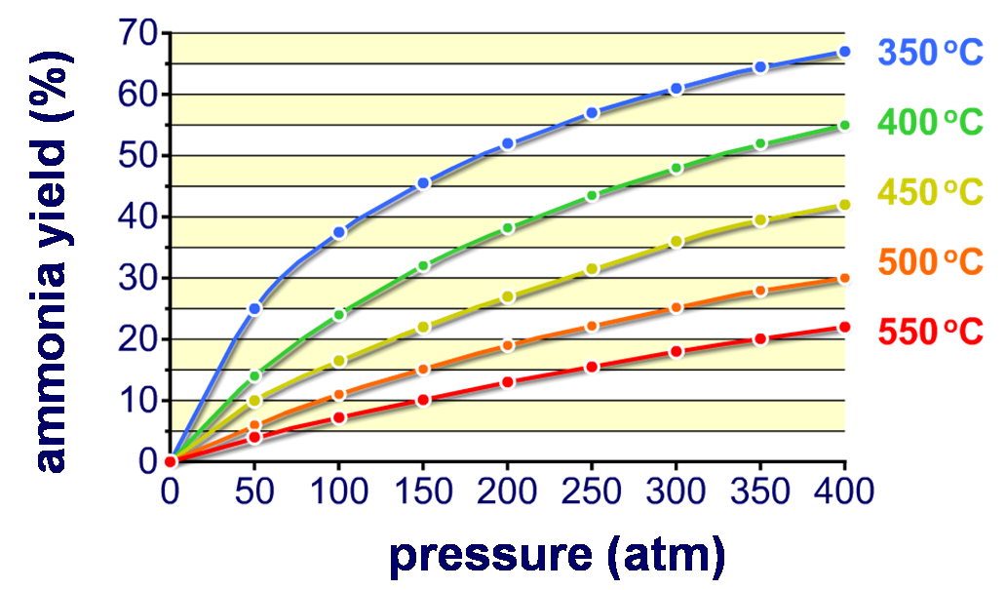
What is yield?
The amount of product made in a reaction is called the yield and is usually expressed as a percentage.
The yield of ammonia produced by the Haber process depends on the temperature and pressure of the reaction.
Notes:
Teacher notes
The graph shows the effect of temperature and pressure on the yield of ammonia obtained in the Haber process. At every temperature, an increase in pressure increases the yield of ammonia. However, as you increase the temperature, the yield of ammonia decreases.

Slide 8
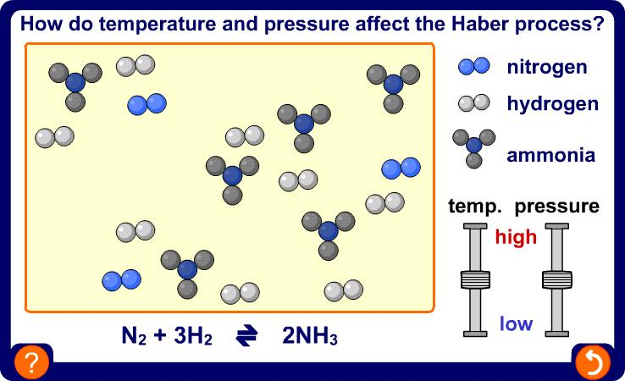
Temperature, pressure and yield
Notes:
Teacher notes
This activity could be used as an introductory or summary activity on the effects of temperature and pressure on the Haber process.

Slide 9
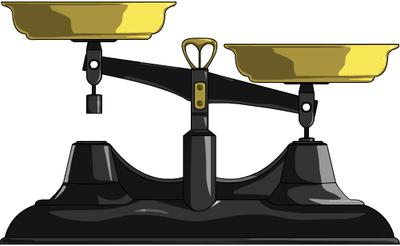
Position of equilibrium
If a change is made to a system in equilibrium, the system will react to oppose the change until equilibrium is reached again.
This causes the position of the equilibrium to shift, which changes the relative amounts of the reactants and products.
Temperature, pressure and concentration can all affect the position of equilibrium.
The response of a reaction system depends on the properties of the forward and backward reactions.

Slide 10
Effect of pressure
In the Haber process, there are fewer moles of product (ammonia) than reactant (nitrogen and hydrogen).
N₂ (g)
+
3H₂ (g)
2NH₃ (g)
If pressure is increased, the position of equilibrium will shift to oppose the change.
It will shift to decrease the pressure by moving in the direction that produces the fewest moles.
This means that increasing the pressure increases the yield of ammonia.
On an industrial scale, why is the Haber process not run at really high pressures?
Notes:
Teacher notes
There are 4 moles on the reactant side and 2 moles on the product side.
Running a reaction at high pressures is uneconomical as it requires stronger and more expensive equipment. Therefore, the Haber process is run at a high enough pressure to get a good yield of ammonia but at a low enough pressure that costs are not too high.
This slide covers the Science and Engineering Practices:
Asking Questions and Defining Problems: Ask questions to clarify and refine a model, an explanation, or an engineering problem.
Constructing Explanations and Designing Solutions: Design, evaluate, and/or refine a solution to a complex real-world problem, based on scientific knowledge, student-generated sources of evidence, prioritized criteria, and trade-off considerations.

Slide 11
Effect of temperature
The forward reaction of the Haber process is exothermic, which means it releases heat.
exothermic
N₂ (g)
+
3H₂ (g)
2NH₃ (g)
endothermic
If the temperature is increased, the position of equilibrium will shift to oppose the change.
It will shift to decrease the temperature by moving in the reverse, endothermic direction. This leads to an increase in the amount of nitrogen and hydrogen produced.
This means that decreasing the temperature will increase the yield of ammonia.
On an industrial scale, why is the Haber process not run at really low temperatures?
Notes:
Teacher notes
If the Haber process was run at really low temperatures, the position of equilibrium would shift in the direction of the forward, exothermic reaction. This would increase the yield of ammonia.
However, a low temperature would decrease the rate of reaction and make the process uneconomical. Therefore, a compromise temperature is chosen that is high enough to give a good rate of reaction but low enough to get a good yield of ammonia.
This slide covers the Science and Engineering Practices:
Asking Questions and Defining Problems: Ask questions to clarify and refine a model, an explanation, or an engineering problem.
Constructing Explanations and Designing Solutions: Design, evaluate, and/or refine a solution to a complex real-world problem, based on scientific knowledge, student-generated sources of evidence, prioritized criteria, and trade-off considerations.

Slide 12
Changing the equilibrium position
Notes:
Teacher notes
This interactive animation shows the Haber process reaction and how reaction conditions can change the position of equilibrium. The scales represent the relative abundance of the reactants and products. If the scales are lower on the left, the reactants are more abundant. The slider bars can be dragged from left to right to show the effect of changing the temperature and pressure on the position of equilibrium. Changing the slider bars will result in either the products or the reactants becoming more abundant.

Slide 13
Fill the gaps: temperature and pressure
Notes:
Teacher notes
This completing sentences activity could be used as an introductory or summary activity on the Haber process.
This slide covers the Science and Engineering Practice:
Constructing Explanations and Designing Solutions: Apply scientific ideas, principles, and/or evidence to provide an explanation of phenomena and solve design problems, taking into account possible unanticipated effects.

Slide 14
What is the Haber compromise?
Based on the equilibrium position, the highest yield of ammonia is theoretically produced by using a low temperature and a high pressure.
In practice, these conditions are not used. Why?
Lowering the temperature slows down the rate of reaction. This means it takes longer for ammonia to be produced.
Increasing the pressure means stronger, more expensive equipment is needed. This increases the cost of producing the ammonia.
Industrial conditions produce an acceptable yield of ammonia in a reasonable timeframe, whilst keeping costs as low as possible. This is known as the Haber compromise.
Notes:
This slide covers the Science and Engineering Practice:
Constructing Explanations and Designing Solutions: Design, evaluate, and/or refine a solution to a complex real-world problem, based on scientific knowledge, student-generated sources of evidence, prioritized criteria, and trade-off considerations.

Slide 15
Conditions used in the Haber process
Notes:
Teacher notes
This interactive animation shows the effects of temperature and pressure on the yield of ammonia obtained in the Haber process. At every temperature, an increase in pressure increases the yield of ammonia. However, as you increase the temperature, the yield of ammonia decreases.
This slide covers the Science and Engineering Practices:
Analyzing and Interpreting Data: Analyze data to identify design features or characteristics of the components of a proposed process or system to optimize it relative to criteria for success.
Constructing Explanations and Designing Solutions: Design, evaluate, and/or refine a solution to a complex real-world problem, based on scientific knowledge, student-generated sources of evidence, prioritized criteria, and trade-off considerations.

Slide 16
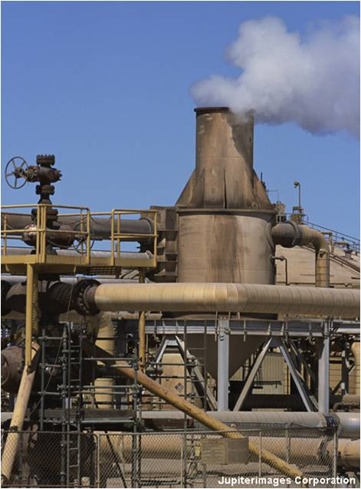
The Haber compromise
On an industrial scale, the Haber process is carried out at 450 °C and 200 atmospheres. This produces a high yield of ammonia, at a reasonable rate and without the need for overly expensive equipment.
Industrially, the most important factor in deciding what conditions to use is total cost, not yield.
What costs are involved in the industrial production of ammonia?
raw materials
energy
equipment
wages.
Notes:
Photo credit: © Jupiterimages Corporation 2018

Slide 17
Maximizing productivity
What else can be done to maximize productivity in the manufacture of ammonia?
An iron catalyst is used to increase the rate of reaction. It speeds up the forward and backward reactions equally, so the position of equilibrium is not affected.
The ammonia is cooled, liquefied and then removed as it is produced. This causes the equilibrium to shift to the right to produce more ammonia.
Unreacted nitrogen and hydrogen are recycled by being fed back into the reactor.
Gases flow through the reactor too quickly for equilibrium to be reached so only the forward reaction can occur.

