Slide 1
Nanoparticles

Slide 2
Information
Constructing Explanations and Designing Solutions
3. Scale, Proportion, and Quantity
6. Structure and Function

Slide 3
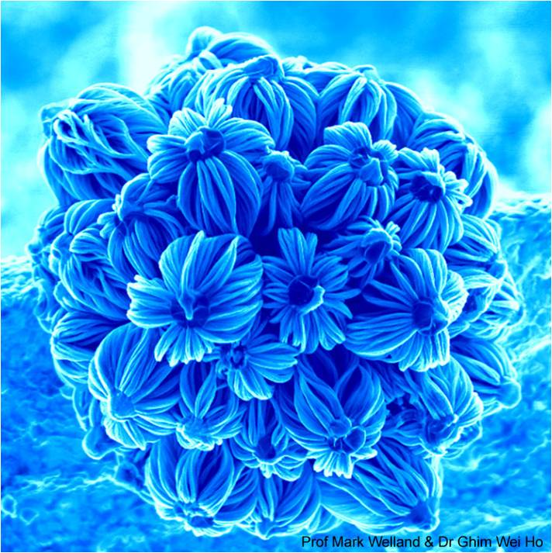
What is nanotechnology?
Nanotechnology involves the study and use of extremely small substances, often called nanoparticles.
The word “nano” comes from the Greek word nanos, which means “dwarf.”
A nanometer (nm) is
0.000000001 meter (or 10^{–9} m). That’s one millionth of a millimeter.
Nanoparticles are very small, approximately 1–100 nm across, but just how small is that?
Notes:
Teacher notes
Nanotechnology could be defined as the technology that has allowed for the control, manipulation, study, and manufacture of structures and devices in the “nanometer” size range.
The “nano-flowers” in the image were created from silicon carbide nanowires growing on gallium particles. The individual nanowires are about one thousandth the diameter of a human hair. The wires grow as a gas containing methane flows over the surface. Possible applications for these structures include water-repellent coatings and parts of a new type of solar cell. This image was taken with a scanning electron microscope.
Photo credit: © courtesy of Prof Mark Welland and Dr Ghim Wei Ho, Nanoscience Centre, University of Cambridge, UK 2018

Slide 4
How small is nanotechnology?
Notes:
Teacher notes
This interactive zoom activity shows students how small the structures are in nanotechnology. The size at which structures become nanoparticles (100 nm) is highlighted in red.
Each zoom stage down towards the atom is 1/10th the size of the previous stage up.
A micrometer (1 µm) measures one-millionth of a meter.

Slide 5
Size of nanoparticles
Nanoparticles are 1–100 nm in size. This is of the order of a few hundred atoms.
Particulate matter (PM) in air is divided into different categories according to the size of the particles.
How does the size of nanoparticles compare to the size of particles found in air?
They are smaller than coarse particles.
Coarse particles (PM₁₀) are often referred to as dust and have diameters ranging between 2,500 and 10,000 nm.
They are also smaller than fine particles.
Fine particles (PM_{2.5}) have diameters ranging between 100 and 2,500 nm.
Notes:
Teacher notes
PM stands for particulate matter. PM₁₀ particles are those that generally have a diameter of 10 micrometers (µm) or less. PM_{2.5} particles are those that generally have a diameter of 2.5 micrometers (µm) or less.
The diameter of a fine particle is between 1 × 10⁻⁷ and 2.5 × 10⁻⁶ m.
The diameter of a coarse particle is between 2.5 × 10⁻⁶ and 1 × 10⁻⁵ m.

Slide 6
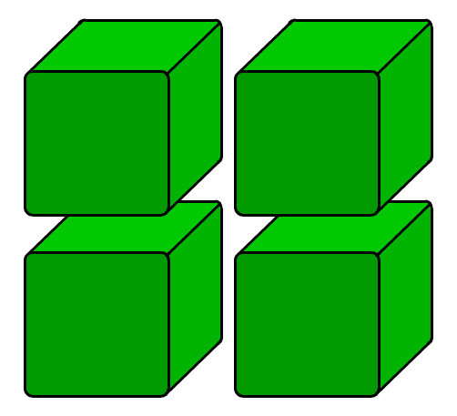
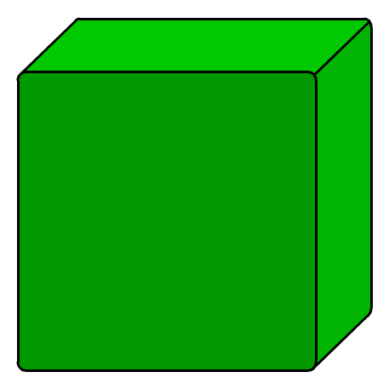
Surface area to volume ratio
Nanoparticles of a material have different properties from those of the same material in bulk.
One reason for this is that nanoparticles have a much larger surface area to volume ratio than bigger particles.
As the side of a cube decreases by a factor of 10, the surface area to volume ratio increases by a factor of 10.
high surface area to volume ratio
low surface area to volume ratio
A larger surface area to volume ratio may mean that a smaller quantity of nanoparticles is needed to be effective, compared to materials with a normal particle size.

Slide 7
Nanotechnology – true or false?
Notes:
Teacher notes
This true-or-false activity could be used as a introductory or summary exercise on nanotechnology, or at the start of the lesson to gauge students’ existing knowledge of the subject matter. Colored traffic light cards (red = false, yellow = don’t know, green = true) could be used to make this a whole-class exercise.

Slide 8
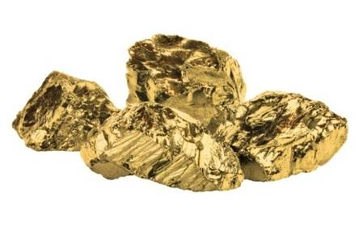
Properties of nanoparticles
The large surface area to volume ratio of nanoparticles means that their properties differ to those of the same material in bulk.
For example, gold particles are gold-colored but gold nanoparticles appear as deep red or black when in solution.
There is a lot of research being done into the uses of nanoparticles. However, it is often difficult to predict the properties and health effects of nanoparticles by researching the substance from which they are made.
As a result, there is limited data about the possible health effects of nanoparticles.
Notes:
Photo credit: © macrowildlife, shutterstock.com 2018

Slide 9
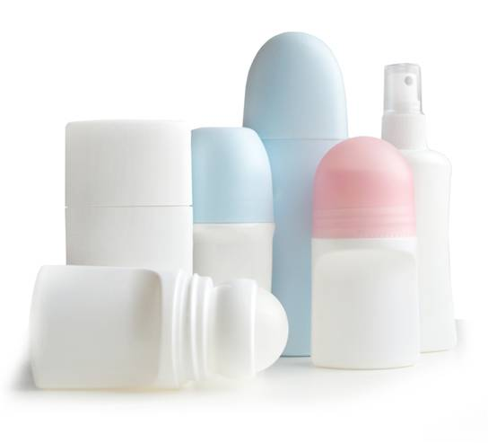
Applications of nanoparticles
Finding new applications for nanoparticles is an important area of research due to their wide range of unusual properties. Uses of nanoparticles include:
deodorants and fabrics to prevent the growth of bacteria
electronics
cosmetics and sun creams
medical applications
fuel cell materials
the development of new catalysts.
Notes:
Photo credit: © hobitnjak, shutterstock.com 2018

Slide 10
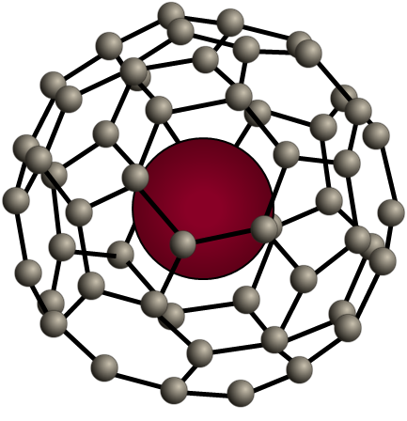
Uses of nanoparticles: medicine
There are lots of benefits of using nanoparticles in new technology, but the risks must also be considered.
Nanoparticles can be used in medicine to enable controlled drug delivery.
Advantages:
Nanoparticles can be used to deliver small amounts of a drug to targeted cells, meaning there will be fewer side effects.
Disadvantages:
carbon fullerene cage with a drug particle inside
Nanoparticles could have unknown effects on other cells in the body.
Notes:
Teacher notes
For more information about fullerenes, please refer to slides 17 and 18.
Nanoparticles are also being used in medicine in the development and improvement of synthetic skin.
This slide covers the Science and Engineering Practice:
Constructing Explanations and Designing Solutions: Design, evaluate, and/or refine a solution to a complex real-world problem, based on scientific knowledge, student-generated sources of evidence, prioritized criteria, and trade-off considerations.

Slide 11
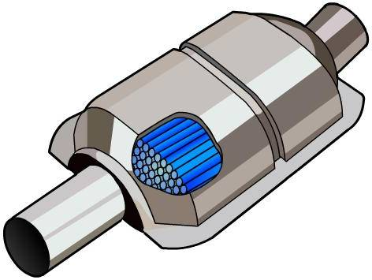
Uses of nanoparticles: catalysts
Nanoparticles are also used to develop new catalysts.
Advantages:
Nanoparticles have a large surface area to volume ratio, so can react quickly and speed up reactions.
This also means less catalyst will be required, making many processes cheaper.
Disadvantages:
It can be difficult to predict how a potential catalyst will react before it is tested.
There are also questions about their environmental effect when they are disposed of.
Notes:
Teacher notes
Image shows a catalytic converter.
For more information about catalysts, please refer to the Catalysts presentation.
This slide covers the Science and Engineering Practice:
Constructing Explanations and Designing Solutions: Design, evaluate, and/or refine a solution to a complex real-world problem, based on scientific knowledge, student-generated sources of evidence, prioritized criteria, and trade-off considerations.

Slide 12
Uses of nanoparticles: fuel cells
Nanoparticles are used in the development of new catalysts for fuel cells. Fuel cells generate power and can be used in cars and laptops.
Advantages:
Nanoparticles could help to develop smaller, safer and more efficient fuel cells.
Current fuel cells rely on an expensive platinum metal catalyst. Using nanoparticles may make fuel cells cheaper.
Disadvantages:
These catalysts are expensive to develop and a large amount of testing is required before new catalysts can be used on a large scale.
Notes:
This slide covers the Science and Engineering Practice:
Constructing Explanations and Designing Solutions: Design, evaluate, and/or refine a solution to a complex real-world problem, based on scientific knowledge, student-generated sources of evidence, prioritized criteria, and trade-off considerations.

Slide 13
Uses of nanoparticles: antibacterial
Silver nanoparticles are used in deodorants and fabrics to stop the growth of bacteria.
Advantages:
Silver nanoparticles in plasters, deodorants and even athletes’ socks can kill bacteria that lead to bad smells and infections.
Disadvantages:
Due to their small size, nanoparticles could enter the human body. This could cause unknown health effects.
Notes:
This slide covers the Science and Engineering Practice:
Constructing Explanations and Designing Solutions: Design, evaluate, and/or refine a solution to a complex real-world problem, based on scientific knowledge, student-generated sources of evidence, prioritized criteria, and trade-off considerations.

Slide 14
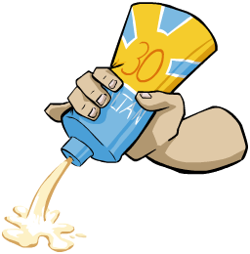
Risks of nanoparticles
Nanoparticles of zinc oxide and titanium dioxide are used in sunscreens to block UV light from reaching the skin. The nanoparticles are so small that they appear transparent on the skin.
It is not known whether there are health effects associated with using nanoparticles. There is a lot more data about the uses of nanoparticles than the possible health effects.
There is also little known about the effects of nanoparticles on the environment when they are disposed of or washed away.
It is difficult to analyse the health and environmental effects of nanoparticles because they are small and difficult to detect.
Notes:
Teacher notes
It is difficult to predict the properties of nanoparticles by researching the substance from which they are made. This makes it difficult to predict the health and environmental effects. The health benefits of sunscreen are more than likely to outweigh any possible health risks.
This slide covers the Science and Engineering Practice:
Constructing Explanations and Designing Solutions: Design, evaluate, and/or refine a solution to a complex real-world problem, based on scientific knowledge, student-generated sources of evidence, prioritized criteria, and trade-off considerations.

Slide 15
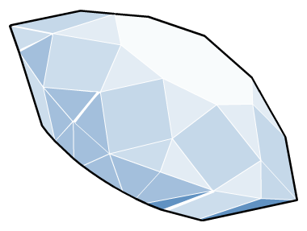
The carbon atom
Carbon is a non-metallic element found in group 4 of the periodic table.
Carbon can exist in a huge number of different forms. These forms are called allotropes.
Allotropes are families of similar molecules.
Some allotropes of carbon are nanomaterials and have a wide range of properties and uses.
Notes:
Teacher notes
For more information about covalent bonds, please refer to the Covalent Bonding presentation.

Slide 16
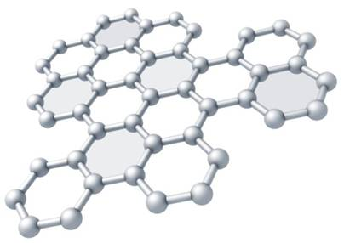
Graphene
Graphene is a single layer of graphite, consisting of a sheet of carbon atoms that is one atom thick. This means that graphene is classed as a nanostructure.
Graphene is very strong: it is significantly stronger than steel due to the strong carbon-carbon covalent bonds that tightly pack the carbon atoms in the sheet.
Graphene conducts electricity: as with graphite, the delocalized electrons are free to move and carry a charge.
Graphene is flexible: the single sheet gives graphene flexibility, which together with its strength makes it a desirable material to use.
Notes:
Photo credit: © Eugene Sergeev, shutterstock.com 2018

Slide 17
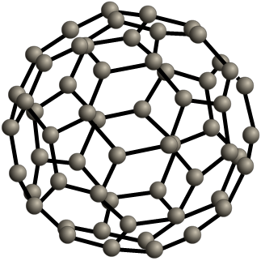
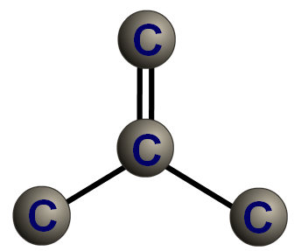
Fullerenes
Fullerenes are another allotrope of carbon. They form hollow 3D structures.
Buckminsterfullerene is a type of fullerene. It contains 60 carbon atoms, each of which is bonded to three others by two single and one double bond.
The atoms form a sphere. These molecules are often called “bucky balls.” They are large but still classed as nanoparticles. Carbon can form fullerenes with different numbers of atoms.

Slide 18
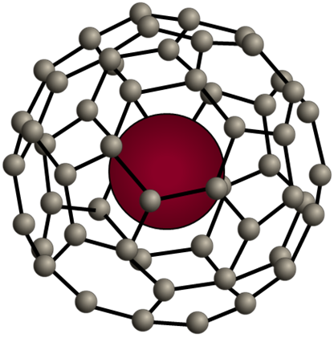
What are the uses of fullerenes?
Some of the uses of fullerenes that scientists are currently working on include:
non-stick slippery coatings for machinery, which act like miniature ball bearings
cages to hold drug molecules that can be delivered directly into the body and allow the delivery of the drug to targeted cells
molecular sieves which trap large particles while allowing smaller particles to pass through
chemical sponges to soak up toxic substances in the body.

Slide 19
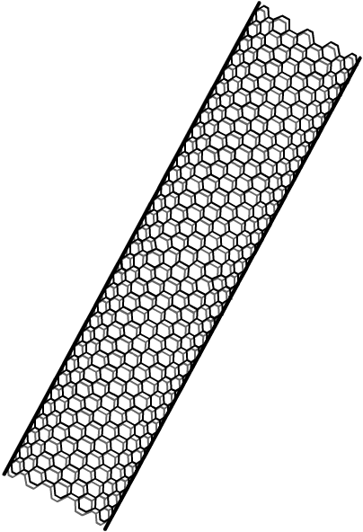
Carbon nanotubes
Carbon nanotubes are another form of fullerene. They are tubes of carbon hexagons, similar to sheets of graphene rolled into cylinders.
Carbon nanotubes have many useful properties, including:
very high tensile strength
unique electrical properties
good heat conductance.
Multi-walled nanotubes exist. In these, several tubes can rotate and slide within each other, almost without friction.
Metal atoms can be attached to the outer surface of the tubes.
Can you suggest any uses for carbon nanotubes?
Notes:
Teacher notes
The high tensile strength of nanotubes means that it takes a very large force for them to break.
Some uses of carbon nanotubes include:
semiconductors in electrical circuits
industrial catalysts (the catalyst can be attached to the surface of the nanotube, and a large surface area is available)
to reinforce graphite in tennis rackets.

