Slide 1
Mixtures

Slide 2
Information
Planning and Carrying Out Investigations
Constructing Explanations and Designing Solutions
1. Patterns

Slide 3
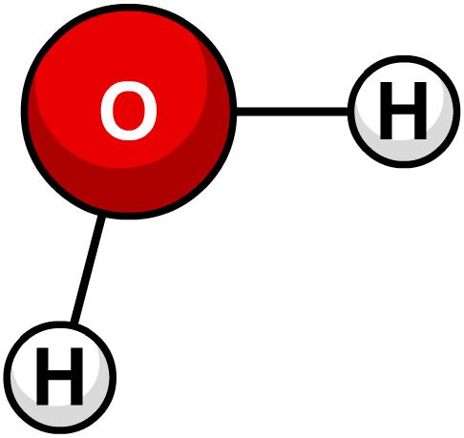
Pure and impure substances
All materials can be classified as either a pure substance or an impure substance.
A pure substance has a set chemical composition, and can be either an element or a compound. For example:
pure gold is made up of only gold atoms
pure water (H₂O) is made up of only hydrogen and oxygen atoms in a precise 2:1 ratio.
A pure substance has set properties, such as boiling and melting points. Pure water has a boiling point of 100 °C and a melting point of 0 °C.

Slide 4
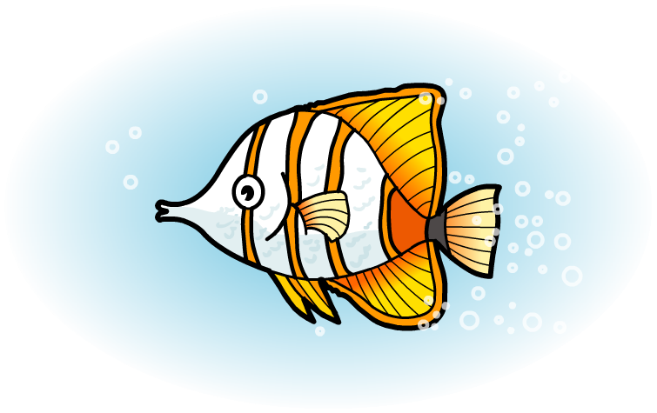
What is a mixture?
A mixture is an impure substance that contains two or more substances that have been mixed together, but have not chemically bonded with each other.
For example, seawater is a mixture of water, salt and other substances.
The chemical properties of each substance in the mixture are unchanged.
As they are not chemically joined, the different substances in the mixture can be separated by physical processes such as filtration or evaporation.
Can you name some mixtures and pure substances?

Slide 5
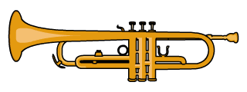
Substances in a mixture
The substances in a mixture can be elements or compounds.
Seawater is a mixture of the compounds water (H₂O) and salt (NaCl).
Brass is a mixture of the elements copper and zinc. A mixture containing a metal is called an alloy.
Air is a mixture of elements and compounds.
The main elements in air are nitrogen, oxygen and argon.
The main compounds in air are water vapor (H₂O) and carbon dioxide (CO₂). Air also contains a small amount of other gases.
Notes:
Teacher notes
For more information about alloys, please refer to the Properties of Metals and Alloys presentation.

Slide 6
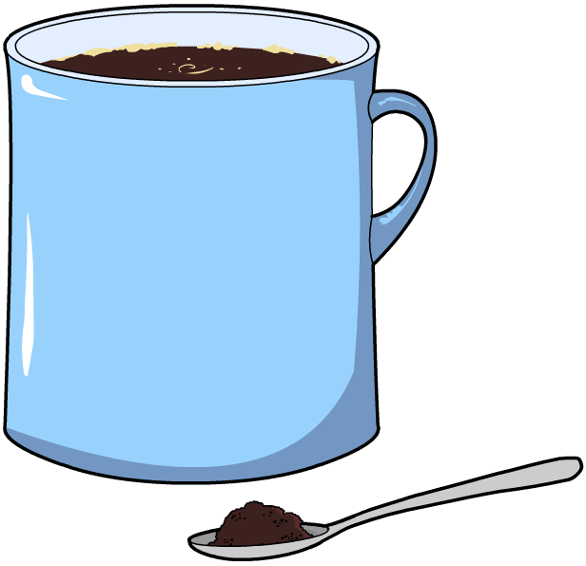
What is a solution?
A solution is a special type of mixture that is made when one substance dissolves and mixes fully with another.
For example, a cup of instant coffee is a solution.
The solid that dissolves (e.g. coffee granules) is called the solute. The liquid that does the dissolving (e.g. hot water) is called the solvent.
Some substances do not dissolve. These are called insoluble.
How many solutions can you think of?
Notes:
Teacher notes
Make sure students understand that a solution is a type of mixture, but not all mixtures are solutions. A solution is a mixture that is the same throughout, also called a homogenous mixture. Mixtures that are not solutions are not the same throughout, you can see or identify the different components.

Slide 7
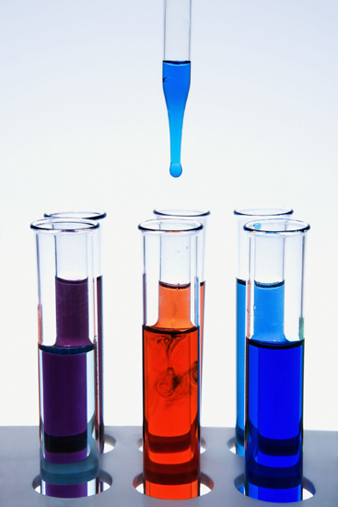
Properties of a mixture
What are the properties of a mixture?
The proportions in a mixture are not fixed (for example, there might be lots of salt in seawater, or very little).
The properties of a mixture are often an “average” of the properties of the substances it is made from. For example, a mixture of a red liquid and a blue liquid is a purple liquid.
The proportion of each substance in the mixture will affect the properties. For example, the melting point of saltwater decreases as the proportion of salt increases.
Notes:
Teacher notes
Here, proportion is used to describe a part in its relation to the whole – e.g. the amount of salt in a given amount of seawater.
The word proportion is also used in science to describe the relationship between two quantities – e.g. Ohm’s law (V = IR) says that current is directly proportional to voltage, and inversely proportional to resistance.
Photo credit: © Jupiterimages Corporation, 2018

Slide 8
Mixtures and compounds
Mixtures are impure substances while compounds are pure substances. This table shows the differences between them:
 | mixture | compound
proportion
chemical bonds
properties
separation
examples
variable – the amount of each substance can change
fixed – the ratio of each substance does not change
different substances are not bonded together
different substances are chemically bonded together
the compound has different properties to the substances within it
each substance keeps its own properties
can be easily separated by physical processes
can only be separated by chemical reactions
air, seawater, brass
carbon dioxide, water, salt

Slide 9
Iron, sulfur and iron sulfide
When they are heated, iron and sulfur react together to make the compound iron sulfide (FeS).
How is iron sulfide different to a mixture of iron and sulfur?
Proportion:
The proportion of iron and sulfur in iron sulfide is fixed, so the ratio of iron to sulfur is always 1:1.
In a mixture of iron and sulfur, the proportion is not fixed, so the mixture can contain more or less iron than sulfur.
Proportion
Chemical bonds:
In iron sulfide, the iron and sulfur are joined by ionic bonds.
In the mixture, the iron and sulfur atoms are not chemically joined together.
Chemical bonds
Properties:
The properties of iron sulfide are different from both iron and sulfur.
In the mixture, iron and sulfur keep their own properties.
Properties
Separation:
Iron sulfide can only be separated by chemical reactions.
The mixture can be separated by picking out the iron using a magnet.
Separation

Slide 10
A mixture or a pure substance?

Slide 11
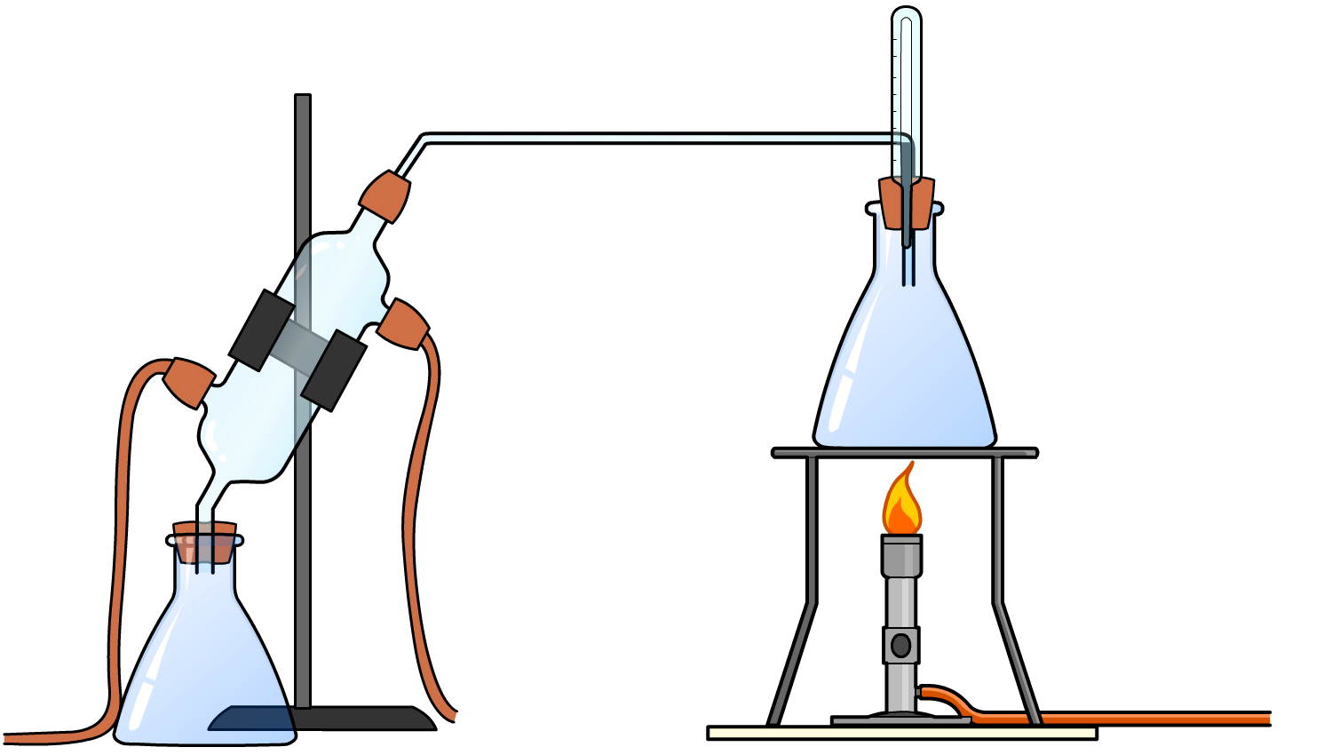
Separating mixtures
The different substances in a mixture are not joined together by chemical bonds.
This means the substances can be separated by physical processes. These include:
filtration
crystallization
chromatography
simple distillation
fractional distillation.
These physical processes do not involve chemical reactions.

Slide 12
Liquids and insoluble solids
Sometimes, a mixture is made of a liquid and an insoluble solid. Some examples include:
rice in water
pulp in orange juice
seeds in wholegrain mustard
sand in saltwater
silver chloride precipitate in sodium nitrate solution.
How could you separate an insoluble solid from a liquid?

Slide 13
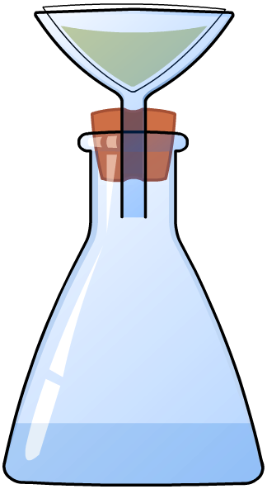
Filtration
An insoluble solid can be separated from a liquid by filtering the mixture.
The insoluble solid cannot pass through the filter paper but the liquid can.
The solid that is trapped by the filter paper is called the residue.
The liquid that passes through the filter paper is called the filtrate.

Slide 14
Filteration apparatus
Notes:
This slide covers the Science and Engineering Practice:
Planning and Carrying Out Investigations: Select appropriate tools to collect, record, analyze, and evaluate data.

Slide 15
Solutions and soluble solids
Sometimes, a soluble solid is dissolved in a solvent to make a solution. Some examples include:
salt in water
glucose in blood
instant coffee in hot water
chocolate powder in milk
copper sulfate in water.
How could you separate a soluble solid from a solution?

Slide 16
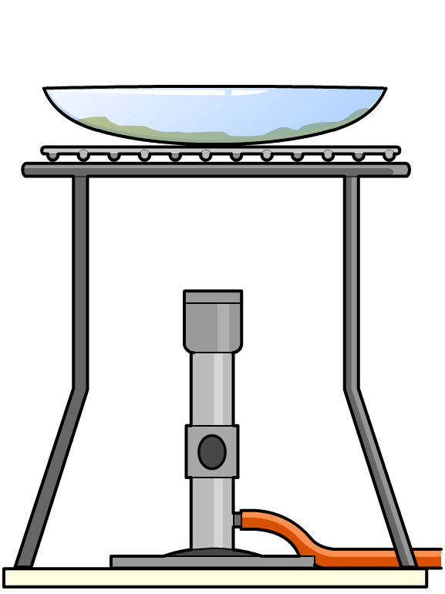
Crystallization
A soluble solid can be separated from a solution by crystallization.
The solution is heated so that most of the solvent evaporates and leaves behind a saturated solution.
The saturated solution is left to cool, and the solid comes out of the solution and forms crystals.

Slide 17
Crystallization apparatus
Notes:
This slide covers the Science and Engineering Practice:
Planning and Carrying Out Investigations: Select appropriate tools to collect, record, analyze, and evaluate data.

Slide 18
Separating soluble and insoluble solids
Sometimes, a soluble solid and an insoluble solid are mixed together. Some examples include:
salt and sand
sugar and rice
copper sulfate (soluble) and calcium carbonate (insoluble).
How could you separate soluble and insoluble solids?
​Add a solvent to dissolve the soluble solid. This gives a mixture of an insoluble solid and a solution.
​Separate the insoluble solid from the solution by filtration.
​Collect the soluble solid from the solution by crystallization.

Slide 19
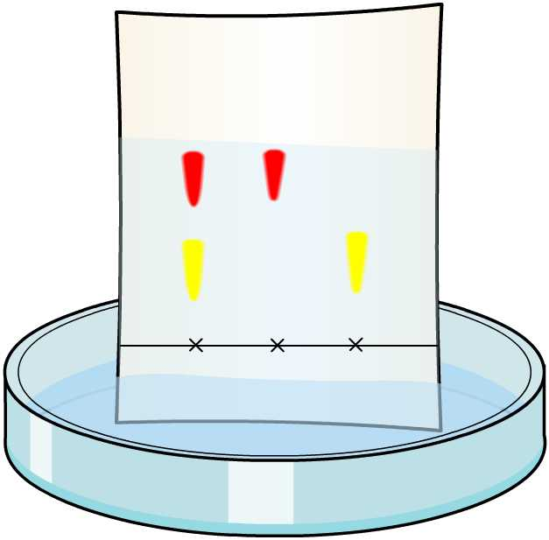
Chromatography
Chromatography is used for separating mixtures of substances that are soluble in the same solvent.
In chromatography, there is a stationary phase and a mobile phase.
stationary phase
The stationary phase is a solid, or a liquid supported on a solid.
mobile phase
The mobile phase is a solvent (liquid or gas) that flows over the stationary phase.
The mixture to be tested dissolves in the mobile phase and moves along the stationary phase.
Notes:
Teacher notes
For more information about chromatography, please refer to the Chromatography presentation.

Slide 20
Types of chromatography
There are many types of chromatography, including:
Paper chromatography:
The stationary phase is paper and the mobile phase is a liquid solvent.
Paper chromatography is usually used to separate mixtures of colored substances such as inks, paints or dyes.
Paper chromatography
Thin layer chromatography:
This is like paper chromatography, except that the stationary phase is a thin layer of inert solid (e.g. silica) supported on a flat unreactive layer (e.g. glass).
Thin layer chromatography
Gas chromatography:
The stationary phase is a thin layer of inert solid or liquid packed into a long tube.
The mobile phase is an inert gas, such as helium, which is piped through the tube.
Gas chromatography
Electrophoresis:
The stationary phase is a layer of gel. An electric current is used instead of a mobile phase to move the substances along the gel.
Electrophoresis is used to separated DNA fragments according to their size.
Electrophoresis
How many uses can you think of for chromatography?
Notes:
Teacher notes
Encourage students to think of as many uses of chromatography as they can. You may want to discuss the following uses:
Counterfeiting: chromatography is used for detecting forgeries by matching inks from forged money with ink from suspects’ printing machines.
DNA fingerprinting: DNA fingerprinting is used to identify the unique genetic makeup of an individual. This is done using a version of chromatography called electrophoresis, which involves separating out DNA fragments according to their size.
Forensics: column chromatography is often used to separate the compounds in a mixture, such as drugs from blood, or pollutants from water.
Drug testing: gas chromatography machines are used to identify the chemical make-up of unknown substances. During gas chromatography, different amounts of different molecules will ‘stick’ to the column, so it can be used to find the masses (and therefore chemical structure and identity) of the compounds.

Slide 21
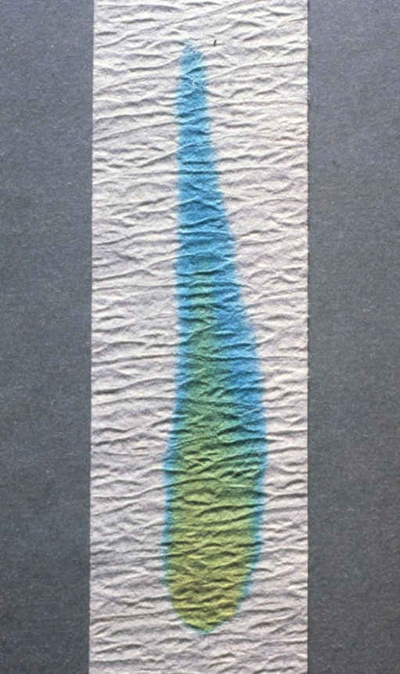
Paper chromatography
How are mixtures separated using paper chromatography?
​In pencil, draw a line at the bottom of the paper. Put a dot of the mixture on the line.
​Put the bottom of the paper in the solvent, making sure the pencil line is above the level of the liquid.
The solvent moves up the paper by a process called capillary action.
The substances in the mixture dissolve in the solvent and are carried up the paper.
The substances move at different rates and become separated.
Notes:
Teacher notes
This photo shows simple paper chromatography of some green food coloring. The yellow dye and the blue dye in the coloring move at different rates and become separated.
Photo credit: © Fundamental Photos / Science Photo Library

Slide 22
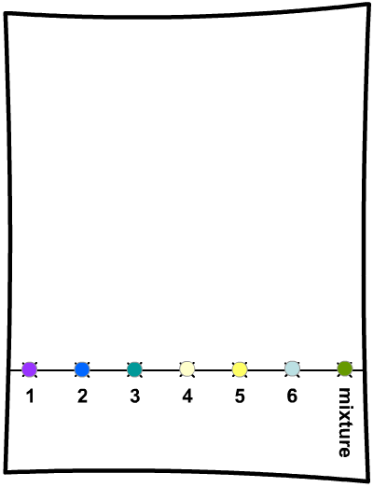
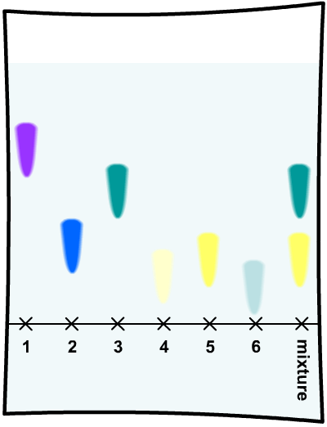
Identifying substances in a mixture
Chromatography can be used to work out which substances are contained in a mixture.
Dots of single substances are placed alongside a dot of unknown mixture.
The solvent moves up the paper, and then the pattern of the substances in the mixture can be compared with the single substances.
The pattern on the paper is called a chromatogram.
Which substances does the mixture contain?
Notes:
Teacher notes
The mixture contains substances 3 and 5.

Slide 23
Chromatography experiment
Notes:
This slide covers the Science and Engineering Practice:
Planning and Carrying Out Investigations: Select appropriate tools to collect, record, analyze, and evaluate data.

Slide 24
Separating a liquid from a solution
Sometimes, a solvent is used to dissolve a soluble solid to make a solution. Some examples include water being used to dissolve salt, sugar or copper sulfate.
The solid can be separated from the solution by crystallization,
but the liquid evaporates and escapes as a gas.
How could you separate a solution and keep the liquid?
Distillation can be used to separate a liquid from a solution.
It involves three steps:
​evaporation
​condensation
​collection.

Slide 25
Distillation
How does distillation work?
Evaporation The solution is heated so that the liquid evaporates and is turned into a gas. Everything else is left behind.
condenser
Condensation The gas is cooled in the condenser and turns back into a liquid.
Collection The liquid is then collected in the flask below the condenser.
Notes:
This slide covers the Science and Engineering Practice:
Planning and Carrying Out Investigations: Select appropriate tools to collect, record, analyze, and evaluate data.

Slide 26
Distillation apparatus
Notes:
This slide covers the Science and Engineering Practice:
Planning and Carrying Out Investigations: Select appropriate tools to collect, record, analyze, and evaluate data.

Slide 27
Examples of distillation
Distillation can also be used to separate a mixture of two liquids with different boiling points.
The liquid with the lower boiling point evaporates, condenses and is collected, while the liquid with the higher boiling point is left behind.
Here are some examples of mixtures that can be separated by distillation:
water can be collected from saltwater
water can be collected from copper sulfate solution
ethanol (b.p. 78 °C) can be separated from water (100 °C)
pentane (36 °C) can be separated from octane (126 °C).

Slide 28
Separating ethanol and water

Slide 29
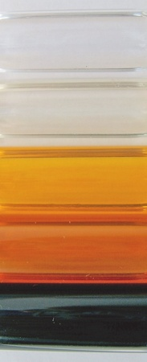
What is fractional distillation?
Fractional distillation is another form of distillation used to separate liquids with different boiling points.
When the mixture is heated, liquids with a low boiling point evaporate and turn to vapor.
Liquids with a higher boiling point remain as liquid. The vapor can then be separated from the liquid.
Fractional distillation is used to separate crude oil into useful products called fractions. It can also be used to separate nitrogen and oxygen from liquid air.
Notes:
Teacher notes
For more information about fractional distillation, please refer to the Fractional Distillation presentation.

Slide 30
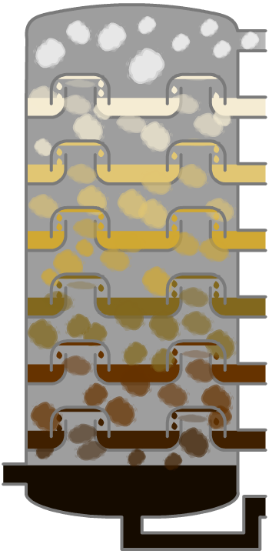
Fractional distillation of crude oil
How is crude oil separated into fractions?
​Oil is heated to about 370 °C and pumped into the bottom of a tall tower called a fractionating column, where it vaporizes.
​The column is very hot at the bottom but much cooler at the top. As the vaporized oil rises, it cools and condenses.
​Heavy fractions (containing large molecules) have high boiling points and condense near the bottom of the column.
​Lighter fractions (containing small molecules) have lower boiling points and condense further up the column.

Slide 31
How does fractional distillation work?
Notes:
Teacher notes
This six-stage interactive animation shows how fractional distillation is used on an industrial scale to separate crude oil into different fractions. At the end of the animation, you can view a summary of each fraction by clicking on its name. While showing the animation, the one-way nature of the bubble caps could be highlighted. Suitable prompts could include:
What is special about the molecules in a fraction?
Which fraction will be the hardest to vaporize?
Why is the vapor slowed down by the bubble caps as it rises up the column?
What makes the fractions condense at different heights in the column?
Will all the molecules that enter the column condense?
Are the molecules in a fraction identical?
This slide covers the Science and Engineering Practice:
Constructing Explanations and Designing Solutions: Apply scientific ideas, principles, and/or evidence to provide an explanation of phenomena and solve design problems, taking into account possible unanticipated effects.

Slide 32
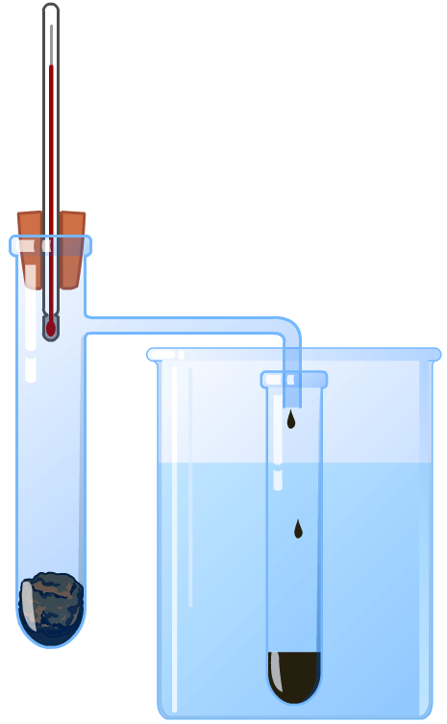
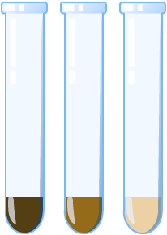
Fractional distillation in the lab
The principle of how fractional distillation can be used to separate crude oil can be demonstrated in the laboratory by heating crude oil and collecting the vapor produced at different temperatures.
fractions collected previously (at lower temperatures)
mineral wool soaked in crude oil
cooling water

