Slide 1
Ionic Compounds

Slide 2
Information
Developing and Using Models
Planning and Carrying Out Investigations
Using Mathematics and Computational Thinking
Constructing Explanations and Designing Solutions
Obtaining, Evaluating and Communicating Information
1. Patterns
4. Systems and System Models
5. Energy and Matter
6. Structure and Function

Slide 3
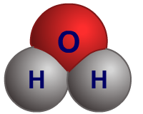
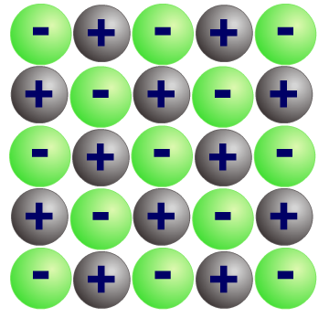
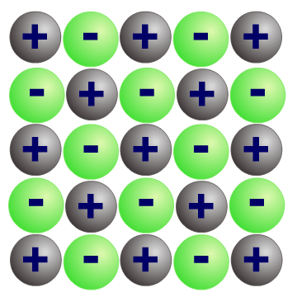
Elements and compounds
Elements are made up of just one type of atom.
Some elements exist as single atoms (e.g. argon, Ar).
In other elements, the atoms are joined to each other by chemical bonds (e.g. chlorine, Cl₂).
Compounds are made up of different types of atoms. They are formed when different elements react and form bonds with each other (e.g. water, H₂O).
There are four different types of compound. These are:
ionic
simple molecular covalent
giant covalent
metallic.

Slide 4
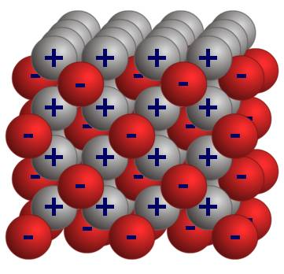
What are ionic compounds?
Compounds that contain ions are called ionic compounds.
They are usually formed by a reaction between a metal and a non-metal.
There are strong electrostatic forces of attraction in all directions between oppositely charged ions.
This electrostatic attraction is called ionic bonding.
The type of bonding in a compound affects its physical properties, including melting and boiling points, solubility and electrical conductivity.
It is the whole compound that has these properties, not the atoms themselves.
Notes:
Teacher notes
For more information about ionic bonding, please refer to the Ionic Bonding presentation.

Slide 5
How are ionic bonds formed?
Notes:
Teacher notes
This two-part interactive animation shows how bonding occurs in two compounds – sodium chloride and magnesium oxide. It shows how the ions are formed, which electrons are transferred and how this leads to the formation of the ionic lattices.
This slide covers the Science and Engineering Practice:
Developing and Using Models: Develop, revise, and/or use a model based on evidence to illustrate and/or predict the relationships between systems or between components of a system.
Constructing Explanations and Designing Solutions: Apply scientific ideas, principles, and/or evidence to provide an explanation of phenomena and solve design problems, taking into account possible unanticipated effects.

Slide 6
Chemical formula
The chemical formula of a compound tells you how many of each type of atom or ion are in each molecule.
For example, the chemical formula for water is H₂O. This says that there are two hydrogen atoms and one oxygen atom in each water molecule.
In ionic compounds, there are millions of ions held together by electrostatic forces. Instead of counting how many of each type of ion there are, we look at the ratio of the ions.
The ratio of ions, written in its simplest form, is called the empirical formula. The positive ion is written first.
Notes:
Teacher notes
For more information on chemical formulae and empirical formulae, please refer to the Formulae and Equations presentation.

Slide 7
Empirical formula
The empirical formula describes the ratio of ions.
In magnesium oxide, for every Mg²⁺ ion there is one O^{2–} ion, so the ratio of ions is 1:1. This means the empirical formula for magnesium oxide is MgO.
In calcium chloride, for every Ca²⁺ ion there are two Cl– ions, so the ratio of ions is 1:2. This means the empirical formula for calcium chloride is CaCl₂.
In aluminum oxide, for every two Al³⁺ ions there are three O^{2–} ions, so the ratio of ions is 2:3. This means the empirical formula for aluminum oxide is Al₂O₃.

Slide 8
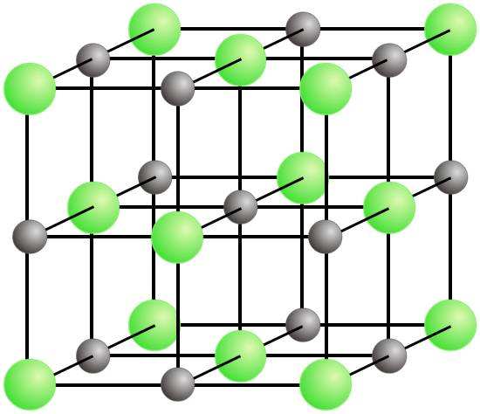
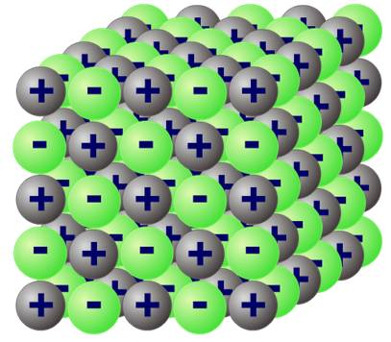
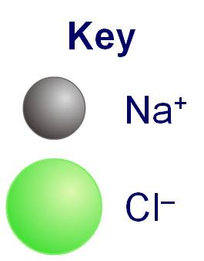
Finding the formula from a diagram (1)
This is a diagram of sodium chloride.
What is the empirical formula?
Count the number of bonds for each type of ion.
Each chloride ion is bonded to six sodium ions.
Each sodium ion is bonded to six chloride ions.
This means the ratio of sodium ions to chloride ions is 1:1, so the empirical formula is NaCl.
Notes:
This slide covers the Science and Engineering Practice:
Developing and Using Models: Develop, revise, and/or use a model based on evidence to illustrate and/or predict the relationships between systems or between components of a system.

Slide 9
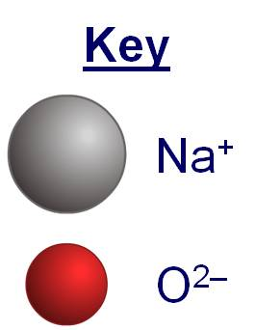
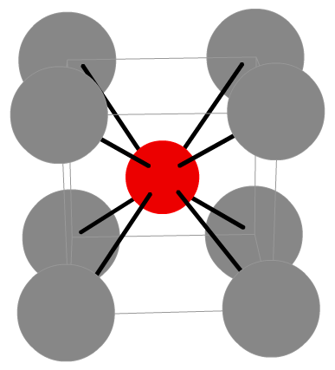
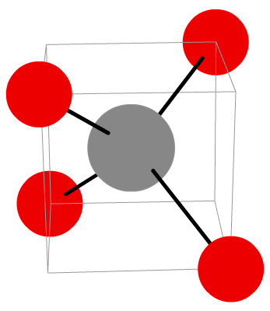
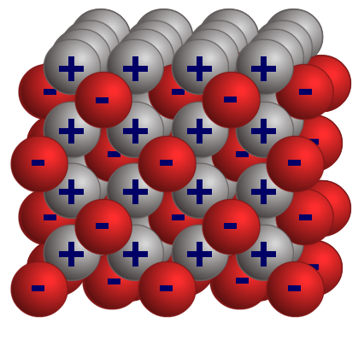
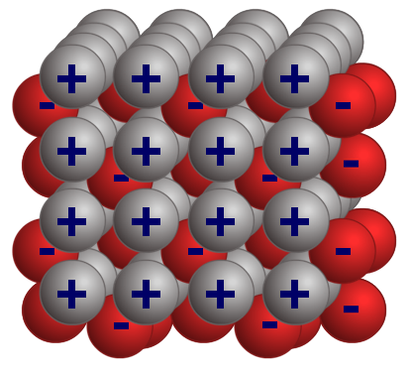
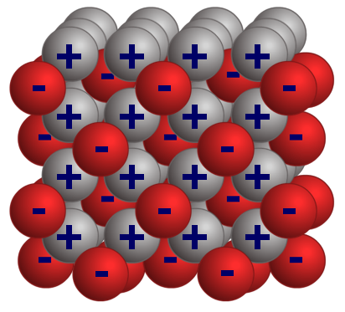
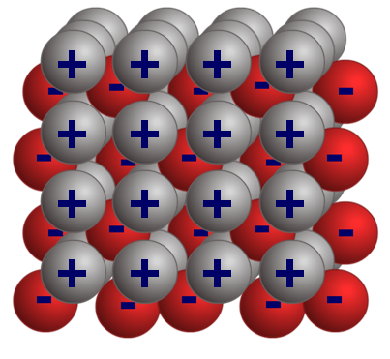
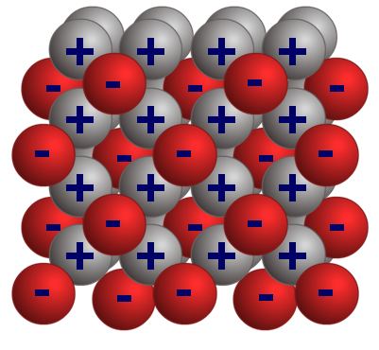
Finding the formula from a diagram (2)
What is the empirical formula of sodium oxide?
Count the number of bonds for each type of ion.
Each oxide ion is bonded to eight sodium ions.
Each sodium ion is bonded to four oxide ions.
This means the ratio of sodium ions to oxide ions is 2:1,
so the empirical formula is Na₂O.
Notes:
This slide covers the Science and Engineering Practice:
Developing and Using Models: Develop, revise, and/or use a model based on evidence to illustrate and/or predict the relationships between systems or between components of a system.

Slide 10
Finding the formula from the ions
Some positive ions and some negative ions react together to form an ionic compound.
How do you find the empirical formula of the compound?
To work out the empirical formula of an ionic compound:
1.
Write down the symbol for each element – the metal is always written first.
2.
Calculate the charge for each type of ion.
3.
Balance the number of ions so that the positive and negative charges are balanced and equal zero. This gives the ratio of ions.
4.
Use the ratio to write down the empirical formula of the ionic compound.
Notes:
Teacher notes
For more information about how to find the charge on an ion, please refer to the Ionic Bonding presentation.

Slide 11
Empirical formula of potassium iodide
What is the formula of potassium iodide?
K
I
Symbol
Ion charge
Balance the number of ions
Ratio of ions
Empirical formula
+1
–1
1 potassium ion is needed
for 1 iodide ion
1:1
KI

Slide 12
Empirical formula of lithium oxide
What is the formula of lithium oxide?
Li
O
Symbol
Ion charge
Balance the number of ions
Ratio of ions
Empirical formula
+1
–2
2 lithium ions are needed
for 1 oxide ion
2:1
Li₂O

Slide 13
Empirical formula of aluminum bromide
What is the formula of aluminum bromide?
Al
Br
Symbol
Ion charge
Balance the number of ions
Ratio of ions
Empirical formula
+3
–1
1 aluminum ion is needed
for 3 bromide ions
1:3
AlBr₃

Slide 14
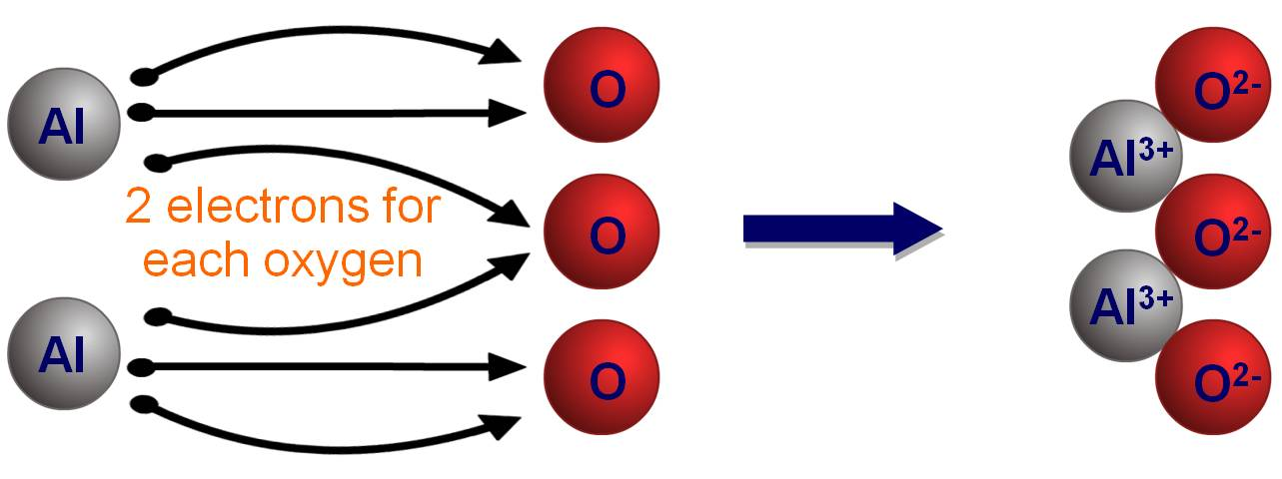
Empirical formula of aluminum oxide
What is the formula of aluminum oxide?
Al
O
Symbol
Ion charge
Balance the number of ions
Ratio of ions
Empirical formula
+3
–2
2 aluminum ions are needed
for 3 oxide ions
2:3
Al₂O₃

Slide 15
More ionic formulae
Work out the formulae of the missing ionic compounds.
metals
non-metals
Li
Ca
Na
Mg
Al
K
F
LiF
CaF₂
NaF
MgF₂
AlF₃
KF
O
Li₂O
CaO
Na₂O
MgO
Al₂O₃
K₂O
N
Li₃N
Ca₃N₂
Na₃N
Mg₃N₂
AlN
K₃N
Br
LiBr
CaBr₂
NaBr
MgBr₂
AlBr₃
KBr
S
Li₂S
CaS
Na₂S
MgS
Al₂S₃
K₂S
Cl
LiCl
CaCl₂
NaCl
MgCl₂
AlCl₃
KCl

Slide 16
What is the empirical formula?
Notes:
Teacher notes
This drag and drop activity could be used as an introductory or summary activity to check students’ ability to work out the formula of ionic compounds. Class voting or the use of colored traffic light cards could be make this a whole-class exercise.

Slide 17
What is an ionic lattice?
In an ionic compound, millions and millions of ions are packed together in a regular lattice arrangement, joined by strong ionic bonds between oppositely charged ions.
This forms a giant 3D structure called a giant ionic lattice.
The ionic lattice will continue to build in this way until there are no more ions left to add.
The structure of the ionic lattice affects the properties of the ionic compound.
Notes:
This slide covers the Science and Engineering Practice:
Developing and Using Models: Develop, revise, and/or use a model based on evidence to illustrate and/or predict the relationships between systems or between components of a system.

Slide 18
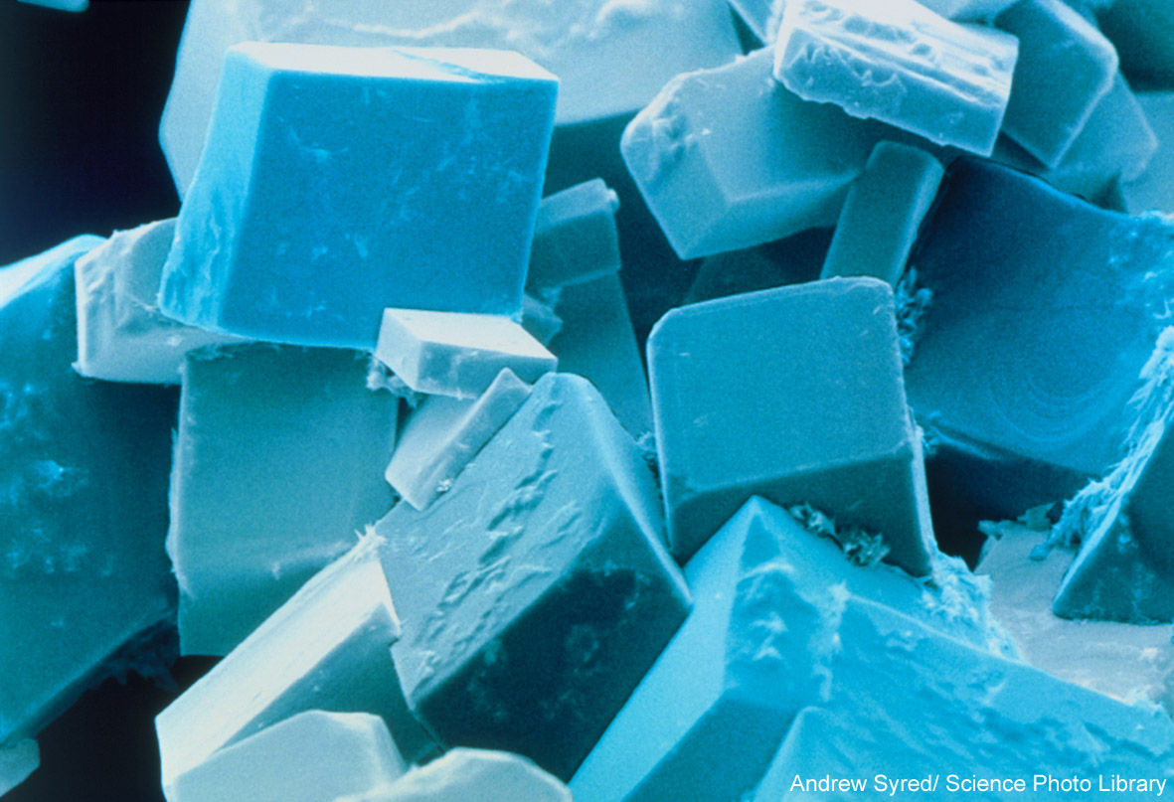
Why do ionic compounds form crystals?
When solid, sodium chloride forms crystals with a cubic shape. This is due to the regular structure of the ionic lattice.
All ionic compounds form lattices and crystals when solid.
Notes:
Teacher notes
The image is a colored scanning electron micrograph (SEM) of common salt, sodium chloride, recrystallized from distilled water. The salt crystal is built up from a cubic lattice of sodium and chloride ions. In the absence of impurities, the exact cubic crystal form is produced. This micrograph shows that, in practice, this basic cube is usually disrupted by dislocations; these give rise to crystals with a variety of shapes, although they all retain the basic cubic symmetry. Magnification: ×280 at 5 × 7 cm size.
Photo credit: © Andrew Syred/Science Photo Library 2018

Slide 19
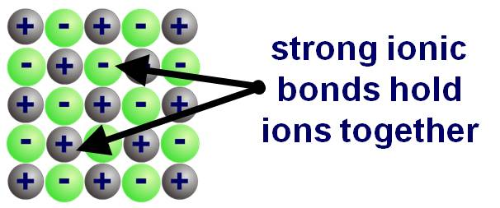
Heating ionic compounds
Ionic compounds are solid at room temperature and have high melting points and boiling points.
ion charges
melting point (°C)
boiling point (°C)
compound
sodium chloride
1⁺ and 1–
801
1,413
magnesium oxide
2⁺ and 2–
2,852
3,600
Ionic compounds have lots of strong ionic bonds, so a large amount of energy is needed to break them.
Larger ionic charges produce stronger ionic bonds, so much more energy is required to break the ionic bonds in magnesium oxide than in sodium chloride.

Slide 20
Comparing melting points (1)
Ionic compounds have high melting points because lots of energy is needed to break the strong ionic bonds.
Substances made up of simple covalent molecules have low melting points. This is because not much energy is needed to break the weak intermolecular forces between the molecules.
Giant covalent structures have high melting points because lots of energy is needed to break all of the strong covalent bonds between the atoms.
Metals have high melting points because lots of energy is needed to break their strong metallic bonds.
Notes:
Teacher notes
For more information about simple covalent molecules and giant covalent structures, please refer to the Covalent Compounds presentation.
For more information about metals, please refer to the Metals and Non-Metals presentation.

Slide 21
Comparing melting points (2)
The type of bonding in a substance affects its properties.
Fill in the gaps in the table.
bonding | type of structure | melting point |  | state at room temperature
ionic
covalent
metallic
NaCl: 801 °C
MgO: 2,852 °C
giant ionic
high
solid
simple
molecular
CH₄: –182 °C
H₂O: 0 °C
usually gas or liquid
low
giant
covalent
diamond: 3,730 °C
SiO₂: 1,610 °C
high
solid
giant
metallic
Cu: 1,085 °C
Al: 660 °C
solid (except mercury – liquid)
high
Notes:
Teacher notes
You may want to recap covalent and metallic structures with the class before you complete this exercise.

Slide 22
How do ionic compounds dissolve?
Notes:
This slide covers the Science and Engineering Practice:
Developing and Using Models: Develop, revise, and/or use a model based on evidence to illustrate and/or predict the relationships between systems or between components of a system.
Constructing Explanations and Designing Solutions: Apply scientific ideas, principles, and/or evidence to provide an explanation of phenomena and solve design problems, taking into account possible unanticipated effects.

Slide 23
Electrical conductivity
Notes:
Teacher notes
This virtual experiment illustrates which substances, and in what state, conduct electricity and why. It could be used as a precursor to running the practical in the lab, or as a summary exercise.
You may wish to remind students that all ionic compounds, including magnesium oxide (MgO), conduct electricity when molten or in solution.
For more information about covalent bonding, please refer to the Covalent Bonding presentation.
This slide covers the Science and Engineering Practice:
Planning and Carrying Out Investigations: Plan and conduct an investigation individually and collaboratively to produce data to serve as the basis for evidence, and in the design: decide on types, how much, and accuracy of data needed to produce reliable measurements and consider limitations on the precision of the data (e.g., number of trials, cost, risk, time), and refine the design accordingly.
Constructing Explanations and Designing Solutions: Apply scientific ideas, principles, and/or evidence to provide an explanation of phenomena and solve design problems, taking into account possible unanticipated effects.

Slide 24
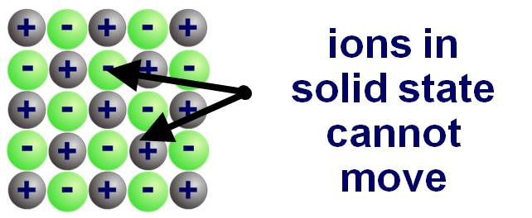
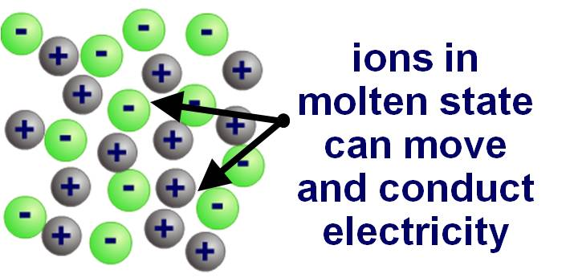
How can ionic compounds conduct electricity?
As solids, ionic compounds cannot conduct electricity because their ions are
bonded together in the lattice.
When liquid (molten), the ions can break free of the lattice and are able to move. The ions are charged particles and so can carry an electric current.
Ionic compounds are usually soluble in water because water molecules have a slight electrical charge and so can attract the ions away from the lattice. When dissolved, the ions are free to move and can carry an electric current.
Notes:
This slide covers the Science and Engineering Practice:
Developing and Using Models: Develop, revise, and/or use a model based on evidence to illustrate and/or predict the relationships between systems or between components of a system.

Slide 25
Ionic compounds – true or false?
Notes:
Teacher notes
This true-or-false activity could be used as an introductory or summary activity on the properties of ionic compounds, or at the start of the lesson to gauge students’ existing knowledge of the subject matter. Colored traffic light cards (red = false, yellow = don’t know, green = true) could be used to make this a whole-class exercise.

Slide 26
The effect of structure on properties
Notes:
Teacher notes
This matching activity could be used as an introductory or summary activity to check students’ ability to understand the properties of different structures. You may want to recap metallic and covalent structures with the class before you complete this activity. Colored traffic light cards could be used with this activity to increase class participation.
This slide covers the Science and Engineering Practice:
Developing and Using Models: Develop, revise, and/or use a model based on evidence to illustrate and/or predict the relationships between systems or between components of a system.

