Slide 1
Ionic Bonding

Slide 2
Information
Developing and Using Models
Constructing Explanations and Designing Solutions
Obtaining, Evaluating and Communicating Information
1. Patterns
4. Systems and System Models
5. Energy and Matter
6. Structure and Function

Slide 3
Electron shells
Notes:
Teacher notes
The element in the flash activity is argon.
This presentation is accompanied by the worksheet Ionic Bonding.
This slide covers the Science and Engineering Practice:
Developing and Using Models: Develop, revise, and/or use a model based on evidence to illustrate and/or predict the relationships between systems or between components of a system.

Slide 4
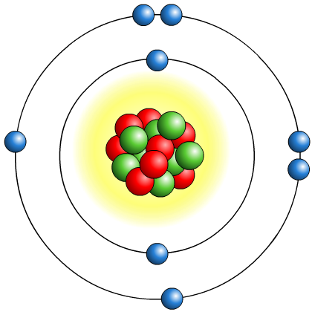
What is an ion?
Atoms have an equal number of protons and electrons and so do not have an overall charge.
Atoms with incomplete outer electron shells are unstable. By either gaining or losing electrons, atoms can obtain full outer electron shells and become stable.
When this happens, atoms have an unequal number of protons and electrons and so have an overall charge. This is how atoms become ions.
An ion is an atom or group of atoms that has an electrical charge, either positive or negative.

Slide 5
Positive and negative ions
Notes:
Teacher notes
It should be pointed out that the lithium ion is represented by Li⁺ not Li¹⁺, etc.
This slide covers the Science and Engineering Practice:
Developing and Using Models: Develop, revise, and/or use a model based on evidence to illustrate and/or predict the relationships between systems or between components of a system.
Constructing Explanations and Designing Solutions: Apply scientific ideas, principles, and/or evidence to provide an explanation of phenomena and solve design problems, taking into account possible unanticipated effects.

Slide 6
Electronic structure and charge
Metals in group 1 have 1 electron in their outer shell. They lose this 1 electron to form ions with a +1 charge.
Metals in group 2 have 2 electrons in their outer shell. They lose these 2 electrons to form ions with a +2 charge.
Non-metals in group 6 have 6 electrons in their outer shell. They gain 2 electrons to form ions with a –2 charge.
Non-metals in group 7 have 7 electrons in their outer shell. They gain 1 electron to form ions with a –1 charge.
The ions produced by elements in groups 1, 2, 6 and 7
all have full outer shells. This means they have the same electronic structure as a noble gas (group 0).
Notes:
Teacher notes
For more information about metals and non-metals, please refer to the Metals and Non-Metals presentation.

Slide 7
Calculating ion charges
What is the charge on the ion of each element?
element | calcium | hydrogen | phosphorus | fluorine | beryllium
electron shells | 2.8.8.2 | 1 | 2.8.5 | 2.7 | 2.2
metal / non-metal | metal | non-metal* | non-metal | non-metal | metal
group | 2 | 1 | 5 | 7 | 2
charge on ion
+2
+1
–3
–1
+2
*hydrogen is not a metal, but it forms ions in the same way as group 1 metals

Slide 8
Protons and electrons in ions
In an atom, the number of protons and electrons is the same, and is given by the atomic number in the periodic table.
When an atom becomes an ion, it loses or gains electrons.
How do we find the number of electrons in an ion?
Number of electrons = atomic number – charge on ion
e.g. For a sodium ion, Na⁺:
Number of electrons = 11 – 1 = 10.
e.g. For a oxide ion, O^{2–}:
Number of electrons = 8 – (–2) = 10.

Slide 9
Building an ion
Notes:
Teacher notes
This activity could be used to check students’ understanding of electron arrangement and how this changes during the formation of ions. It will also check their understanding of the charges on ions.
This slide covers the Science and Engineering Practice:
Developing and Using Models: Develop, revise, and/or use a model based on evidence to illustrate and/or predict the relationships between systems or between components of a system.

Slide 10
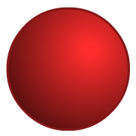
What is a compound ion?
Ions can be made up of a single atom or a group of atoms. An ion made up of a group of atoms is called a compound ion.
Ion
Formula
Charge
Atoms present
hydroxide
OH–
–1
O
H
sulfate
SO₄^{2–}
–2
S
O
O
O
O
nitrate
NO₃–
–1
N
O
O
O
carbonate
CO₃^{2–}
–2
C
O
O
O
ammonium
NH₄⁺
+1
N
H
H
H
H

Slide 11
Naming ions and compound ions
There are two common types of ions: –ide ions and –ate ions.
What is the difference?
Generally, –ide ions are negatively-charged ions of an element, e.g. sulfide (S^{2–}), fluoride (F–), oxide (O^{2–}).
–ate ions are negatively-charged compound ions that include oxygen, e.g. sulfate (SO₄^{2–}), nitrate (NO₃–), carbonate (CO₃^{2–}).
The exception to this rule is the hydroxide ion, which contains both hydrogen and oxygen (OH–).

Slide 12
Comparing positive and negative ions
Notes:
Teacher notes
This drag and drop activity provides the opportunity for informal assessment of students’ understanding of the differences between positive and negative ions. Appropriately colored voting cards could be used with this activity to increase class participation.

Slide 13
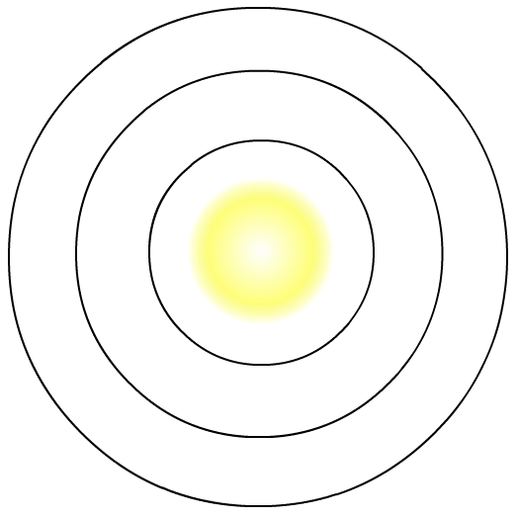
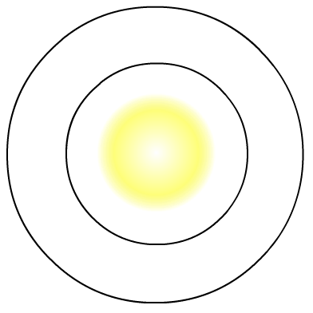
Dot and cross diagrams for positive ions
The dot and cross diagram for a sodium atom is shown below.
How do we draw the dot and cross diagram for a sodium ion?
+
Na
Na
sodium atom, 2.8.1
sodium ion, [2.8]⁺
Sodium, other metals and hydrogen become ions by losing the electrons in their outer shell. Draw the dot and cross diagram for the ion without the outer shell electron.
Draw square brackets around the diagram, then draw a
“+” sign to show the positive charge.
Notes:
This slide covers the Science and Engineering Practice:
Developing and Using Models: Develop, revise, and/or use a model based on evidence to illustrate and/or predict the relationships between systems or between components of a system.

Slide 14
Dot and cross diagrams for negative ions
The dot and cross diagram for a chlorine atom is shown below.
How do we draw the dot and cross diagram for a chlorine ion?
–
Cl
Cl
chlorine atom, 2.8.7
chlorine ion, [2.8.8]–
Chlorine and other non-metals become ions by gaining electrons to fill their outer shell. The electrons from the atom are dots, so draw the extra electron as a cross.
Draw square brackets around the diagram, then draw a
“–” sign to show the negative charge.
Notes:
This slide covers the Science and Engineering Practice:
Developing and Using Models: Develop, revise, and/or use a model based on evidence to illustrate and/or predict the relationships between systems or between components of a system.

Slide 15
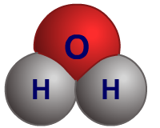
What are bonds?
Elements are made up of just one type of atom, sometimes joined to other atoms of the same element by chemical bonds. This forms molecules such as chlorine (Cl₂).
Compounds are formed when different elements chemically react and form bonds with each other, e.g. water (H₂O).
Different types of bonds are formed depending on the types of atoms involved:
ionic bonding occurs between metal and non-metal atoms.
covalent bonding occurs between non-metals atoms only.
All bonding involves changes to the number of electrons in the outer shells of atoms.

Slide 16
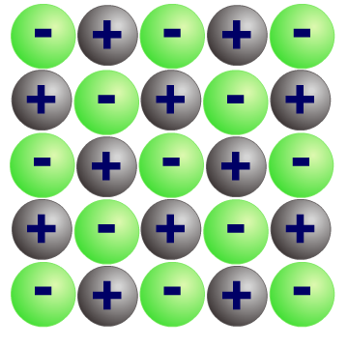
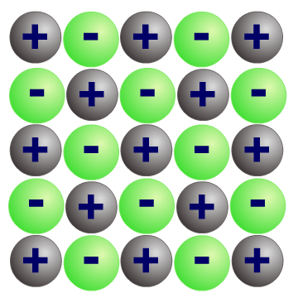
What is ionic bonding?
Compounds that contain ions are called ionic compounds. These compounds are usually formed by a reaction between a metal and a non-metal.
Why do these substances react together and form bonds?
The metal and non-metal atoms have incomplete outer electron shells and so are unstable.
Electrons are transferred from each metal atom to each non-metal atom. The metal and the non-metal atoms form ions with completely full outer shells and become stable.
There are strong electrostatic forces of attraction in all directions between oppositely charged ions. This electrostatic attraction is called ionic bonding.
Notes:
Teacher notes
For more information about the structure and properties of ionic compounds, please refer to the Ionic Compounds presentation.

Slide 17
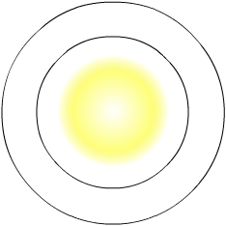
Group 1 and group 7 elements
The alkali metals, found in group 1 of the periodic table, react with non-metals to form ionic compounds.
The alkali metals all have one electron in their outer shell.
They lose this electron to form an ion with a single positive charge.
Li
2.1
The halogens, found in group 7 of the periodic table, react with metals to form ionic compounds.
The halogens all have seven electrons in their outer shell. They gain an extra electron to form an ion with a single negative charge.
2.7
F
Notes:
Teacher notes
For more information about alkali metals, please refer to the Group 1: Alkali Metals presentation.
For more information about halogens, please refer to the Group 7: Halogens presentation.
This slide covers the Science and Engineering Practice:
Developing and Using Models: Develop, revise, and/or use a model based on evidence to illustrate and/or predict the relationships between systems or between components of a system.

Slide 18
How are ionic bonds formed?
Sodium chloride is an ionic compound formed by the reaction between sodium (group 1) and chlorine (group 7).
+
Sodium has 1 electron
in its outer shell.
Na
Na
By losing this electron, it has a full outer shell and forms a positive ion.
2.8.1
[2.8]⁺
Chlorine has 7 electrons in its outer shell.
–
By gaining an electron from sodium, it has a full outer shell and forms a negative ion.
Cl
Cl
2.8.7
[2.8.8]–
Notes:
This slide covers the Science and Engineering Practice:
Developing and Using Models: Develop, revise, and/or use a model based on evidence to illustrate and/or predict the relationships between systems or between components of a system.

Slide 19
How are ionic bonds formed?
The positive sodium ions and the negative chloride ions are strongly attracted to each other.
–
+
Na
Cl
It is this electrostatic attraction that forms ionic bonds in sodium chloride and other ionic compounds.
Notes:
This slide covers the Science and Engineering Practice:
Developing and Using Models: Develop, revise, and/or use a model based on evidence to illustrate and/or predict the relationships between systems or between components of a system.

Slide 20
How do ionic bonds form?
Notes:
Teacher notes
This two-part interactive animation shows how bonding occurs in two compounds – sodium chloride and magnesium oxide. It shows how the ions are formed, which electrons are transferred and how this leads to the formation of ionic lattices.

Slide 21
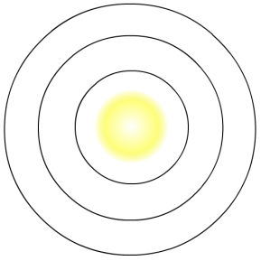
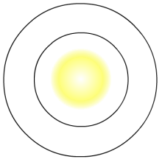
Dot and cross diagrams for compounds
To draw dot and cross diagrams for an ionic compound, you need to draw a dot and cross diagram for each ion in the formula of the compound.
If crosses are used for the electrons in the positive ion, then in the negative ion the electrons from the atom should be dots and the gained electrons should be crosses.
Sodium chloride, NaCl
Lithium oxide, Li₂O
+
–
+
Li
Na
Cl
2–
O
+
Li
Notes:
This slide covers the Science and Engineering Practice:
Developing and Using Models: Develop, revise, and/or use a model based on evidence to illustrate and/or predict the relationships between systems or between components of a system.

Slide 22
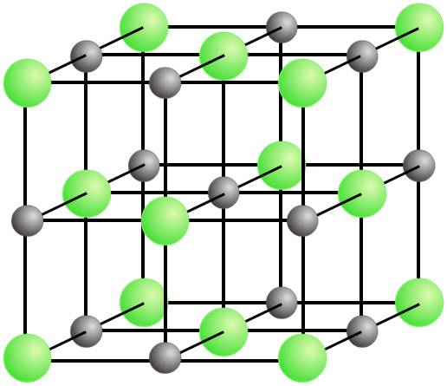
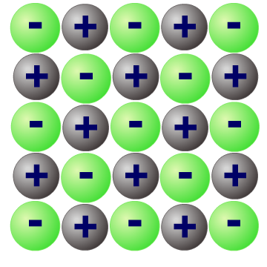
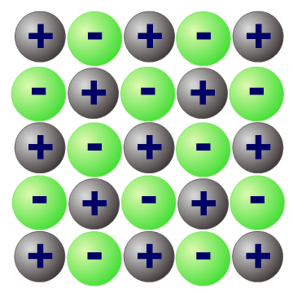
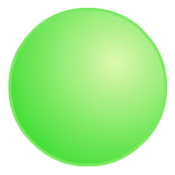
Other diagrams for ionic compounds
Other ways to draw ionic compounds are
ball-and-stick models and space-filling models.
In a ball-and-stick model, the balls show the ions and the sticks show the electrostatic attraction between them.
In a space-filling model, the ions are shown packed together and their charges are labeled.
Key
Na⁺
Cl–
Notes:
Teacher notes
To represent 3D shapes in 2D and vice versa, students could be asked to make models of ionic compounds.
This could be done using plasticine, or with sweets/polystyrene balls and cocktail sticks.
This slide covers the Science and Engineering Practice:
Developing and Using Models: Develop, revise, and/or use a model based on evidence to illustrate and/or predict the relationships between systems or between components of a system.
Obtaining, Evaluating, and Communicating Information: Communicate scientific and/or technical information or ideas (e.g. about phenomena and/or the process of development and the design and performance of a proposed process or system) in multiple formats (including orally, graphically, textually, and mathematically).

Slide 23
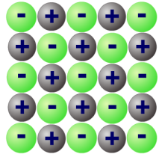
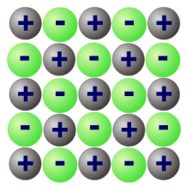
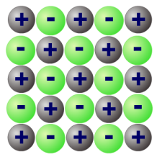
Comparing ways to draw ionic compounds
 | Empirical formula | Dot and cross | Ball-and-stick | Space filling
Example | NaCl
Simple to draw
Easy to see the ratio of ions
Shows the charges on each ion
Shows the 3D arrangement
+
-
Na
Cl
Notes:
This slide covers the Science and Engineering Practice:
Obtaining, Evaluating, and Communicating Information: Communicate scientific and/or technical information or ideas (e.g. about phenomena and/or the process of development and the design and performance of a proposed process or system) in multiple formats (including orally, graphically, textually, and mathematically).

Slide 24
Ions and ionic bonding – summary
Notes:
Teacher notes
This completing sentences activity could be used as an introductory or summary activity on ions and ionic bonding. Students could be asked to write down the missing words in their books and the activity could be completed by the whole class.

Slide 25
Comparing covalent and ionic bonding
Notes:
Teacher notes
This drag and drop activity provides the opportunity for informal assessment of students’ understanding of the differences between covalent and ionic bonding. Appropriately colored voting cards could be used with this activity to increase class participation.

