Slide 1
Group 7: Halogens

Slide 2
Information
Developing and Using Models
Planning and Carrying Out Investigations
Analyzing and Interpreting Data
Using Mathematics and Computational Thinking
Constructing Explanations and Designing Solutions
1. Patterns
6. Structure and Function

Slide 3
Columns of elements
In the periodic table, the elements are arranged by their properties and the number of protons they contain.
The vertical columns in the table are called groups.
1
2
groups
3
4
5
6
7
0
H
He
Li
Be
B
C
N
O
F
Ne
Na
Mg
Al
Si
P
S
Cl
Ar
K
Ca
Sc
Ti
V
Cr
Mn
Fe
Co
Ni
Cu
Zn
Ga
Ge
As
Se
Br
Kr
Rb
Sr
Y
Zr
Nb
Mo
Tc
Ru
Rh
Pd
Ag
Cd
In
Sn
Sb
Te
I
Xe
Cs
Ba
La
Hf
Ta
W
Re
Os
Ir
Pt
Au
Hg
Tl
Pb
Bi
Po
At
Rn
Fr
Ra
Ac
Rf
Db
Sg
Bh
Hs
Mt
Ds
Rg
Cn
Uut
Fl
Uup
Lv
Uus
Uuo

Slide 4
Where are the halogens?
Elements in the same group in the periodic table have very similar properties.
This is because all elements in a single group have the same number of electrons in their outer shell, causing them to react in a similar manner.
The elements in group 7, on the right of the periodic table, are called the halogens.
F
fluorine
Cl
chlorine
H
He
Li
Be
B
C
N
O
F
Ne
Br
bromine
Na
Mg
Al
Si
P
S
Cl
Ar
K
Ca
Sc
Ti
V
Cr
Mn
Fe
Co
Ni
Cu
Zn
Ga
Ge
As
Se
Br
Kr
iodine
Rb
Sr
Y
Zr
Nb
Mo
Tc
Ru
Rh
Pd
Ag
Cd
In
Sn
Sb
Te
I
Xe
I
Cs
Ba
La
Hf
Ta
W
Re
Os
Ir
Pt
Au
Hg
Tl
Pb
Bi
Po
At
Rn
Fr
Ra
Ac
Rf
Db
Sg
Bh
Hs
Mt
Ds
Rg
Cn
Uut
Fl
Uup
Lv
Uus
Uuo
At
astatine

Slide 5
What are the halogens?

Slide 6
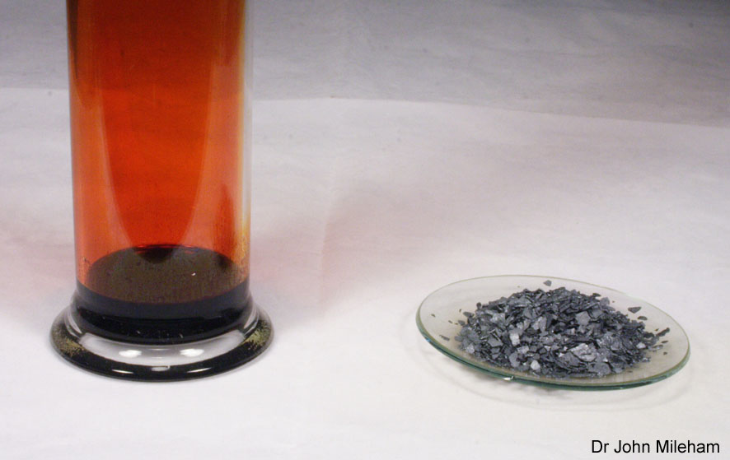
Why are they called the “halogens?”
Halogens are very reactive non-metals. As a result, they all have the potential to be toxic or harmful.
Before antiseptics, iodine was used to clean wounds. This is because it is able to destroy harmful organisms, such as bacteria.
Due to their reactivity, halogens are never found in nature in their pure form. Instead they are found in metal compounds.
These halogen-metal compounds are called salts. This gives halogens their name – “halo-gen” means “salt-former.”
Notes:
Teacher notes
The image shows liquid bromine on the left and solid iodine on the right.
Photo credit: © Dr John Mileham, 2018

Slide 7
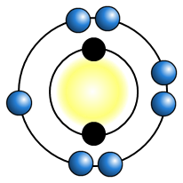
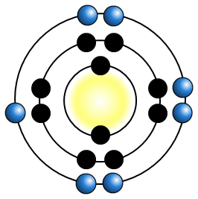
Electron structure
All halogens have seven electrons in their outer shell.
This means that:
They can easily obtain a full outer shell by gaining one electron.
fluorine
2,7
They can gain an electron in reactions to form negative ions with a –1 charge.
chlorine
2,8,7
They have similar chemical properties.
Notes:
Teacher notes
The numbers next to each atom represent the electronic structure.
e.g. 2,7 next to fluorine means that fluorine has 2 electrons in its first shell, and 7 electrons in its second shell.
This slide covers the Science and Engineering Practices:
Developing and Using Models: Develop, revise, and/or use a model based on evidence to illustrate and/or predict the relationships between systems or between components of a system.
Using Mathematics and Computational Thinking: Use mathematical, computational, and/or algorithmic representations of phenomena or design solutions to describe and/or support claims and/or explanations.

Slide 8
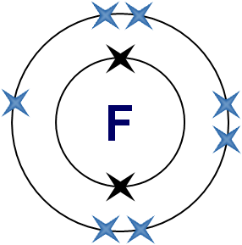
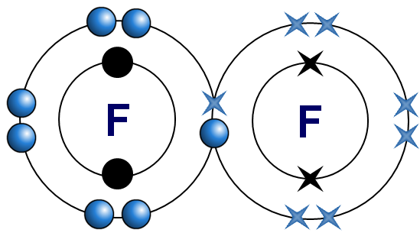
How do halogen molecules exist?
To become stable, halogen atoms require one additional electron to obtain a full outer shell.
Each atom can achieve this by sharing one electron with another atom to form a single covalent bond.
F
+
This means that all halogens exist as diatomic molecules: F₂, Cl₂, Br₂ and I₂.
Notes:
This slide covers the Science and Engineering Practices:
Developing and Using Models: Develop, revise, and/or use a model based on evidence to illustrate and/or predict the relationships between systems or between components of a system.
Using Mathematics and Computational Thinking: Use mathematical, computational, and/or algorithmic representations of phenomena or design solutions to describe and/or support claims and/or explanations.

Slide 9
Testing for chlorine
We can test for chlorine gas using damp blue litmus paper. The chlorine dissolves in the water on the paper, and then reacts with the litmus dye.
First, the litmus paper will turn red. This is because chlorine is acidic.
The paper will then be bleached white.
Chlorine will also turn universal indicator paper red then white, and will turn starch-iodide paper from white to blue-black.
Notes:
Teacher notes
Litmus paper:
Some of the chlorine dissolves in the water on the damp paper.
A reversible reaction between the chlorine and water produces hydrochloric acid (HCl) and hypochlorous acid (HClO).
Dissolved HCl forms H⁺ ions and Cl⁻ ions.
Some of the dissolved HClO forms H⁺ ions and ClO⁻ ions.
The H⁺ ions react reversibly with the litmus dye, changing the color from blue to red.
ClO⁻ ions are found in household bleach. They react irreversibly with the litmus dye, and the color changes to white.
Universal indicator paper:
By a similar method to litmus paper, chlorine will turn damp universal indicator paper red, and then bleach it white.
Starch-iodide paper:
Starch-iodide paper contains potassium iodide and starch.
Potassium iodide and starch are colorless, so the paper looks white.
When chlorine dissolves on damp starch iodide paper, the chloride ions react with the potassium iodide to form potassium chloride and iodine.
The iodine reacts with the starch, and changes color to blue-black.

Slide 10
Identifying halide ions
Halide ions are negative ions formed from the halogens. These can be detected using silver nitrate solution.
The substance to be tested is first acidified with a small amount of nitric acid. Silver nitrate solution is then added. If a halide ion is present, a precipitate will form.
The precipitates formed are silver halides.
sodium chloride
+
silver nitrate
silver chloride
+
sodium nitrate
NaCl (aq)
+
AgNO₃ (aq)
AgCl (s)
+
NaNO₃ (aq)
Cl– (aq)
+
Ag⁺ (aq)
AgCl (s)
Notes:
Teacher notes
Lead nitrate can also be used as a substitute for silver nitrate.

Slide 11
Silver halides
The different types of silver halide precipitates can be distinguished by their color.
chloride
bromide
iodide
white AgCl precipitate
cream AgBr precipitate
yellow AgI precipitate

Slide 12
What are the properties of the halogens?
All the halogens are:
non-metals and so do not conduct electricity
brittle and crumbly when solid
poisonous and strong-smelling.
They become darker in color down the group:
fluorine
is a pale yellow gas at room temperature.
chlorine
is a green-yellow gas at room temperature.
bromine
is a dark orange liquid at room temperature. It becomes an orange-brown gas when heated.
iodine
is a dark grey solid at room temperature. It sublimes to a purple gas when heated.
astatine
is a dark-colored solid at room temperature.
Notes:
Teacher notes
Astatine is a rare, radioactive element that has a half-life of only 8 hours. Astatine compounds have only been made in tiny amounts. Many of the properties of astatine are unknown, and instead are predicted using the trends down the group.

Slide 13
Size, mass and density
Going down group 7, the size, density and relative molecular mass of halogens all increase.
element | relative size | relative molecular mass | density (g/cm³)
38
0.0017
71
0.0032
160
3.1
254
4.9
astatine
420
approx 6.4*
Notes:
Teacher notes
Astatine is so rare that its exact density is unknown.

Slide 14
Melting and boiling points
The melting and boiling points of the halogens increase down the group. Predict the states and values to fill in the table.
element | state at room temperature | melting point (°C) | boiling point (°C)
 | gas
 |  | –101
 |  |  | 59
 |  | 114
 | solid | 302* | 337*
–220
–188
gas
–34
liquid
–7
solid
184
astatine
Notes:
Teacher notes
The melting and boiling points for astatine are unknown, and have been predicted using the trend down the group.
The melting points increase down the group because the intermolecular forces increase as size increases.

Slide 15
Melting and boiling points of halogens
Notes:
Teacher notes
Ask students to describe why the boiling and melting points of the halogens increase going down the group. Ask them to refer to other properties of these elements.
This slide covers the Science and Engineering Practice:
Constructing Explanations and Designing Solutions: Apply scientific ideas, principles, and/or evidence to provide an explanation of phenomena and solve design problems, taking into account possible unanticipated effects.

Slide 16
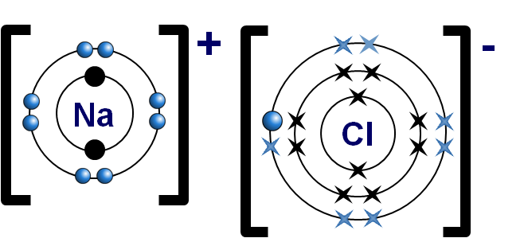
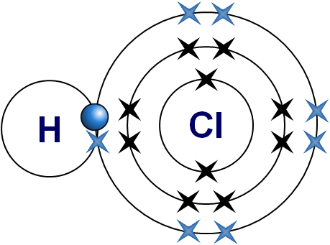
Reactions with metals and non-metals
Halogens have 7 electrons in their outer shell. By gaining one more electron they can obtain a full shell and become stable.
Metals need to lose electrons in order to gain a full outer shell. Metals can react with halogens to form ionic compounds called metal halides.
sodium chloride
Non-metals need to gain electrons to become stable. When non-metals react with halogens, they can share electrons and form covalent bonds.
hydrogen chloride
Notes:
This slide covers the Science and Engineering Practices:
Developing and Using Models: Develop, revise, and/or use a model based on evidence to illustrate and/or predict the relationships between systems or between components of a system.
Using Mathematics and Computational Thinking: Use mathematical, computational, and/or algorithmic representations of phenomena or design solutions to describe and/or support claims and/or explanations.

Slide 17
What are halides?
Halogen atoms can form negative ions by gaining an electron.
When this happens, they are called halides.
The name of each of the halogens changes once it has reacted. Instead of ending with “–ine,” it ends with “–ide.”
halogen
halide
(F)
fluoride (F–)
(Cl)
chloride (Cl–)
(Br)
bromide (Br–)
(I)
iodide (I–)

Slide 18
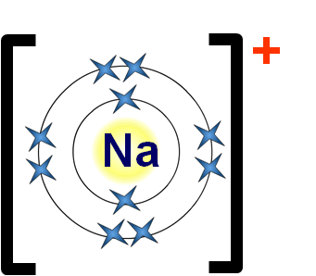
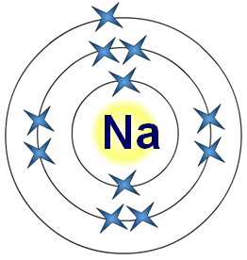
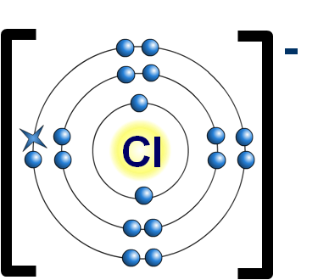
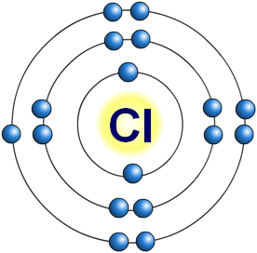
How do alkali metals react with halogens?
The electron structure of halogens means that they react vigorously with group 1 alkali metals.
An alkali metal has one electron in its outer shell.
By losing this electron, it has a filled outer shell and forms a positive ion.
2.8.1
[2.8]⁺
A halogen has seven electrons in its outer shell.
By gaining an electron from the alkali metal, it obtains a filled outer shell and forms a negative ion.
2.8.7
[2.8.8]–
Notes:
This slide covers the Science and Engineering Practices:
Developing and Using Models: Develop, revise, and/or use a model based on evidence to illustrate and/or predict the relationships between systems or between components of a system.
Using Mathematics and Computational Thinking: Use mathematical, computational, and/or algorithmic representations of phenomena or design solutions to describe and/or support claims and/or explanations.

Slide 19
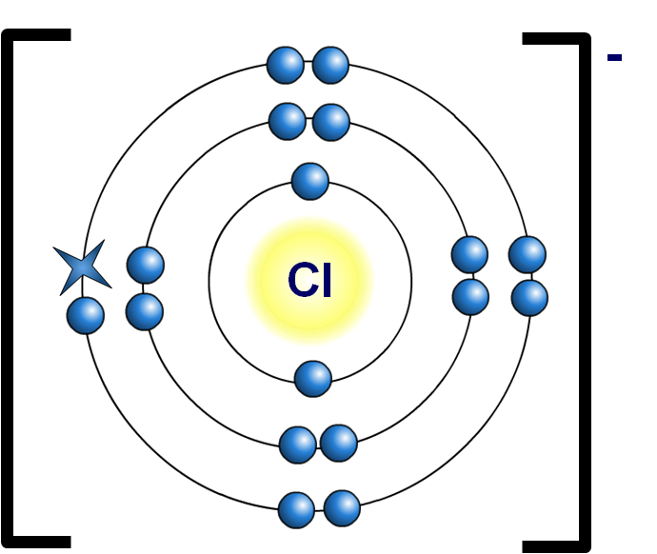
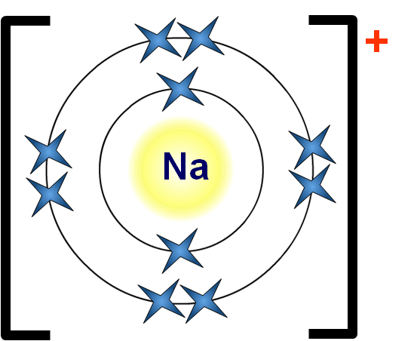
How are ionic bonds formed?
The positive alkali metal ions and the negative halide ions are strongly attracted to each other.
It is this electrostatic attraction that forms ionic bonds in metal halides and other ionic compounds.
Notes:
This slide covers the Science and Engineering Practices:
Developing and Using Models: Develop, revise, and/or use a model based on evidence to illustrate and/or predict the relationships between systems or between components of a system.
Using Mathematics and Computational Thinking: Use mathematical, computational, and/or algorithmic representations of phenomena or design solutions to describe and/or support claims and/or explanations.

Slide 20
Equations for halogens and alkali metals
When a halogen reacts with a metal it forms a metal halide:
halogen + metal metal halide
Write a balanced symbol equation for the reaction between chlorine and sodium.
+
sodium chloride
chlorine
sodium
Cl₂
+
2Na
2NaCl
Write a word equation and a balanced symbol equation for the reaction between bromine and potassium.
+
potassium bromide
bromine
potassium
Br₂
+
2K
2KBr
Notes:
Teacher notes
For more information about word and symbol equations, please refer to the Formulae and Equations presentation.

Slide 21
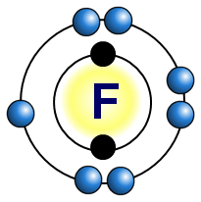
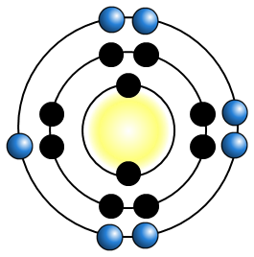
Electron structure and reactivity
The reactivity of halogens decreases going down the group.
What is the reason for this?
The atoms of each element get larger going down the group.
This means that the outer shell gets further away from the nucleus and is shielded by more electron shells.
decrease in reactivity
The further the outer shell is from the positive attraction of the nucleus, the harder it is to attract another electron to complete the outer shell.
Cl
Notes:
This slide covers the Science and Engineering Practices:
Using Mathematics and Computational Thinking: Use mathematical, computational, and/or algorithmic representations of phenomena or design solutions to describe and/or support claims and/or explanations.
Constructing Explanations and Designing Solutions: Apply scientific ideas, principles, and/or evidence to provide an explanation of phenomena and solve design problems, taking into account possible unanticipated effects.

Slide 22
Halogen reaction with iron wool
Notes:
Teacher notes
This virtual experiment compares the reactivity of the halogens with iron wool. It could be used as a precursor to running the experiment in the lab, or as a revision exercise. When using this activity, it should be made clear that the reaction with iodine takes several minutes of strong heating before it reacts. This is illustrated by the stop watch, but is not shown in real time.
This slide covers the Science and Engineering Practices:
Planning and Carrying Out Investigations: Plan and conduct an investigation or test a design solution in a safe and ethical manner including considerations of environmental, social, and personal impacts.
Planning and Carrying Out Investigations: Select appropriate tools to collect, record, analyze, and evaluate data.

Slide 23
What is the reactivity of the halogens?
The iron wool experiment shows that the reactivity of halogens decreases down the group.
halogen
reaction with iron wool
Iron wool burns and glows brightly.
Iron wool glows, but less brightly than with chlorine.
Iron wool has a very slight glow.
Astatine appears directly below iodine in group 7. Fluorine appears directly above chlorine.
How do you think astatine and fluorine would react with iron wool?
Notes:
Teacher notes
Astatine is too rare to carry out the experiment with iron wool.
However, astatine is less reactive than iodine, so it would probably have a very weak reaction or no reaction.
Fluorine reacts instantly with almost anything, which makes it very dangerous to handle.
Iron wool bursts into flame as fluorine passes over it – no heating required.

Slide 24
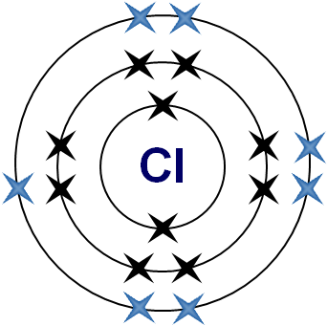
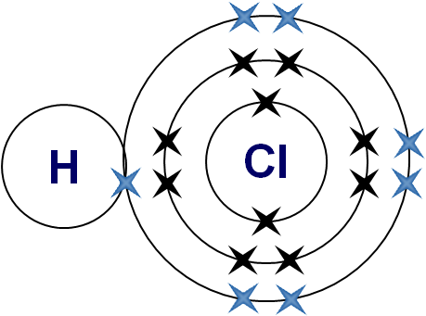
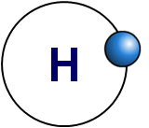
How do the halogens react with hydrogen?
Halogens react with hydrogen to create hydrogen halides.
+
hydrogen
chlorine
hydrogen chloride
When halogens react with non-metals, they can share electrons to form a covalent compound.
All hydrogen halides are gases. They dissolve easily in water and form strong acids.
Notes:
This slide covers the Science and Engineering Practices:
Developing and Using Models: Develop, revise, and/or use a model based on evidence to illustrate and/or predict the relationships between systems or between components of a system.
Using Mathematics and Computational Thinking: Use mathematical, computational, and/or algorithmic representations of phenomena or design solutions to describe and/or support claims and/or explanations.

Slide 25
Reactions with other non-metals
As well as hydrogen, other non-metals can react with halogens to form covalent compounds. These include:
halohydrocarbons, e.g. Chloromethane, PVC, PTFE
phosgene (COCl₂), used as a chemical weapon in WW1
silicon tetrachloride (SiCl₄), used to produce high purity silicon
nitrogen tribromide (NBr₃), extremely explosive
sulfur dichloride (SCl₂), used in the process of making sulfur compounds.

Slide 26
True or false?
Notes:
Teacher notes
This true-or-false activity could be used as an introductory or summary activity on halogens, or at the start of the lesson to gauge students’ existing knowledge of the subject matter. Colored traffic light cards (red = false, yellow = don’t know, green = true) could be used to make this a whole-class exercise.

Slide 27
Displacement of halogens
If a halogen is added to a solution of a compound containing a less reactive halogen, it will react with the compound and form a new one.
This is called displacement.
+
sodium chloride
sodium fluoride
+
fluorine
chlorine
F₂ (aq)
+
2NaCl (aq)
2NaF (aq)
+
Cl₂ (aq)
A more reactive halogen will always displace a less reactive halide from its compounds in solution.
Why will a more reactive halogen always displace a less reactive halogen?

Slide 28
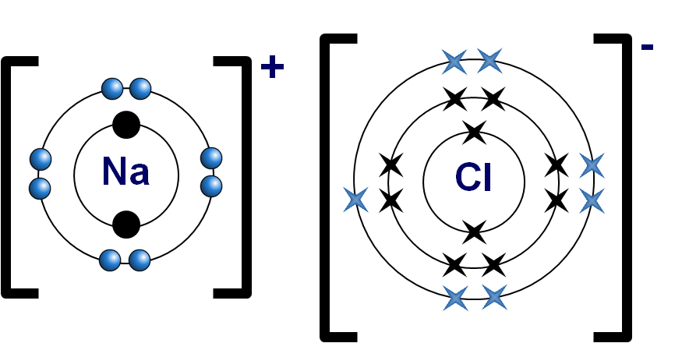
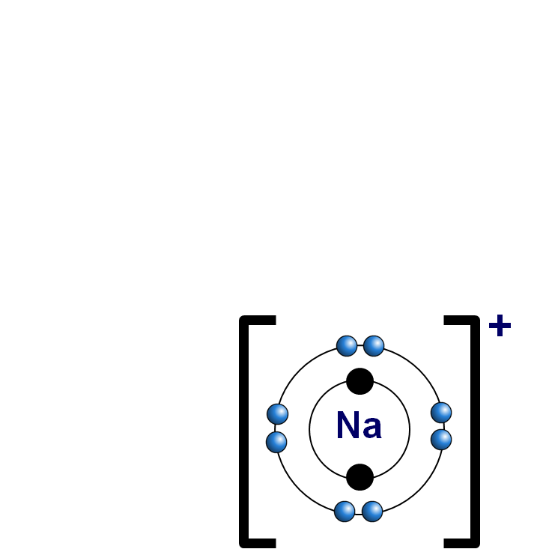
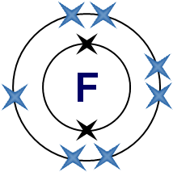
Displacement theory
Fluorine is more reactive than chlorine.
What happens when fluorine is added to sodium chloride?
The products of the reaction are chlorine and sodium fluoride.
sodium
chloride
chlorine
The chlorine has been displaced by the fluorine.
-
In sodium chloride, the outer shell electron from the sodium atom has been transferred to the chlorine atom, to make sodium and chloride ions.
When fluorine is added, the
extra electron will be transferred
from chlorine to fluorine.
The chloride ion becomes a chlorine atom, and the fluorine atom becomes a fluoride ion.
sodium
fluorine
fluoride
fluoride
Notes:
This slide covers the Science and Engineering Practices:
Developing and Using Models: Develop, revise, and/or use a model based on evidence to illustrate and/or predict the relationships between systems or between components of a system.
Using Mathematics and Computational Thinking: Use mathematical, computational, and/or algorithmic representations of phenomena or design solutions to describe and/or support claims and/or explanations.
Constructing Explanations and Designing Solutions: Apply scientific ideas, principles, and/or evidence to provide an explanation of phenomena and solve design problems, taking into account possible unanticipated effects.

Slide 29
Reduction and oxidation
During a displacement reaction, the less reactive halogen is oxidized (loses an election) and the more reactive halogen is reduced (gains an electron).
Oxidation:
2Cl⁻
+
2e⁻
Cl₂
Reduction:
F₂
+
2e⁻
2F⁻
The reaction involves both reduction and oxidation, so it is a redox reaction.
Remember OIL RIG: Oxidation Is Loss of electrons, Reduction Is Gain of electrons.

Slide 30
Displacement reactions
Notes:
Teacher notes
This virtual experiment illustrates how a more reactive halogen will displace a less reactive halogen. It could be used as a precursor to running the practical in the lab, or as a summary exercise.

Slide 31
Predicting displacement reactions
What will happen if bromine is added to sodium iodide?
The bromine will displace the iodide ion in the solution to form sodium bromide.
Write a word equation and a balanced symbol equation for this reaction.
+
sodium iodide
sodium bromide
+
bromine
iodine
Br₂
+
2NaI
2NaBr
+
I₂

Slide 32
Is there a displacement reaction?
Notes:
Teacher notes
This drag and drop activity provides the opportunity for informal assessment of students’ understanding of halogens and displacement.

