Slide 1
Giant Covalent Structures

Slide 2
Information
Constructing Explanations and Designing Solutions
6. Structure and Function

Slide 3
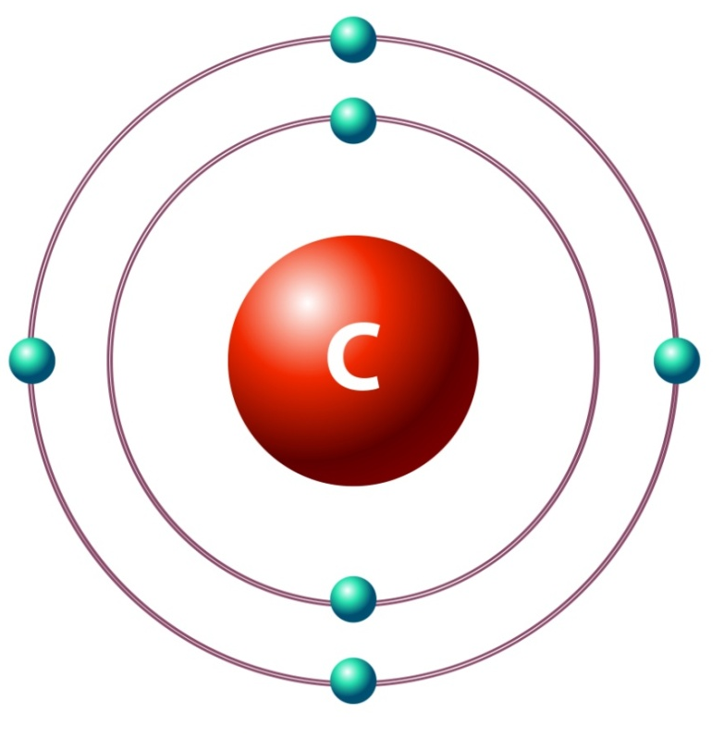
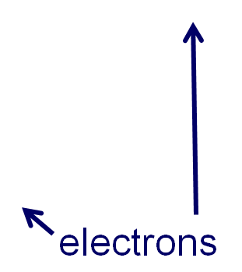
The carbon atom
Carbon is a non-metallic element found in group 4 of the periodic table.
It has 6 electrons, with 4 located in the outer shell.
This means carbon is able to form a maximum of four covalent bonds with other atoms.
Carbon can exist in a huge number of different forms. These forms are called allotropes.
Allotropes are families of similar molecules.
Notes:
Teacher notes
For more information about covalent bonds please refer to the Covalent Bonding presentation.
Photo credit: © BlueRingMedia, Shutterstock.com 2018

Slide 4
Many carbon molecules
The ability of carbon to form different compounds is due to its different properties:
a carbon atom can bond to other carbon atoms to form long chains
carbon atoms can form branches and rings, which can lead to the formation of large complex structures
the four outer shell electrons allow carbon atoms to share two electrons with other atoms to form double bonds
the four outer shell electrons allow carbon atoms to form bonds with atoms of other elements, such as hydrogen.
What materials are made of carbon?
Notes:
Teacher notes
Carbon can also share 3 electrons with another atom to form a triple bond.

Slide 5
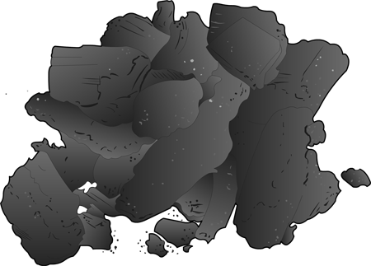
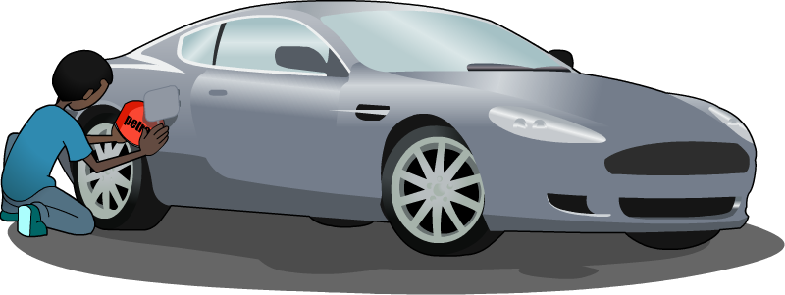
Carbon everywhere
Carbon is found in nearly all materials and organisms.
Some examples of materials that contain carbon include:
coal
wood
diamond
hydrocarbons in petroleum
hydrocarbons in plastics
graphite in pencils
biological molecules, such as carbohydrates.
How do the different structures of diamond and graphite influence their properties?
Notes:
Teacher notes
For more information about hydrocarbons please refer to the Alkanes presentation.

Slide 6
What is the structure of diamond?
Notes:
Teacher notes
This three-stage animation shows how carbon makes up the structure of diamond, and builds to make a giant covalent lattice.

Slide 7
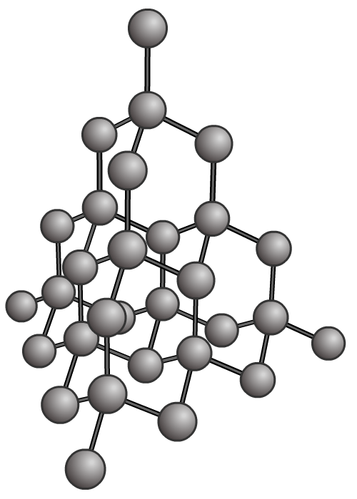
What are the properties of diamond?
In diamond, all the electrons in the outer shell of each carbon atom are involved in forming covalent bonds.
This affects the properties of this allotrope of carbon.
Diamond is very hard: it is the hardest natural substance, so it is often used to make jewelry and cutting tools.
Diamond has a very high melting and boiling point: a lot of energy is needed to break the covalent bonds.
Diamond cannot conduct electricity: there are no free electrons or ions to carry a charge.
Notes:
This slide covers the Science and Engineering Practice:
Constructing Explanations and Designing Solutions: Apply scientific ideas, principles, and/or evidence to provide an explanation of phenomena and solve design problems, taking into account possible unanticipated effects.

Slide 8
What is the structure of graphite?
Notes:
Teacher notes
This four-stage animation shows how carbon makes up the structure of graphite, and builds to make a giant covalent lattice. It also shows how graphite is soft and slippery (because the bonds between layers are weak), and can conduct electricity (because there are delocalized electrons between the layers).

Slide 9
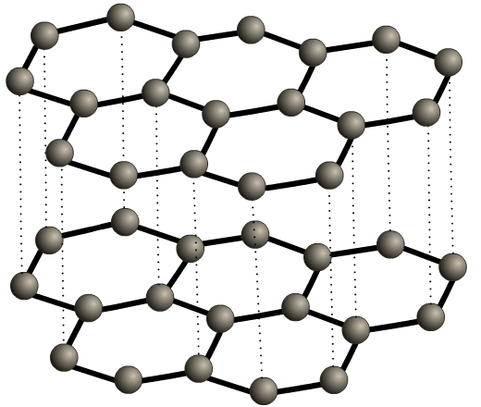
What are the properties of graphite? (1)
In graphite, only three of the four electrons in the outer shell of each carbon atom are involved in covalent bonds.
This affects the properties of this allotrope of carbon.
Graphite has a high melting point: similar to diamond, a large amount of energy is required to break the large number of covalent bonds.
Graphite is a poor conductor of heat: this is due to the large gaps and weak forces between the graphite sheets. Diamond, on the other hand, is a good conductor of heat.
Notes:
This slide covers the Science and Engineering Practice:
Constructing Explanations and Designing Solutions: Apply scientific ideas, principles, and/or evidence to provide an explanation of phenomena and solve design problems, taking into account possible unanticipated effects.

Slide 10
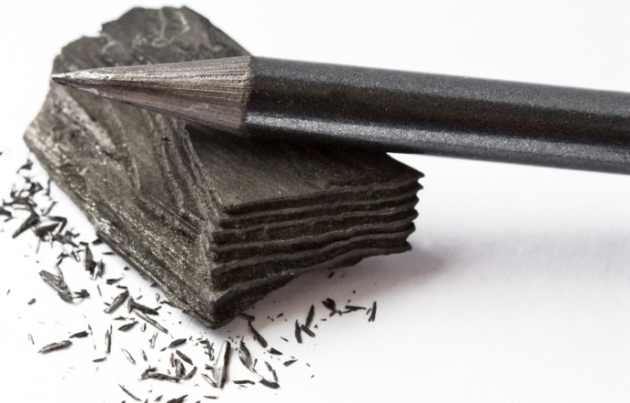
What are the properties of graphite? (2)
Graphite conducts electricity: the only non-metal to do so. Similar to metals, delocalized electrons in the structure are able to carry charge.
One electron from each carbon atom is free to move within the structure. This means that each layer has delocalized electrons.
Graphite is soft and slippery: the carbon layers can easily slide over each other because the weak, non-covalent forces of attraction are easily broken. This is why graphite can be used as a lubricant.
Notes:
This slide covers the Science and Engineering Practice:
Constructing Explanations and Designing Solutions: Apply scientific ideas, principles, and/or evidence to provide an explanation of phenomena and solve design problems, taking into account possible unanticipated effects.
Photo credit: © remedios55, Shutterstock.com 2018

Slide 11
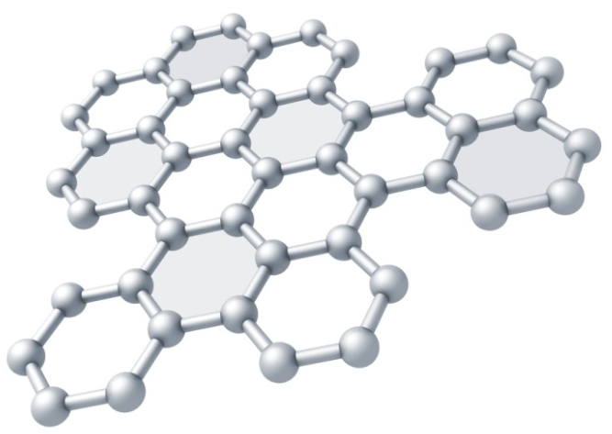
Graphene
Graphene is a single layer of graphite, consisting of a sheet of carbon atoms that is one atom thick.
Graphene is very strong: it is around 200 times stronger than steel! This is due to the strong carbon-carbon covalent bonds that tightly pack the carbon atoms in the sheet.
Graphene conducts electricity: as with graphite, the delocalized electrons are free to move and carry a charge.
Graphene is flexible: the single sheet gives graphene flexibility, which, together with its strength makes it a desirable material to use.
Notes:
This slide covers the Science and Engineering Practice:
Constructing Explanations and Designing Solutions: Apply scientific ideas, principles, and/or evidence to provide an explanation of phenomena and solve design problems, taking into account possible unanticipated effects.
Photo credit: © Eugene Sergeev, Shutterstock.com 2018

Slide 12
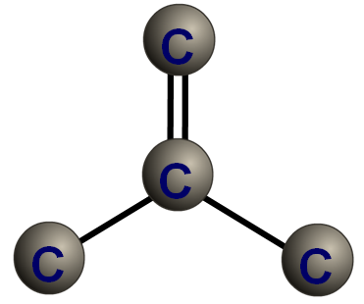
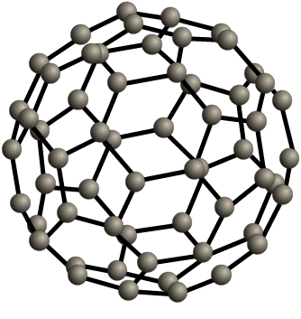
Are there other allotropes of carbon?
Another class of carbon compounds are fullerenes. These form hollow 3D structures.
Buckminsterfullerene is one type of fullerene. It contains 60 carbon atoms, each of which is bonded to three others by two single bonds and one double bond.
The atoms in this allotrope of carbon form a sphere-like shape, similar to a soccer ball. The molecules are also called “bucky balls.” They are large, but are not classified as giant structures.
Notes:
Teacher notes
Students should be aware that carbon can also form fullerenes with different numbers of carbon atoms.

Slide 13
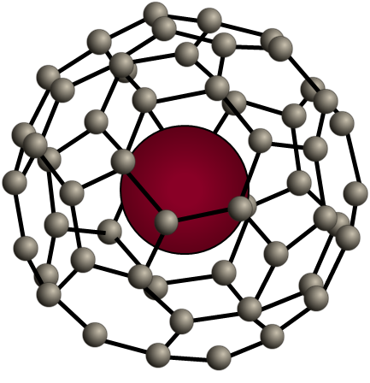
What are the uses of fullerenes?
Some of the uses of fullerenes that scientists are currently working on include:
non-stick slippery coatings for machinery, which act like miniature ball bearings
cages to hold drug molecules that can be delivered directly into the body
molecular sieves which trap large particles whilst allowing smaller particles to pass through
chemical sponges to soak up toxic substances in the body.

Slide 14
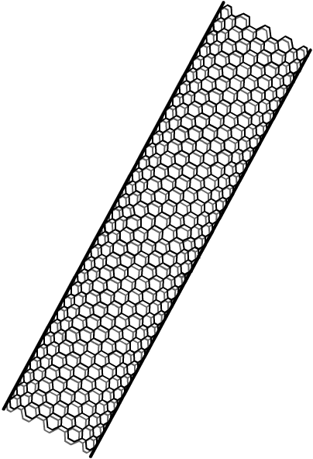
Carbon nanotubes
Carbon nanotubes are another form of fullerene. They are tubes of carbon hexagons, similar to sheets of graphene rolled into cylinders.
Carbon nanotubes have many useful properties, including:
very high tensile strength
unique electrical properties
good heat conductance.
Multi-walled nanotubes exist. In these, several tubes can rotate and slide within in each other, almost without friction.
Metal atoms can be attached to the outer surface of the tubes.
With these properties, what might nanotubes be used for?
Notes:
Teacher notes
The high tensile strength of nanotubes means that it takes a very large force for them to break.
Some uses of carbon nanotubes include:
semiconductors in electrical circuits
industrial catalysts (the catalyst can be attached to the surface of the nanotube, and a large surface area is available)
to reinforce graphite in tennis rackets.

