Slide 1
Fractional Distillation

Slide 2
Information
Analyzing and Interpreting Data
Constructing Explanations and Designing Solutions
1. Patterns
6. Structure and Function

Slide 3
Carbon families
The different properties of carbon enable it to form a range of different compounds, both natural and synthetic.
These carbon compounds can be grouped into families according to their chemical properties.
This means that members of the same family will behave similarly in chemical reactions, enabling scientists to predict how molecules will react. For example, the hydrocarbons alkanes.
Despite their similarities, molecules of the same family can be distinguished by their varying physical properties, such as melting and boiling point.
Notes:
Teacher notes
For more information about different carbon compounds please refer to the Giant Covalent Structures presentation.

Slide 4
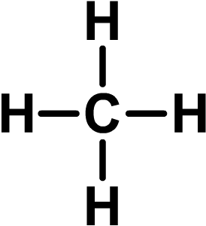
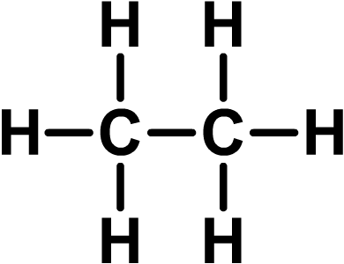
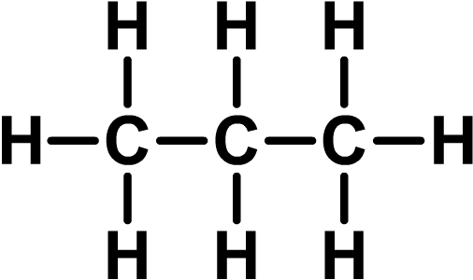
Alkanes
Alkanes are a family of hydrocarbon compounds with the general formula C_{n}H_{2n+2}. This means that an alkane will have two hydrogen atoms for every carbon atom, plus two more.
The simplest alkane is methane. It has the formula CH₄.
The second simplest alkane is ethane. It has the formula C₂H₆.
The third simplest alkane is propane. It has the formula C₃H₈.
Notes:
Teacher notes
Students may notice that the molecular formulae of neighboring alkanes differ by CH₂.

Slide 5
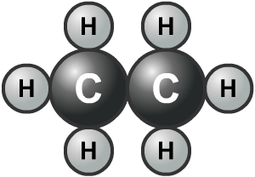
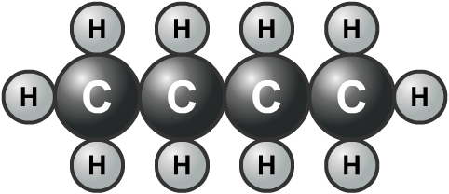
Hydrocarbons
Many of the compounds in crude oil only contain the elements carbon and hydrogen. They are called hydrocarbons.
Most hydrocarbons in crude oil are alkanes.
The alkanes in crude oil can be separated by chain length (the number of carbon atoms in the chain) using fractional distillation.
Notes:
Teacher notes
For more information about hydrocarbons please refer to the Hydrocarbons presentation.

Slide 6
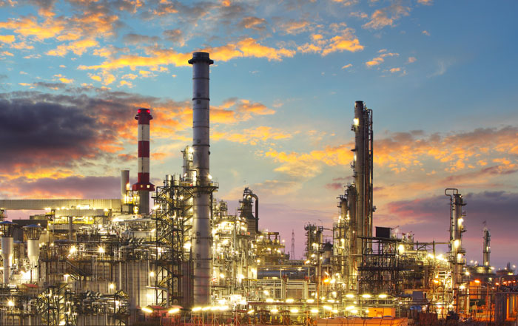
How can crude oil be made useful?
Crude oil itself has no uses – it must first be processed or refined. This is done in an oil refinery.
During refining, compounds in the oil are separated into simpler groups called fractions. This is the basis of fractional distillation.
Each fraction contains a mix of compounds with a similar number of carbon atoms.
Notes:
Photo credit: oil refinery © Ttstudio, Shutterstock.com 2018

Slide 7
What is fractional distillation?
Fractional distillation is a process used to separate a mixture of liquids that have different boiling points.
When the mixture is heated, liquids with a high boiling point remain as liquid. Liquids with a lower boiling point evaporate and turn to vapor.
The vapor can then be separated from the liquid.
Fractional distillation separates crude oil into useful products called fractions. It can be done industrially and in the laboratory.

Slide 8
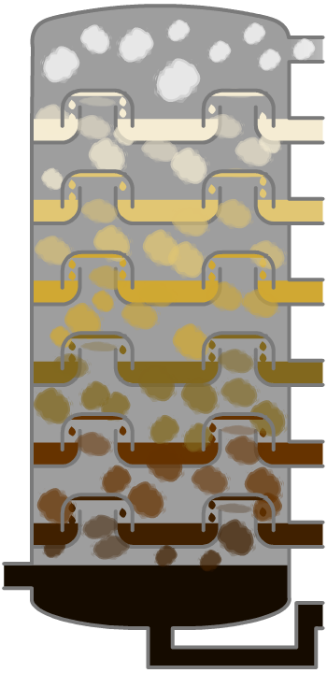
Fractional distillation of crude oil
How is crude oil separated into fractions?
1. Oil is heated to about 370 °C and pumped into the bottom of a tall tower called a fractionating column, where it vaporizes.
2. The column is very hot at the bottom but much cooler at the top. As the vaporized oil rises, it cools and condenses.
3. Heavy fractions (containing large molecules) have high boiling points and condense near the bottom of the column.
4. Lighter fractions (containing small molecules) have lower boiling points and condense further up the column.
Notes:
This slide covers the Science and Engineering Practice:
Constructing Explanations and Designing Solutions: Apply scientific ideas, principles, and/or evidence to provide an explanation of phenomena and solve design problems, taking into account possible unanticipated effects.

Slide 9
How does fractional distillation work?
Notes:
Teacher notes
This six-stage interactive animation shows how fractional distillation is used on an industrial scale to separate crude oil into different fractions. At the end of the animation, you can view a summary of each fraction by clicking on its name. While showing the animation, the one-way nature of the bubble caps could be highlighted. Suitable prompts could include:
What is special about the molecules in a fraction?
Which fraction will be the hardest to vaporize?
Why is the vapor slowed down by the bubble caps as it rises up the column?
What makes the fractions condense at different heights in the column?
Will all the molecules that enter the column condense?
Are the molecules in a fraction identical?
This slide covers the Science and Engineering Practice:
Constructing Explanations and Designing Solutions: Apply scientific ideas, principles, and/or evidence to provide an explanation of phenomena and solve design problems, taking into account possible unanticipated effects.

Slide 10
How do fractions differ?
Hydrocarbons in different fractions differ from each other in a number of ways. These differences include:
the number of carbon and hydrogen atoms they contain
boiling point
ease of ignition (how easy it is to set it alight)
viscosity (thickness).
Notes:
Teacher notes
Longer hydrocarbon molecules in a fraction become tangled with each other and have more points of contact. This means there are a greater number of intermolecular forces between the hydrocarbon molecules. It takes a greater amount of energy to overcome these forces and so the resulting fractions are more viscous, less easy to ignite, and have a higher boiling point.

Slide 11
Molecule size and boiling point
Molecules in crude oil can contain anything from just one carbon atom to well over fifty.
The more carbon atoms in a hydrocarbon molecule, the larger the molecule. How does this affect its boiling point?
Generally, the larger a hydrocarbon, the higher its boiling point.
This is because the intermolecular forces between large molecules are stronger than the intermolecular forces between small molecules.
More energy is needed to break the forces between large molecules, and so the boiling point is higher.
Notes:
Teacher notes
The boiling point of hydrocarbons increases with the size of the molecule due to increasing surface area. A larger surface area means that there are more weak, intermolecular forces between adjacent molecules.

Slide 12
Forces between molecules
Notes:
This slide covers the Science and Engineering Practice:
Constructing Explanations and Designing Solutions: Apply scientific ideas, principles, and/or evidence to provide an explanation of phenomena and solve design problems, taking into account possible unanticipated effects.

Slide 13
Boiling point of alkanes
Notes:
Teacher notes
This animated graph shows the boiling point of the first 12 alkanes. Roll over each point on the graph for the name and exact boiling point of each alkane. This activity could be used in a number of ways, for example, helping the students to practice:
plotting graphs with a negative axis – the boiling points could be rounded for groups who find graph plotting challenging
plotting an X–Y scatter graph using a spreadsheet and fitting a trend line
finding unknown data by interpolation and extrapolation – the data for alkanes with 8 and 12 carbon atoms could be omitted, and students could use either hand-drawn or computer-generated graphs to estimate the missing boiling points.
This slide covers the Science and Engineering Practice:
Analyzing and Interpreting Data: Analyze data using tools, technologies, and/or models (e.g., computational, mathematical) in order to make valid and reliable scientific claims or determine an optimal design solution.

Slide 14
Order of fractions
Notes:
Teacher notes
This ordering activity could be used as an introductory or summary activity on the order of fractions in a fractionating column. Mini whiteboards could be used to make this a whole-class exercise.

Slide 15
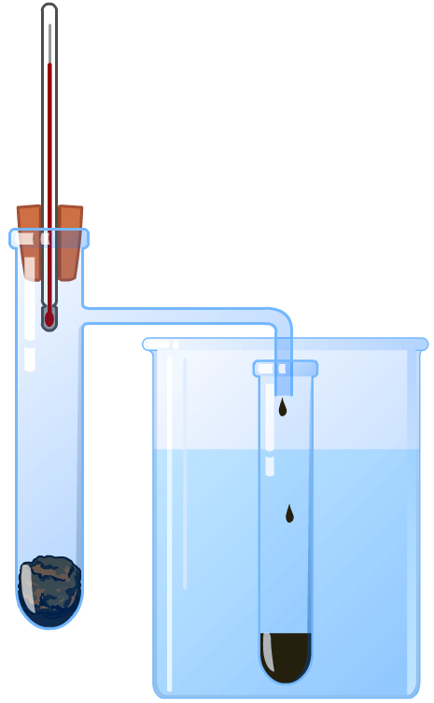
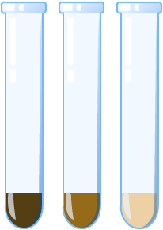
Fractional distillation in the lab
The principle of fractional distillation can be demonstrated in the laboratory.
fractions collected previously (at lower temperatures)
The crude oil is heated and the vapor produced is collected at different temperatures.
mineral wool soaked in crude oil
cooling water

Slide 16
Fractional distillation – true or false?
Notes:
Teacher notes
This true-or-false activity could be used as an introductory or summary activity on refining crude oil, or at the start of the lesson to gauge students’ existing knowledge of the subject matter. Colored traffic light cards (red = false, yellow = don’t know, green = true) could be used to make this a whole-class exercise.

Slide 17
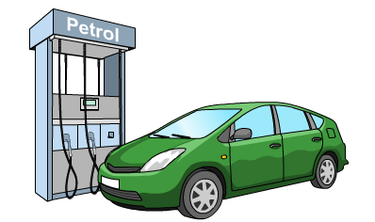
Hydrocarbons as fuels
Over 85% of crude oil is used as a fuel for heating and transport. Only 8% is used to make plastics and other chemicals.
A fuel is a substance that reacts with oxygen to release useful energy.
A large amount of oil is used as fuel because the hydrocarbons in the fractions burn easily and release a large amount of useful energy.

Slide 18
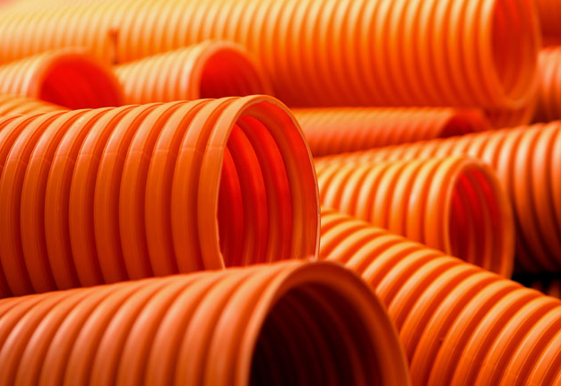
Using fractions
Modern life depends on the petrochemical industry for the production of many useful materials.
Fractions collected during fractional distillation are processed and used to produce:
car fuel – produced from the gasoline and diesel fractions
solvents – used to dissolve other substances
lubricants – used in engines
polymers – used to create plastics and other materials
detergents – used as cleaning products.
Notes:
Photo credit: plastic pipes © ArtWell, Shutterstock.com 2018

Slide 19
What are fractions used for?
Notes:
Photo credits: LPG © koya979; truck © s_oleg; engine © Kalabi Yau; ship © Olga Gavrilova; aeroplane © travellight; gasoline © bunyarit, all at Shutterstock.com 2018

Slide 20
Which fraction?
Notes:
Teacher notes
This activity could be used as a summary exercise to check students’ ability to identify uses of fractions. Class voting or the use of mini whiteboards could make this a whole-class exercise.

Slide 21
How important are these fractions?
Notes:
Teacher notes
This interactive activity enables the individual opinions of the class to be represented graphically.
Students should be encouraged to think about uses of oil other than as a source of fuel. For example, what materials are made from oil, and which fractions are used? Students could also be asked to think about possible uses of the fractions that do not affect them directly but are nevertheless important. For example, what food and products are imported into this country on airplanes or ships?

Slide 22
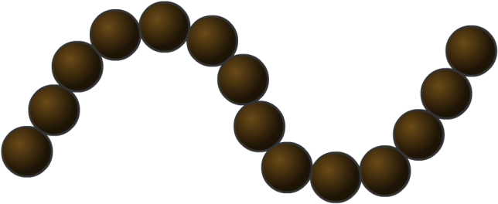
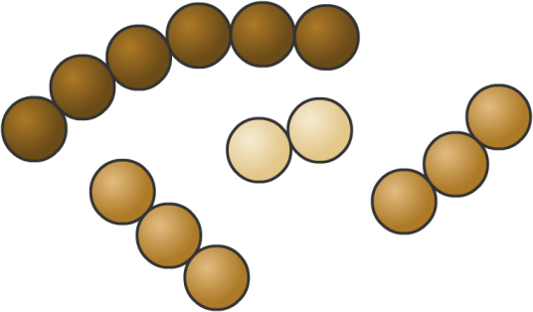
Supply and demand
The amount of each type of fraction obtained by fractional distillation does not usually match the amount of each fraction that is needed.
Crude oil often contains a greater quantity of heavier fractions than lighter fractions. Lighter fractions are more useful, and therefore more in demand.
The large hydrocarbon molecules in the heavier fractions can be broken down into smaller, more useful molecules. These can be used to produce fuels and plastics.

Slide 23
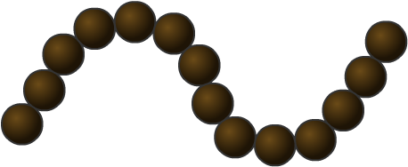
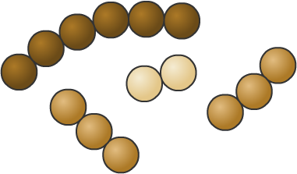
Catalytic cracking
The breakdown of long-chain hydrocarbon molecules into smaller, more useful molecules is called cracking.
During cracking, the molecules break apart, forming smaller alkanes and alkenes.
The presence of the reactive double bond in alkenes makes them useful starting materials.
Alkenes are therefore crucial for the manufacture of commonly used materials and chemicals, such as polymers, fuels and alcohol.
Notes:
Teacher notes
For more information about catalytic cracking and alkenes, please refer to the Cracking Hydrocarbons and Alkenes presentations respectively.

Slide 24
Polymers from alkenes
Polymerization is the reaction used to convert monomers into polymers.
The monomers used are often alkenes, which join together to form long chained polymers.
section of a polymer
Polymers are the basis of plastics and are crucial for the development of packaging, clothing and other materials.
Notes:
Teacher notes
For more information about the production and use of polymers, please refer to the Polymers presentation.

Slide 25
Production and consumption
Notes:
Teacher notes
Students could be asked to analyze and interpret the data provided. They may also like to suggest why it is useful to measure oil consumption per capita as well as by country.
The term “production,” when applied to crude oil, refers to the amount of oil that is extracted from reserves, rather than the literal creation of the substance.
Data credit: ENI 17th World Oil, Gas and Renewables Review Volume 1: World Oil Review 2018 , available at https://www.eni.com/docs/en_IT/enicom/company/fuel-cafe/WORLD-OIL-REVIEW-2018-Volume-1.pdf
This weblink was working at the time of publication. Boardworks cannot be held responsible for the content of external weblinks.

Slide 26
Problems with crude oil
Notes:
Photo credits: no gas © David Falconer. This image is in the public domain; oily bird © wim claes, Shutterstock.com 2018; pharmaceutical factory © Light & Magic Photography, Shutterstock.com 2018

Slide 27
Deepwater Horizon

