Slide 1
Electronic Structure

Slide 2
Information
Asking Questions and Defining Problems
Developing and Using Models
Using Mathematics and Computational Thinking
Obtaining, Evaluating and Communicating Information
1. Patterns
3. Scale, Proportion, and Quantity
4. Systems and System Models
5. Energy and Matter
7. Stability and Change

Slide 3
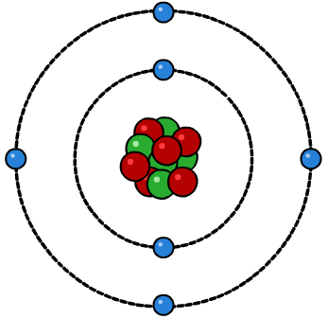
Atomic structure
Everything is made up of atoms. Atoms are the smallest unit of any element and cannot be seen with the naked eye.
electron shell
Atoms have a unique structure. They are made up of a very small core nucleus which contains protons and neutrons. The nucleus is surrounded by electrons which are in fixed energy levels, known as electron shells.
nucleus
This is known as the nuclear model of the atom.
Notes:
Teacher notes
For more information about the development of the current atomic model, please refer to the Atomic Models presentation.
This presentation is accompanied by the worksheet Electronic Structure.
This slide covers the Science and Engineering Practice:
Developing and Using Models: Develop, revise, and/or use a model based on evidence to illustrate and/or predict the relationships between systems or between components of a system.

Slide 4
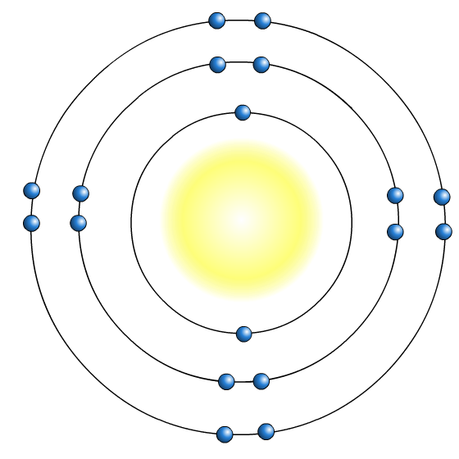
How are electrons arranged?
A Danish scientist called Niels Bohr first suggested that electrons orbit the nucleus in fixed energy levels called shells (energy levels).
1st shell holds a maximum of 2 electrons
Each shell has a maximum number of electrons that it is able to hold. Electrons fill the shells nearest the nucleus first.
2nd shell holds a maximum of 8 electrons
3rd shell holds a maximum of 8 electrons
This electron arrangement is written as 2,8,8.
This is the element argon.
Notes:
This slide covers the Science and Engineering Practice:
Developing and Using Models: Develop, revise, and/or use a model based on evidence to illustrate and/or predict the relationships between systems or between components of a system.

Slide 5
How are electrons arranged? (2)
Notes:
Teacher notes
Students should understand that the electrons fill the lowest energy levels first - those closest to the nucleus.
Note that the diagram is not drawn to scale – the atom is mostly empty space. If the electron shells were the size shown, the nucleus would be too small to see.

Slide 6
The periodic table and electron arrangement
The elements in the periodic table are arranged in order of increasing atomic number.
atomic number = number of protons
number of protons = number of electrons
atomic number = number of electrons
As atomic number increases by one, the number of electrons also increases by one.
Therefore, the elements in the periodic table are also arranged in order according to the number of electrons.

Slide 7
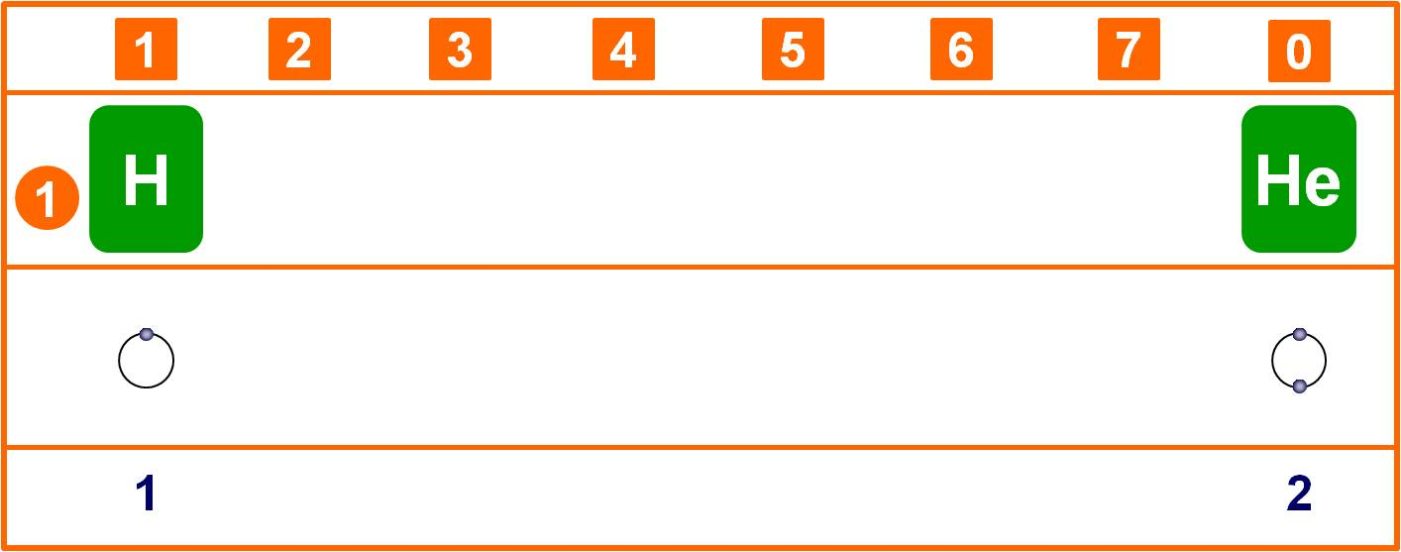
Electrons in period 1
Elements in period 1 only have electrons in the first shell.
Why are there only two elements in period 1?
The first shell can hold a maximum of two electrons,
so period 1 only includes the elements hydrogen and helium.
What is special about the outer shell of helium?
Notes:
Teacher notes
The outer shell of helium is full and it is therefore a noble gas (extremely unreactive).
This slide covers the Science and Engineering Practice:
Asking Questions and Defining Problems: Ask questions that arise from examining models or a theory, to clarify and/or seek additional information and relationships.

Slide 8
Electrons in period 2
Elements in period 2 all have a complete first shell.
What happens to electrons in the second shell in period 2?
1
2
3
4
5
6
7
0
2
Li
Be
B
C
N
O
F
Ne
2,1
2,2
2,3
2,4
2,5
2,6
2,7
2,8
The second shell is filled across the period from left to right.
What is special about the outer shell of neon?
Notes:
Teacher notes
The outer shell of neon is full and it is therefore a noble gas (extremely unreactive).
This slide covers the Science and Engineering Practice:
Asking Questions and Defining Problems: Ask questions that arise from examining models or a theory, to clarify and/or seek additional information and relationships.

Slide 9
Electrons in period 3
Elements in period 3 have complete first and second shells.
What happens to electrons in the third shell in period 3?
1
2
3
4
5
6
7
0
3
Na
Mg
Al
Si
P
S
Cl
Ar
2,8,1
2,8,2
2,8,3
2,8,4
2,8,5
2,8,6
2,8,7
2,8,8
The third shell is filled across the period from left to right.
What is special about the outer shell of argon?
Notes:
Teacher notes
The outer shell of argon is full and it is therefore a noble gas (extremely unreactive).
This slide covers the Science and Engineering Practice:
Asking Questions and Defining Problems: Ask questions that arise from examining models or a theory, to clarify and/or seek additional information and relationships.

Slide 10
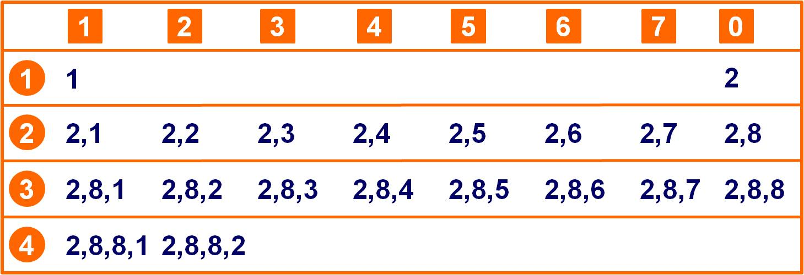
Patterns of electron arrangement
Consider the electron arrangements of the first 20 elements in the periodic table.
What is the pattern of outer shell electrons in a group?
What is the pattern of outer shell electrons across a period?
What is the pattern of full electron shells in a group?
Notes:
Teacher notes
There are the same number of outer shell electrons for every element in a group.
Across a period, the number of outer shell electrons increases by 1 until the outer shell is full. The elements in a period all have the same number of shells.
The number of complete electron shells increases by 1 as you go one element down a group.
This slide covers the Science and Engineering Practices:
Asking Questions and Defining Problems: Ask questions to clarify and refine a model, an explanation, or an engineering problem.
Using Mathematics and Computational Thinking: Use mathematical, computational, and/or algorithmic representations of phenomena or design solutions to describe and/or support claims and/or explanations.

Slide 11
Electron trends in the periodic table
Trends down a group:
the number of outer shell electrons is the same
the number of complete electron shells increases by one.
The number of a group is the same as the number of electrons in the outer shell of elements in that group, except for group 0.
Trends across a period:
the number of outer shell electrons increases by one
the number of complete electron shells stays the same.
The point at which a new period starts is the point at which electrons begin to fill a new shell.
Notes:
Teacher notes
The trends are helpful for students to check that the electronic structure they have calculated from an element’s atomic number is correct.
This slide covers the Science and Engineering Practice:
Developing and Using Models: Develop, revise, and/or use a model based on evidence to illustrate and/or predict the relationships between systems or between components of a system.

Slide 12
Calculating electronic structure
Notes:
Teacher notes
This activity could be used to check students’ understanding of electron arrangement and how to use the atomic number to work out the number of electrons in an element and therefore the electronic structure.
This slide covers the Science and Engineering Practice:
Obtaining, Evaluating, and Communicating Information: Communicate scientific and/or technical information or ideas (e.g. about phenomena and/or the process of development and the design and performance of a proposed process or system) in multiple formats (including orally, graphically, textually, and mathematically).

Slide 13
What’s the electron arrangement?
Notes:
Teacher notes
This quiz could be used as a introductory or summary activity to check students’ understanding of the electron configuration in the periodic table. Colored traffic light cards could be used with this activity to increase class participation.

Slide 14
Which element?
Notes:
Teacher notes
This activity could be used to check students’ understanding of the relationship between atomic number and an element’s electronic structure.

