Slide 1
Electrolysis

Slide 2
Information
Developing and Using Models
Planning and Carrying Out Investigations
6. Structure and Function

Slide 3
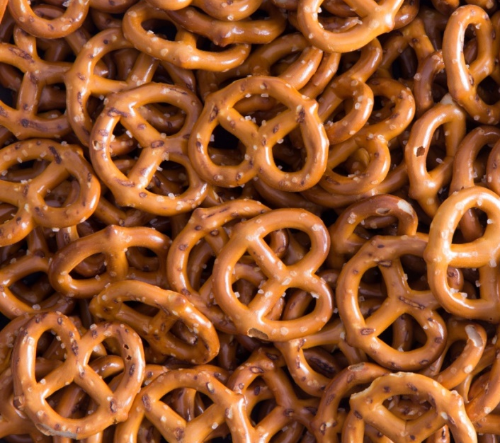
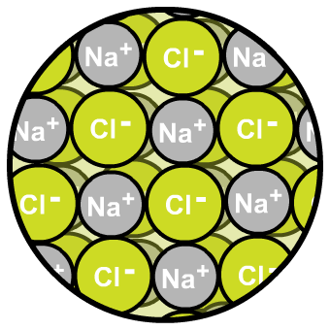
What are ionic compounds?
Ionic compounds are made up of positive ions and negative ions. What ions are in sodium chloride, NaCl?
positive sodium ions
negative chloride ions
The positive and negative ions in an ionic compound attract each other strongly. It takes a lot of energy to separate them.
When an ionic substance is melted or dissolved in water, the ions are free to move about within the liquid or solution.
Notes:
Photo credit: salted pretzels © Ozgur Coskun, Shutterstock.com 2018

Slide 4
What is electrolysis?
An ionic compound can be split into its elements by passing an electric current through it. This is electrolysis. The substance the electric current passes through is called the electrolyte.
An ionic compound contains charged particles called ions. An ion is an atom that has gained or lost electrons and so carries a positive or negative charge. This charge is shown after its formula.
aluminum atom
loses 3 electrons
aluminum ion
Ions with a positive charge have lost electrons, and ions with a negative charge have gained electrons.
Notes:
Teacher notes
Electrolysis may also be described as the decomposition of an electrolyte with an electric current.
For more information about ions, please refer to the Ionic Bonding presentation.

Slide 5
Do molten ionic compounds conduct?
Notes:
This slide covers the Science and Engineering Practice:
Planning and Carrying Out Investigations: Plan an investigation or test a design individually and collaboratively to produce data to serve as the basis for evidence as part of building and revising models, supporting explanations for phenomena, or testing solutions to problems. Consider possible variables or effects and evaluate the confounding investigation’s design to ensure variables are controlled.

Slide 6
Do dissolved ionic compounds conduct?
Notes:
This slide covers the Science and Engineering Practice:
Planning and Carrying Out Investigations: Plan an investigation or test a design individually and collaboratively to produce data to serve as the basis for evidence as part of building and revising models, supporting explanations for phenomena, or testing solutions to problems. Consider possible variables or effects and evaluate the confounding investigation’s design to ensure variables are controlled.

Slide 7
Does it conduct electricity?
Notes:
Teacher notes
Appropriately colored voting cards could be used with this classification activity to increase class participation.

Slide 8
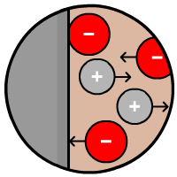
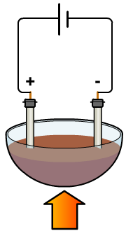
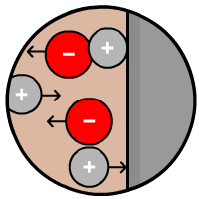
Movement of ions during electrolysis
During electrolysis an electric current is passed through a substance using electrodes.
Negative ions move
to the positive electrode (anode) and lose electrons. This is oxidation.
Positive ions move to the negative electrode (cathode) and gain electrons. This is reduction.
Non-metal elements form at the positive electrode.
Metal elements form at the negative electrode.
heat
Notes:
Teacher notes
Metals ions, such as sodium, magnesium and iron, are positive, and so will move to the negative electrode.
Non-metal ions, such as chlorine, oxygen and nitrogen, are negative, and so will move to the positive electrode.

Slide 9
OILRIG
An easy way to remember what happens to the electrons during oxidation and reduction is to think OIL RIG:
Equations written to show what happens to electrons during oxidation or reduction are called half-equations.
Notes:
This slide covers the Science and Engineering Practice:
Developing and Using Models: Develop, revise, and/or use a model based on evidence to illustrate and/or predict the relationships between systems or between components of a system.

Slide 10
Electrolysis of molten lead bromide

Slide 11
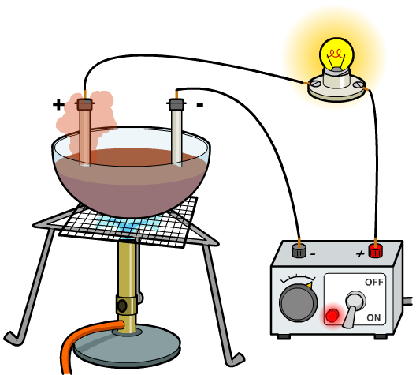
Electrolysis of molten PbBr₂ – half equations
What happens at the electrodes during electrolysis can be described using redox equations, also called half equations.
At the negative electrode: Pb²⁺ + 2e– → Pb (reduction)
At the positive electrode: 2Br – → Br₂ + 2e– (oxidation)
What is the overall equation for the electrolysis of molten lead bromide?
Notes:
This slide covers the Science and Engineering Practice:
Developing and Using Models: Develop, revise, and/or use a model based on evidence to illustrate and/or predict the relationships between systems or between components of a system.

Slide 12
Balancing half equations
Notes:
Teacher notes
This fill-in-the-blanks activity could be used as an introductory or summary exercise on half equations.

Slide 13
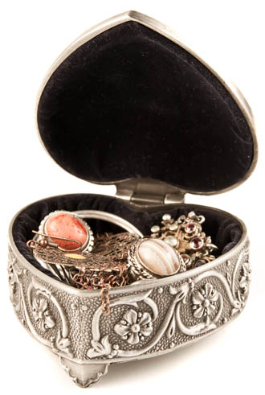
Use of electrolysis
Electrolysis has many uses, including:
purifying copper
plating metals with silver and gold
extracting reactive metals, such as aluminum
making chlorine, hydrogen and sodium hydroxide.
Electrolysis is often used to electroplate objects. Copper plating of coins and silver plating of jewelry are particularly common uses.
Notes:
Teacher notes
Electroplating is achieved by placing an object in an electrolyte bath containing ions of the plating metal. The object that is to be plated is negatively charged, making it the negative electrode. Positive metal ions are attracted to the negative electrode, where they gain electrons. As these ions gain electrons and become stable, they form a metal plating on the outside of the object.
Photo credit: © raresirimie, Shutterstock.com 2018

Slide 14
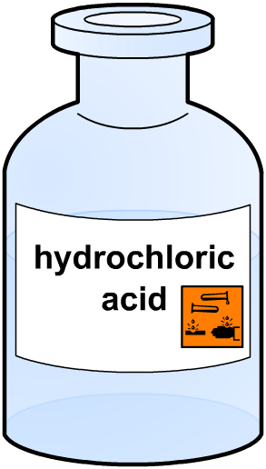
Splitting water by electrolysis
Electrolysis can be used to split water (H₂O) into its elements, hydrogen and oxygen.
Water is a covalent compound, and so is a poor conductor of electricity. However, it does contain a few free H⁺ and OH– ions: H₂O (l) → H⁺ (aq) + OH–(aq).
The conductivity of water can be improved by adding an acid, such as dilute sulfuric or hydrochloric acid. This releases more ions so that more current flows during electrolysis.
Notes:
Teacher notes
This is how hydrogen for fuel cells can be made, and how oxygen can be produced from water on spacecraft.

Slide 15
Using hydrochloric acid
Notes:
Teacher notes
This experiment shows that if the hydrochloric acid is a more concentrated solution, hydrogen and chlorine are formed because the chlorine ions are preferentially discharged over the hydroxide ions at the negative electrode. This may be described as the electrolysis of hydrochloric acid. Students are not expected to give explanations of the reactions at the electrodes, but should be able to recall that the electrolysis of dilute hydrochloric acid produces hydrogen and chlorine.
If the hydrochloric acid is more diluted, so that there is more water than chlorine, hydrogen and oxygen are formed, because in this scenario the hydroxide ions are preferentially discharged. This may be described as the electrolysis of water. Students may be expected to recall that the electrolysis of water produces hydrogen and oxygen. In this experiment, the dilute hydrochloric acid is used to speed up the electrolysis process. Without the dilute hydrochloric acid, the water could still be split by electrolysis, but it would be a very lengthy process.

Slide 16
Redox equations
What happens at the electrodes during the electrolysis of water?
At the negative electrode: 2H⁺ + 2e– → H₂ (reduction)
At the positive electrode: 4OH– → 2H₂O + O₂ + 4e– (oxidation)
What is the overall equation for the electrolysis of water?
Twice as much hydrogen forms as oxygen. Why is this?
Notes:
Teacher notes
In water, there are two hydrogen atoms for every oxygen atom, so the ratio by volume of H₂ to O₂ is 2:1.
This slide covers the Science and Engineering Practice:
Developing and Using Models: Develop, revise, and/or use a model based on evidence to illustrate and/or predict the relationships between systems or between components of a system.

