Slide 1
Cracking Hydrocarbons

Slide 2
Information
Developing and Using Models
Constructing Explanations and Designing Solutions
1. Patterns
2. Cause and Effect

Slide 3
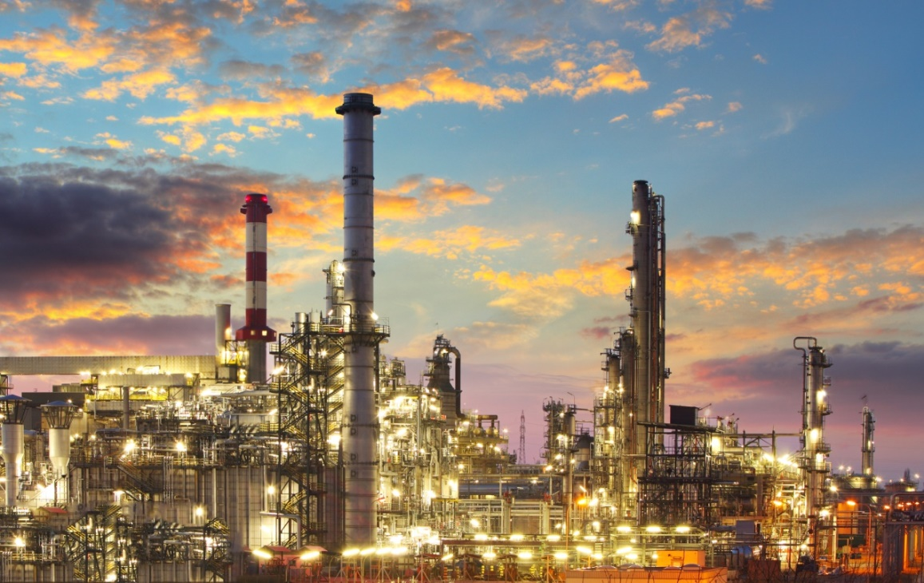
What is crude oil?
Crude oil is a hydrocarbon (it contains only hydrogen and carbon atoms). Crude oil itself has no uses – it must first be processed and refined. This is done in an oil refinery.
During the refining of crude oil, compounds in the oil are separated into similar groups called fractions.
Each fraction contains a mix of compounds with a similar number of carbon atoms.
Notes:
This presentation is accompanied by the worksheet Cracking Hydrocarbons.
Photo credit: oil refinery © Ttstudio, Shutterstock.com 2018

Slide 4
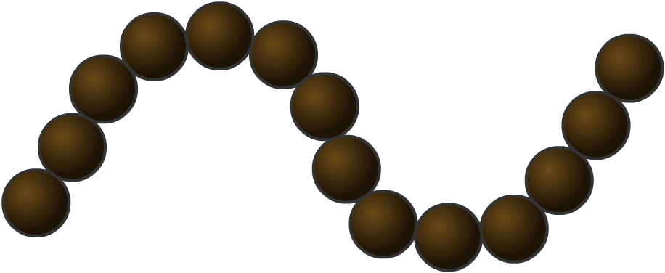
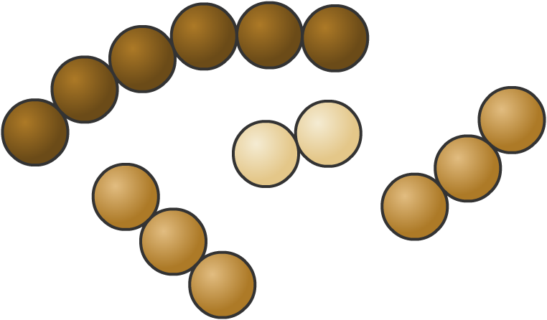
Supply and demand
The amount of each type of fraction obtained by fractional distillation does not usually match the amount of each fraction that is needed.
Crude oil often contains a greater quantity of heavier fractions than lighter fractions. Lighter fractions are more useful and therefore more in demand.
The large hydrocarbon molecules in the heavier fractions can be broken down into smaller, more useful molecules. This is called cracking.
Notes:
Teacher notes
For more information about fractions and fractional distillation please refer to the Fractional Distillation presentation.

Slide 5
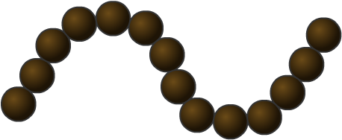
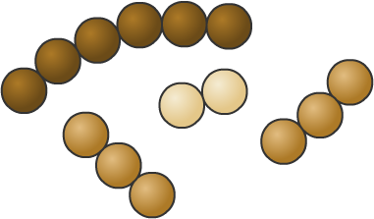
Catalytic cracking
Long-chain hydrocarbon molecules can be broken down into smaller, more useful molecules using a catalyst.
This is called catalytic cracking and is an example of a thermal decomposition reaction.
Catalytic cracking requires:
high temperatures
a catalyst.
During cracking, the long molecules break apart, forming smaller alkanes and alkenes. Alkenes are reactive molecules that are used to make plastics and other chemicals.
Notes:
Teacher notes
It may be worth pointing out to students that the molecules crack – rather than burn – when heated, because oxygen is kept out of the reaction vessel.

Slide 6
How does catalytic cracking work?
Notes:
Teacher notes
This six-stage interactive animation shows how catalytic cracking is used on an industrial scale to break down large fractions into smaller, more useful fractions. Suitable prompts could include:
Which fractions of oil would it be best to crack?
What makes the hydrocarbon molecules break up?
Would you expect all the products to be the same?
How could you separate the mixture of alkanes and alkenes produced?
Would you expect the catalyst to be used up during the reaction?
This slide covers the Science and Engineering Practices:
Developing and Using Models: Use a model to provide mechanistic accounts of phenomena.
Constructing Explanations and Designing Solutions: Apply scientific ideas, principles, and/or evidence to provide an explanation of phenomena and solve design problems, taking into account possible unanticipated effects.

Slide 7
Catalytic cracking in the lab

Slide 8
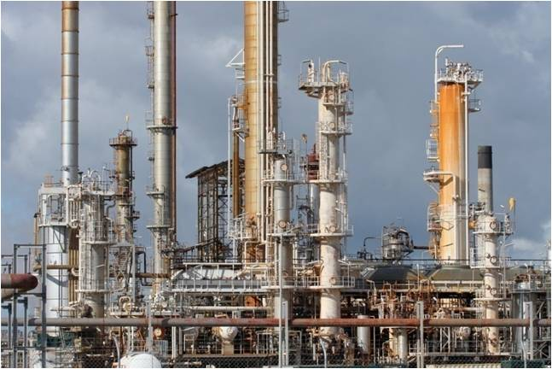
Steam cracking
Another method of cracking hydrocarbons uses steam.
This is an uncatalyzed method of breaking down the hydrocarbons.
The fractions, containing gaseous hydrocarbon molecules, are mixed with steam and heated to very high temperatures – over 800 °C!
This results in the breaking of the covalent bonds in the hydrocarbon molecules.
This is also an example of thermal decomposition.
Notes:
Photo credit: Industrial plant © Joe Gough, Shutterstock.com 2018

Slide 9
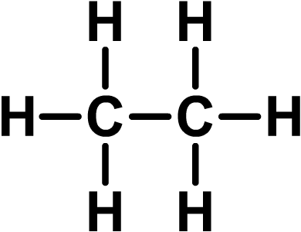
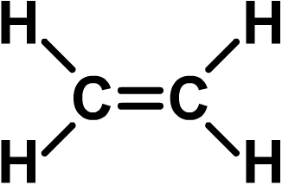
Products of cracking hydrocarbons
The products of catalytic cracking include smaller alkanes and alkenes.
Alkanes are a type of hydrocarbon compound with the general formula C_{n}H_{2n+2}, such as C₂H₆ (ethane).
Alkenes are a family of hydrocarbon compounds with the general formula C_{n}H_{2n}, such as C₂H₄ (ethene).
Notes:
Teacher notes
For more information about alkenes please refer to the Alkenes presentation.

Slide 10
Alkanes or alkenes?

Slide 11
What are alkenes?
Alkanes contain chains of carbon atoms joined by single carbon–carbon covalent bonds. This means that they are saturated hydrocarbons.
Alkenes are very similar to alkanes, but they contain at least one double covalent bond between the carbon atoms. This means that they are unsaturated hydrocarbons.
The double covalent bond in alkenes makes them much more reactive than alkanes.
double covalent bond
The simplest alkene is ethene. It has the formula C₂H₄.
Notes:
Teacher notes
The alkenes are a homologous series and it should be pointed out to students that the general formula allows the molecular formula of any alkene to be determined. The naming of alkenes could also be introduced, making it clear that all alkenes end in “-ene.” The start of the name denotes the number of carbon atoms in each molecule.

Slide 12
Testing for alkenes

Slide 13
Alkane or alkene?
Notes:
Teacher notes
This activity could be used as an introductory or summary activity on alkanes and alkenes, or at the start of the lesson to gauge students’ existing knowledge of the subject matter. Colored traffic light cards (red = alkene, green = alkane) could be used to make this a whole-class exercise.

Slide 14
Chemical reactions of cracking
Multiple reactions occur at random during cracking. This produces a range of different short chain products.
One example is the cracking of nonane, C₉H₂₀.
nonane
propene
+
hextane
The balanced equation for this reaction would be:
C₉H₂₀
C₃H₆
+
C₆H₁₄
Nonane can also be cracked into other products.
What other combinations of products could be formed from cracking nonane?
Notes:
Teacher notes
Nonane could also be split into ethene, ethane and propene.

Slide 15
Cracking nonane – what’s the product? (1)
Nonane could also be split into two molecules of ethene and one molecule of ethane.
nonane
C₉H₂₀
+
+
+
?
ethene
ethene
ethane
The number of carbon and hydrogen atoms in the products must equal that in the reactant.
What is the third product in the reaction?
Notes:
Teacher notes
The third product in the reaction is propene, C₃H₆.

Slide 16
Cracking nonane – what’s the product? (2)
Compare the number of carbon and hydrogen atoms in the products with that found in nonane, C₉H₂₀.
2 molecules of ethene:
number of carbon atoms: 4
number of hydrogen atoms: 8
1 molecule of ethane:
number of carbon atoms: 2
number of hydrogen atoms: 6
Total number of carbon atoms in products: 4 + 2 = 6
Total number of hydrogen atoms in products: 8 + 6 = 14

Slide 17
Cracking nonane – what’s the product? (3)
There are 9 carbon atoms in nonane; this means that the number of carbon atoms in the third product equals:
9 – 6 = 3
There are 20 hydrogen atoms in nonane; this means that the number of hydrogen atoms in the third product equals:
20 – 14 = 6
The formula for the third product is therefore:
C₃H₆
The full equation for the cracking of nonane is:
C₉H₂₀
2C₂H₄
+
C₂H₆
+
C₃H₆
Is the equation balanced?
Notes:
Teacher notes
Note that the 3 carbon atoms were calculated on the previous slide by adding up the total number of carbon atoms in the products. The 14 hydrogen atoms were calculated on the previous slide by adding up the total number of hydrogen atoms in the products.

Slide 18
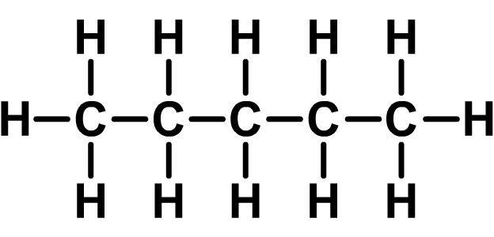
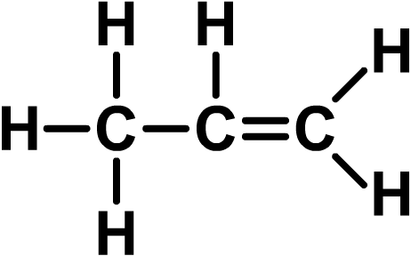
Cracking decane
Another example is decane, from the naphtha fraction. This can be cracked to form pentane, propene and ethene.
decane (C₁₀H₂₂)
+
+
pentane
propene
ethene
What is the symbol equation for this reaction?
Notes:
Teacher notes
Balanced symbol equation: C₁₀H₂₂ → C₅H₁₂+ C₃H₆ + C₂H₄

Slide 19
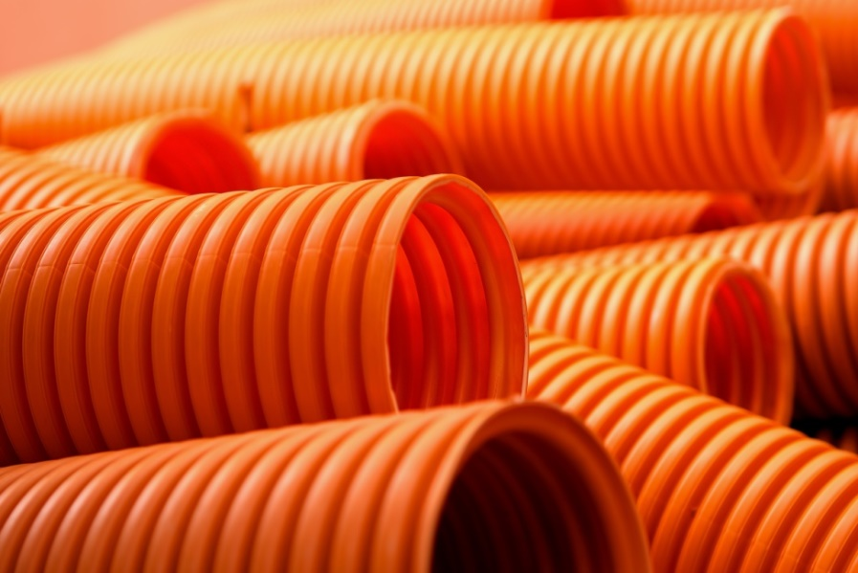
Alkenes and polymers
Cracking converts less useful alkanes into more useful alkenes.
The presence of the reactive double bond in alkenes makes them useful starting materials.
Alkenes are therefore crucial for the manufacture of commonly used materials and chemicals.
Alkenes can be used to make:
polymers e.g. PVC and polyethene
fuels
alcohols and other industrial chemicals.
Notes:
Photo credit: plastic pipes © ArtWell, Shutterstock.com 2018

Slide 20
Polymers
Polymerization is the reaction used to convert monomers into polymers.
The monomers used are often alkenes, which join together to form long chained polymers.
Polymers are the basis of plastics and are crucial for the development of packaging, clothing and other materials.
section of a polymer
Notes:
Teacher notes
For more information about polymers please refer to the Polymers presentation.

Slide 21
How is polyethene made?
Notes:
Teacher notes
This interactive animation illustrates the formation of low-density polyethene as an example of addition polymerization. Suitable prompts could include:
What special property of ethene enables it to be used in making polymers?
What has to happen to start the process?
Why is the process called addition polymerization?
This slide covers the Science and Engineering Practices:
Developing and Using Models: Use a model to provide mechanistic accounts of phenomena.
Constructing Explanations and Designing Solutions: Apply scientific ideas, principles, and/or evidence to provide an explanation of phenomena and solve design problems, taking into account possible unanticipated effects.

