Slide 1
Chromatography

Slide 2
Information
Analyzing and Interpreting Data
Using Mathematics and Computational Thinking
Constructing Explanations and Designing Solutions
1. Patterns

Slide 3
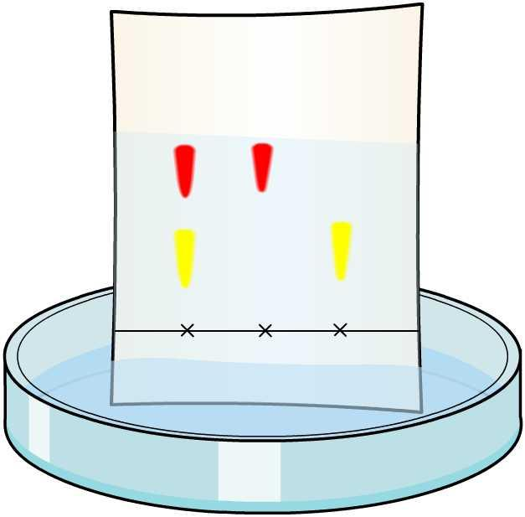
What is chromatography?
Different instrumental methods can be used to analyze and identify the different components in a mixture.
The sensitivity, accuracy and speed of these methods are important, particularly when the mass or concentration of a substance is very small.
Chromatography is one such method, and is used to separate a mixture into its different components.
There are different types of chromatography, including paper and thin layer chromatography.

Slide 4
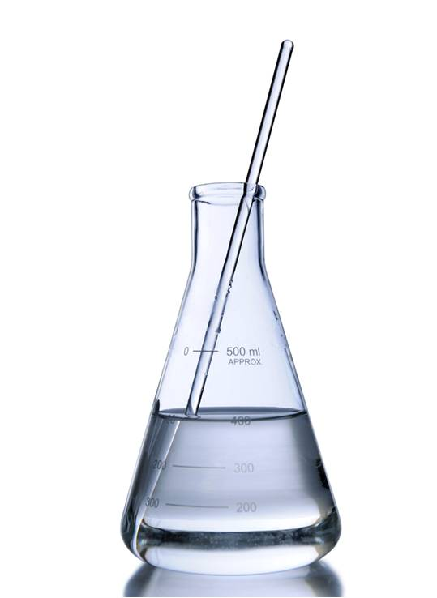
How chromatography works
In all types of chromatography, two phases are present:
stationary phase: a solid or liquid
mobile phase: a liquid or a gas that flows over the stationary phase.
The mobile phase acts as a solvent. This means that the substance to be tested dissolves in the mobile phase.
If a liquid solvent is used, it can be either aqueous (water) or non-aqueous (not water). Examples of non-aqueous solvents include alcohols.
Notes:
Photo credit: © R Gino Santa Maria, Shutterstock.com 2018

Slide 5
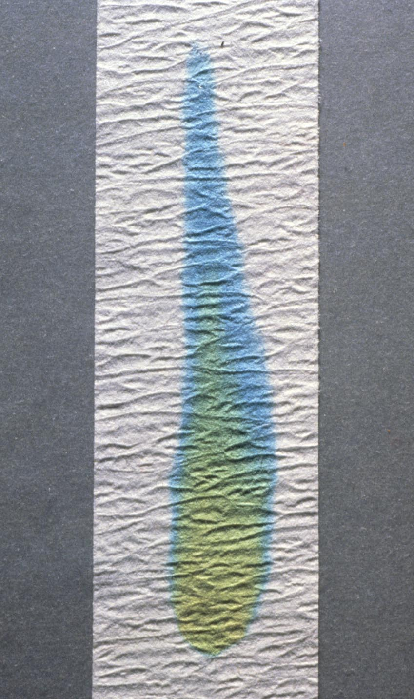
Movement between the phases
The mobile phase contains the dissolved components of a mixture. It flows up the stationary phase, carrying the different components.
This allows the two phases to exchange components.
Components in the mobile phase can attach to the stationary phase.
However, this attachment is only temporary, which means it slows the movement of the components along the stationary phase.
Notes:
Teacher notes
This photo shows simple paper chromatography of some green food coloring. The yellow dye in the coloring favors the stationary phase while the blue dye in the coloring favors the mobile phase and travels further up the paper.
This slide covers the Science and Engineering Practice:
Constructing Explanations and Designing Solutions: Apply scientific ideas, principles, and/or evidence to provide an explanation of phenomena and solve design problems, taking into account possible unanticipated effects.
Photo credit: © Fundamental Photos / Science Photo Library

Slide 6
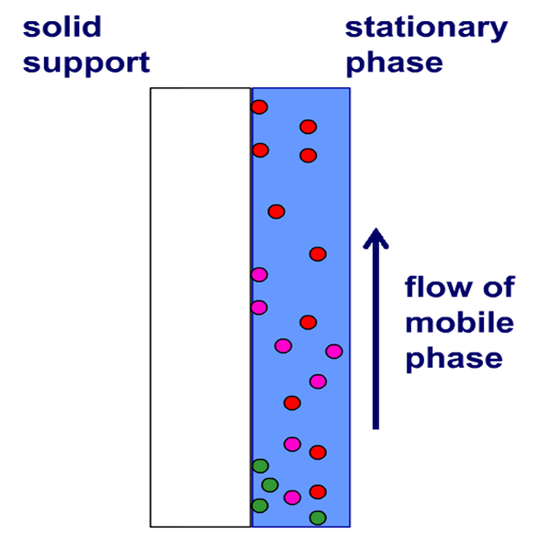
Separating components
The different components of a mixture interact with both phases to a different extent.
If a component is more strongly attracted to the stationary phase, its movement through the stationary phase will be slowed.
Components that are more attracted to the mobile phase than the stationary phase will stay dissolved for longer.
This is the basis for separating the components of a mixture.
The separation of components is dependent on the distribution of the components between the two phases.
Notes:
Teacher notes
The diagram shows the movement of components during thin layer chromatography. The silica gel is the stationary phase which is attached to a solid support, usually a glass plate. The green components have the highest attraction for the stationary phase, as they are traveling the slowest. The red components have the lowest attraction for the stationary phase, as they are traveling the fastest, and so travel the furthest.
This slide covers the Science and Engineering Practice:
Constructing Explanations and Designing Solutions: Apply scientific ideas, principles, and/or evidence to provide an explanation of phenomena and solve design problems, taking into account possible unanticipated effects.

Slide 7
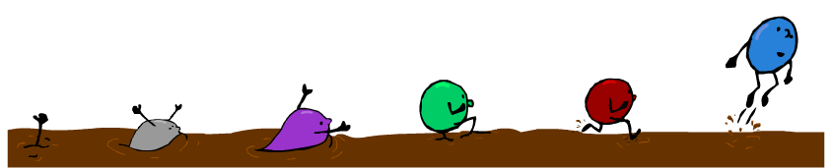
Different rates of travel
The speed at which the different components of a mixture travel up the stationary phase depends on two factors:
the solubility of the component in the solvent (mobile phase) – how easily it dissolves
the attraction of the component for the stationary phase.
The weaker the attraction for the stationary phase, the faster the component travels and the further along the stationary phase it is found.
Notes:
Teacher notes
The cartoon represents chromatography. The stationary phase (the mud) slows the molecules by differing amounts. This causes them to separate by type so that those least affected by the stationary phase travel further.
The level of attraction of a component for the stationary of mobile phase is called affinity.

Slide 8
Chromatography: recap activity
Notes:
Teacher notes
This activity could be used to assess students’ knowledge of chromatography before teaching the topic in detail.

Slide 9
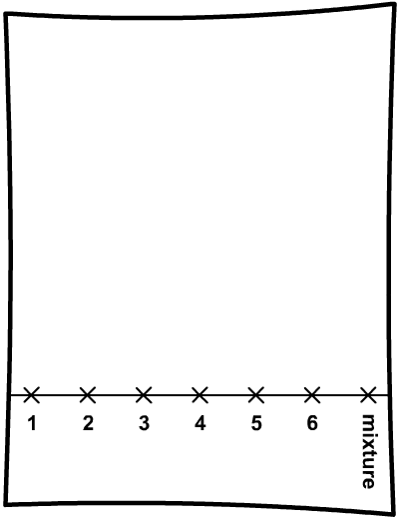
Paper chromatography
Paper chromatography is used to separate and identify components of mixtures.
Dots of single dyes are placed alongside a dot of the unknown mixture.
The solvent is drawn up the paper by capillary action.
As the solvent moves up the paper, the pattern of the single dyes can be compared to that of the mixture.
Which dyes are present in this mixture?
Notes:
Teacher notes
The mixture contains dyes 3 and 5.
Students should be made aware that the paper is the stationary phase, and the solvent is the mobile phase.
Capillary action is the movement of water up a substance due to forces of attraction between the liquid and the surface of the substance.

Slide 10
Which ink do you think?
Notes:
Teacher notes
This virtual experiment illustrates how chromatography can be used to identify an unknown substance. It could be used as a precursor to running a practical in the lab, perhaps involving food colorings, or as a summary exercise.

Slide 11
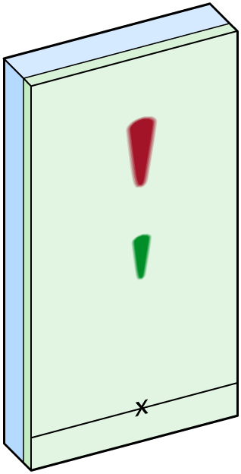
Thin layer chromatography
Remember, all types of chromatography involve a stationary phase and a mobile phase.
glass plate
In thin layer chromatography (TLC) the stationary phase is a layer of silica gel fixed onto a plate. The plate can be glass, foil or plastic.
silica gel
The mobile phase is a solvent that travels up the plate, carrying the substances.

Slide 12
How does TLC work?
TLC uses the same basic principle as paper chromatography: capillary action draws the solvent up the plate.
A dry sample of the mixture of interest is placed in the silica gel. As the solvent moves up the gel, it dissolves the sample and carries it up the plate.
The distance each component travels depends on its attraction to the gel. This depends on the interaction between the solvent, component and gel.

Slide 13
TLC or paper chromatography?
Thin layer chromatography has a number of advantages over paper chromatography.
The glass plate is rigid, not flexible like paper, so it is easy to control.
Separation is more efficient due to the smaller particle size of the stationary phase.
TLC results are easily reproducible.
Following TLC, the substances in the mixture can be recovered and the glass plates used again.

Slide 14
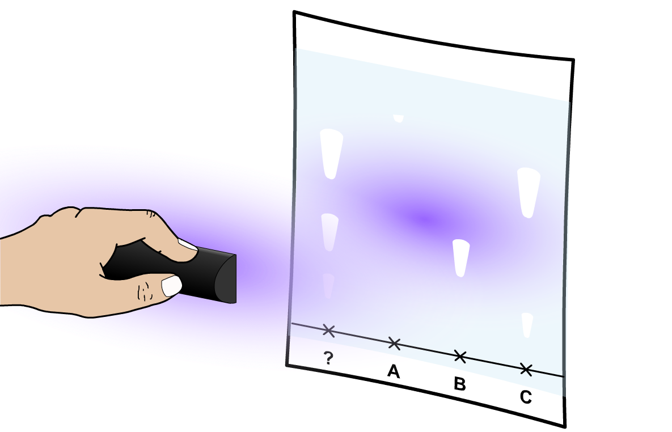
UV and locating agents
Many substances are white or colorless, and so are not visible on a TLC plate.
One way of making colorless substances show up is to use UV light.
An alternative method is to use a chemical locating agent which binds to the substance in the spot. A second chemical is then added; this reacts with the locating agent to form a colored compound.

Slide 15
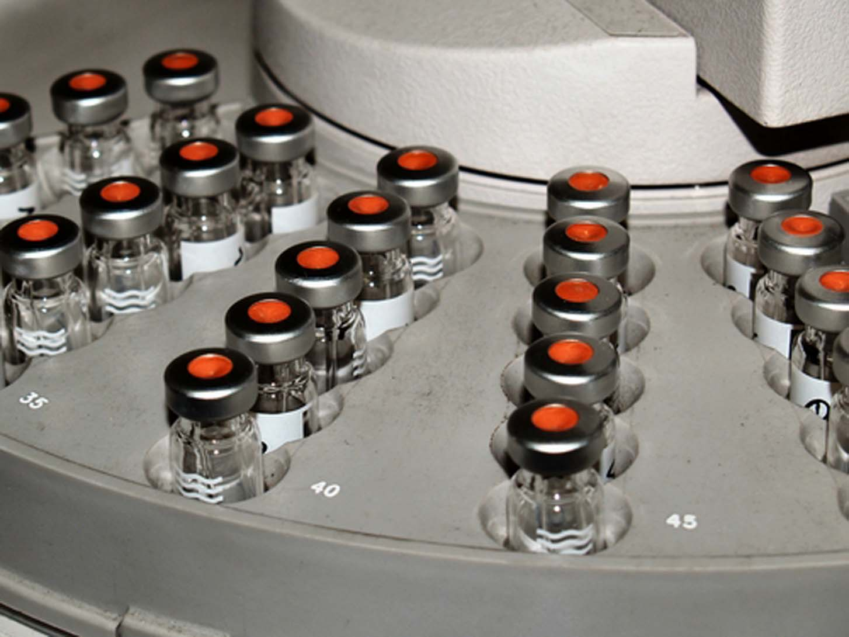
Gas chromatography
Gas chromatography (GC) is used widely in many analytical laboratories, including forensic police labs, synthetic chemical labs, and drugs testing labs.
In paper and thin layer chromatography, the mobile phase is a liquid.
However, the mobile phase in gas chromatography is an inert gas. The stationary phase is usually a long thin tube of silica gel.
Notes:
Photo credit: © Dermot McBrierty, Shutterstock.com 2018

Slide 16
How does gas chromatography work?
Like all forms of chromatography, GC uses a stationary phase to impede the movement of a mobile test substance.
Different substances are attracted to the matrix by different amounts, and therefore journey along it at different speeds.
In GC, the sample is injected into the machine, where it is vaporized. It is then washed over the matrix by an inert gas.
Some substances will be more attracted to the matrix than others. These will take much longer to reach the detector.
The detector measures the abundance of a substance at a given time, and this data is plotted on a graph.

Slide 17
Using gas chromatography
Notes:
Teacher notes
Each peak on the graph represents a different substance. Substances with a low attraction to the stationary phase will reach the detector sooner than those which are highly attracted. The area under each peak determines the overall quantity of a substance.
This slide covers the Science and Engineering Practice:
Analyzing and Interpreting Data: Analyze data using tools, technologies, and/or models (e.g., computational, mathematical) in order to make valid and reliable scientific claims or determine an optimal design solution.

Slide 18
R_{f} values
Notes:
This slide covers the Science and Engineering Practices:
Using Mathematics and Computational Thinking: Use mathematical, computational, and/or algorithmic representations of phenomena or design solutions to describe and/or support claims and/or explanations.
Using Mathematics and Computational Thinking: Apply ratios, rates, percentages, and unit conversions in the context of complicated measurement problems involving quantities with derived or compound units (such as mg/mL, kg/m3, acre-feet, etc.).

Slide 19
Calculating R_{f} values
Notes:
This slide covers the Science and Engineering Practice:
Using Mathematics and Computational Thinking: Apply ratios, rates, percentages, and unit conversions in the context of complicated measurement problems involving quantities with derived or compound units (such as mg/mL, kg/m3, acre-feet, etc.).

Slide 20
Reference materials
Scientists can compare the R_{f} value of an unknown compound to R_{f} values of known compounds of that type.
amino acid
R_{f} value
The R_{f} values of compounds such as amino acids are published in data books.
alanine
0.38
serine
0.27
leucine
0.75
The amino acids present in a mixture can be identified by comparing the R_{f} values calculated from a chromatogram to those in the data book.
lysine
0.14
valine
0.61
phenylalanine
0.68
glycine
0.26
cysteine
0.40

Slide 21
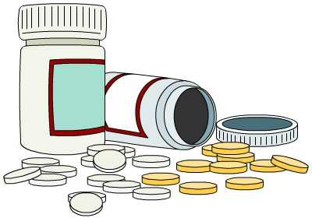
Pure or impure?
A mixture consists of more than one component. It can be referred to as impure. An example is the air, which is a mixture of different gases.
Many consumer products, such as drugs, must not contain impurities. Drugs are often mixtures of multiple pure substances that have been specifically combined.
A pure sample consists of only one element or compound. It has no impurities.
It is important to be able to test a product for impurities using methods such as chromatography.

Slide 22
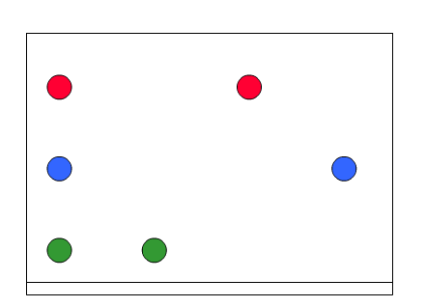
Testing for purity
As well as identifying components in a mixture, chromatography can be used to determine if a substance is pure.
A pure sample can easily be visualized as a single spot on the chromatogram.
In contrast, an impure sample, composed of different substances, will be seen as multiple spots on a chromatogram.
mixture
pure samples
In the above diagram, what might the pure samples be used for?
Notes:
Teacher notes
The pure samples can be used as references for the different components of the mixture and the R_{f} values can be calculated and compared in order to identify the unknown components. For example, if you want to know which amino acids are present in a sample, you can compare the mixture of unknown amino acids with pure samples of known amino acids.

Slide 23
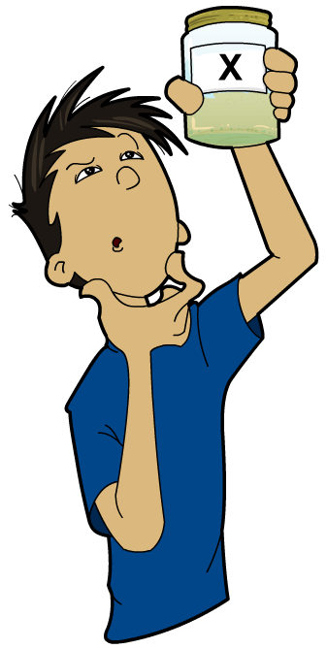
Changing the solvent
Changing the solvent can be useful for identifying different components in a mixture.
Different solvents separate mixtures differently, producing different patterns of spots.
This means that different R_{f} values are obtained in different solvents.
This is useful as some components may not be soluble in the same solvent or may have similar R_{f} values in one solvent.
What effect would using different solvents on a pure sample have?
Notes:
Teacher notes
The solvent can be changed to enhance the separation of the components. It is often a case of trial and error to find the right solvent for the mixture. This can help to identify the different components of a mixture.
A pure sample consists of only one component. This means that only one dot will be seen on the chromatograph, no matter what solvent is used!

Slide 24
Chromatography: review activity
Notes:
Teacher notes
Statement 5: Students should be aware that a chemical’s R_{f} value can vary with the solvent used. It is possible that two different chemicals may have the same (or very similar) R_{f} values in the same solvent. It is important that a sample is tested with at least two solvents to confirm the number of constituent parts. Two-way chromatography is the standard method for this.

