Slide 1
Atomic Models

Slide 2
Information
Developing and Using Models
Constructing Explanations and Designing Solutions
4. Systems and System Models

Slide 3
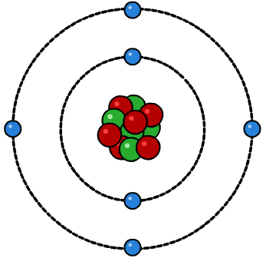
Introduction to atoms
Everything is made up of atoms. Atoms are the smallest unit of any element and cannot be seen.
Atoms of different elements can combine to make new substances. Like this, we can make all of the materials on the planet!
electron shell
nucleus
They are made up of a core nucleus which contains protons and neutrons. The nucleus is surrounded by electrons which are in electron shells.
Notes:
This presentation is accompanied by the worksheet Atomic Models.
This slide covers the Science and Engineering Practice:
Using Mathematics and Computational Thinking: Apply techniques of algebra and functions to represent and solve scientific and engineering problems.

Slide 4
How big are atoms?
Atoms have a diameter of about 1 × 10^{–10} meters (m), or 0.1 nanometers (nm), which is far too small to be seen with the naked eye.
Within atoms are smaller, subatomic particles called neutrons, protons and electrons.
The nucleus, which contains neutrons and protons is 1/10,000 the size of the atom and has a diameter of about 0.00001 nm.

Slide 5
Atomic zoom
Notes:
Teacher notes
centi (c) = 10–²
milli (m) = 10^{–3}
micro (µ) = 10–⁶
nano (n) = 10^{–9}

Slide 6
Size of particles

Slide 7
Who discovered the atom?
Notes:
This slide covers the Science and Engineering Practices:
Developing and Using Models: Evaluate merits and limitations of two different models of the same proposed tool, process, mechanism, or system in order to select or revise a model that best fits the evidence or design criteria.
Constructing Explanations and Designing Solutions: Apply scientific reasoning, theory, and/or models to link evidence to the claims to assess the extent to which the reasoning and data support the explanation or conclusion.

Slide 8
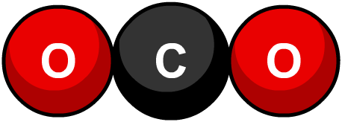
John Dalton
John Dalton was an English chemist who lived in 19th century. Dalton did a lot of scientific experiments involving gases. His experiments led to him to think about what gases are made up of.
The ancient Greeks had already come up with a theory that everything is made of very small units, called atoms, which cannot be broken down any further.
Dalton went on to do many experiments which showed that, when atoms of different elements combine to form chemical compounds, they always do so in whole numbers.
For example, 2 oxygen atoms will always react with 1 carbon atom to make carbon dioxide, CO₂.

Slide 9
Dalton’s theory
Despite some errors in Dalton’s work, which were later corrected, most of his theory was correct.
Dalton theorized that:
elements are made of extremely small particles, so small in fact that we cannot see them
atoms of a given element are identical in size and mass, and atoms of different elements differ in size and mass
atoms cannot be subdivided, created, or destroyed
atoms of different elements combine to form chemical compounds.
Dalton also discovered color blindness!
Notes:
This slide covers the Science and Engineering Practices:
Developing and Using Models: Evaluate merits and limitations of two different models of the same proposed tool, process, mechanism, or system in order to select or revise a model that best fits the evidence or design criteria.
Constructing Explanations and Designing Solutions: Apply scientific reasoning, theory, and/or models to link evidence to the claims to assess the extent to which the reasoning and data support the explanation or conclusion.

Slide 10
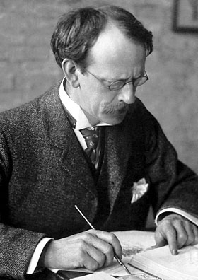
JJ Thomson
At the end of the 19th century, the English physicist Sir Joseph John Thomson carried out an experiment where he passed a high voltage beam through a low pressure gas.
He found that the beam would always be attracted to a positive charge, and therefore must be negative itself. He had discovered the electron!
Thomson found that the electron had a very small mass. Therefore, he thought that approximately 2,000 electrons must be needed to make one hydrogen atom.
Notes:
Photo credit: this image is in the public domain

Slide 11
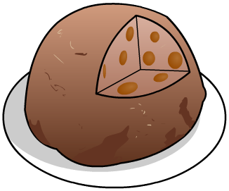
Plum pudding model
Thousands of electrons in a hydrogen atom would mean that it is negatively charged. This was not observed, so he suggested another theory.
Positively-charged pudding
Thomson concluded that there must be fewer electrons, which are spread out and mixed with positive charges, like plums in a pudding. This led to the formation of the plum pudding model.
Negatively-charged plums
Thomson’s work earned him the Nobel Prize in Physics in 1906.
Notes:
This slide covers the Science and Engineering Practices:
Developing and Using Models: Evaluate merits and limitations of two different models of the same proposed tool, process, mechanism, or system in order to select or revise a model that best fits the evidence or design criteria.
Constructing Explanations and Designing Solutions: Apply scientific reasoning, theory, and/or models to link evidence to the claims to assess the extent to which the reasoning and data support the explanation or conclusion.

Slide 12
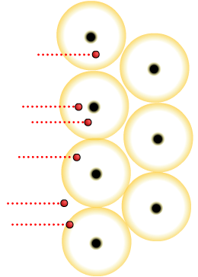
Ernest Rutherford
Ernest Rutherford was a student of JJ Thomson. Rutherford designed an experiment to test out the plum pudding model theory.
alpha particle
The experiment was conducted by his assistants, Geiger and Marsden.
Geiger and Marsden fired positively-charged alpha particles at a sheet of gold foil, which is made up of gold atoms. They expected the alpha particles to pass through the gold atoms.
gold nucleus
Notes:
Teacher notes
An alpha particle is a positively-charged particle consisting of two neutrons and two protons, i.e. the nucleus of a helium atom. They are usually produced in the process of alpha decay.

Slide 13
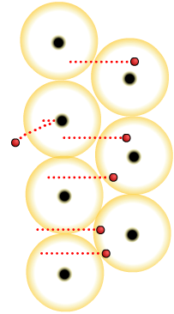
Naming the proton
It was expected that the alpha particles would pass straight through the gold atoms but instead some were slightly deflected and some were very strongly deflected.
alpha particle
They concluded that, for this to occur, there must be a small core of positive charge that is repelling the alpha particles. They had discovered the nucleus!
gold nucleus
alpha particle deflected
Rutherford named the positive charges protons, from the Greek word protos meaning “first.”
Why is there no deflection here?
Notes:
This slide covers the Science and Engineering Practices:
Developing and Using Models: Evaluate merits and limitations of two different models of the same proposed tool, process, mechanism, or system in order to select or revise a model that best fits the evidence or design criteria.
Constructing Explanations and Designing Solutions: Apply scientific reasoning, theory, and/or models to link evidence to the claims to assess the extent to which the reasoning and data support the explanation or conclusion.

Slide 14
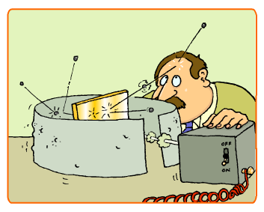
Nuclear model
New experimental evidence may lead to a scientific model being changed or replaced.
Rutherford changed the plum pudding model to show a core of positive charge in the nucleus surrounded by negatively-charged electrons. He surmised that the nucleus was very small.
Rutherford’s nuclear model replaced the plum pudding model.
Notes:
This slide covers the Science and Engineering Practices:
Developing and Using Models: Evaluate merits and limitations of two different models of the same proposed tool, process, mechanism, or system in order to select or revise a model that best fits the evidence or design criteria.
Constructing Explanations and Designing Solutions: Apply scientific reasoning, theory, and/or models to link evidence to the claims to assess the extent to which the reasoning and data support the explanation or conclusion.

Slide 15
Niels Bohr
In 1914, Danish scientist Niels Bohr further adapted the nuclear model.
electron energy levels (shells)
Bohr suggested that electrons are not just orbiting the nucleus randomly, but are in fixed energy levels.
electron
You can compare it to how planets orbit the Sun. They have a fixed path that they follow, just like the electrons around the nucleus.
nucleus
Many scientists did not accept Bohr’s idea until experimental data supported his claim. Bohr won a Nobel Prize for his work in 1922.
Notes:
This slide covers the Science and Engineering Practices:
Developing and Using Models: Evaluate merits and limitations of two different models of the same proposed tool, process, mechanism, or system in order to select or revise a model that best fits the evidence or design criteria.
Constructing Explanations and Designing Solutions: Apply scientific reasoning, theory, and/or models to link evidence to the claims to assess the extent to which the reasoning and data support the explanation or conclusion.

Slide 16
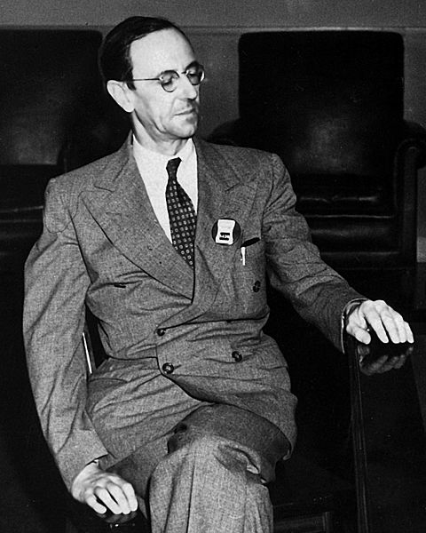
Sir James Chadwick
A few years later in 1932, the English physicist James Chadwick carried out a series of experiments involving radiation.
Chadwick discovered small particles with the same mass as protons but no charge. He had discovered neutrons.
Chadwick won a Nobel Prize in 1935 for his discovery.
Notes:
This slide covers the Science and Engineering Practices:
Developing and Using Models: Evaluate merits and limitations of two different models of the same proposed tool, process, mechanism, or system in order to select or revise a model that best fits the evidence or design criteria.
Constructing Explanations and Designing Solutions: Apply scientific reasoning, theory, and/or models to link evidence to the claims to assess the extent to which the reasoning and data support the explanation or conclusion.
Photo credit: © Los Alamos National Laboratory
Unless otherwise indicated, this information has been authored by an employee or employees of the Los Alamos National Security, LLC (LANS), operator of the Los Alamos National Laboratory under Contract No. DE-AC52-06NA25396 with the U.S. Department of Energy. The U.S. Government has rights to use, reproduce, and distribute this information. The public may copy and use this information without charge, provided that this Notice and any statement of authorship are reproduced on all copies. Neither the Government nor LANS makes any warranty, express or implied, or assumes any liability or responsibility for the use of this information.

Slide 17
True or false?

