Slide 1
Acids and Bases

Slide 2
Information
Asking Questions and Defining Problems
Developing and Using Models
Planning and Carrying Out Investigations
Using Mathematics and Computational Thinking
Constructing Explanations and Designing Solutions
1. Patterns
2. Cause and Effect
3. Scale, Proportion, and Quantity
4. Systems and System Models

Slide 3
What are acids and alkalis?
Notes:
Photo credits: vinegar © Ivaylo Ivanov, fertilizer © flashgun, all at Shutterstock.com, 2018
This presentation is accompanied by the worksheet Acids and Bases.

Slide 4
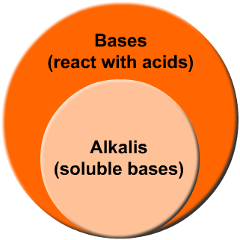
What are bases?
All alkalis are bases. Bases are substances that react with acids by absorbing hydrogen ions (H⁺).
The oxides, hydroxides and carbonates of metals, such as sodium hydroxide, are bases.
Some bases are soluble in water. These are called alkalis.
All alkalis contain hydroxide ions (OH–). The more OH– ions in the solution, the stronger the alkali.
Notes:
This slide covers the Science and Engineering Practice:
Developing and Using Models: Use a model to provide mechanistic accounts of phenomena.

Slide 5
What are acids?
All acids contain a positive hydrogen ion (H⁺) bound to a negative ion (A–).
The general formula of an acid is HA, where “H” represents the hydrogen ion and “A” represents the accompanying negative ion.
When in solution, the acid ionizes. This means that it forms its charged ions, which are released into solution:
Notes:
This slide covers the Science and Engineering Practice:
Developing and Using Models: Develop, revise, and/or use a model based on evidence to illustrate and/or predict the relationships between systems or between components of a system.

Slide 6
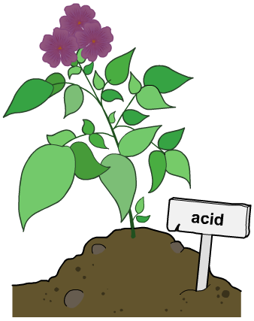
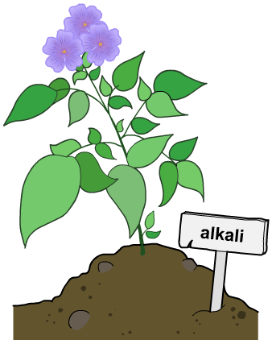
What are indicators?
Indicators are chemicals that change color in the presence of an acid or an alkali.
There are many different indicators. Lots of them come from plants, like red cabbage. Different indicators turn different colors.
Geranium plants grown in acidic soil have red flowers, while geraniums grown in alkaline soil have blue flowers.
Universal indicator is a mixture of indicators. It is useful because it shows a range of colors from pH 1–14.

Slide 7
Acids and bases – true or false?
Notes:
Teacher notes
This true-or-false quiz could be used as a summary exercise to work on acids and bases. Students could be given colored traffic light cards (red = false, green = true) to vote on the statements shown. To stretch students, they could be asked to explain their voting.

Slide 8
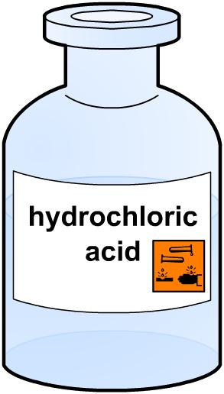
Strong acids
Acids can be strong or weak depending on how much they ionize in solution.
Strong acids ionize fully in solution, so that all of their H⁺ ions are released into the mixture.
Hydrochloric acid is a strong acid as it fully ionizes in solution:
Other strong acids include nitric acid (HNO₃) and sulfuric acid (H₂SO₄).
Notes:
This slide covers the Science and Engineering Practice:
Developing and Using Models: Develop, revise, and/or use a model based on evidence to illustrate and/or predict the relationships between systems or between components of a system.

Slide 9
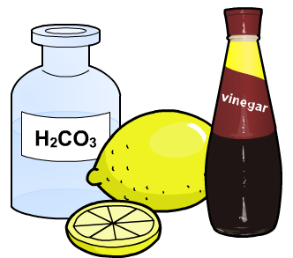
Weak acids
Weak acids do not fully ionize in solution. This is because some of their H⁺ ions stay attached to the acid molecule, (HA).
The ionization of a weak acid is a reversible reaction:
Ethanoic acid (vinegar) is a typical weak acid as it does not fully ionize in solution:
Other weak acids include citric acid in lemons and carbonic acid (H₂CO₃).
Notes:
Teacher notes
The ionization of a weak acid is in dynamic equilibrium, where the reaction is moving in both directions at the same rate.
This slide covers the Science and Engineering Practice:
Developing and Using Models: Develop, revise, and/or use a model based on evidence to illustrate and/or predict the relationships between systems or between components of a system.

Slide 10
Identifying strong and weak acids
Notes:
This slide covers the Science and Engineering Practices:
Asking Questions and Defining Problems: Ask questions that can be investigated within the scope of the school laboratory, research facilities, or field (e.g., outdoor environment) with available resources and, when appropriate, frame a hypothesis based on a model or theory.
Planning and Carrying Out Investigations: Make directional hypotheses that specify what happens to a dependent variable when an independent variable is manipulated.
Constructing Explanations and Designing Solutions: Apply scientific reasoning, theory, and/or models to link evidence to the claims to assess the extent to which the reasoning and data support the explanation or conclusion.

Slide 11
Strong or weak?

Slide 12
What does the pH scale show?
The pH scale runs from 0 to 14. The numbers 0 to 6 represent acidic conditions and 8 to 14 represent alkaline conditions. A pH value 7 is neutral.
What are the pH values of some everyday items?
0
1
2
3
4
5
6
7
8
9
10
11
12
13
14
increasing acidity
increasing alkalinity

Slide 13
What does the pH scale show?
Notes:
Teacher notes
You may wish to ask the students to guess which is the most acidic or alkaline liquid, before playing the animation.
The pH values for each of the liquids are as follows:
tea: 6.25
coffee: 5.43
pineapple juice: 3.72
cola: 3.45
milk: 6.55
water: 7.92.
This slide covers the Science and Engineering Practice:
Asking Questions and Defining Problems: Ask questions that can be investigated within the scope of the school laboratory, research facilities, or field (e.g., outdoor environment) with available resources and, when appropriate, frame a hypothesis based on a model or theory.

Slide 14
What is the order of pH?
Notes:
Teacher notes
This ordering activity could be used as an introductory or summary activity on pH. Mini-whiteboards could be used to make this a whole-class exercise.

Slide 15
pH of strong and weak acids
pH is a measure of the concentration of H⁺ ions in solution. A lower pH means more H⁺ ions are present in solution.
As strong acids ionize fully in solution, they contain many H⁺ ions per molecule of acid, producing a lower pH.
Weak acids do not fully ionize. They therefore contain fewer H⁺ ions per molecule of acid and:
have higher pH values
are worse conductors of electricity
react less quickly.
higher H⁺ concentration
lower H⁺ concentration
Notes:
Teacher notes
Students should be made aware that comparisons are made here between strong and weak acids of the same concentration.

Slide 16
Acidity and acid strength
The acidity of an aqueous solution depends on the number of H⁺ ions present. It is a measure of how acidic the solution is, and indicates the strength of an acid.
Acid strength is measured in pH. It is the concentration of H⁺ ions in solution. The higher the concentration of H⁺ ions, the lower the pH, and the stronger the acid.
The pH scale also measures alkalinity. As the concentration of OH– ions increases, the concentration of H⁺ decreases. This results in an increase in pH.

Slide 17
Neutrality
A solution is neutral at pH 7, when the concentration of H⁺ ions equals the concentration of OH– ions.
When an acid reacts with a base, a neutralization reaction occurs:
As the base (OH–) is added, the number of free hydrogen ions in solution decreases, causing an increase in pH.
This means the neutrality of a solution is determined by the concentration of hydrogen ions present.
Notes:
Teacher notes
For more information about neutralization reactions and acids and bases, please refer to the Neutralization presentation.

Slide 18
Diluting acids
Strong acids have a relatively high concentration of H⁺ ions, and therefore a low pH.
When a strong acid is diluted, the concentration of H⁺ falls and the pH rises. This decreases the acid strength.
pH
H⁺concentration (mol/dm³)
1
10^{–1}
10^{–2}
10^{–3}
10^{–4}
10^{–5}
10^{–6}
10^{–7}
decreasing H⁺ concentration
As the concentration of H⁺ ions decreases by a factor of 10, the pH increases by one unit.
Notes:
Teacher notes
The concentration of hydrogen ions (H⁺) is in the units moles/cubic decimeter (mol/dm³).
pH is calculated using the equation pH = –log[H⁺], where [H⁺] is the concentration of H⁺ ions in mol dm⁻³. Since strong acids are fully dissociated, all the molecules of acid will produce H⁺ ions, so their pH is equal to the –log of their concentration. Weak acids are more complex and pH is calculated using their equilibrium constant values, which give a measure of their degree of dissociation.
This slide covers the Science and Engineering Practice:
Using Mathematics and Computational Thinking: Apply techniques of algebra and functions to represent and solve scientific and engineering problems.

Slide 19
Diluting acids
Notes:
Teacher notes
In order to determine the pH of an acid you need to know the concentration of H⁺ ions present. This is simple for strong acids as they fully dissociate. For example: 1 mole HCl dissociates to give 1 mole H⁺ + 1 mole Cl⁻ . This means that 0.2M HCl dissociates to give 0.2M of H⁺ ions. pH is then calculated using the equation pH = –log[H⁺].

Slide 20
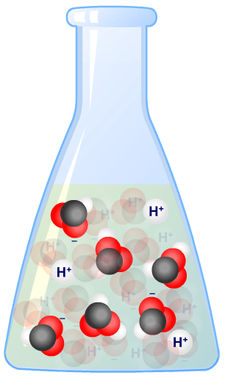
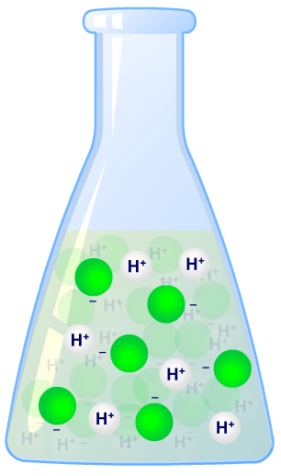
Reactivity of strong and weak acids
A solution of ethanoic acid reacts more slowly than hydrochloric acid of the same concentration.
Hydrochloric acid is fully dissociated, so all the hydrogen ions are available to react.
Ethanoic acid is partially dissociated, so there are fewer hydrogen ions to react.
The lower concentration of H⁺ ions in ethanoic acid leads to a lower collision frequency between reactant molecules, and so a slower reaction.
Notes:
Teacher notes
A strong acid is fully ionized, and so all the H⁺ ions react with the reactant. A weak acid is only partially ionized and forms an equilibrium in solution.
As the H⁺ ions in a weak acid react, the equilibrium shifts to the right making more H⁺ ions until no more of the unionized acid is left. The same volume of a weak acid and a strong acid of equal concentration will contain the same number of moles of H⁺ and so will produce the same volume of product.

Slide 21
Acids and carbonates
When a carbonate is mixed with an acid, the products are a salt, carbon dioxide and water.
For example, the reaction of nitric acid (a strong acid) and copper carbonate:
What would you expect to observe in this reaction?
What difference might you see in the reaction of ethanoic acid and copper carbonate?
Notes:
Teacher notes
Bubbles will be produced by the carbon dioxide gas. This can be identified using limewater – when carbon dioxide is bubbled through limewater, the mixture becomes cloudy.
Fewer/less vigorous bubbles will be seen in the reaction of ethanoic acid with copper carbonate.
This slide covers the Science and Engineering Practice:
Asking Questions and Defining Problems: Ask questions that arise from examining models or a theory, to clarify and/or seek additional information and relationships.

Slide 22
Weak acids and carbonates
As ethanoic acid is a weak acid, only moderate fizzing would be expected.
This is because ethanoic acid has fewer H⁺ ions in solution than a strong acid of the same concentration.
This means there are fewer collisions occurring with the carbonate and so a slower rate of reaction.
What would happen if the concentration of ethanoic acid was increased?
Notes:
Teacher notes
It is important to remember that increasing the concentration does not effect the ability of the acid to dissociate in solution. The acid is still a weak acid as it is unable to fully dissociate. Increasing the concentration of the acid will increase the number of molecules in solution. This would increase the number of collisions occurring with the carbonate and so increase the rate of reaction.
This slide covers the Science and Engineering Practices:
Asking Questions and Defining Problems: Ask questions that arise from examining models or a theory, to clarify and/or seek additional information and relationships.
Developing and Using Models: Use a model to provide mechanistic accounts of phenomena.

Slide 23
Reacting with metals
Notes:
Teacher notes
The reaction between an acid and a metal is not a neutralization reaction because the pH does not change and no water is produced.
A metal will only react with an acid if the metal is more reactive than hydrogen. Otherwise the metal is not reactive enough to separate the hydrogen ion from it’s negative ion.
Some prompts for students include:
What is the word equation for the reaction of an acid and a metal?
Why does HCl react more quickly that ethanoic acid?
This slide covers the Science and Engineering Practices:
Asking Questions and Defining Problems: Ask questions that arise from examining models or a theory, to clarify and/or seek additional information and relationships.
Using Mathematics and Computational Thinking: Use mathematical, computational, and/or algorithmic representations of phenomena or design solutions to describe and/or support claims and/or explanations.
Constructing Explanations and Designing Solutions: Apply scientific reasoning, theory, and/or models to link evidence to the claims to assess the extent to which the reasoning and data support the explanation or conclusion.

