Slide 1
The Endocrine System

Slide 2
Information
Constructing Explanations and Designing Solutions
Obtaining, Evaluating and Communicating Information
2. Cause and Effect
3. Scale, Proportion, and Quantity
6. Structure and Function

Slide 3
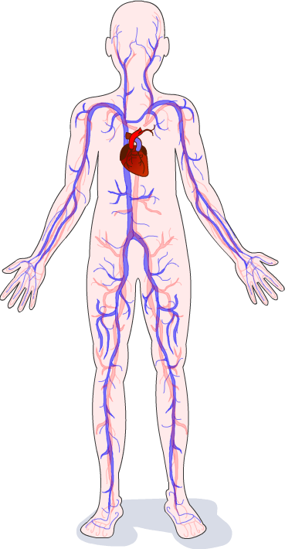
What is the endocrine system?
The endocrine system is a collection of glands found throughout the body that secrete hormones directly into the blood.
There are many different endocrine glands, each of which produces one or more different types of hormone.
Hormones produced by the endocrine system regulate body functions including metabolism, fertility and water balance.
Notes:
Teacher notes
For more information on the regulation of water balance, please refer to the Excretion presentation.

Slide 4
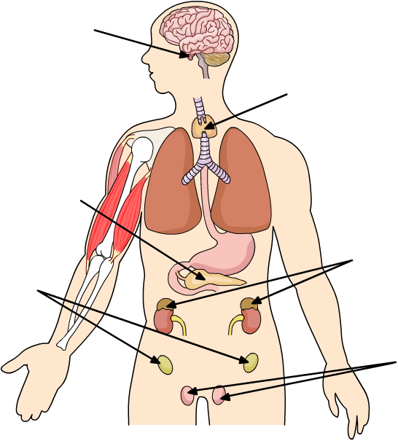
Endocrine glands of the body
How many endocrine glands of the body labeled below can you name correctly?
pituitary gland
thyroid gland
pancreas
ovaries (females only)
adrenal glands
testes (males only)
Notes:
Teacher notes
For more information about hormones produced by the pancreas, please refer to the Glucoregulation presentation.

Slide 5
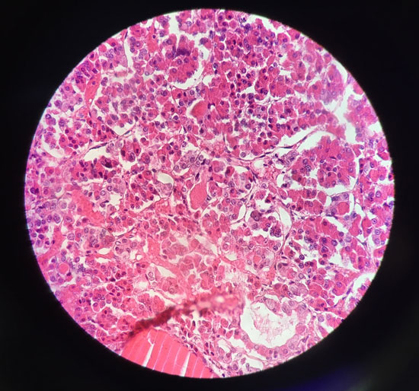
What are glands made of? (1)
Glands are made of specialized cells called epithelial cells.
Epithelial cells are found in many types of organ.
However, the epithelial cells found in glands are specialized for the secretion of hormones.
The epithelial cells work together to form an organized tissue that produces hormones and releases them into the bloodstream.
Notes:
Teacher notes
The image shows a stained section of the anterior pituitary gland viewed through a light microscope. The pink, densely clustered cells are secretory epithelial cells, which secrete the hormones made by this part of the pituitary gland. Help students to identify these, as well as their darkly stained nuclei.
Photo credit: © Phithiwat Siritham, Shutterstock.com 2018

Slide 6
What are glands made of? (2)
Glands also contain another type of tissue called connective tissue.
Connective tissue does not secrete hormones. Instead, it acts to support and protect the epithelial tissue.
Glands also have a blood supply and may contain nervous tissue.
Where do glands sit in the hierarchy of multicellular organisms?
Notes:
Teacher notes
Help students to identify that glands contain two or more tissues working together, which means they can be considered organs within the endocrine system, which is an organ system.
This slide covers the Science and Engineering Practices:
Constructing Explanations and Designing Solutions: Apply scientific ideas, principles, and/or evidence to provide an explanation of phenomena and solve design problems, taking into account possible unanticipated effects.
Obtaining, Evaluating, and Communicating Information: Communicate scientific and/or technical information or ideas (e.g. about phenomena and/or the process of development and the design and performance of a proposed process or system) in multiple formats (including orally, graphically, textually, and mathematically).

Slide 7
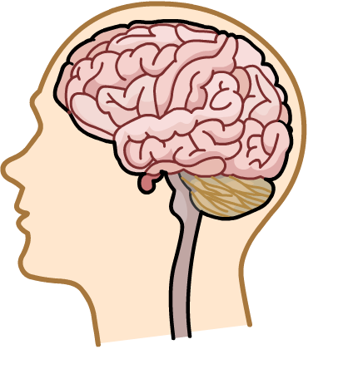
The pituitary gland
The pituitary gland is a pea-sized gland located at the base of the brain.
It secretes several types of hormone in response to changes in body conditions.
Some pituitary hormones are used to regulate the activity of other endocrine glands, which secrete their own hormones in response.
pituitary gland
As a result, it is often referred to as a “master gland.”
Notes:
Teacher notes
Ask whether students can identify the location of the pituitary gland on the image before revealing its label.

Slide 8
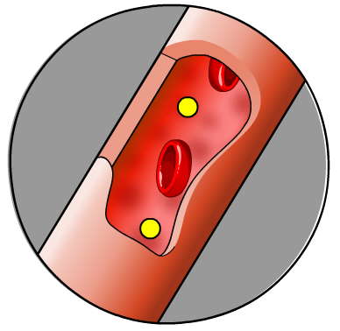
How do hormones work?
Hormones are large chemical molecules produced by endocrine glands.
Their role is to act as chemical messengers, in order to regulate key bodily functions.
Hormones are transported in the blood to their target organ(s).
This means an endocrine gland can be located a long distance from where the hormone it secretes has an effect.
Receptors on the cell membranes of cells in the target organ recognize the hormone. The cells then respond by changing their cellular activity to bring about a particular effect.

Slide 9
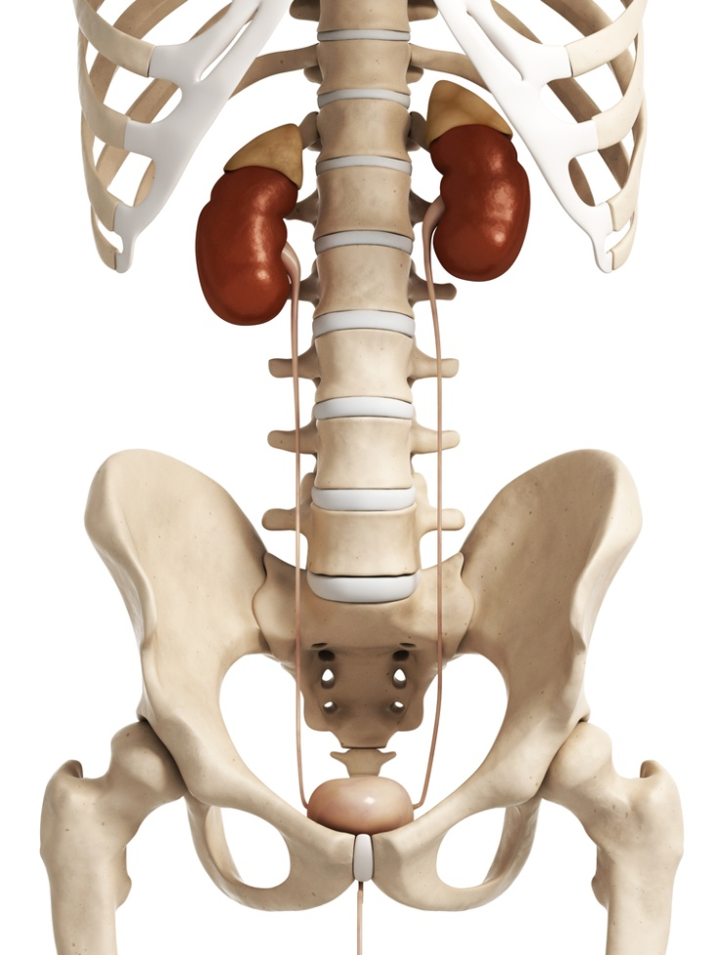
Hormones example: adrenaline
Adrenaline is a hormone secreted by the adrenal glands.
The adrenal glands are located just above the kidneys.
Adrenaline is secreted directly into the blood and transported in the circulatory system throughout the body.
adrenal glands
Adrenaline targets several parts of the body, including the heart, blood vessels and liver.
Notes:
Photo credit: © Sebastian Kaulitzk, Shutterstock.com 2018

Slide 10
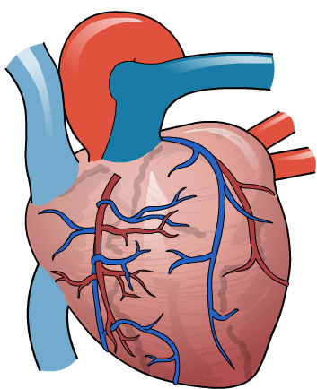
What effect does adrenaline have?
Adrenaline is sometimes called the “fight or flight” hormone.
This is because its role is to prepare the body for action in times of fear or stress. It has several effects, including:
increasing heart rate
increasing blood pressure
increasing blood flow to muscles
relaxing the airways and increasing breathing rate
stimulating the liver to convert glycogen to glucose, which is released into the blood to increase blood glucose levels.
Notes:
Teacher notes
Increasing heart rate: adrenaline causes the heart to contract faster.
Increasing blood pressure: an increase in heart rate causes an increase in blood pressure.
Increasing blood flow to muscles: adrenaline cause the blood vessels supplying the muscles to dilate.
Glucose release from the liver: the liver stores glucose as glycogen.
Adrenaline also widens the bronchioles in the lungs so that more air can be breathed in and out. This increases the amount of oxygen that can be taken up by the blood from the alveoli.

Slide 11
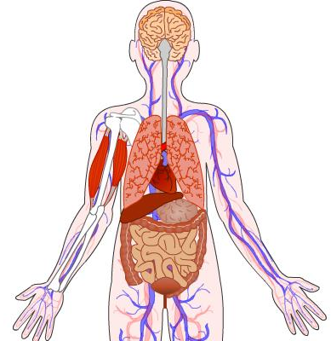
Importance of the endocrine system
The endocrine system coordinates the activity of many different organs and bodily functions.
It plays a key role in homeostasis, by enabling cells to alter their activity in response to changes in body conditions.
If the endocrine system does not work properly, it can prevent internal conditions from being regulated effectively.
For example, if the pancreas cannot produce enough insulin to control blood glucose levels, it can lead to diabetes.
Notes:
Teacher notes
Insulin is a hormone secreted by the pancreas in response to an increase in blood glucose levels. It stimulates the liver and muscle cells to take up excess glucose and store it as glycogen, lowering blood glucose levels back to normal.
For more information on insulin and diabetes, please refer to the Glucoregulation presentation.

Slide 12
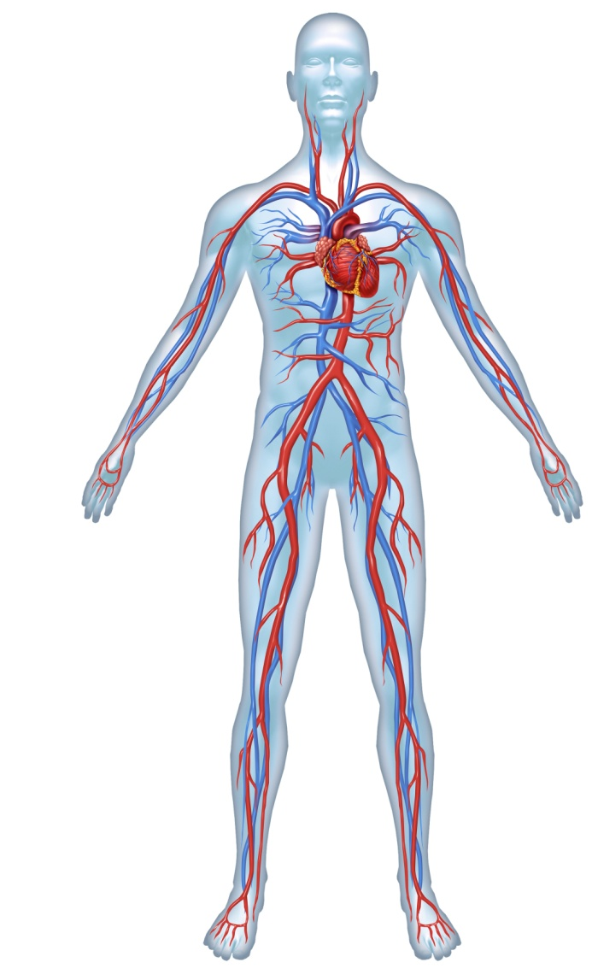
Hormonal and nervous signals
Hormones in the blood and electrical signals transmitted by nerve cells in the nervous system can carry messages long distances in the body.
Transport in the blood is relatively slow. This means that hormones take longer than nervous signals to have an effect.
However, responses caused by hormones usually last longer than
those caused by nervous signals.
As a result, hormones are able to cause long-term changes to bodily functions.
Notes:
Photo credit: © Lightspring, Shutterstock.com 2018

