Slide 1
Speciation

Slide 2
Information
Constructing Explanations and Designing Solutions
Obtaining, Evaluating and Communicating Information
1. Patterns
2. Cause and Effect
5. Energy and Matter
6. Structure and Function
7. Stability and Change

Slide 3
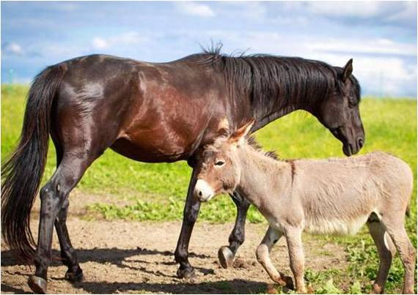
What is speciation?
A species is a group of similar individuals that can breed together to produce fertile offspring. This allows the exchange of genes within a population of a species.
Speciation occurs when two populations of the same species become so different from each other that they can no longer breed together to produce fertile offspring.
The two populations have become different species.
Notes:
Teacher notes
Genetic variation means that individuals of a population have many different alleles, resulting in different characteristics.
Photo credit: © DragoNika, Shutterstock.com 2018

Slide 4
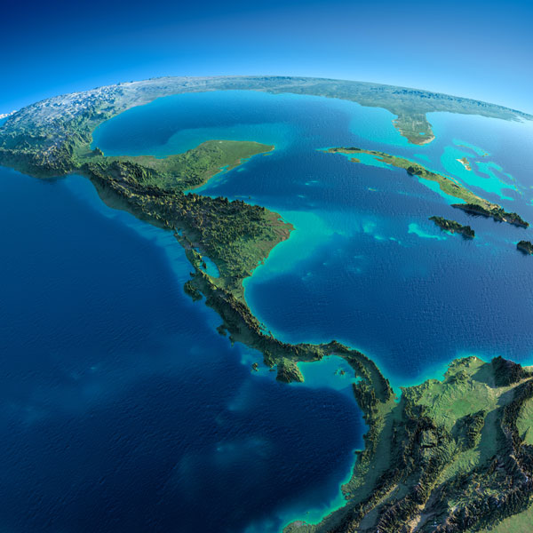
Speciation: isolation
Two important concepts in the process of speciation are isolation and natural selection.
Isolation means a group of individuals becomes separated in some way from others in a population of a species.
The isolated individuals cannot exchange genes with the rest of the population.
The isolated individuals experience different conditions from the rest of the population.
Notes:
Teacher notes
The image shows the countries of Central America. The isthmus of Panama formed around 2.8 million years ago, separating the Atlantic and Pacific Oceans. Populations of marine species on either side of the isthmus were isolated from one another, resulting in several speciation events.
Photo credit: © Anton Balazh, Shutterstock.com 2018

Slide 5
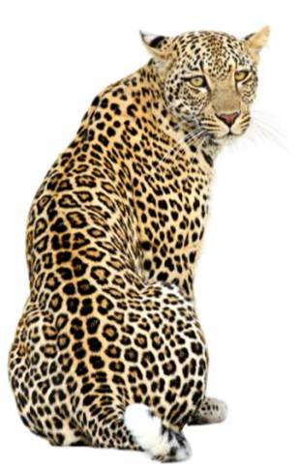
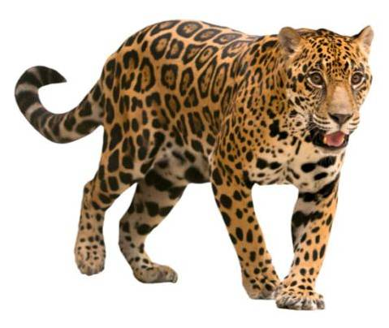
Speciation: natural selection
Natural selection continues to act on both the isolated individuals and the rest of the population.
The different conditions experienced by the two groups causes different characteristics to be favored by natural selection.
As a result, different genes will become common in each population.
Over time, the populations become so different that they would be unable to interbreed even if they were no longer isolated.
Notes:
Teacher notes
The leopard is the closest relative of the jaguar. They are different species that evolved from the same ancestor.
Photo credit: jaguar © Anan Kaewkhammuland, leopard © geraldb, both Shutterstock.com 2018

Slide 6
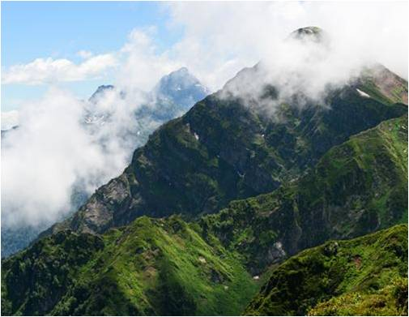
Barriers leading to isolation
What can cause populations to become isolated?
geographical barriers, such as the presence of rivers or mountains
differences in their position in the ecosystem, such as eating different foods, mating in different areas or living in different habitats
the inability to breed due to different behaviors or physical differences
Each of these produces a barrier that isolates groups of individuals.
Notes:
Teacher notes
Discuss students’ ideas for the question. Help them to apply their understanding of topics from Earth and Space Sciences and Life Science and justify their answers with scientific ideas.
This slide covers the Science and Engineering Practices:
Constructing Explanations and Designing Solutions: Apply scientific ideas, principles, and/or evidence to provide an explanation of phenomena and solve design problems, taking into account possible unanticipated effects.
Obtaining, Evaluating, and Communicating Information: Communicate scientific and/or technical information or ideas (e.g. about phenomena and/or the process of development and the design and performance of a proposed process or system) in multiple formats (including orally, graphically, textually, and mathematically).
Photo credit: © EvgenySHCH, Shutterstock.com 2018

Slide 7
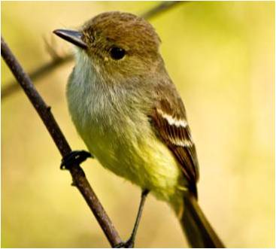
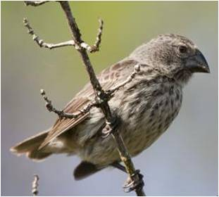
Speciation and Darwin’s finches
Darwin discovered similar species of finch on the Galapagos Islands that differed in their beak size and shape.
The ground finch and the warbler finch are found on different islands. They evolved from a single species of finch as a result of population isolation.
Natural selection favored beak characteristics that were useful for the different food sources available on each island.
Ground finches have large beaks for crushing seeds. Warbler finches have narrow beaks for feeding on insects.
Notes:
Photo credit: warbler finch (top right) © Fotos593 and ground finch (bottom right) © Stubblefield Photography, both at Shutterstock.com 2018

Slide 8
The mechanism of speciation
Notes:
Teacher notes
This ordering activity could be used as an introductory or summary activity on speciation.
This slide covers the Science and Engineering Practice:
Constructing Explanations and Designing Solutions: Apply scientific ideas, principles, and/or evidence to provide an explanation of phenomena and solve design problems, taking into account possible unanticipated effects.

Slide 9
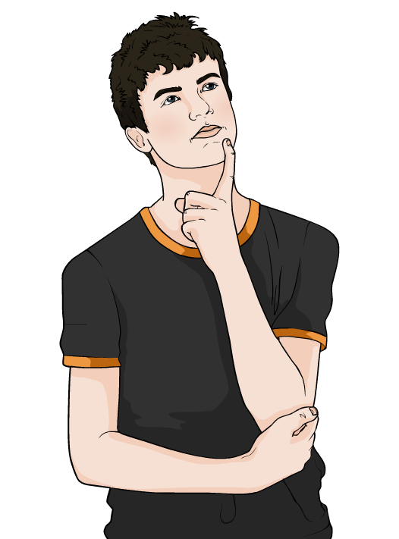
Impact on biodiversity
What impact do you think speciation will have on biodiversity?
Biodiversity is the variety of all the different species of organisms on Earth or within an ecosystem.
The greater the number of different species in an ecosystem, the higher its biodiversity.
Speciation increases biodiversity.
Notes:
Teacher notes
Discuss students’ ideas for the question. Help them to apply their understanding of biodiversity and justify their answers with scientific ideas.
This slide covers the Science and Engineering Practices:
Constructing Explanations and Designing Solutions: Apply scientific ideas, principles, and/or evidence to provide an explanation of phenomena and solve design problems, taking into account possible unanticipated effects.
Obtaining, Evaluating, and Communicating Information: Communicate scientific and/or technical information or ideas (e.g. about phenomena and/or the process of development and the design and performance of a proposed process or system) in multiple formats (including orally, graphically, textually, and mathematically).

Slide 10
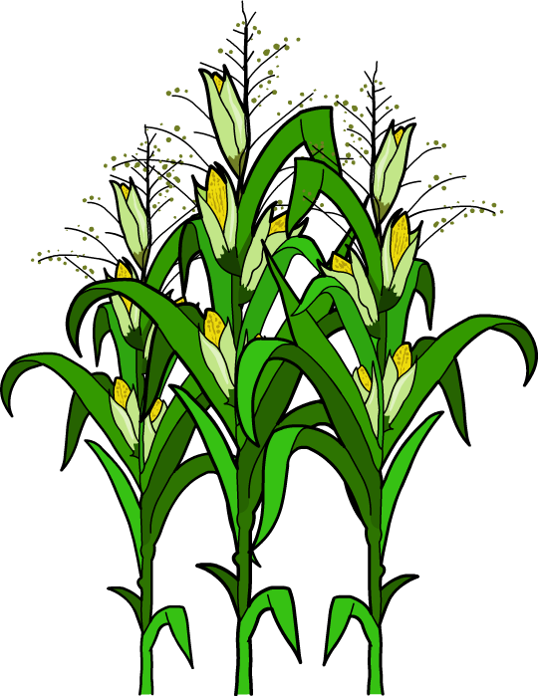
Human impact on speciation (1)
How do you think human activity may contribute to the formation of new species?
Humans have used the process of selective breeding to develop desirable characteristics in some animals and plants.
This has sometimes caused organisms to become so different that a new species is formed.
However, in most cases, domesticated plants and animals can still interbreed with their wild ancestors.
This means that, despite their differences, they are still currently the same species.
Notes:
Teacher notes
Discuss students’ ideas for the question. Help them to apply their understanding of the impact of human activities on ecosystems and justify their answers with scientific ideas.
This slide covers the Science and Engineering Practices:
Constructing Explanations and Designing Solutions: Apply scientific ideas, principles, and/or evidence to provide an explanation of phenomena and solve design problems, taking into account possible unanticipated effects.
Obtaining, Evaluating, and Communicating Information: Communicate scientific and/or technical information or ideas (e.g. about phenomena and/or the process of development and the design and performance of a proposed process or system) in multiple formats (including orally, graphically, textually, and mathematically).

Slide 11
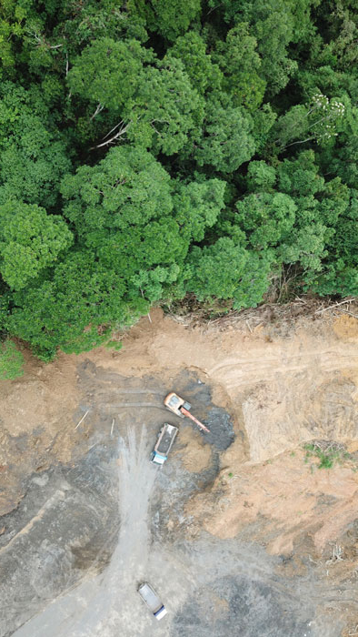
Human impact on speciation (2)
Some human activities contribute to the isolation of populations by fragmenting their habitat.
However, the impact of this process on speciation is unclear.
This is because isolated populations are also at risk of local extinction.
The probability of local extinction in populations isolated by human activity may be higher than the probability of speciation.
Can you explain why?
Notes:
Teacher notes
Help students to apply their knowledge of extinction to answer the question. Smaller populations have a greater risk of extinction. Populations isolated by human activities may also experience additional human pressures.
This slide covers the Science and Engineering Practices:
Constructing Explanations and Designing Solutions: Apply scientific ideas, principles, and/or evidence to provide an explanation of phenomena and solve design problems, taking into account possible unanticipated effects.
Obtaining, Evaluating, and Communicating Information: Communicate scientific and/or technical information or ideas (e.g. about phenomena and/or the process of development and the design and performance of a proposed process or system) in multiple formats (including orally, graphically, textually, and mathematically).
Photo credit: Rich Carey © Shutterstock.com 2018

