Slide 1
Response to Exercise

Slide 2
Information
Asking Questions and Defining Problems
Planning and Carrying Out Investigations
Using Mathematics and Computational Thinking
Constructing Explanations and Designing Solutions
Obtaining, Evaluating and Communicating Information
1. Patterns
2. Cause and Effect
6. Structure and Function
7. Stability and Change

Slide 3
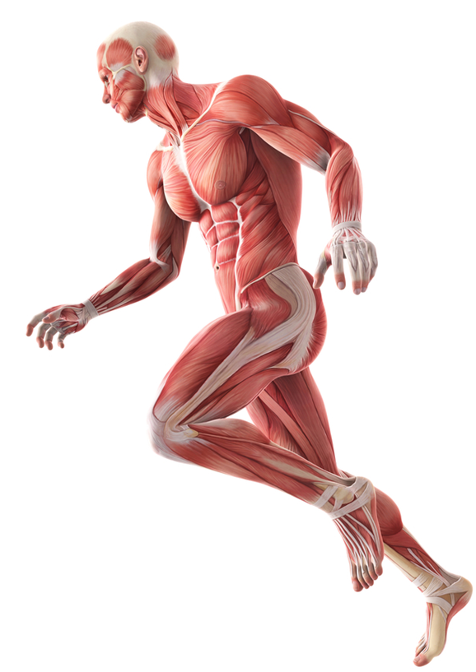
Energy for exercise
During exercise, the muscles contract to enable movement.
Like any other living process, muscle contraction requires a supply of energy.
Energy is released from glucose by cells through the process of cellular respiration.
In the muscle cells, the energy released can be used for muscle contraction.
Notes:
Photo credit: © Ramona Kaulitzki, Shutterstock.com 2018

Slide 4
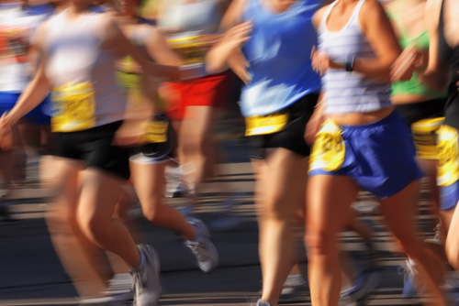
Changes during exercise (1)
During exercise the human body reacts to an increased demand for energy from the muscles.
As a result, changes occur in the body:
heart rate increases
breathing rate and volume increases
blood vessels supplying the muscles dilate (become wider).
Notes:
Teacher notes
The arteries supplying the muscles dilate to accommodate increased blood flow. Blood flow can increase to 35 times its normal volume during exercise.
During exercise, blood is diverted away from systems that are not involved in activity, such as the digestive system.
Photo credit: © Suzanne Tucker, Shutterstock.com 2018

Slide 5
Changes during exercise (2)
What effect do the changes that occur during exercise have on the body?
An increase in breathing rate and volume means that more oxygen can be transferred to the blood.
Increasing heart rate allows blood to be pumped around the body faster.
The dilation of blood vessels around the muscles increases their blood supply.
The changes allow more oxygenated blood to reach the muscles.
Notes:
This slide covers the Science and Engineering Practices:
Constructing Explanations and Designing Solutions: Apply scientific ideas, principles, and/or evidence to provide an explanation of phenomena and solve design problems, taking into account possible unanticipated effects.
Obtaining, Evaluating, and Communicating Information: Communicate scientific and/or technical information or ideas (e.g. about phenomena and/or the process of development and the design and performance of a proposed process or system) in multiple formats (including orally, graphically, textually, and mathematically).

Slide 6
Asking questions about heart rate
Heart rate increases during exercise.
Do you think heart rate will continue to increase for as long as exercise takes place? Explain your answer.
What do you think will happen to heart rate after exercise stops?
How could you find out whether or not your predictions are correct?
Notes:
Teacher notes
These questions are intended to provide an introduction for an investigation into heart rate, which is covered in the following slides.
This slide covers the Science and Engineering Practices:
Asking Questions and Defining Problems: Ask questions that arise from examining models or a theory, to clarify and/or seek additional information and relationships.
Asking Questions and Defining Problems: Ask questions to determine relationships, including quantitative relationships, between independent and dependent variables.
Planning and Carrying Out Investigations: Make directional hypotheses that specify what happens to a dependent variable when an independent variable is manipulated.

Slide 7
Heart rate activity
Plan an experiment to find out what happens to heart rate during exercise.
Describe the methods you will use in your experiment.
Think about these words in your experimental design:
variable
control
accurate
precise
reliable
valid.
Notes:
This slide covers the Science and Engineering Practices:
Planning and Carrying Out Investigations: Plan an investigation or test a design individually and collaboratively to produce data to serve as the basis for evidence as part of building and revising models, supporting explanations for phenomena, or testing solutions to problems. Consider possible variables or effects and evaluate the confounding investigation’s design to ensure variables are controlled.
Planning and Carrying Out Investigations: Plan and conduct an investigation individually and collaboratively to produce data to serve as the basis for evidence, and in the design: decide on types, how much, and accuracy of data needed to produce reliable measurements and consider limitations on the precision of the data (e.g., number of trials, cost, risk, time), and refine the design accordingly.
Planning and Carrying Out Investigations: Select appropriate tools to collect, record, analyze, and evaluate data.
Obtaining, Evaluating, and Communicating Information: Communicate scientific and/or technical information or ideas (e.g. about phenomena and/or the process of development and the design and performance of a proposed process or system) in multiple formats (including orally, graphically, textually, and mathematically).
Photo credit: © lzf, Shutterstock.com 2018

Slide 8
Heart rate experiment
Notes:
Teacher notes
Help students to describe that heart rate increases during exercise until a maximum value is reached. When exercise stops, heart rate begins to fall again. The value for maximum heart rate depends on the intensity of the exercise and the fitness level of the person exercising.
This slide covers the Science and Engineering Practices:
Using Mathematics and Computational Thinking: Use mathematical, computational, and/or algorithmic representations of phenomena or design solutions to describe and/or support claims and/or explanations.
Constructing Explanations and Designing Solutions: Make a quantitative and/or qualitative claim regarding the relationship between dependent and independent variables.

Slide 9
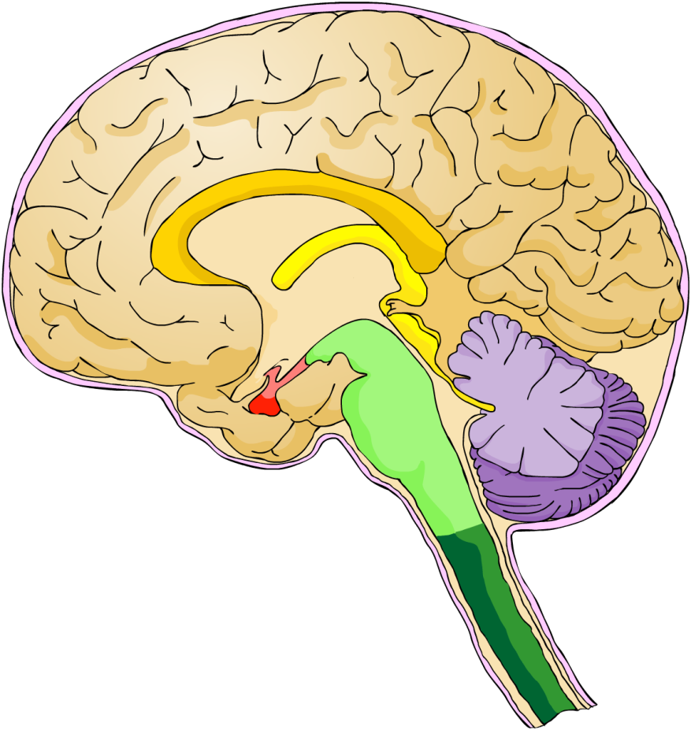
Controlling heart rate
Heart rate is controlled by part of the brain called the medulla oblongata (or medulla).
The medulla receives information from nerves connected to the muscles.
Nerves also connect the medulla to the heart.
How do you think the medulla coordinates heart rate during exercise?
medulla
Notes:
Teacher notes
Help students to use the information provided to explain how heart rate is coordinated. During exercise, muscles send electrical impulses to the medulla through the nerves. This causes the medulla to send an electrical impulse to the heart, which increases the heart rate. When exercise stops, this information is received by the medulla from the muscles. The medulla sends an electrical impulse to the heart to decrease heart rate.
For more information about the brain, please refer to The Nervous System presentation.
This slide covers the Science and Engineering Practices:
Constructing Explanations and Designing Solutions: Apply scientific ideas, principles, and/or evidence to provide an explanation of phenomena and solve design problems, taking into account possible unanticipated effects.
Obtaining, Evaluating, and Communicating Information: Communicate scientific and/or technical information or ideas (e.g. about phenomena and/or the process of development and the design and performance of a proposed process or system) in multiple formats (including orally, graphically, textually, and mathematically).

Slide 10
Cellular respiration during exercise (1)
Initially during exercise all muscle cells carry out aerobic respiration. This uses oxygen to release energy from glucose.
The increase in heart rate, breathing and blood flow to the muscles helps provide more oxygenated blood to the active muscles. However, the demand for oxygen may still exceed supply.
If this occurs, muscle cells can release energy from glucose using anaerobic respiration. This takes place without oxygen.
Notes:
Teacher notes
Aerobic respiration is more efficient than anaerobic respiration, releasing more energy per molecule of glucose.
Photo credit: © Suzanne Tucker, Shutterstock.com 2018

Slide 11
Cellular respiration during exercise (2)
Here is the word equation for aerobic respiration:
+
carbon dioxide
+
glucose
oxygen
water
+
( energy)
Here is the word equation for anaerobic respiration. This only occurs in muscle cells if the supply of oxygen is insufficient:
The equations show that aerobic respiration and anaerobic respiration produce different waste products.
Notes:
Teacher notes
Students should understand that anaerobic respiration does not replace aerobic respiration. Only cells that require more energy, such as muscle cells, will carry out anaerobic respiration if there is not enough oxygen present.

Slide 12
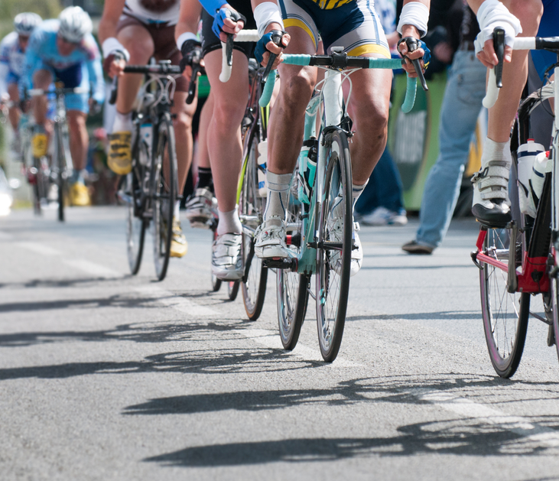
Anaerobic respiration
Anaerobic respiration produces the waste product lactic acid.
This is produced because, unlike aerobic respiration, the oxidation of glucose in anaerobic respiration is incomplete.
Lactic acid builds up in muscle cells, preventing them from contracting efficiently. This can cause fatigue, pain and cramping.
After vigorous exercise, the body needs to remove lactic acid before it damages cells.
Notes:
Photo credit: © sainthorant daniel, Shutterstock.com 2018

Slide 13
Breaking down lactic acid
Lactic acid produced during long periods of exercise is broken down to enable the muscles to contract effectively again.
Blood flowing through the muscles transports some of the lactic acid to the liver, where it is converted into glucose.
The glucose can be used for cellular respiration, or stored as glycogen.
The remaining lactic acid is broken down by oxidation in the muscle itself.
Notes:
Teacher notes
Glycogen is a type of carbohydrate, made of many glucose molecules joined together. It acts as a storage molecule for glucose in animal cells.
The glucose in glycogen can later be released and used for cellular respiration if blood glucose levels fall.
For more information about glycogen, please refer to the Glucoregulation presentation.
Photo credit: © Izf, Shutterstock.com 2018

Slide 14
Oxygen debt
The breakdown of lactic acid requires oxygen. The build-up of lactic acid in the muscle during vigorous exercise creates an oxygen debt.
This is the amount of oxygen needed to break down the lactic acid in the muscle.
Even after strenuous exercise is over, you continue to breathe heavily and have an elevated heart rate.
This helps move lactic acid to the liver, and supplies the liver and muscle cells with the oxygen required to break it down.
Notes:
Photo credit: © Peter Bernik, Shutterstock.co.uk 2018

Slide 15
Complete the sentences
Notes:
This slide covers the Science and Engineering Practices:
Constructing Explanations and Designing Solutions: Apply scientific ideas, principles, and/or evidence to provide an explanation of phenomena and solve design problems, taking into account possible unanticipated effects.
Obtaining, Evaluating, and Communicating Information: Communicate scientific and/or technical information or ideas (e.g. about phenomena and/or the process of development and the design and performance of a proposed process or system) in multiple formats (including orally, graphically, textually, and mathematically).

