Slide 1
Plant Diseases

Slide 2
Information
Constructing Explanations and Designing Solutions
Engaging in Argument from Evidence
Obtaining, Evaluating and Communicating Information
1. Patterns
2. Cause and Effect
3. Scale, Proportion, and Quantity
6. Structure and Function

Slide 3
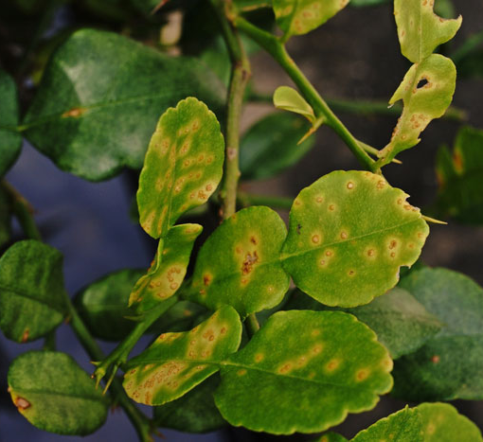
What are plant diseases?
A plant disease is the abnormal growth or function of a plant.
Plant diseases can either cause the death of a plant, or reduce its ability to survive, grow or reproduce. They
can be caused by living or non-living factors.
Living causes of plant disease
include microorganisms, such
as viruses, bacteria and fungi.
Insects can also cause disease.
Non-living plant diseases have an environmental cause, such
as a shortage of nutrients in
the soil.
Notes:
Photo credit: © Lertwit-Sasipreyajun, Shutterstock.com 2018

Slide 4
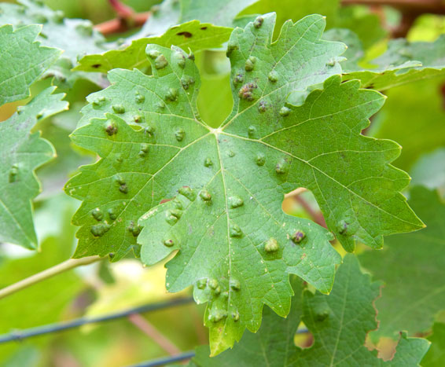
Detecting and identifying plant diseases
Plant diseases are often initially detected at their site of growth through observation. This is possible because many plant diseases cause visible symptoms. These include:
spots on leaves
growths
discoloration
malformed stems or leaves
areas of decay
stunted growth
presence of pests.
Notes:
Photo credit: © Sheila-Fitzgerald, Shutterstock.com 2018

Slide 5
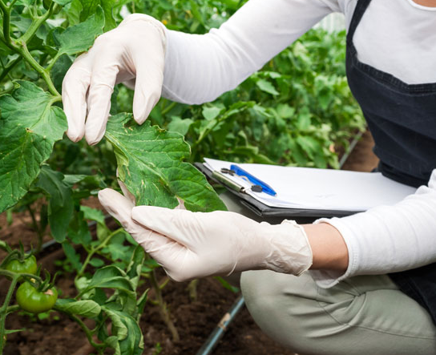
Field identification of plant disease
Some types of plant disease can be identified using observed symptoms alone. These can be looked up using a reference book or website to work out what particular disease could be the cause.
Another method that can be
used in the field is microscopy.
This enables a sample of tissue from a diseased plant to be analyzed in more detail to help identify the disease.
If a diagnosis is not possible using these techniques, then laboratory tests can be carried out to investigate further.
Notes:
Teacher notes
For more information on microscopy, please refer to the Studying Cells presentation.
Photo credit: © Vlad Teodor, Shutterstock.com 2018

Slide 6
Laboratory identification of plant disease
Diagnostic testing in a laboratory can be used to identify pathogens that cause plant disease.
A plant or a sample of plant tissue can be analyzed for
the presence of DNA or antigens from a pathogen using monoclonal antibodies.
Particular types of monoclonal antibody are used to identify
specific pathogens.
As a result, laboratory tests
can a provide a very accurate
diagnosis of plant disease.
Notes:
Photo credit: © Romaset, Shutterstock.com 2018

Slide 7
Plant diseases: true or false?
Notes:
Teacher notes
This true-or-false quiz could be used as an introductory or summary activity on plant diseases and their identification, or at the start of a lesson to gauge students’ existing knowledge of the subject matter. Colored traffic light cards (red = false, yellow = don’t know, green = true) could be used to make this a whole-class exercise.

Slide 8
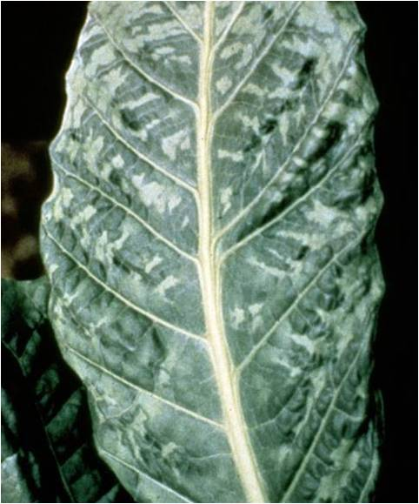
Viral plant disease
Tobacco mosaic virus is a type of viral plant disease that affects plants in the Solanaceae family, including tobacco, tomato and cucumber plants.
It causes a plant’s leaves to
become discolored in a mottled
pattern, resembling a mosaic.
Although tobacco mosaic virus does not cause plant death, it
does result in stunted growth.
Why do you think this is?
The disease can be controlled by removing infected plants
and improving sanitation, e.g. washing hands before planting.
Notes:
Teacher notes
Help students to draw on their understanding of photosynthesis to answer the question. Tobacco mosaic virus affects the ability of the leaves to carry out photosynthesis. Photosynthesis is needed to produce food for the plant, which it can use to support growth. Infection early in the growing season will have the biggest effect on plant growth.
The image shows mottling on an infected leaf of a tobacco plant.
This slide covers the Science and Engineering Practices:
Constructing Explanations and Designing Solutions: Apply scientific ideas, principles, and/or evidence to provide an explanation of phenomena and solve design problems, taking into account possible unanticipated effects.
Engaging in Argument from Evidence: Construct, use, and/or present an oral and written argument or counter-arguments based on data and evidence.
Obtaining, Evaluating, and Communicating Information: Communicate scientific and/or technical information or ideas (e.g. about phenomena and/or the process of development and the design and performance of a proposed process or system) in multiple formats (including orally, graphically, textually, and mathematically).
Photo credit: This image is in the public domain because it is a work of the U.S. Federal Government and is therefore not subject to copyright.

Slide 9
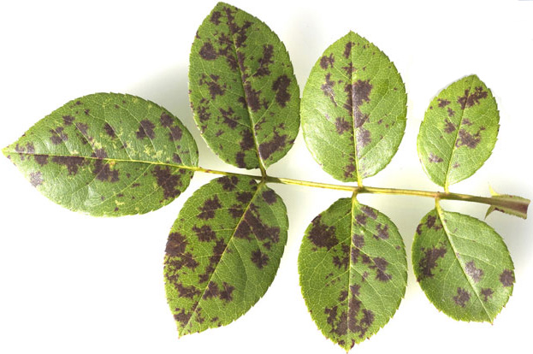
Fungal plant diseases
Black spot is a type of fungal disease that affects
rose plants.
As the name of the disease suggests, it causes black
spots to appear on the plant’s leaves.
Under wet conditions, the fungus produces spores which can be
spread by water to infect other
leaves and plants.
To treat the disease, infected
leaves can be removed or
sprayed with antifungal chemicals
that help to destroy the fungus.
Notes:
Photo credit: © Manfred-Ruckszio, Shutterstock.com 2018

Slide 10
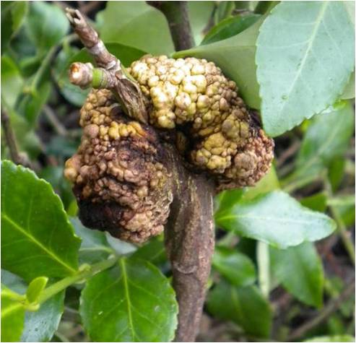
Bacterial plant disease
Crown gall disease is a type of bacterial disease that
affects many different kinds of woody plants, including grapes, blackberries and roses.
The bacteria enter the plant through wounds on the roots or the stem. They cause the plant’s tissues to grow abnormally, producing swellings called galls.
The disease can affect plant growth.
If the galls become very large, this can prevent a plant from being able
to transport water and nutrients.
To prevent the disease spreading,
infected plants are usually removed.
Notes:
Photo credit: spindle tree infected by crown gall disease © Elizabeth Bush, Virginia Polytechnic Institute and State University, Bugwood.org 2018

Slide 11
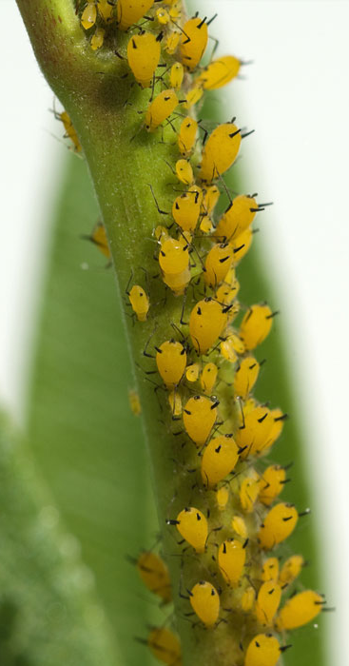
Insects causing disease
Pests are a major cause of plant disease. Many types of insect feed on plants, or use them to reproduce. This can have a detrimental effect on a plant’s health.
Aphids are a type of insect pest that feed
on plants by sucking sap from their leaves
or stems.
They can cause a lot of damage, including
reduced plant growth rates, mottled leaves,
yellowing, wilting and even death.
Aphids are commonly controlled using
chemicals called insecticides.
Notes:
Photo credit: © Manfred-Ruckszio, Shutterstock.com 2018

Slide 12
Mineral ion deficiency
Mineral ions in the soil are important for plant growth and health. If the level of ions in the soil becomes too low, plants can become deficient, which can lead to disease.
Nitrate ions are needed for protein synthesis. As a result,
a lack of nitrate ions in the soil can stunt growth.
Magnesium ions are used to make chlorophyll.
Magnesium deficiency can cause
chlorosis, which leads to a lack
of green coloration in the leaves.
This reduces photosynthesis, and
as a result, decreases growth.
Notes:
Photo credit: magnesium-deficient leaf © ChameleonsEye, Shutterstock.com 2018

Slide 13
Mineral deficiencies and plant growth

