Slide 1
Plant Defences

Slide 2
Information
Constructing Explanations and Designing Solutions
Obtaining, Evaluating and Communicating Information
1. Patterns
2. Cause and Effect
6. Structure and Function
Lesson name

Slide 3
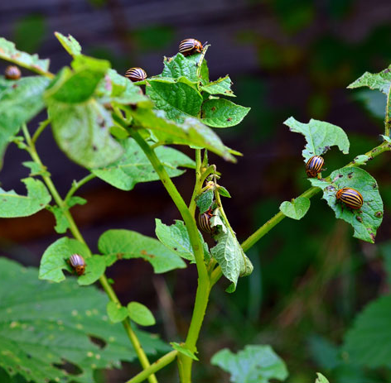
Plant defences
Plants have a range of defence responses to prevent damage and disease.
These defences protect plants from disease-causing microorganisms, known as pathogens, and herbivores, which are animals that only eat plants.
There are two main types of plant
defence response:
Physical defences: these provide a barrier against attack.
Chemical defences: these are chemical substances produced by a plant.
Notes:
Teacher notes
For more information about types of plant diseases, please refer to the ‘Plant Diseases’ presentation.
Photo credit: © Violart, Shutterstock.com 2018

Slide 4
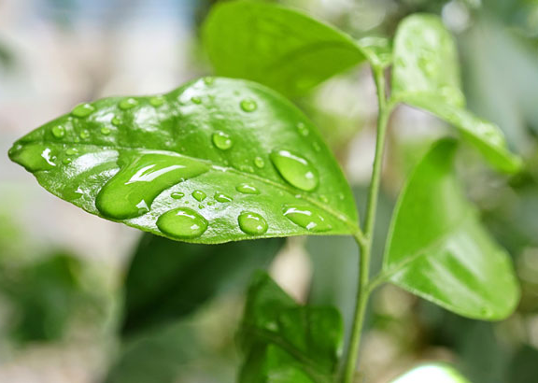
Physical defences
Physical plant defences involve features of the plant’s surface, in particular the leaves.
Can you name any parts of a plant, or plant cells, that have a role in defence?
cell walls
leaf cuticle
stem surface
These can each help a plant resist invasion from microorganisms.
Notes:
Teacher notes
Discuss students’ ideas for the question before revealing the answers. Encourage them to draw on their understanding of plant cells and tissues to find answers. Help them to remember the role of cellulose in building a tough, resistive structure, and the role of the waxy leaf cuticle in providing a waterproof, resistive coating.
For more information on plant structures, please refer to the Cells presentation and the Plant Tissues and Organs presentation.
This slide covers the Science and Engineering Practices:
Constructing Explanations and Designing Solutions: Apply scientific ideas, principles, and/or evidence to provide an explanation of phenomena and solve design problems, taking into account possible unanticipated effects.
Obtaining, Evaluating, and Communicating Information: Communicate scientific and/or technical information or ideas (e.g. about phenomena and/or the process of development and the design and performance of a proposed process or system) in multiple formats (including orally, graphically, textually, and mathematically).
Photo credit: © Jomic, Shutterstock.com 2018

Slide 5
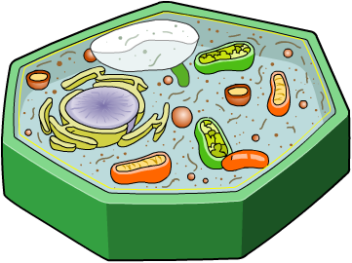
Cell walls
Plant cell walls are made out of a type of carbohydrate called cellulose. The cell wall surrounds the cell membrane and has a role in physical defence.
Cellulose is a tough, fibrous material which helps protect
plant cells from being invaded.
plant cell
To break down the cell wall,
microorganisms have to be able
to produce special enzymes.
Most animals and insects do
not have these enzymes, so
are unable to digest cellulose.
cell wall
cell membrane
Notes:
Teacher notes
Ask if students are able to identify the cell wall in the image of the plant cell before revealing its label.
For more information about enzymes, please refer to the ‘Enzymes’ presentation.

Slide 6
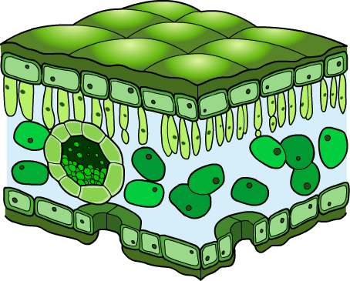
Leaf cuticle
The leaf cuticle is a thin, waxy layer which covers the
epidermis. This is the layer of cells forming the leaf’s
outer surface.
cuticle
epidermis
As well as reducing water loss
by evaporation, the cuticle also
has a role in physical defence.
The cuticle helps to prevent
viruses, bacteria and fungi
from entering the leaf tissue.
This is because microorganisms
find it difficult to penetrate the
waxy surface.
cross-section of a leaf
Notes:
Teacher notes
For more information about the structure of leaves and plant tissues, please refer to the ‘Plant Tissues and Organs’ presentation.

Slide 7
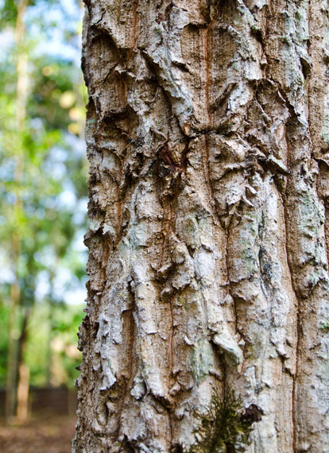
Plant stems
Plant stems can be surrounded by a layer of dead plant cells which have a role in physical defence. In trees, this layer forms the bark, which covers the trunk and branches.
The dead cells form a tough, woody
surface that is difficult for herbivores
and pathogens to penetrate.
This helps protect plants from being
eaten or infected by disease.
In some trees, the bark peels off,
taking any pathogens on the tree’s
surface with it.
Notes:
Photo credit: © treesak, Shutterstock.com 2018

Slide 8
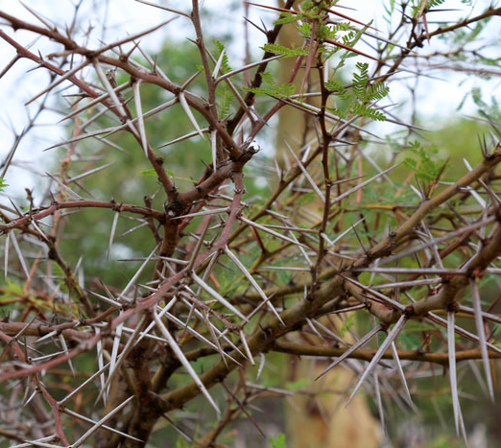
Mechanical adaptations
Plants have many structural features that have a role in defence against herbivores.
These features can help protect a plant from a specific herbivore, or several different types and are known as mechanical adaptations.
Can you name any structural
features that help plants defend
themselves from herbivores?
thorns
spines or prickles
hairs on leaves or stems
Notes:
Teacher notes
Discuss students’ ideas for the question before revealing the answer. Encourage them to draw on their existing knowledge of plant structures and adaptations. For more information about plant adaptations, please refer to the ‘Adaptations’ presentation.
This slide covers the Science and Engineering Practices:
Constructing Explanations and Designing Solutions: Apply scientific ideas, principles, and/or evidence to provide an explanation of phenomena and solve design problems, taking into account possible unanticipated effects.
Obtaining, Evaluating, and Communicating Information: Communicate scientific and/or technical information or ideas (e.g. about phenomena and/or the process of development and the design and performance of a proposed process or system) in multiple formats (including orally, graphically, textually, and mathematically).
Photo credit: © Barry Tuck, Shutterstock.com 2018

Slide 9
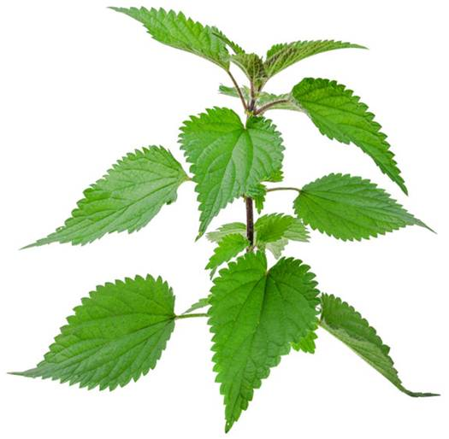
Thorns and hairs
Thorns and hairs are types of mechanical adaptation that
slow down the rate at which herbivorous animals can feed
on a plant. This makes it more likely that the animal will move on to eat something else.
Thorns are most effective against large animals, whereas
hairs defend plants from small animals, such as insects.
Hairs on some plants contain
chemicals that cause irritation
to deter herbivores further.
For example, the hairs on the leaves of stinging nettles contain a chemical that causes inflammation.
Notes:
Teacher notes
Plant hairs are known as trichomes.
Photo credit: © Roman-Pelesh, Shutterstock.com 2018

Slide 10
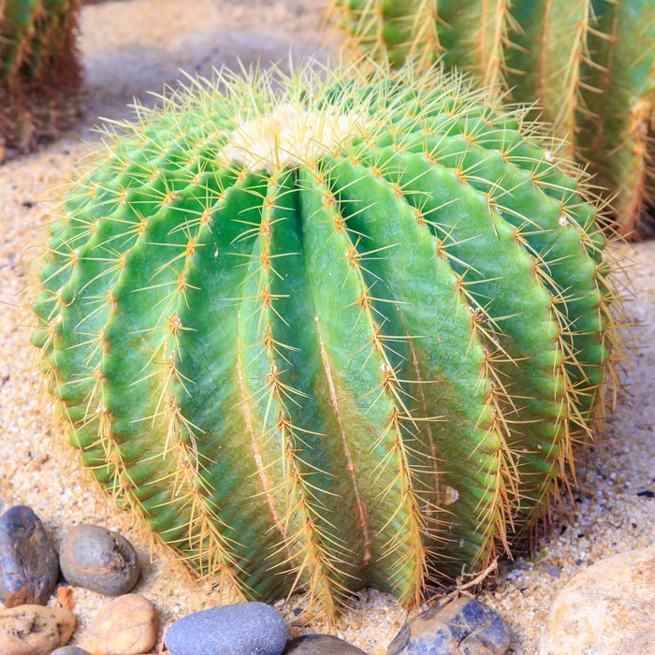
Spines
Spines are another type of mechanical adaptation. Like thorns and hairs, they prevent herbivorous animals from feeding on a plant.
Spines are modified leaves. They are very sharp, making it difficult for herbivores to reach the plant tissue below.
The surface of cacti have a dense covering of spines.
In the desert, these help protect cacti from small herbivorous animals, such as mice and bats.
Notes:
Photo credit: © xwing, Shutterstock.com 2018

Slide 11
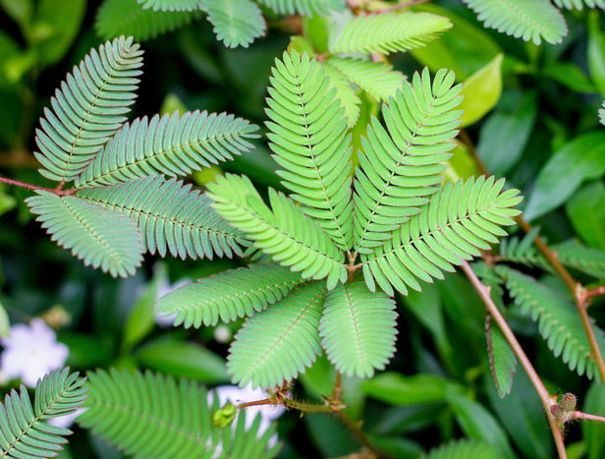
Moving leaves
The leaves of some plants are able to curl or droop in response to touch.
For example, if a Mimosa plant is touched, its leaves fold in half to become ‘shut’.
This reduces the surface
area of the leaf available
for a herbivore to eat.
The movement can also
dislodge insects from the plant, making them fall off.
Such a response reduces damage and makes it more likely that the herbivore will look for an alternative plant to eat.
Notes:
Teacher notes
The movement of leaves in response to touch is known as thigmonasty.
Photo credit: © trytrle, Shutterstock.com 2018
Mimosa pudica

Slide 12
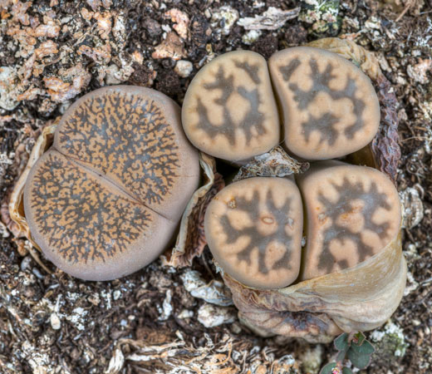
Mimicry
Some plants are adapted to look like other plants, animals
or their environment to prevent herbivores from feeding on them. This is known as mimicry.
For example, the Lithops plant
resembles a stone pebble.
In the wild, they are found in the
dry regions of southern Africa,
where they are a food source
for many types of animal.
However, their appearance enables them to blend in with
their surroundings. This makes it less likely that they
will be seen by herbivores and eaten.
Notes:
Photo credit: © Sarah2, Shutterstock.com 2018

Slide 13
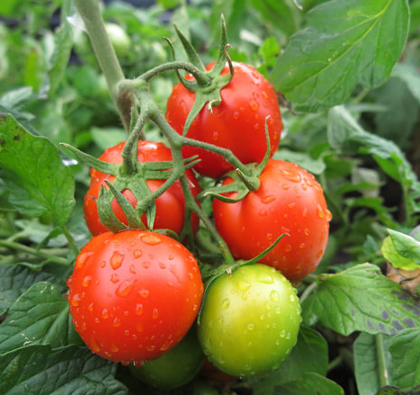
Antimicrobial chemicals
As well as physical defences, many plants produce chemicals to protect themselves from microorganisms and herbivores.
Antimicrobial chemicals are a type of chemical defence.
They can kill or slow the growth of pathogens, including
viruses, bacteria and fungi.
Some of these chemicals target
specific types of pathogen,
whereas others are effective
against a range of pathogens.
For example, tomato plants can produce an antimicrobial chemical called saponin that protects them from fungi.
Notes:
Teacher notes
Some antimicrobial chemicals are pre-formed and are found stored in plants. Other types are produced only once infection has occurred.
Photo credit: © photowind, Shutterstock.com 2018

Slide 14
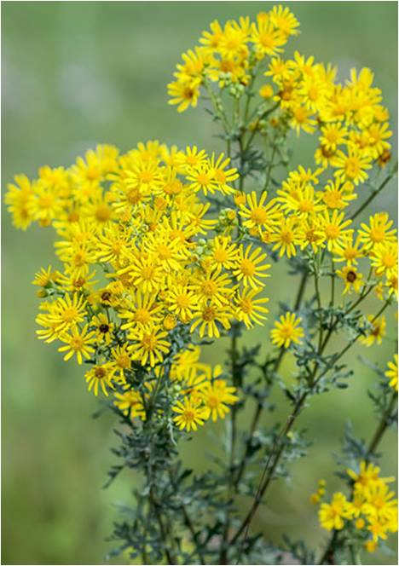
Poisons
Poisons are another type of chemical defence. They are
toxic chemicals which can make a plant inedible. As a result, they help protect plants from herbivores.
Poisonous plants usually have a
bitter taste to deter herbivores
from eating them. However, some
toxic chemicals can cause severe side effects and even death.
For example, ragwort contains
a poisonous chemical. If eaten by animals, such as cattle, sheep or horses, it can lead to liver disease and sometimes death.
Notes:
Photo credit: © Starover Sibiriak, Shutterstock.com 2018

Slide 15
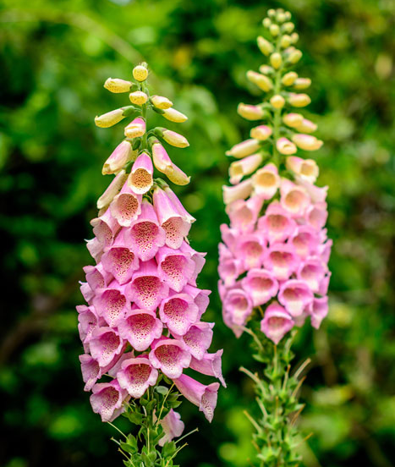
How can humans use plant chemicals?
Many drugs used to treat diseases and their symptoms originate from chemicals produced by plants.
Aspirin is a type of painkiller that is derived from willow trees.
Eating foxglove plants can cause a heart attack as they contain a poisonous chemical.
However, in controlled dosages the
same chemical can be used to treat patients with irregular heart rates.
Plant antimicrobial chemicals can also be useful to humans.
Oils taken from tea tree and witch hazel plants have antibacterial properties and are used as antiseptics.
Notes:
Teacher notes
For more information about antiseptics and drugs, please refer to the ‘Drug Development’ and ‘Vaccination and Medication’ presentations.
Photo credit: © nitsawan katerattanaku, Shutterstock.com 2018

Slide 16
Defence definitions
Notes:
16
Teacher notes
This matching activity could be used as a plenary or revision exercise on plant defences. Students could be asked to complete the questions in their books and the activity could be concluded by completion on the IWB.
Photo credit: © Photos.com 2018

