Slide 1
Making Proteins

Slide 2
Information
Developing and Using Models
Constructing Explanations and Designing Solutions
Obtaining, Evaluating and Communicating Information
2. Cause and Effect
3. Scale, Proportion, and Quantity
4. Systems and System Models
6. Structure and Function

Slide 3
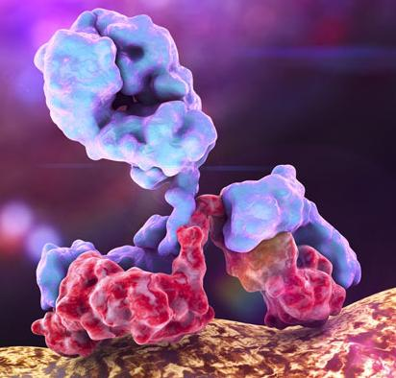
Introducing proteins
Proteins are a diverse group of biological molecules, made up of long chains of amino acids.
They have a wide range of biological roles, including:
structural: proteins are the main component of most body tissues
catalytic: all enzymes are proteins, catalyzing many biochemical reactions
signaling: many hormones and cell receptors are proteins
immunological: all antibodies are proteins.
Notes:
Teacher notes
For more information about enzymes, please refer to the Enzymes presentation.
For more information about antibodies, please refer to The Body’s Defense Systems presentation.
For more information about hormones, please refer to The Endocrine System presentation.
Photo credit: antibody on a bacterial cell © Kateryna Kon, Shutterstock.com 2018

Slide 4
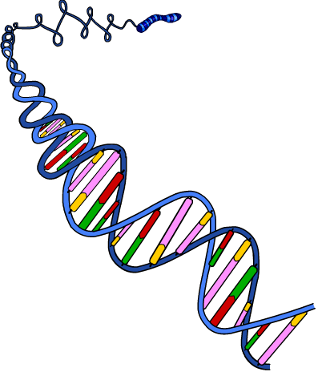
The role of DNA
DNA is a long molecule found in the nucleus of cells. It determines the function of cells by controlling the production of proteins.
Short sections along the DNA molecule contain the information required to make proteins. These sections are called genes.
All body cells contain the same genes.
gene

Slide 5
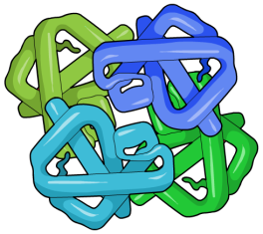
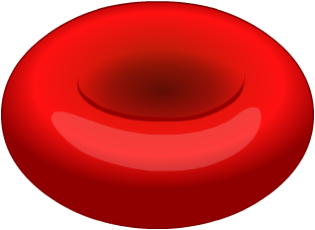
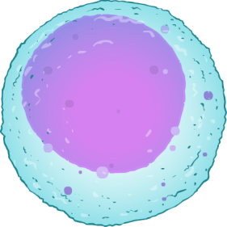
Active and inactive genes
Many of the genes inside any particular cell are inactive or switched off. Inactive genes do not produce any protein.
red blood cell
hemoglobin
The active genes control the activity of the cell by making sure it produces the specific proteins it needs to function properly.
white blood cell
antibody
Whether a gene is active or inactive depends on the type of cell it is in. This means that different types of cells produce different proteins.
Notes:
Teacher notes
In red blood cells, the genes that encode hemoglobin are switched on; however, the genes that encode antibodies are switched off. In white blood cells, the genes that encode antibodies are switched on. This means that white blood cells produce antibody proteins but not hemoglobin and red blood cells produce hemoglobin but not antibody proteins.

Slide 6
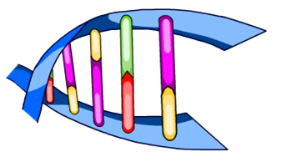
The triplet code
DNA is a polymer made of a chain of nucleotides. Each nucleotide contains a base. There are four different types of bases, represented using the letters A, T, G, and C.
The order of bases in a gene determines the order of amino acids in a protein.
A set of three DNA bases corresponds to a single amino acid. This is called the triplet code.
It is important that the correct order of amino acids is achieved in order for each protein to function properly.
triplet code of three bases
Notes:
Teacher notes
There are 20 types of amino acid that DNA can code for. Each amino acid is coded for by a different sequence of bases.
All organisms rely on the same 4 bases in their DNA to code for amino acids. As a result, the genetic code is described as being “universal.”
For more information about DNA, please refer to the DNA and the Genome presentation.

Slide 7
The link between genes and proteins
Notes:
Teacher notes
This three-stage sequence introduces the link between genes and proteins.
This slide covers the Science and Engineering Practices:
Developing and Using Models: Use a model to provide mechanistic accounts of phenomena.
Constructing Explanations and Designing Solutions: Apply scientific ideas, principles, and/or evidence to provide an explanation of phenomena and solve design problems, taking into account possible unanticipated effects.

Slide 8
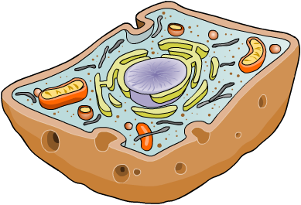
How are proteins synthesized from DNA?
Protein synthesis involves the production of a chain of amino acids called a polypeptide chain.
The stages of protein synthesis include:
transcription of the gene in the nucleus to make a strand of mRNA
transcription
translation
translation of the mRNA on a ribosome to form a polypeptide chain
​modification of the polypeptide chain to make the final protein.

Slide 9
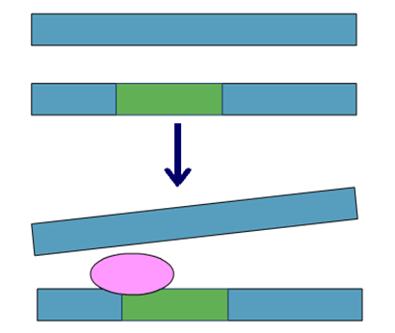
Stage 1: Transcription in the nucleus
Protein synthesis begins in the nucleus. The DNA is too large to move into the cytoplasm and so a copy of the gene must be made. This is called transcription and involves several steps:
The two strands of DNA must be unzipped (separated) to allow access to the sequence of bases in the gene.
A large protein called RNA polymerase binds to a section of DNA in front of the gene.
gene
RNA polymerase
RNA polymerase runs along the DNA, producing a copy of the gene. This copy is called messenger RNA (mRNA).
mRNA
Notes:
Teacher notes
RNA polymerase is an enzyme that catalyzes the synthesis of mRNA. The mRNA produced is a copy of the gene in the coding strand of DNA.
The diagram shows a target gene for transcription (green). The two DNA strands must be separated for RNA polymerase to bind to the start of the gene and begin transcription. RNA polymerase produces a copy of the coding strand, this is messenger RNA (purple).

Slide 10
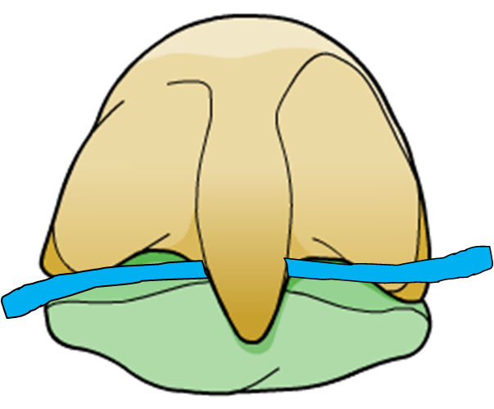
Stage 2: Translation in the cytoplasm
Following transcription, the mRNA moves out of the nucleus and into the cytoplasm where it attaches to a ribosome.
The mRNA acts as a template for translation:
A carrier molecule called tRNA brings amino acids to the ribosome.
The ribosome reads the mRNA and joins the correct amino acids together according to the triplet code.
When the final amino acid is added, the complete polypeptide chain is released into the cytoplasm.
mRNA
ribosome

Slide 11
How are proteins made?
Notes:
Teacher notes
This six-stage sequence shows how proteins are made. Suitable prompts could include:
Why does the messenger RNA move out of the nucleus?
How many bases are involved in the code for one amino acid?
How will protein synthesis differ in different specialized cells?
This slide covers the Science and Engineering Practices:
Developing and Using Models: Use a model to provide mechanistic accounts of phenomena.
Constructing Explanations and Designing Solutions: Apply scientific ideas, principles, and/or evidence to provide an explanation of phenomena and solve design problems, taking into account possible unanticipated effects.

Slide 12
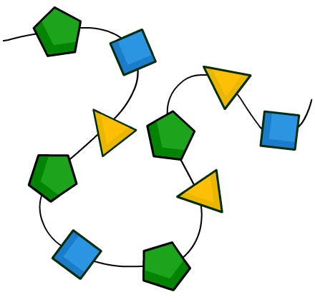
Stage 3: Formation of the final protein
The polypeptide chain produced during translation must fold into a unique three dimensional shape. This allows it to carry out its specific function.
For example, an enzyme must fold correctly to form its active site. This enables it to bind to its substrate.
polypeptide chain
A protein can be made of more than one polypeptide chain folding together. For example, the protein collagen is made up of three polypeptide chains.
folded protein
Notes:
Teacher notes
For more information about the active site of an enzyme, please refer to the Enzymes presentation.

Slide 13
Sequence of events in protein synthesis
Notes:
This slide covers the Science and Engineering Practice:
Constructing Explanations and Designing Solutions: Apply scientific ideas, principles, and/or evidence to provide an explanation of phenomena and solve design problems, taking into account possible unanticipated effects.

Slide 14
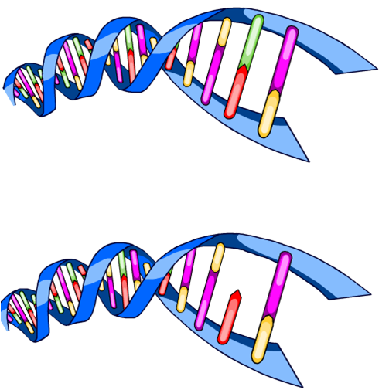
Changing the protein sequence
Each protein has a specific number and sequence of amino acids that determine its shape and function. If just one amino acid is incorrect, the protein might not function.
Changes to the order of bases in DNA can alter the order of amino acids in a protein.
These changes in DNA are called mutations and can be due to:
the deletion of a base
mutation
the addition/insertion of an extra base
the replacement of one base for another.
Notes:
Teacher notes
The process by which DNA is copied during cell division is called DNA replication. A mutation is often caused by errors that occur during DNA replication.

Slide 15
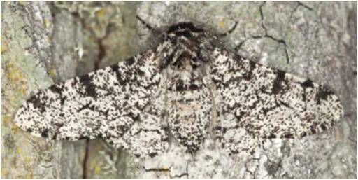
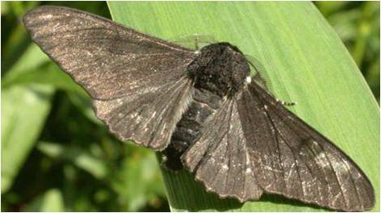
Genetic mutations
Mutations are continuously occurring in your body, however most do not affect protein function.
This is because many mutations do not alter the protein, or do not alter it significantly enough to affect its function.
Some mutations can be beneficial and provide the genetic variation needed for evolution.
For example, a mutation may change the phenotype of an individual, providing them with a greater ability to survive.
Notes:
Teacher notes
Many mutations do not affect protein function as they occur in DNA that does not code for a protein. The body is also able to repair many mutations that do arise.
Both the moths in the images are peppered moths. A random mutation caused a population of peppered moths to have black wings. During the industrial revolution, tree trunks near cities were turned black by pollution. The black winged mutants were better camouflaged against these tree trunks than the original white peppered moths. This meant there was a decrease in the number of white peppered moths in the population.
Over time, as pollution decreased, the tree barks returned to their normal color. This resulted in a decrease in black peppered moths and an increase in white peppered moths in the population.
Photo credits: black moth © Steve McWilliam, peppered moth © Henrik Larsson both at Shutterstock.com 2018

Slide 16
Mutations in coding DNA
Coding DNA is the part of a gene which determines the order of amino acids in a protein.
When a mutation occurs in coding DNA, it can alter the phenotype of an individual by changing the activity of a protein.
A change in the base sequence of a gene may lead to the production of a different protein, a change in the protein structure or no protein being made at all.
altered protein activity
Notes:
Teacher notes
The mutation may alter the way that a protein folds, or prevent the protein from folding at all. This will change the structure of a protein, which may alter its function.

Slide 17
Mutations and enzymes
What could happen if a mutation occurs in a gene coding for an enzyme?
If a mutation alters the structure of an enzyme’s active site, the substrate may no longer be able to fit in the enzyme’s active site.
This will prevent it from catalyzing important cellular reactions that enable the body to function.
Mutations that affect other parts of the enzyme may alter the location of the enzyme in the cell, which could affect its activity.
Notes:
Teacher notes
If an enzyme cannot reach its target substrate in the cell, then it will not be able to bind to the substrate and carry out catalysis.
This slide covers the Science and Engineering Practices:
Developing and Using Models: Use a model to provide mechanistic accounts of phenomena.
Constructing Explanations and Designing Solutions: Apply scientific ideas, principles, and/or evidence to provide an explanation of phenomena and solve design problems, taking into account possible unanticipated effects.
Obtaining, Evaluating, and Communicating Information: Communicate scientific and/or technical information or ideas (e.g. about phenomena and/or the process of development and the design and performance of a proposed process or system) in multiple formats (including orally, graphically, textually, and mathematically).

Slide 18
Mutations in non-coding DNA (1)
Some sections of DNA do not code for proteins. This is called non-coding DNA. Some non-coding DNA can control whether a specific gene is transcribed by switching it on or off.
Mutations in non-coding DNA can affect the phenotype of an individual, by changing gene transcription.
This is because RNA polymerase binds to non-coding DNA at the start of transcription.
What will happen if a mutation in non-coding DNA prevents RNA polymerase from binding?
Notes:
Teacher notes
Non-coding DNA controls the production of proteins by regulating transcription. If RNA polymerase is unable to bind to non-coding DNA, then transcription cannot take place. This results in a decrease in the amount of mRNA produced and so a decrease in the amount of protein made.
This slide covers the Science and Engineering Practices:
Constructing Explanations and Designing Solutions: Apply scientific ideas, principles, and/or evidence to provide an explanation of phenomena and solve design problems, taking into account possible unanticipated effects.
Obtaining, Evaluating, and Communicating Information: Communicate scientific and/or technical information or ideas (e.g. about phenomena and/or the process of development and the design and performance of a proposed process or system) in multiple formats (including orally, graphically, textually, and mathematically).

Slide 19
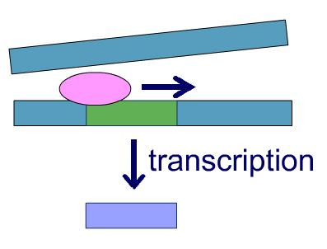
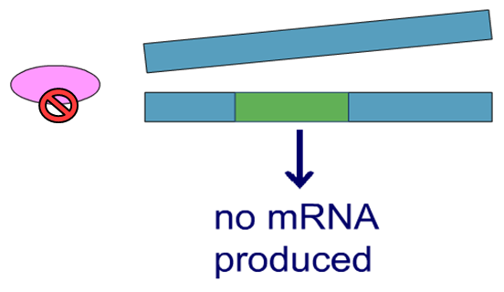
Mutations in non-coding DNA (2)
Mutations in non-coding DNA at the start of a gene can prevent RNA polymerase from binding to DNA.
If RNA polymerase is unable to bind to the DNA, then transcription cannot take place.
This results in a decrease in mRNA production, which means less protein is made during translation.
mRNA
Mutations in non-coding DNA can therefore affect the amount of protein produced in a cell.

Slide 20
Mutagenic agents
Most mutations occur when DNA is replicated in cell division.
During cell division, a new cell containing an identical copy of DNA to the parent cell, is produced. Sometimes mistakes are made when the DNA is copied, leading to mutation.
The occurrence of mutations can be increased by mutagenic agents, such as UV radiation and harmful chemicals.
Mutagenic agents disrupt the structure of DNA or interfere with protein synthesis.
Notes:
Photo credit: © Rido, Shutterstock.com 2018

