Slide 1
Inherited Disorders

Slide 2
Information
Developing and Using Models
Constructing Explanations and Designing Solutions
Engaging in Argument from Evidence
Obtaining, Evaluating and Communicating Information
1. Patterns
2. Cause and Effect
4. Systems and System Models
6. Structure and Function

Slide 3
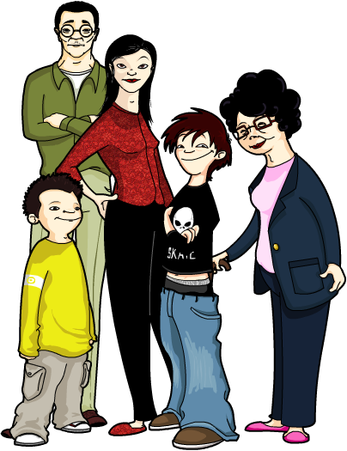
What is inheritance?
Each person has a unique set of characteristics, such as eye color, height and blood group.
These characteristics are determined by the combination of the genes they inherit from their parents and the environment in which they develop.
Different versions of genes exist, which result in variation in specific characteristics, such as eye color. These versions are called alleles.
Notes:
Teacher notes
For more information about inheriting genes, please refer to the Inheritance presentation.

Slide 4
Inherited disorders
Inherited disorders are caused by faulty genetic material that is passed on to future generations. They are sometimes called genetic disorders.
Many inherited disorders are caused by mutations in DNA, resulting in faulty alleles that are unable to express a functioning protein.
Mutations can be spontaneous or caused by exposure to DNA-damaging substances called mutagens. These include radiation and certain chemicals.
There are over 4,000 known inherited disorders, although the specific alleles involved are only known for 25% of them.
Notes:
Teacher notes
For more information about mutation and genetic variation, please refer to the Inheritance and Making Proteins presentations.

Slide 5
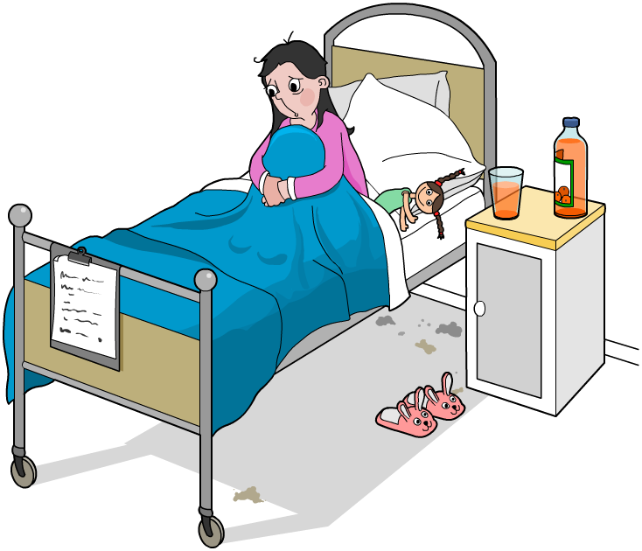
Treating inherited disorders
Many inherited disorders are serious and life-limiting. However, with the appropriate treatment, some patients are able to lead relatively normal lives.
Most inherited diseases cannot yet be cured. Why is this?
Curing an inherited disorder involves replacing faulty genes with normal genes.
This is called gene therapy. It is a very complex and relatively new technique, and has yet to be widely successful.
Notes:
Teacher notes
Discuss students’ ideas for the question before revealing the answer. Help them to identify and explain the difficulty of curing a disorder caused by faulty DNA.
This slide covers the Science and Engineering Practices:
Constructing Explanations and Designing Solutions: Apply scientific ideas, principles, and/or evidence to provide an explanation of phenomena and solve design problems, taking into account possible unanticipated effects.
Obtaining, Evaluating, and Communicating Information: Communicate scientific and/or technical information or ideas (e.g. about phenomena and/or the process of development and the design and performance of a proposed process or system) in multiple formats (including orally, graphically, textually, and mathematically).

Slide 6
Symptoms

Slide 7
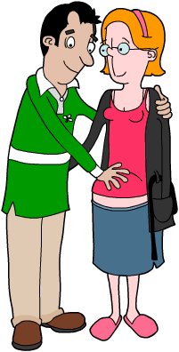
Types of inherited disorders
There are different types of inherited disorders:
Single-gene
These are caused by mutations in single genes. Examples include Huntington’s disease, cystic fibrosis and sickle-cell anemia.
Multifactorial
These are caused by mutations in several genes, combined with environmental factors. Examples include cardiovascular disease and cancer.
Chromosomal
Some disorders are caused when a person inherits an abnormal number or structure of chromosomes. Examples include Down’s syndrome and Klinefelter syndrome.
Notes:
Teacher notes
Someone who has a genetic predisposition to a multifactorial disorder such as heart disease or cancer will not definitely develop the disease. However, they may be at higher risk of developing it, particularly when environmental factors, including lifestyle, are taken into account. With multifactorial disorders, the outcome, for example cancer, is often referred to as a “disease,” whereas the genetic mutation that may lead to the disease is referred to as a “disorder.”

Slide 8
Fill in the gaps
Notes:
This slide covers the Science and Engineering Practice:
Constructing Explanations and Designing Solutions: Apply scientific ideas, principles, and/or evidence to provide an explanation of phenomena and solve design problems, taking into account possible unanticipated effects.

Slide 9
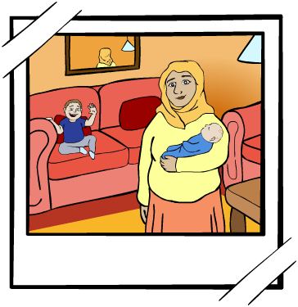
Carriers
Some inherited disorders, such as Huntington’s disease, are caused by dominant alleles. However, most, including cystic fibrosis, are caused by recessive alleles.
If a person only has one faulty allele that codes for a recessive inherited disorder, they may not show symptoms of the disease.
This is because the normal functioning allele is dominant. These people are called carriers of the disease.
A person must inherit two copies of the faulty recessive allele in order to develop the disease.
Notes:
Teacher notes
If two carriers for an inherited disorder have a child, that child may go on to develop the disorder.
For more information about dominant and recessive alleles, please refer to the Inheritance presentation.

Slide 10
True or false?
Notes:
Teacher notes
This true-or-false activity could be used as an introductory or summary activity on inherited disorders, or at the start of the lesson to gauge students’ existing knowledge of the subject matter. Colored traffic light cards (red = false, yellow = don’t know, green = true) could be used to make this a whole-class exercise.

Slide 11
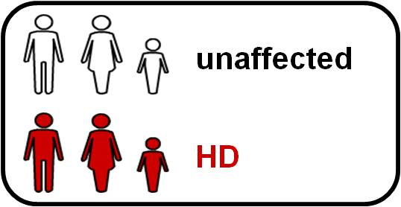
Huntington’s disease
Huntington’s disease (HD) is an inherited disorder caused by a dominant allele. This means a person only needs to inherit one faulty allele in order to have Huntington’s disease.
It damages the nerve cells in certain areas of the brain and eventually leads to the loss of brain function.
HD does not develop until later in life, meaning that people may pass it on to their children before they have been diagnosed.
Notes:
Teacher notes
As HD is caused by a dominant allele, a person only needs to inherit one copy of the faulty allele in order to suffer symptoms of HD. If a person carries the faulty gene, there is a 50% chance that each child they have will inherit the faulty gene.
The diagram shows the inheritance of the HD faulty allele in a family. The woman at the top has HD, which means she has at least one copy of the dominant allele. The woman had 4 children with a man who does not have HD and the faulty allele is therefore passed onto only one of their children. This child passes the faulty allele for HD onto two of their children.
This slide covers the Science and Engineering Practice:
Developing and Using Models: Use a model to provide mechanistic accounts of phenomena.

Slide 12
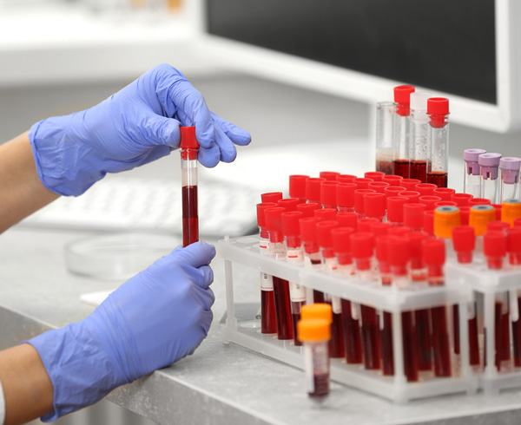
Diagnosing Huntington’s disease
Huntington’s disease is usually diagnosed from the physical symptoms of the patient and confirmed by a blood test.
The blood test can also be used in people who have yet to show symptoms, but who have a family history of the disease.
This means they can start taking useful drugs before they display symptoms.
Not everyone with a family history of an inherited disorder will want to know if they have inherited it. Why?
Notes:
This slide covers the Science and Engineering Practices:
Constructing Explanations and Designing Solutions: Apply scientific ideas, principles, and/or evidence to provide an explanation of phenomena and solve design problems, taking into account possible unanticipated effects.
Obtaining, Evaluating, and Communicating Information: Communicate scientific and/or technical information or ideas (e.g. about phenomena and/or the process of development and the design and performance of a proposed process or system) in multiple formats (including orally, graphically, textually, and mathematically).
Photo credit: © Africa Studio, Shutterstock.com 2018

Slide 13
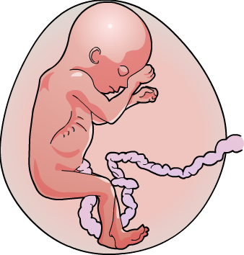
Diagnosing cystic fibrosis
Cystic fibrosis in children is usually diagnosed using a sweat test which measures chloride levels in sweat. People with cystic fibrosis have more chloride in their sweat.
If a couple has a family history of cystic fibrosis, they may want to test their unborn child's chromosomes for the disease.
There are two types of test:
amniocentesis – fetal cells are collected from the fluid surrounding the baby (amniotic fluid) via a hollow needle
placenta sampling – fetal cells are collected from the placenta with a suction tube.
Notes:
Teacher notes
Amniocentesis can be used to test for other genetic diseases, such as Down’s syndrome. It is only offered if there is a high risk that the baby may have a genetic condition. This may be due to a family history of the disease or a previous pregnancy with these issues. There are both benefits and risks to amniocentesis, however it is up to the patient to decide whether they have the test.
Placenta sampling is also known as chorionic villus sampling.

Slide 14
How is cystic fibrosis inherited?
Notes:
This slide covers the Science and Engineering Practices:
Developing and Using Models: Develop, revise, and/or use a model based on evidence to illustrate and/or predict the relationships between systems or between components of a system.
Constructing Explanations and Designing Solutions: Apply scientific ideas, principles, and/or evidence to provide an explanation of phenomena and solve design problems, taking into account possible unanticipated effects.

Slide 15
Fetal testing
Notes:
Teacher notes:
The following facts can be used to discuss probability and risk:
The risk of miscarriage as a result of amniocentesis or placenta sampling (chorionic villus sampling) is 0.5–2%.
According to one study, the baseline population risk for all couples of having an infant with a major genetic disorder is 2–5%.
The risk is higher if there is a family history of genetic disorder.
Mothers who are more than 35 years of age at the time of delivery have an increased risk of giving birth to infants carrying a chromosomal abnormality. For example, the likelihood of carrying a baby with Down’s syndrome rises from about 1 in 1,295 at age 20, to almost 1 in 30 at age 45.
This slide covers the Science and Engineering Practice:
Engaging in Argument from Evidence: Respectfully provide and/or receive critiques on scientific arguments by probing reasoning and evidence and challenging ideas and conclusions, responding thoughtfully to diverse perspectives, and determining what additional information is required to resolve contradictions.

Slide 16
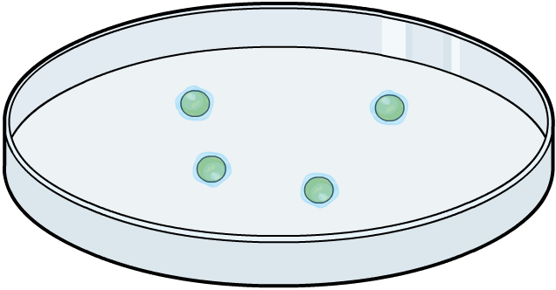
IVF and genetic screening
Couples at risk of having a baby with an inherited disorder may opt to undergo in vitro fertilization (IVF).
In vitro is Latin for “in glass” so IVF means fertilization that takes place outside of the body and in laboratory glassware.
After fertilization, pre-implantation genetic diagnosis (PGD) can be carried out.
During PGD the embryos are checked for specific inherited disorders before being implanted into the woman.
Only embryos without the disorder will be implanted into the woman’s body.
Notes:
Teacher notes
PGD is used to test for certain genetic diseases including cystic fibrosis, hemophilia, Huntington’s disease, sickle cell disease and the predisposition to some cancers. Some diseases, such as hemophilia and Duchenne muscular dystrophy, only affect males.
If there is a family history of the disease, only female embryos will be selected and implanted. Pre-genetic screening (PGS) is used to check embryos to make sure that they have the correct number of chromosomes. More recently, a new type of testing, called Pre-implantation Genetic Haplotyping (PGH), has been developed that enables a much larger number of genetic diseases to be identified.

Slide 17
Opinions on genetic screening
Notes:
This slide covers the Science and Engineering Practice:
Engaging in Argument from Evidence: Respectfully provide and/or receive critiques on scientific arguments by probing reasoning and evidence and challenging ideas and conclusions, responding thoughtfully to diverse perspectives, and determining what additional information is required to resolve contradictions.

