Slide 1
Inheritance

Slide 2
Information
Developing and Using Models
Using Mathematics and Computational Thinking
Constructing Explanations and Designing Solutions
Obtaining, Evaluating and Communicating Information
1. Patterns
2. Cause and Effect
3. Scale, Proportion, and Quantity
6. Structure and Function

Slide 3
What is inheritance?
Inheritance is the process by which parents pass on traits (characteristics) to their offspring.
If a trait can be passed on to the next generation then it is said to be heritable.
Parents pass on genes to their offspring during reproduction. As a result, heritable traits are genetic.
An individual’s characteristics are therefore influenced by the genes they inherit from their parents.
Notes:
Photo credit: © Monkey Business Images, Shutterstock.com 2018

Slide 4
Genotype and phenotype
The full set of genes of an organism is called its genotype.
Phenotype describes the overall observable characteristics of an organism. This depends on:
1.
the organism’s genotype (its inherited characteristics)
2.
the environment in which the organism lives.
This means that an organism’s phenotype depends on its genotype plus its interaction with the environment:
phenotype = genotype + environmental effects

Slide 5
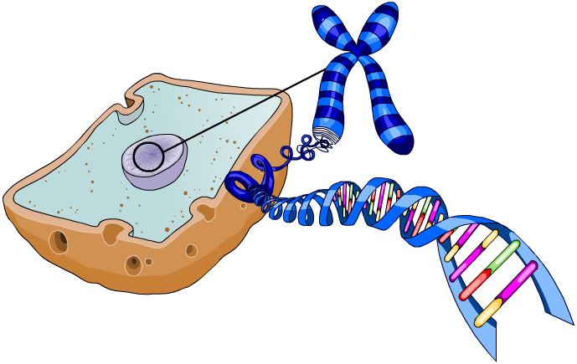
Understanding the genome
The entire genetic material of an organism forms its genome.
An individual’s DNA is located in the nucleus of its cells. In the nucleus, DNA is arranged into chromosomes. Each chromosome is made of a single strand of DNA.
chromosome
A gene is a section of DNA that codes for a specific protein, which contributes to a particular trait.
nucleus
DNA
There can be more than one version of a particular gene. Alternative forms of the same gene are called alleles.
gene
Notes:
Teacher notes
The alleles present operate at a molecular level to develop characteristics (via the proteins they produce) that can contribute to the phenotype.

Slide 6
Chromosomes: missing words
Notes:
Teacher notes
This activity could be used as a summary exercise on genes and chromosomes or to assess your students’ existing knowledge before teaching them about inheritance.

Slide 7
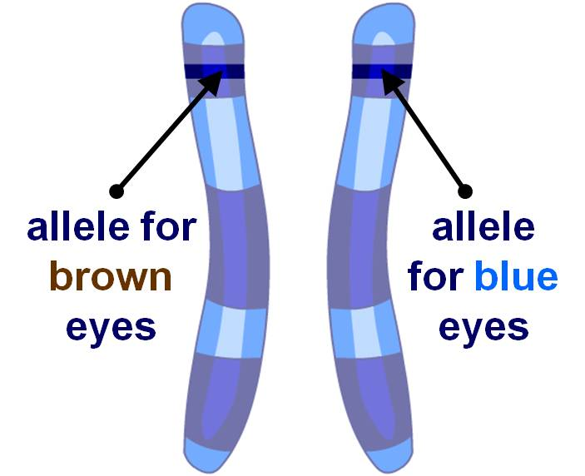
Chromosomes and alleles
In body cells, chromosomes are found in pairs which contain genes coding for the same characteristics, such as eye color.
However, each chromosome in the pair may have a different allele (variant) of the gene.
Chromosomes are said to form homologous pairs, as they contain different alleles for the same genes.
For example, an allele on one chromosome may code for brown eyes, whereas the allele on the other chromosome may code for blue eyes.
Notes:
Teacher notes
It may be worth clarifying to students that, for each gene, one allele is inherited from the mother and the other allele is inherited from the father.

Slide 8
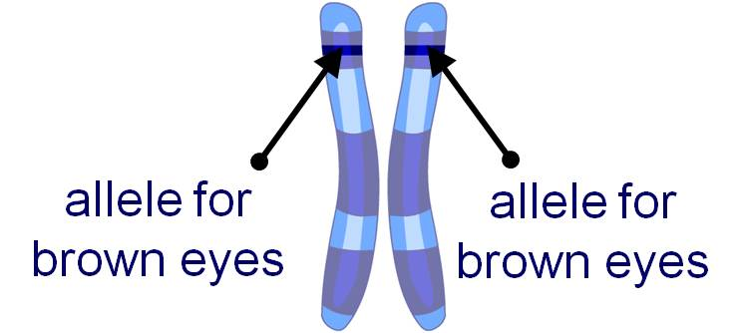
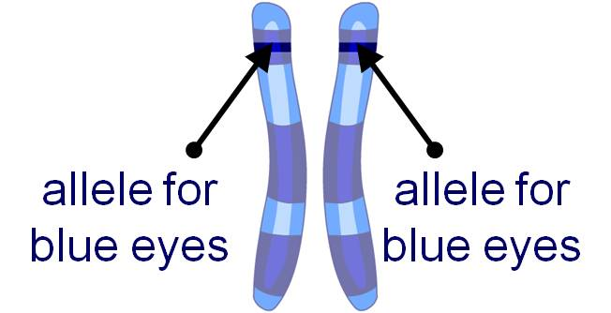
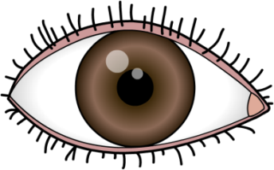
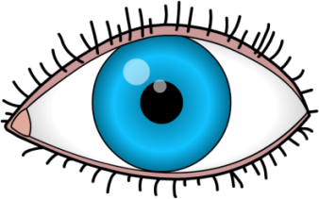
Homozygous alleles
If the alleles for a characteristic in a homologous pair are the same, the individual is said to be homozygous for that characteristic.
What color eyes will an individual have with these homozygous pairs of alleles?
This individual will have brown eyes.
This individual will have blue eyes.
Notes:
Teacher notes
In each homologous pair of chromosomes, one chromosome has been inherited from the mother and other from the father.
Similarly, in a pair of alleles for a particular gene, one has been inherited from the mother and the other from the father.

Slide 9
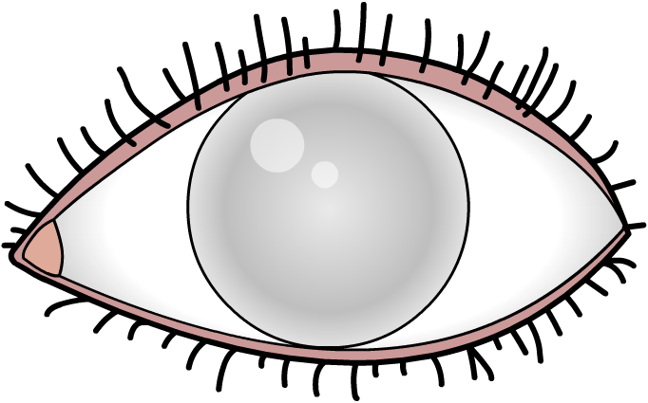
Heterozygous alleles
If the alleles for a characteristic in a homologous pair are different, the organism is said to be heterozygous for that characteristic.
What color eyes will an individual have with this pair of heterozygous alleles?
?
allele for brown eyes
allele for blue eyes
The characteristic produced by the pair of heterozygous alleles will depend on which allele is expressed.
Notes:
Teacher notes
Expression is the term used to describe an active gene that is used for the production of a functional protein. Not all genes in the genome are expressed.
Only genes that are expressed produce protein. If a gene is not expressed it doesn’t produce any protein which means that it cannot contribute to the trait or the organism’s phenotype.

Slide 10
Dominant or recessive?
The phenotype produced by a pair of heterozygous alleles depends on which allele is dominant and which is recessive.
Dominant alleles are always expressed. Only one copy of the dominant allele is needed for it to be expressed.
Dominant alleles (e.g. brown eyes) are represented by an upper case letter (e.g. “B”).
Recessive alleles are only expressed if there are two copies present and no dominant allele. If a dominant allele is present, the recessive allele cannot contribute to the phenotype.
Recessive alleles (e.g. blue eyes) are represented by a lower case letter (e.g. “b”).

Slide 11
What eye color?
If a person is heterozygous for eye color, carrying an allele for blue eyes and an allele for brown eyes, then their genotype for this characteristic can be written as Bb.
The dominant allele (brown) has a capital letter and is written before the recessive allele (blue) which is in lower case.
Using this knowledge, what color eyes will an individual have with this pair of heterozygous alleles?
The individual will have brown eyes, because the dominant brown allele prevents the recessive blue allele from being expressed.
allele for brown eyes
allele for blue eyes
Notes:
This slide covers the Science and Engineering Practice:
Constructing Explanations and Designing Solutions: Apply scientific ideas, principles, and/or evidence to provide an explanation of phenomena and solve design problems, taking into account possible unanticipated effects.

Slide 12
Inheritance terms
Notes:
Teacher notes
This matching activity could be used as a summary exercise on terms about genes.

Slide 13
Passing on genes
During sexual reproduction, the male and female gametes (sperm cells and egg cells) fuse. This causes the genetic material they each carry to combine.
The sperm cell contains genes from the father and the egg cell contains genes from the mother.
When a male and female gamete fuse during fertilization, the new combination of genes produced determines the offspring’s genotype.
However, an individual does not inherit all the genes of both parents. Instead, they only inherit half of each parent’s genes.
What would happen if you inherited all the genes from both your parents?
Notes:
Teacher notes
If the male and female gametes contained all the genes from both parents, the offspring would have double the normal number of chromosomes and genes.
For more information on sexual reproduction, please refer to the Sexual and Asexual Reproduction presentation.
This slide covers the Science and Engineering Practices:
Constructing Explanations and Designing Solutions: Apply scientific ideas, principles, and/or evidence to provide an explanation of phenomena and solve design problems, taking into account possible unanticipated effects.
Obtaining, Evaluating, and Communicating Information: Communicate scientific and/or technical information or ideas (e.g. about phenomena and/or the process of development and the design and performance of a proposed process or system) in multiple formats (including orally, graphically, textually, and mathematically).

Slide 14
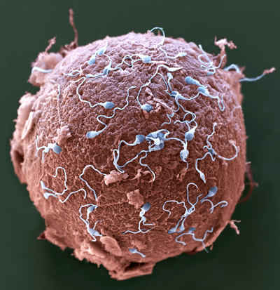
Gametes
Gametes contain half the normal number of chromosomes found in body cells.
This is because, during meiosis, only half the parent’s chromosomes enter each gamete produced. This means gametes only contain one allele of each gene.
When a male and female gamete fuse during fertilization, the full number of chromosomes is restored.
If this did not happen, the zygote (produced by fertilization) would have double the normal number of chromosomes.
Notes:
Teacher notes
A normal human body cell contains 46 chromosomes in 23 pairs. Human gametes (sperm cells and egg cells) contain 23 chromosomes.
For more information on the production of gametes, please refer to the Meiosis presentation.
Photo credit: © Eye of Science / Science Photo Library 2018
Colored scanning electron micrograph (SEM) of sperm (blue) attempting to penetrate a human egg (red). Each sperm (spermatozoa) has a rounded head and a long tail with which it swims. Women usually release one egg (ovum) per month, whereas men release millions of sperm in each ejaculation. Only one of these sperm can penetrate the egg's thick outer layer (zona pellucida) and fertilize it. Fertilization occurs when the sperm's genetic material (deoxyribonucleic acid, DNA) fuses with the egg's DNA. When this occurs the egg forms a barrier to other sperm. Magnification: ×650 when printed 10 centimeters wide.

Slide 15
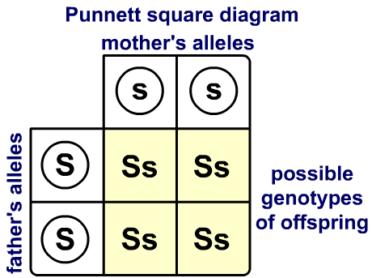
Which alleles are inherited?
A mother and father both have two alleles of every gene.
Only one of these alleles enters any single gamete. When a sperm and egg cell fuse, the offspring inherits one allele for every gene from each parent.
A Punnett square diagram can be used to determine the probability of offspring inheriting a particular combination of alleles.
This also allows us to predict the possible phenotypes of offspring.
Notes:
This slide covers the Science and Engineering Practice:
Developing and Using Models: Develop, revise, and/or use a model based on evidence to illustrate and/or predict the relationships between systems or between components of a system.

Slide 16
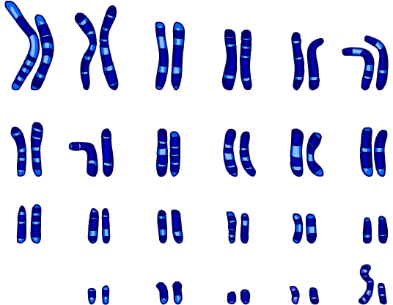
Genetic crosses and Punnett squares
A genetic cross is when two organisms are bred together to produce offspring.
The genotype of the parents and phenotype of the offspring are investigated to determine the pattern by which the parental alleles are inherited.
Punnett squares are used during genetic crosses.
They show the alleles of each parent and their gametes for a particular gene.
This is used to show each possible combination of alleles that can be produced when the mother’s and father’s gametes fuse.

Slide 17
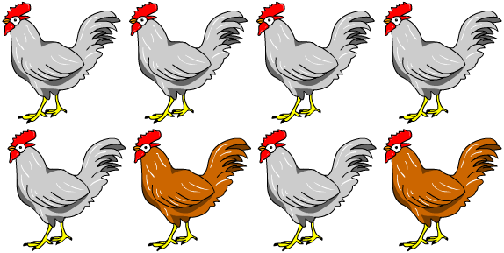
Expressing outcomes
Punnett squares are used to predict the outcome of a genetic cross. Outcomes can be expressed in several ways:
How could you express the number of brown and white chickens shown here?
“The chickens are white or brown in a ratio of 3:1.”
As a ratio:
“75% of the chickens are white and 25% are brown.”
As a percentage:
“The probability of a chicken being white is 0.75, or 3 in 4.”
As a probability:
Notes:
Teacher notes
Ratio: There are 6 white chickens and 2 brown chickens. Therefore the relationship between white and brown chickens is 6:2. This can be simplified as 2 is a common factor of both these numbers. As a result the ratio of white to brown chickens is 3:1. This means that for every 3 white chickens, there is 1 brown chicken.
Percentage: There are 8 chickens in total.
The percentage of white chickens is calculated by dividing the number of white chickens by the total number of chickens, and then multiplying by 100:
(6÷8) × 100 = 75
75% of the total number of chickens are white.
Likewise, the percentage of brown chickens is calculated by dividing the number of brown chickens by the total number of chickens, and then multiplying by 100:
(2÷8) × 100 = 25
25% of the total number of chickens are white.
Probability: This can be written as a number between 0 and 1. The probability of something happening cannot be higher than 1. If something has a probability of 1 it means it will definitely happen.
There are 8 chickens in total. If one is taken at random the likelihood of selecting a white chicken is 6 in 8. This can be simplified to 3 in 4.
3 ÷ 4 = 0.75
So the probability of a chicken being white in 0.75.
Try asking students to convert other outcomes between ratios, percentages and probabilities. Emphasize the difference between a ratio: “1:3” and the corresponding probability: “1 in 4.”
This slide covers the Science and Engineering Practice:
Using Mathematics and Computational Thinking: Use mathematical, computational, and/or algorithmic representations of phenomena or design solutions to describe and/or support claims and/or explanations.

Slide 18
Single-gene crosses
Some characteristics are controlled by a single gene. These characteristics can be investigated using a single-gene cross, also known as a monohybrid cross.
There are two alleles controlling pea shape. This means there are three possible genotypes that the plants could inherit, leading to two possible phenotypes.
genotype
phenotype
homozygous dominant
SS
smooth
homozygous recessive
ss
wrinkly
heterozygous
Ss
smooth
The likelihood of each phenotype being produced during a cross can be mapped out using a Punnett square.
Notes:
Teacher notes
Check that students understand why the heterozygous genotype, Ss, produces smooth peas.

Slide 19
Using a Punnett Square for pea shape
Notes:
This slide covers the Science and Engineering Practice:
Developing and Using Models: Develop, revise, and/or use a model based on evidence to illustrate and/or predict the relationships between systems or between components of a system.

Slide 20
Homozygous gene cross
Notes:
This slide covers the Science and Engineering Practice:
Developing and Using Models: Develop, revise, and/or use a model based on evidence to illustrate and/or predict the relationships between systems or between components of a system.

Slide 21
Heterozygous gene cross
Notes:
his slide covers the Science and Engineering Practice:
Developing and Using Models: Develop, revise, and/or use a model based on evidence to illustrate and/or predict the relationships between systems or between components of a system.

Slide 22
Single-gene cross questions
Notes:
This slide covers the Science and Engineering Practices:
Developing and Using Models: Develop, revise, and/or use a model based on evidence to illustrate and/or predict the relationships between systems or between components of a system.
Using Mathematics and Computational Thinking: Use mathematical, computational, and/or algorithmic representations of phenomena or design solutions to describe and/or support claims and/or explanations.

Slide 23
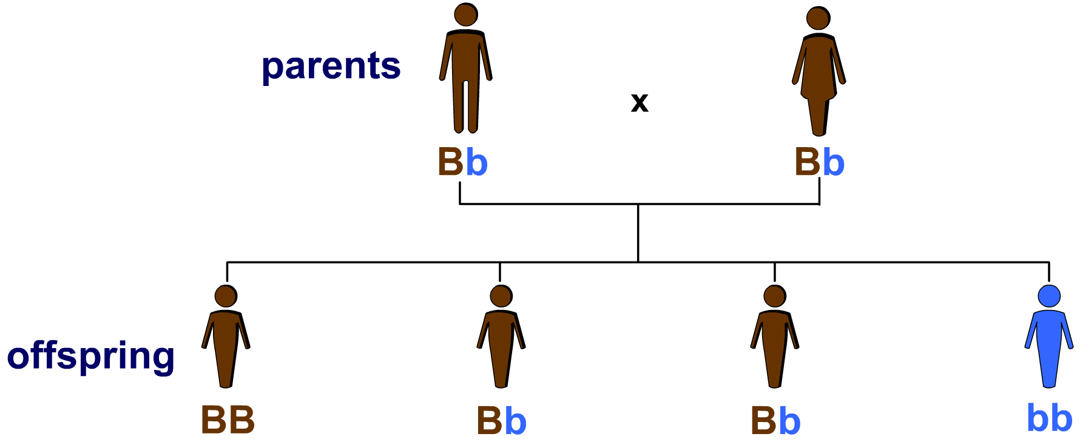
Family trees
A family tree, also known as a family pedigree, is a diagram which shows the inheritance of genes and traits from one generation to the next.
Here is an example of a family tree showing the inheritance of eye color:
What is the probability of a fifth child inheriting blue eyes?
Notes:
Teacher notes
Both parents are heterozygous for eye color. The allele for blue eyes is recessive, so only offspring that inherit a “b” allele from both parents have blue eyes. A Punnett square diagram can be used to show the likelihood of the fifth child inheriting the genotype “bb” is 1 in 4.
This slide covers the Science and Engineering Practices:
Developing and Using Models: Develop, revise, and/or use a model based on evidence to illustrate and/or predict the relationships between systems or between components of a system.
Using Mathematics and Computational Thinking: Use mathematical, computational, and/or algorithmic representations of phenomena or design solutions to describe and/or support claims and/or explanations.

Slide 24
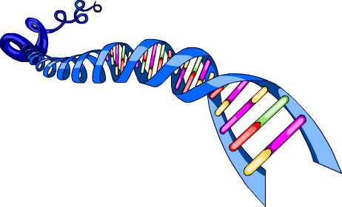
Interacting genes
Very few characteristics are controlled by a single gene. Examples include fur color in mice and pendulous or attached ears in humans.
The majority of phenotypic features are the result of multiple genes interacting with one another.
The pattern of inheritance for these traits is much more difficult to determine. This is because the likelihood of inheriting many different genes and their alleles has to be considered.
Can you think of any heritable traits that involve the interaction of multiple genes?
Notes:
Teacher notes
Examples of multi-gene traits include; height, hair color, weight and skin color.

Slide 25
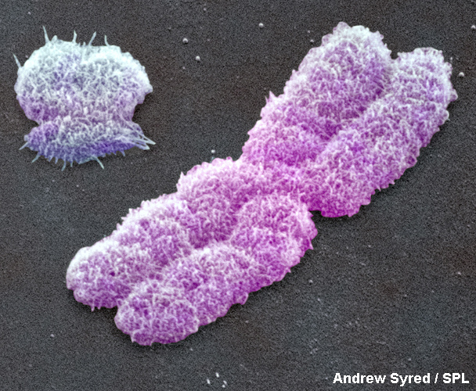
What are sex chromosomes?
Humans body cells contain 23 pairs of chromosomes.
Of these chromosome pairs, 22 control characteristics only but one pair carries genes that determine sex.
Y sex chromosome
The chromosomes in this pair are called the sex chromosomes.
There are two types of sex chromosomes: X and Y.
X sex chromosome
Notes:
Photo credit: Eye of Science/Science Photo Library, 2018
Image shows a colored scanning electron micrograph (SEM) of human X and Y sex chromosomes. Magnification: x7150 at 6x7cm size.

Slide 26
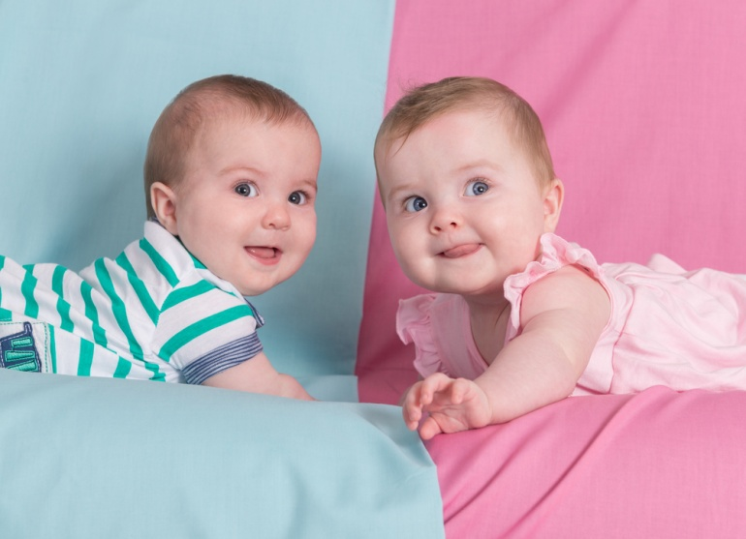
X and Y chromosomes
Both males and females have two sex chromosomes.
Males have one X and one Y chromosome. They have the genotype (XY).
Females have two X chromosomes. They have the genotype (XX).
Y chromosomes are very small and contain just 78 genes.
X chromosomes are larger and contain 900–1,200 genes.
Because females can only produce X gametes, it is the sperm that determines the sex of the offspring at fertilization.
Notes:
Photo credit: © Lev Kropotov, Shutterstock.com 2018

Slide 27
Sex determination
Notes:
This slide covers the Science and Engineering Practice:
Developing and Using Models: Develop, revise, and/or use a model based on evidence to illustrate and/or predict the relationships between systems or between components of a system.

