Slide 1
Glucoregulation

Slide 2
Information
Constructing Explanations and Designing Solutions
Engaging in Argument from Evidence
Obtaining, Evaluating and Communicating Information
1. Patterns
2. Cause and Effect
4. Systems and System Models
6. Structure and Function
7. Stability and Change

Slide 3
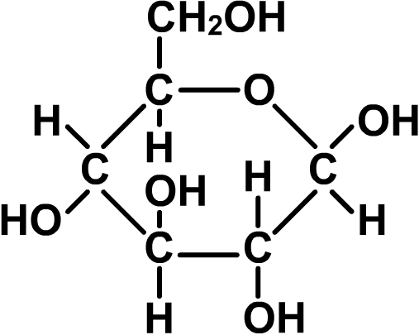
Glucose
Glucose is a type of sugar used for cellular respiration which provides the body with energy.
Glucose is present in many foods, including carbohydrates. These are made of many sugar molecules joined together. Starch is a type of carbohydrate containing glucose.
When food is digested, glucose is released and absorbed into the blood to be transported to cells around the body.
The concentration of glucose in the blood is called the blood glucose level.
Notes:
Teacher notes
Carbohydrates are polymers made of many simple sugar monomers joined together. Glucose is one of these monomers; other types of sugars found in carbohydrates include fructose, lactose and galactose.
The chemical formula for glucose is C₆H₁₂O₆.

Slide 4
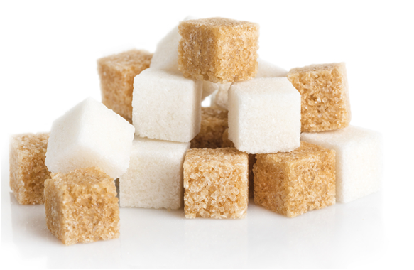
Changing blood glucose levels
What can cause changes in blood glucose?
Eating causes blood glucose levels to rise.
Vigorous exercise causes blood glucose levels to fall.
Sometimes there is too much glucose in the blood, other times not enough.
As a result, blood glucose levels need to be controlled. This process is called glucoregulation.
How does the body carry out glucoregulation?
Blood glucose levels are regulated by hormones that control the movement of glucose between blood and the cells.
Notes:
Teacher notes
Help students to draw on their understanding of other life science topics to answer the questions. Students should be able to apply their understanding of digestion to identify eating as a source of blood glucose, and their understanding of cellular respiration to identify exercise as a reason for blood glucose to fall. Some students may be able to identify hormones as a possible mechanism for glucoregulation.
This slide covers the Science and Engineering Practice:
Constructing Explanations and Designing Solutions: Apply scientific ideas, principles, and/or evidence to provide an explanation of phenomena and solve design problems, taking into account possible unanticipated effects.
Photo credit: © Leonid S. Shtandel, Shutterstock.com 2018

Slide 5
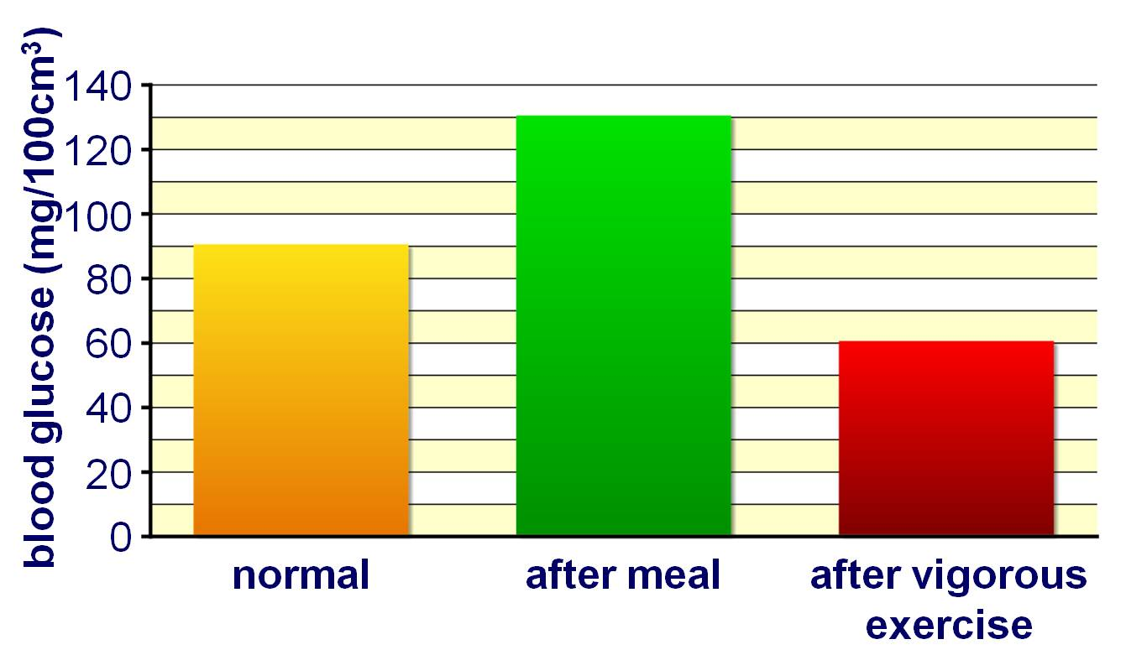
Blood glucose levels
Blood glucose levels rise just after eating, but quickly return to normal.
Why isn’t glucose left in the blood, and where does it go?
Notes:
Teacher notes
Help students to draw on their understanding of cell transport processes to answer the question. After eating, excess glucose is not left in the blood as high levels upset the movement of water in and out of cells by osmosis. This can affect cell function, which can be dangerous to health. The excess glucose is taken up by cells in the muscles and liver and stored.
Similarly, after vigorous exercise, glucose levels need to be increased to return them to normal. Cells throughout the body require glucose for cellular respiration. The energy released from glucose during cellular respiration is used to support all cell processes. If the supply of glucose is not sufficient, cellular function is affected.
This slide covers the Science and Engineering Practices:
Constructing Explanations and Designing Solutions: Apply scientific ideas, principles, and/or evidence to provide an explanation of phenomena and solve design problems, taking into account possible unanticipated effects.
Obtaining, Evaluating, and Communicating Information: Communicate scientific and/or technical information or ideas (e.g. about phenomena and/or the process of development and the design and performance of a proposed process or system) in multiple formats (including orally, graphically, textually, and mathematically).

Slide 6
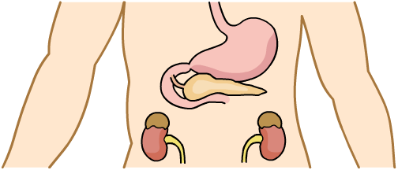
The pancreas and insulin
The pancreas is able to sense changes in blood glucose levels. It produces hormones that enable glucoregulation.
Insulin is a hormone produced by the pancreas in response to high blood glucose levels.
pancreas
It is secreted directly into the bloodstream, and transported around the body.
Insulin affects cells in the liver and muscles, leading to changes that result in a reduction in blood glucose levels.
Notes:
Teacher notes
Before revealing the arrow and label, students could be asked to find the pancreas in the diagram.
The pancreas also manufactures and secretes digestive enzymes into the small intestine.

Slide 7
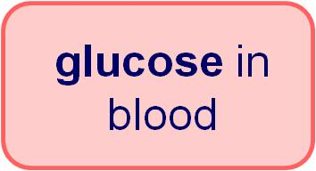
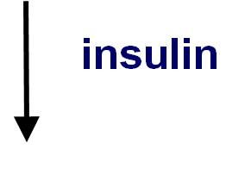
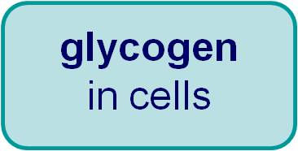
How does insulin work?
Insulin is secreted by the pancreas in response to blood glucose levels becoming too high.
It causes cells in the liver and muscles to take up glucose from the blood. This lowers blood glucose levels.
Once glucose has been transported into the cells, it is used to make glycogen, which can be stored.
Glycogen is a large, insoluble molecule, made of a lot of glucose molecules joined together.

Slide 8
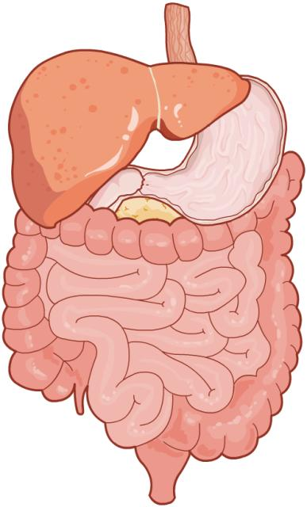
Glucagon
The pancreas produces another hormone called glucagon. It also has a role in regulating blood glucose levels.
The pancreas releases glucagon if blood glucose levels become lower than normal.
liver
Glucagon affects cells in the liver, where it stimulates the conversion of glycogen back into glucose.
The glucose is released from the liver into the blood. This causes blood glucose levels to rise.
Notes:
Teacher notes
Before revealing the arrow and label, students could be asked to find the liver in the diagram.

Slide 9
How do insulin and glucagon interact?
Insulin and glucagon have opposing effects on the movement of glucose between cells and the blood.
Insulin causes blood glucose levels to decrease, whereas glucagon causes them to increase.
glucose in blood
If blood glucose is too high, the pancreas increases insulin secretion and reduces glucagon secretion.
If blood glucose is too low, the pancreas increases glucagon secretion and reduces insulin secretion.
glucagon
insulin
glycogen in cells
As a result, insulin and glucagon enable blood glucose levels to be tightly controlled.

Slide 10
Controlling blood glucose levels
Notes:
Teacher notes
Remind students that insulin also causes glucose to be taken up by the muscles to be stored as glycogen.
This slide covers the Science and Engineering Practice:
Constructing Explanations and Designing Solutions: Apply scientific ideas, principles, and/or evidence to provide an explanation of phenomena and solve design problems, taking into account possible unanticipated effects.

Slide 11
Key words: a recap

Slide 12
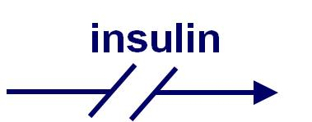
What is diabetes?
Diabetes mellitus is a disease in which the body’s insulin control mechanism is impaired.
The disruption in insulin control causes two problems:
Blood glucose levels become dangerously high, causing damage to cells.
Glucose cannot be stored as glycogen for later use.
The symptoms of diabetes can become very serious if the disease is not managed properly.
Notes:
Teacher notes
Initial symptoms of diabetes include increased thirst, frequent urination, blurred vision, numbness and weight loss. Later symptoms include vomiting and abdominal pain. More serious symptoms include diabetic coma, which is a medical emergency.
Diabetics are at an increased risk of cardiovascular disease, blindness, kidney failure and lower limb amputations. If untreated, diabetes can lead to coma and even death.

Slide 13
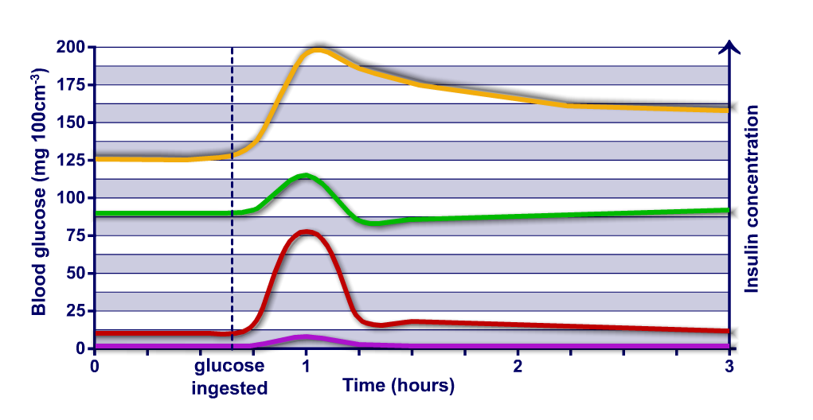
Insulin and blood glucose levels
How does blood glucose affect insulin production?
Notes:
Teacher notes
The graph shows the blood glucose and insulin concentrations of a diabetic and a non-diabetic after the ingestion of glucose. Ask students to interpret the graph. They should notice the following:
the correlation between the concentrations of blood glucose and insulin
the starting blood glucose concentration is higher for the diabetic
This slide covers the Science and Engineering Practices:
Constructing Explanations and Designing Solutions: Make a quantitative and/or qualitative claim regarding the relationship between dependent and independent variables.
Engaging in Argument from Evidence: Construct, use, and/or present an oral and written argument or counter-arguments based on data and evidence.

Slide 14
Insulin: a recap
Notes:
Teacher notes
This completing sentences activity could be used as an introductory or summary activity on insulin and blood glucose regulation.

Slide 15
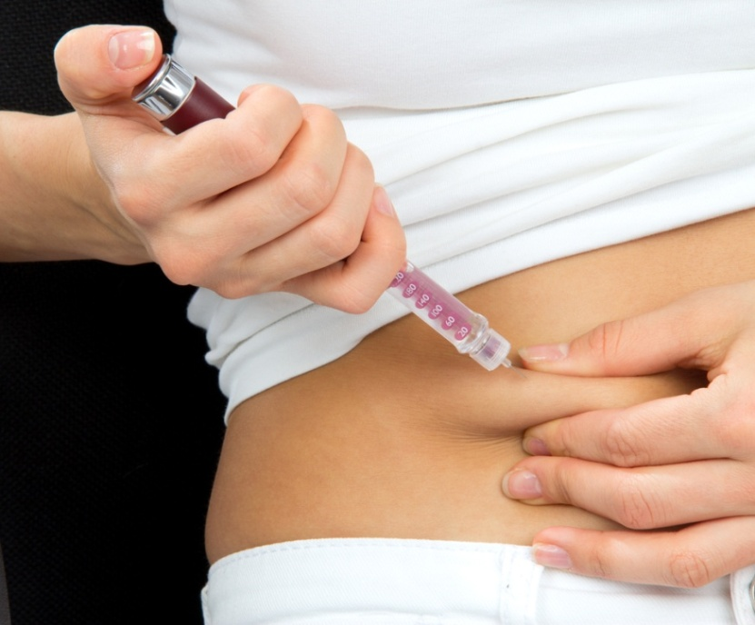
Type 1 diabetes
Type 1 diabetes occurs when the pancreas is unable to produce enough insulin to control blood glucose levels.
The condition is most often treated with insulin injections.
Type 1 diabetics must inject themselves with insulin before they eat. This helps keep their blood glucose at a safe level.
The insulin is usually injected into the subcutaneous fat, which lies directly under the skin.
The amount of insulin needed depends on how much a person eats, the type of food eaten and how active they are.
Notes:
Teacher notes
The more active a person is, the more glucose their body uses up, and the less insulin they need to inject. Alternatively, diabetics who eat a lot without exercising will need to inject more insulin.
If a type 1 diabetic eats food high in glucose or carbohydrates, they will have to inject more insulin than if they ate a food low in glucose or carbohydrates.
Photo credit: subcutaneous injection of insulin into abdomen © Dmitry Lobanov, Shutterstock.com 2018

Slide 16
Type 2 diabetes
Type 2 diabetes occurs when cells in the body become unable to respond to insulin properly.
This is known as insulin resistance.
The pancreas tries to compensate for insulin resistance by producing more insulin.
If the pancreas is unable to produce enough insulin to overcome the resistance, type 2 diabetes develops.
Notes:
Photo credit: © Monkey Business Images, Shutterstock.com 2018

Slide 17
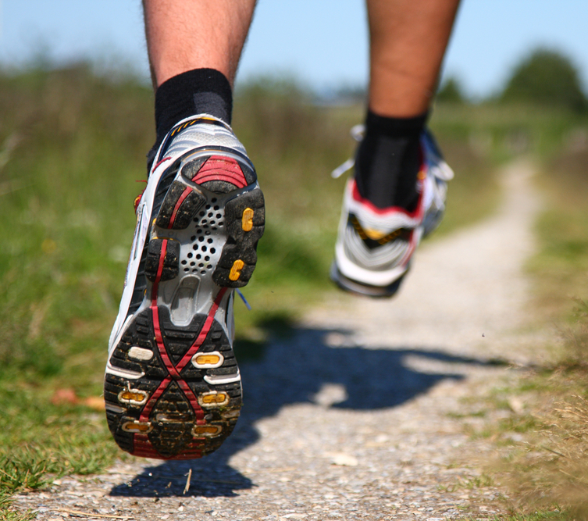
Treating type 2 diabetes
The most common treatment is to adopt a carbohydrate-controlled diet alongside an exercise regime.
Avoiding sugary foods and foods high in carbohydrates helps prevent blood glucose levels from rising too high after eating.
Physical exercise increases the rate at which glucose is used by the body. This helps reduce the level of glucose in the blood.
Notes:
Teacher notes
Insulin injections can also be used to treat type 2 diabetes. However, this treatment option is usually only offered if type 2 diabetes cannot be controlled through changes in lifestyle first.
Photo credit: © Maridav, Shutterstock.com 2018

Slide 18
Diabetes and blood glucose levels
Notes:
Teacher notes
Type 1 and 2 diabetes used to be called “early” and “late onset” respectively. These terms are used less these days, in part because the increase in childhood obesity has meant that people are developing type 2 diabetes earlier in life.
This slide covers the Science and Engineering Practice:
Constructing Explanations and Designing Solutions: Apply scientific ideas, principles, and/or evidence to provide an explanation of phenomena and solve design problems, taking into account possible unanticipated effects.

Slide 19
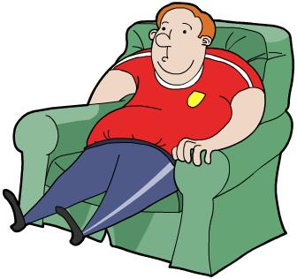
Obesity and diabetes
Obesity is the most significant risk factor for the development of type 2 diabetes.
It is thought to account for around 80% of the risk of developing the condition.
The mechanisms responsible for this link are not fully understood.
Some studies have shown that fat around the waist causes fat cells to release chemicals. These chemicals cause inflammation and make the body less sensitive to insulin.

Slide 20
Type 1 or type 2 diabetes?

