Slide 1
Enzymes

Slide 2
Information
Developing and Using Models
Planning and Carrying Out Investigations
Using Mathematics and Computational Thinking
Constructing Explanations and Designing Solutions
1. Patterns
2. Cause and Effect
3. Scale, Proportion, and Quantity
4. Systems and System Models
6. Structure and Function

Slide 3
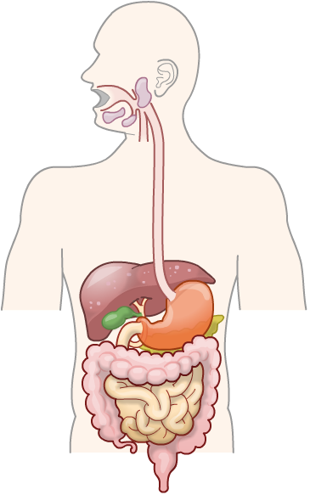
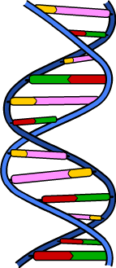
What’s the missing link?
What is the link between…
photosynthesis
digestion
DNA replication?
They all depend on enzymes.

Slide 4
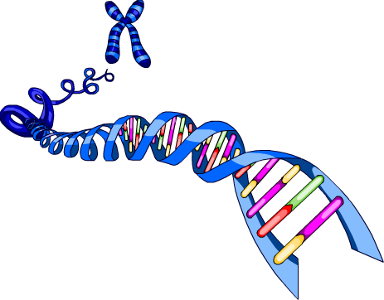
What are enzymes?
Enzymes are biological catalysts – they speed up the chemical reactions that take place inside all cells, but without being used up in the process.
There are thousands of different types of enzyme. Each type catalyzes a different reaction.
Cells create enzymes based on instructions carried in a cell’s genes.
Together, all the reactions that take place inside the body are known as the metabolism. As a result, enzymes are essential to an organism’s metabolism.

Slide 5
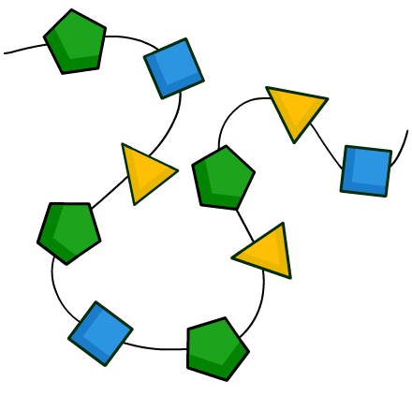
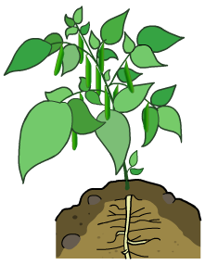
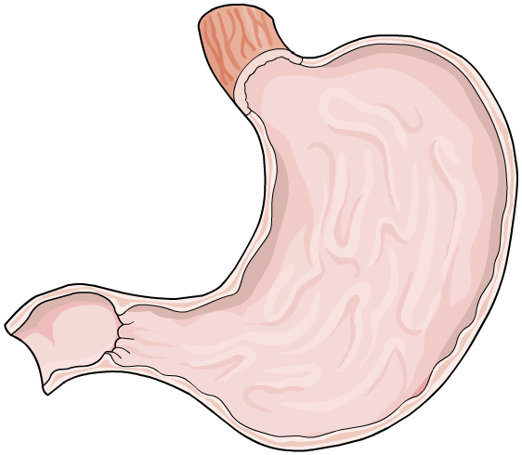
Enzymes in organisms
Enzymes catalyze the thousands of metabolic reactions needed to take place in order to maintain life, including:
protein synthesis
cellular respiration
photosynthesis
DNA replication
digestion.
Notes:
Teacher notes
For more information on reactions in cellular respiration, please refer to the Cellular Respiration presentation.
For more information on reactions in photosynthesis, please refer to the Photosynthesis presentation.
For more information on reactions in digestion, please refer to The Digestive System presentation.

Slide 6
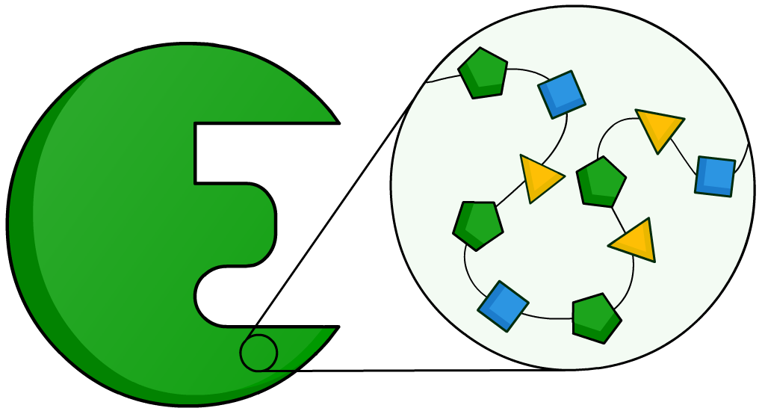
What are enzymes made of?
Enzymes are protein molecules made up of amino acids. Most enzymes contain between 100 and 1,000 amino acids.
These amino acids are joined together in a long chain, which is folded to produce a unique 3D structure.
Different types of enzymes have different shapes and functions. This is because the sequence and type of amino acids in their structure are different.
Notes:
Teacher notes
Proteins are polymers made of many amino acid monomer units joined together.

Slide 7
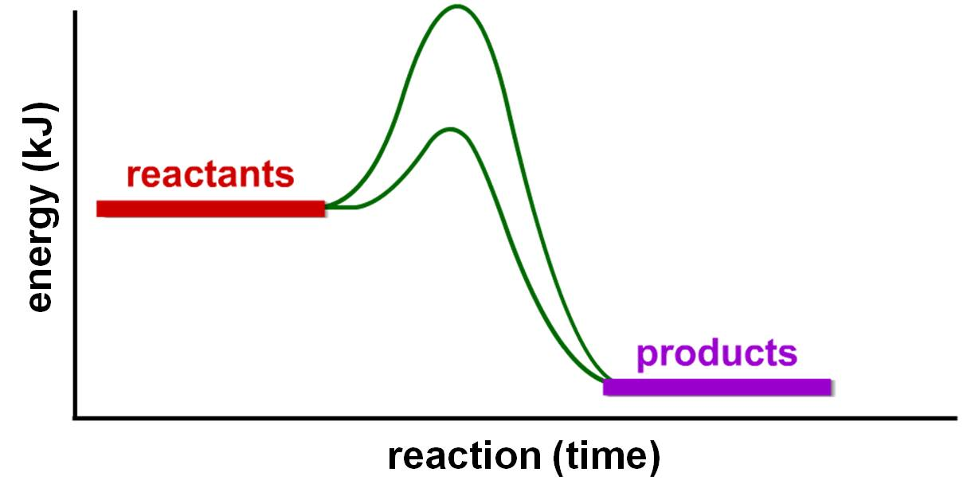
How do enzymes speed up reactions?
Enzymes speed up reactions by lowering the activation energy (E_{a}) of a reaction. The activation energy is the energy needed to start a reaction.
Different reactions have different activation energies.
E_{a} without enzyme
E_{a} with enzyme
Notes:
Teacher notes
From the graph, students can see that when the reaction occurs with an enzyme present the activation energy (E_{a}) is lower.
This means that less energy is needed for the reaction to occur.
The reaction can still happen without the enzyme, but more energy is needed to reach the activation energy to start the reaction.
This slide covers the Science and Engineering Practice:
Developing and Using Models: Develop and/or use multiple types of models to provide mechanistic accounts and/or predict phenomena, and move flexibly between model types based on merits and limitations.

Slide 8
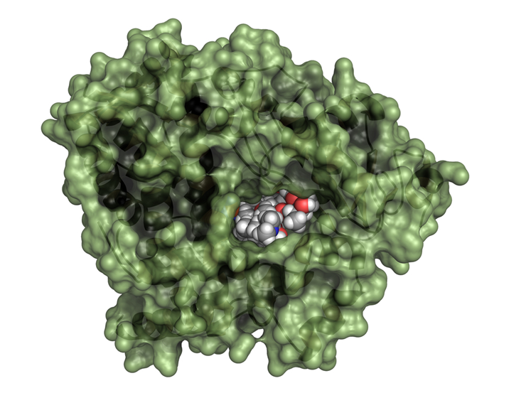
Why are enzymes so specific?
Enzymes are very specific about which reactions they catalyze. Only molecules with exactly the right shape will bind to the enzyme and react. These are the reactant, or substrate, molecules.
The part of the enzyme the reactant binds to is called the active site.
The active site is a very specific shape and the most important part of the enzyme.
Notes:
Photo credit: © molekuul_be, Shutterstock.com 2018
Cytochrome P450 (CYP3A4) liver enzyme in complex with the antibiotic erythromycin. Enzyme shown as cartoon + semi-transparent surface. Erythromycin represented with conventionally colored spheres.

Slide 9
What happens at the active site?
One way of describing how enzymes work is the lock and key theory, which is a simple model of enzyme action. In this model, the enzyme’s active site is said to act as a lock, whilst the substrate is the key.
Notes:
This slide covers the Science and Engineering Practice:
Developing and Using Models: Develop and/or use multiple types of models to provide mechanistic accounts and/or predict phenomena, and move flexibly between model types based on merits and limitations.

Slide 10
The lock and key model
Notes:
Teacher notes
This four-stage animation demonstrates the principles of the “lock and key” model. While showing the animation, the specific shape of the active site could be highlighted.
Suitable prompts could include:
What is special about the shape of the active site?
Is the enzyme the “lock” or the “key?”
This slide covers the Science and Engineering Practices:
Developing and Using Models: Develop and/or use multiple types of models to provide mechanistic accounts and/or predict phenomena, and move flexibly between model types based on merits and limitations.
Constructing Explanations and Designing Solutions: Apply scientific ideas, principles, and/or evidence to provide an explanation of phenomena and solve design problems, taking into account possible unanticipated effects.

Slide 11
Enzymes: true or false?
Notes:
Teacher notes
This true-or-false activity could be used as an introductory or summary activity on enzymes, or at the start of the lesson to gauge students’ existing knowledge of the subject matter. Colored traffic light cards (red = false, yellow = don’t know, green = true) could be used to make this a whole-class exercise.

Slide 12
Factors affecting enzymes (1)
The rate of any given enzyme-catalyzed reaction depends on several factors, including:
temperature
pH
enzyme concentration
substrate concentration.
All enzymes work best at a particular temperature and pH. This set of conditions is called the optimum.
Each type of enzyme has a specific optimal pH and temperature. This means different enzymes need different conditions to function at their best.

Slide 13
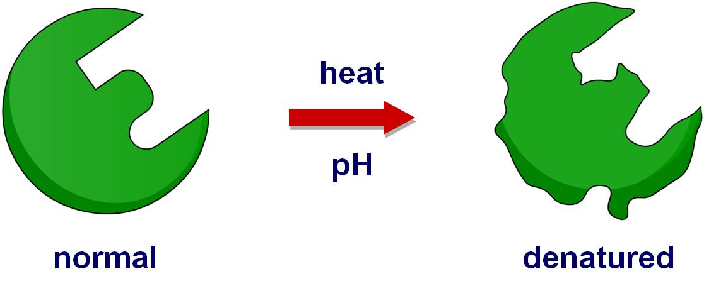
Factors affecting enzymes (2)
If temperature and pH move away from an enzyme’s optimum, it can cause the shape of the enzyme to change irreversibly.
This affects the shape of the active site, and means that the enzyme will no longer function.
If this happens, the enzyme is said to have become denatured.
Notes:
This slide covers the Science and Engineering Practice:
Developing and Using Models: Develop and/or use multiple types of models to provide mechanistic accounts and/or predict phenomena, and move flexibly between model types based on merits and limitations.

Slide 14
Enzymes and reaction rate
The rate of an enzyme-catalyzed reaction can be calculated by measuring the amount of product formed or reactant used, and dividing this by the time taken.
This can written as the following formula:
amount of product formed OR amount of reactant used
rate of reaction =
time taken
If an enzyme-catalyzed reaction produces 50 ml of oxygen in 5 minutes, what is the rate of reaction?
Notes:
Teacher notes
The rate of reaction is calculated by dividing the amount of oxygen produced by the time taken.
50 ml / 5 minutes = 10 ml/minute
Therefore the rate of reaction is 10 ml oxygen/minute.
This slide covers the Science and Engineering Practice:
Using Mathematics and Computational Thinking: Use mathematical, computational, and/or algorithmic representations of phenomena or design solutions to describe and/or support claims and/or explanations.

Slide 15
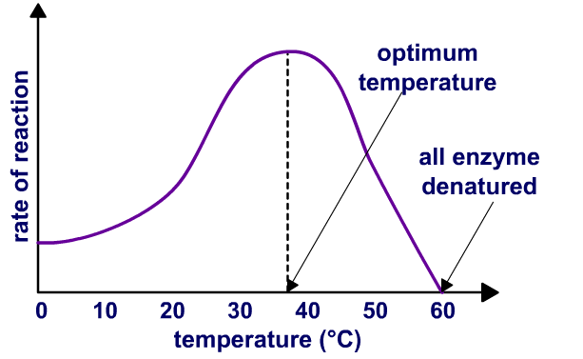
Temperature and reaction rate
As temperature increases, there are more collisions between the enzyme and its reactants. This increases the rate of reaction.
At a certain point, the temperature gets too high and the enzyme becomes denatured.
When this happens, the enzyme can no longer bind to its reactants. Once all the enzyme has become denatured, the reaction stops.
Notes:
Teacher notes
The enzyme and its reactants must collide for the reactants to enter the active site. The more collisions, the more likely this will happen.
Ask students if they can recognize the point on the graph where the rate of reaction is at its highest.
The highest rate of reaction occurs at the optimum temperature.
This slide covers the Science and Engineering Practice:
Using Mathematics and Computational Thinking: Use mathematical, computational, and/or algorithmic representations of phenomena or design solutions to describe and/or support claims and/or explanations.

Slide 16
Enzymes and temperature
Notes:
Teacher notes
This five-stage animation could be used as a precursor to running the experiment in the lab, or as a summary exercise.
This slide covers the Science and Engineering Practices:
Planning and Carrying Out Investigations: Plan and conduct an investigation individually and collaboratively to produce data to serve as the basis for evidence, and in the design: decide on types, how much, and accuracy of data needed to produce reliable measurements and consider limitations on the precision of the data (e.g., number of trials, cost, risk, time), and refine the design accordingly.
Constructing Explanations and Designing Solutions: Make a quantitative and/or qualitative claim regarding the relationship between dependent and independent variables.

Slide 17
What’s the optimum pH?
The optimum pH can vary significantly between types
of enzymes. Some need alkaline conditions, others acidic.
The pH range over which an enzyme can work is often
very narrow. Outside this range, the shape of the enzyme changes irreversibly and the enzyme becomes denatured.
pH
optimum conditions
pH is too low/too high

Slide 18
Optimum pH for enzyme activity
Notes:
Teacher notes
These graphs highlight that the optimum conditions for one type of enzyme may be different for another type of enzyme.
This slide covers the Science and Engineering Practice:
Using Mathematics and Computational Thinking: Use mathematical, computational, and/or algorithmic representations of phenomena or design solutions to describe and/or support claims and/or explanations.

Slide 19
pH and enzyme reactions
Notes:
Teacher notes
Amylase produced by the pancreas has an optimum pH 6.7–7. As a result, the time taken for the blue-black color to disappear is shortest at ph 7. This is because this is the pH at which the starch is broken down to glucose most effectively by amylase. When all the starch has been broken down to glucose the iodine will remain yellow.
The time taken for the blue-black color to disappear increases at pH 6. Although the enzyme can still function at this pH, it cannot work as effectively, so it takes longer to break down all the starch.
In acidic conditions the enzyme is denatured and cannot break starch down to glucose. This means that the iodine will continue to turn blue-black no matter how long the amylase is left in the test solutions at pH 4 and 5. As a result, no result is achieved in the experiment.
This slide covers the Science and Engineering Practices:
Planning and Carrying Out Investigations: Plan and conduct an investigation individually and collaboratively to produce data to serve as the basis for evidence, and in the design: decide on types, how much, and accuracy of data needed to produce reliable measurements and consider limitations on the precision of the data (e.g., number of trials, cost, risk, time), and refine the design accordingly.
Constructing Explanations and Designing Solutions: Make a quantitative and/or qualitative claim regarding the relationship between dependent and independent variables.

