Slide 1
Ecosystems

Slide 2
Information
Developing and Using Models
Constructing Explanations and Designing Solutions
Obtaining, Evaluating and Communicating Information
2. Cause and Effect
4. Systems and System Models
5. Energy and Matter
7. Stability and Change

Slide 3
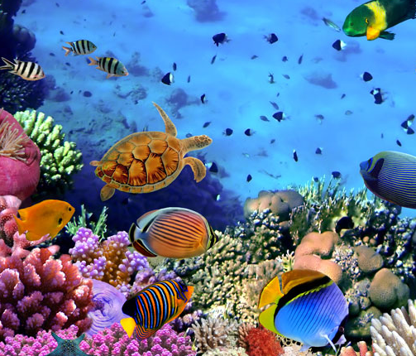
What is an ecosystem?
The environment is made of many different types of ecosystems, such as coral reefs, forests, lakes and deserts.
Each ecosystem can be divided into a:
habitat – the area in which organisms live. This is made up of both biotic (living) and abiotic (non-living) components
community – the living (biotic) part, i.e. all the different organisms living in that particular habitat.
Notes:
Photo credit: © Vlad61, Shutterstock.com 2018

Slide 4
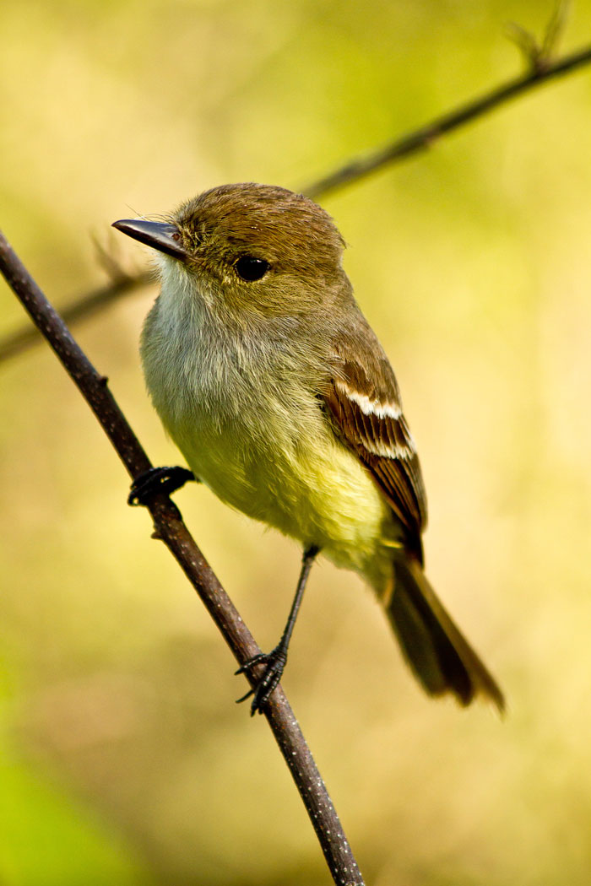
Organization of an ecosystem
Each community is made up of many different populations.
A population is all the members of a particular species living in one area.
For example, the population of finches in a forest.
What are the different levels of an ecosystem?
organism
population
community
ecosystem
Notes:
This slide covers the Science and Engineering Practices:
Constructing Explanations and Designing Solutions: Apply scientific ideas, principles, and/or evidence to provide an explanation of phenomena and solve design problems, taking into account possible unanticipated effects.
Obtaining, Evaluating, and Communicating Information: Communicate scientific and/or technical information or ideas (e.g. about phenomena and/or the process of development and the design and performance of a proposed process or system) in multiple formats (including orally, graphically, textually, and mathematically).
Photo credit: © Fotos593, Shutterstock.com 2018

Slide 5
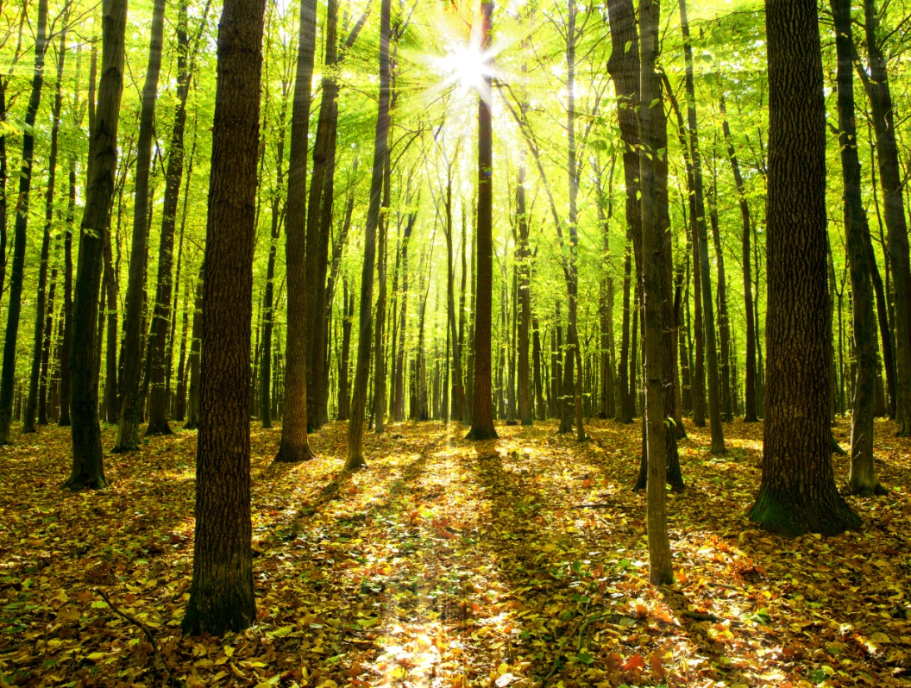
Habitats
A habitat has all of the things that an organism needs to survive, such as oxygen, water, light and shelter.
The availability of these factors will affect the number and distribution of organisms within the habitat.
If these factors are not plentiful in a particular habitat, organisms will compete for them.
Notes:
Teacher notes
Some ecosystems are self-supporting. This means they do not need any external input apart from an energy source, such as the Sun.
Photo credit: © vovan, Shutterstock.com 2018

Slide 6
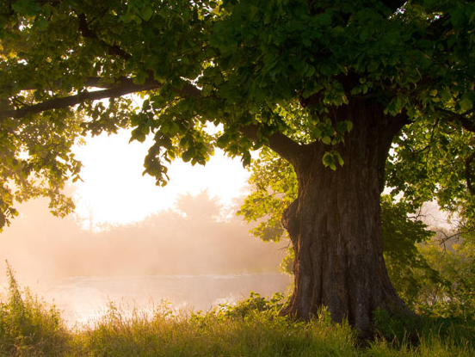
A niche
Each organism has a specific place in an ecosystem.
A niche is the position and role of an organism within its ecosystem. It includes both biotic and abiotic factors.
For example, both squirrels and sparrows live in an oak tree. Each has a different role and position within the ecosystem.
The squirrels feed on acorns, while the sparrows feed on insects.
The two species occupy different niches within the ecosystem.
Notes:
Photo credit: © kosmooss, Shutterstock.com 2018

Slide 7
Ecological terms activity

Slide 8
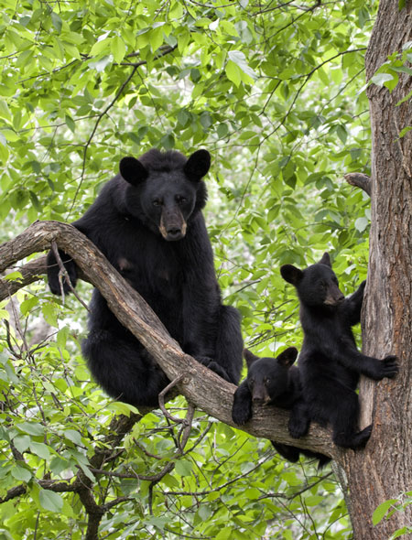
Population sizes in ecosystems
Individuals commonly produce many offspring over their natural lifecycles.
This means that populations within an ecosystem have the potential to become very large.
However, this does not often occur.
This is because population sizes are naturally limited.
Can you think of any factors that may limit the size of a population?
Notes:
Teacher notes
Factors that limit population size include the availability of resources, predation, disease and competition. The limited availability of resources drives competition. These concepts are discussed in more detail later in the presentation.
This slide covers the Science and Engineering Practices:
Constructing Explanations and Designing Solutions: Apply scientific ideas, principles, and/or evidence to provide an explanation of phenomena and solve design problems, taking into account possible unanticipated effects.
Obtaining, Evaluating, and Communicating Information: Communicate scientific and/or technical information or ideas (e.g. about phenomena and/or the process of development and the design and performance of a proposed process or system) in multiple formats (including orally, graphically, textually, and mathematically).
Photo credit: © Debbie Steinhausser, Shutterstock.com 2018

Slide 9
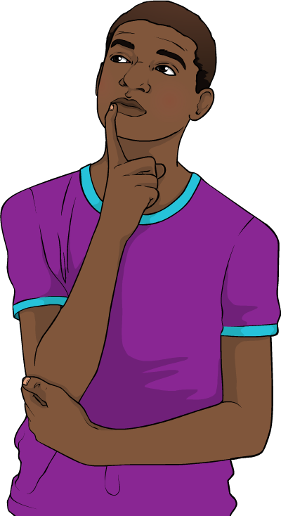
Carrying capacity
Organisms use resources from their environment. The supply of resources in any ecosystem is limited.
This means that the number of organisms that an ecosystem can support is also limited.
The carrying capacity of an ecosystem is the number of organisms that it can support indefinitely.
An ecosystem might be able to support a number of organisms that exceeds the carrying capacity, but only for a short time.
Can you explain why?
Notes:
Teacher notes
Help students to recognize that populations that exceed the carrying capacity will deplete the resources in an ecosystem faster than they can be replaced, causing the quality of the ecosystem to degrade. This in turn will reduce the number of organisms that the ecosystem can support.
This slide covers the Science and Engineering Practices:
Constructing Explanations and Designing Solutions: Apply scientific ideas, principles, and/or evidence to provide an explanation of phenomena and solve design problems, taking into account possible unanticipated effects.
Obtaining, Evaluating, and Communicating Information: Communicate scientific and/or technical information or ideas (e.g. about phenomena and/or the process of development and the design and performance of a proposed process or system) in multiple formats (including orally, graphically, textually, and mathematically).

Slide 10
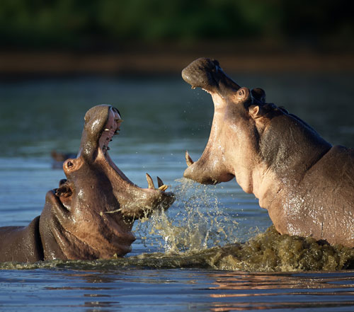
What is competition?
Because the resources in an ecosystem are limited, there are often not enough for all the organisms in a population.
This means that individuals have to fight for resources in order to survive and reproduce.
This is called competition.
Differences exist between the individuals within a population, causing some individuals to be more successful at competing for resources than others.
Notes:
Photo credit: © Johan Swanepoel, Shutterstock.com 2018

Slide 11
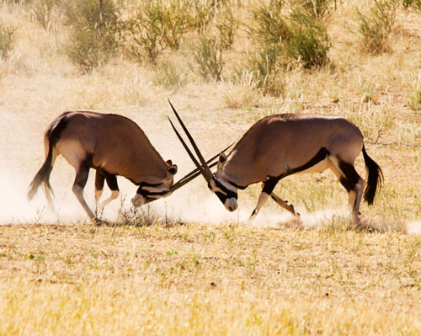
Interspecific and intraspecific
Competition that occurs between members of different species is called interspecific competition.
Competition that occurs between members of the same species is called intraspecific competition.
What may happen to individuals that cannot compete as well as others?
Competition is the driving force behind natural selection.
Notes:
Teacher notes
Students may recognize that individuals or species that are less competitive are at risk of dying out because they will struggle to gain sufficient resources. Individuals with genes that make them more competitive are more likely to survive and pass on those genes; this is the basis of natural selection.
Less competitive species could avoid extinction through adopting new survival strategies or moving to an area where there is less competition.
For more information about natural selection, please refer to the Evolution presentation.
This slide covers the Science and Engineering Practices:
Constructing Explanations and Designing Solutions: Apply scientific ideas, principles, and/or evidence to provide an explanation of phenomena and solve design problems, taking into account possible unanticipated effects.
Obtaining, Evaluating, and Communicating Information: Communicate scientific and/or technical information or ideas (e.g. about phenomena and/or the process of development and the design and performance of a proposed process or system) in multiple formats (including orally, graphically, textually, and mathematically).
Photo credit: © Andre van der Veen, Shutterstock.com 2018

Slide 12
Competition in the meadow
Notes:
Teacher notes
This interactive simulation illustrates the range of factors – and the complexity – involved in competition. Students could be asked to predict how the combination of factors will affect the growth of grass, before pressing “grow grass.” They could then be asked to explain the reasons behind the actual amount of grass that has grown.
This slide covers the Science and Engineering Practices:
Developing and Using Models: Develop, revise, and/or use a model based on evidence to illustrate and/or predict the relationships between systems or between components of a system.
Constructing Explanations and Designing Solutions: Apply scientific ideas, principles, and/or evidence to provide an explanation of phenomena and solve design problems, taking into account possible unanticipated effects.

Slide 13
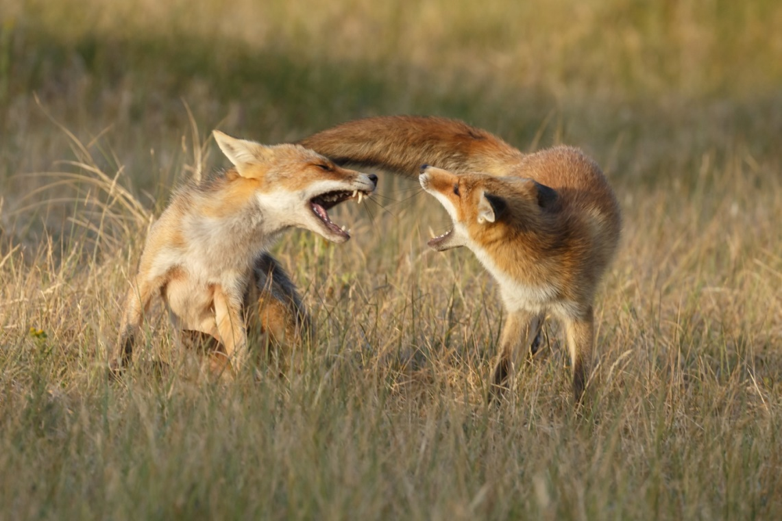
What do animals compete for?
What are the main resources for which animals compete?
food
water
mates
land
Which resource does not cause interspecific competition?
Members of different species will not compete for mates.
Notes:
This slide covers the Science and Engineering Practices:
Constructing Explanations and Designing Solutions: Apply scientific ideas, principles, and/or evidence to provide an explanation of phenomena and solve design problems, taking into account possible unanticipated effects.
Obtaining, Evaluating, and Communicating Information: Communicate scientific and/or technical information or ideas (e.g. about phenomena and/or the process of development and the design and performance of a proposed process or system) in multiple formats (including orally, graphically, textually, and mathematically).
Photo credit: © Menno Schaefer, Shutterstock.com 2018

Slide 14
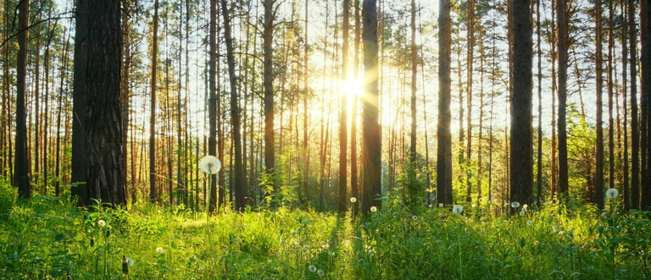
What do plants compete for?
Competition between plants may be less noticeable than competition between animals, but it still takes place.
What main resources do plants compete for?
light
water
minerals
space
Notes:
This slide covers the Science and Engineering Practices:
Constructing Explanations and Designing Solutions: Apply scientific ideas, principles, and/or evidence to provide an explanation of phenomena and solve design problems, taking into account possible unanticipated effects.
Obtaining, Evaluating, and Communicating Information: Communicate scientific and/or technical information or ideas (e.g. about phenomena and/or the process of development and the design and performance of a proposed process or system) in multiple formats (including orally, graphically, textually, and mathematically).
Photo credit: © Valentin Agapor, Shutterstock.com 2018

Slide 15
Who competes for this?

Slide 16
Competition and population size
Since the resources in an ecosystem are finite, competition between members of the same species generally has a stabilizing effect on a population.
population rises
less competition
more competition
population falls
Notes:
This slide covers the Science and Engineering Practice:
Developing and Using Models: Use a model to provide mechanistic accounts of phenomena.

Slide 17
Competition recap
Notes:
Teacher notes
This completing sentences activity could be used as an introductory or summary activity on competition.
This slide covers the Science and Engineering Practice:
Constructing Explanations and Designing Solutions: Apply scientific ideas, principles, and/or evidence to provide an explanation of phenomena and solve design problems, taking into account possible unanticipated effects.

Slide 18
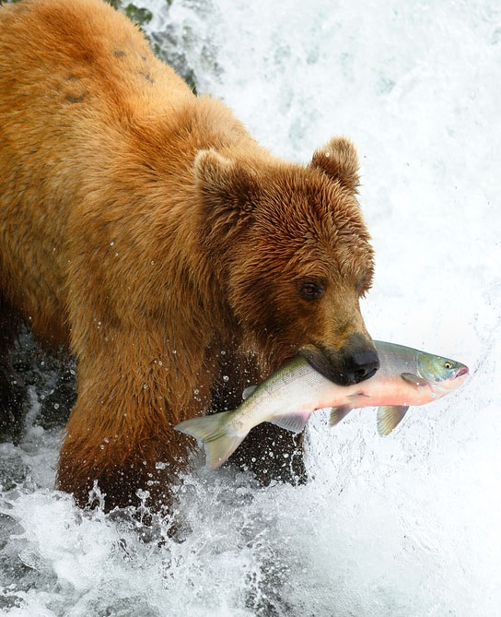
Predation and disease
Other factors that limit population size include predation and disease.
Populations of organisms in lower trophic levels are reduced by predators.
Populations of all organisms are reduced by diseases.
Competition exists in these interactions too. Can you explain how?
Notes:
Teacher notes
Interspecific and intraspecific competition exist between predators for prey species. Help students to remember that diseases may be caused by pathogens. Competition exists within and between pathogen species for hosts.
This slide covers the Science and Engineering Practices:
Constructing Explanations and Designing Solutions: Apply scientific ideas, principles, and/or evidence to provide an explanation of phenomena and solve design problems, taking into account possible unanticipated effects.
Obtaining, Evaluating, and Communicating Information: Communicate scientific and/or technical information or ideas (e.g. about phenomena and/or the process of development and the design and performance of a proposed process or system) in multiple formats (including orally, graphically, textually, and mathematically).
Photo credit: © zixian, Shutterstock.com 2018

Slide 19
Competition in the Petri dish
Notes:
Teacher notes
P. caudatum grew well alone, but when grown together the P. aurelia grew well and the P. caudatum grew poorly, and died off within 16 days. This suggests that the P. aurelia outcompeted P. caudatum under these conditions.
This slide covers the Science and Engineering Practice:
Constructing Explanations and Designing Solutions: Make a quantitative and/or qualitative claim regarding the relationship between dependent and independent variables.

