Slide 1
Cycling
Materials

Slide 2
Information
Developing and Using Models
Planning and Carrying Out Investigations
Constructing Explanations and Designing Solutions
Obtaining, Evaluating and Communicating Information
1. Patterns
2. Cause and Effect
3. Scale, Proportion, and Quantity
4. Systems and System Models
5. Energy and Matter

Slide 3
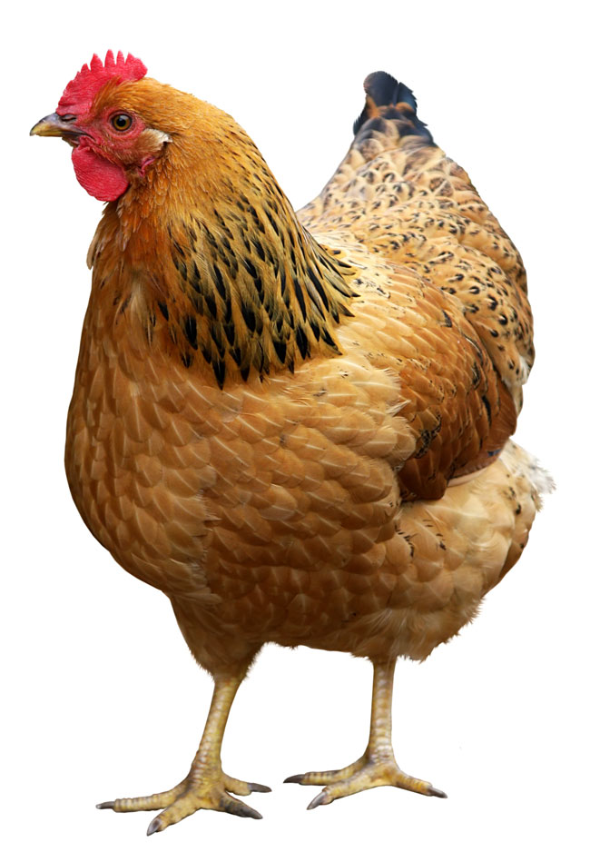

Cycling materials
What is this animal made of?
Its tissues are made up of cells, which are built from biological molecules such as proteins, lipids and carbohydrates.
These molecules are themselves made up of smaller molecules, such as glucose or amino acids.
These molecules are compounds made up of groups of atoms.
Notes:
Photo credit: © Aksenova Natalya, Shutterstock.com 2018

Slide 4



What are living things made of?
Notes:
This slide covers the Science and Engineering Practice:
Developing and Using Models: Use a model to provide mechanistic accounts of phenomena.

Slide 5
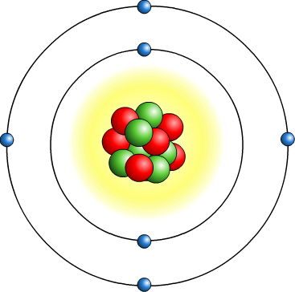
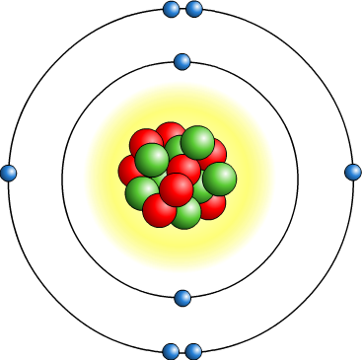
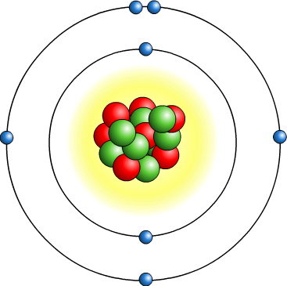
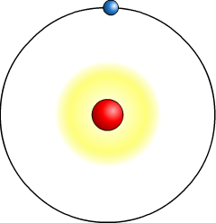
Elements in living things
Most biological molecules are made up of only a few elements: carbon, hydrogen, oxygen and nitrogen.
carbon
oxygen
nitrogen
hydrogen
These elements bond in different ways to make the many different types of compounds found in living organisms.
This living material is known as biomass.

Slide 6
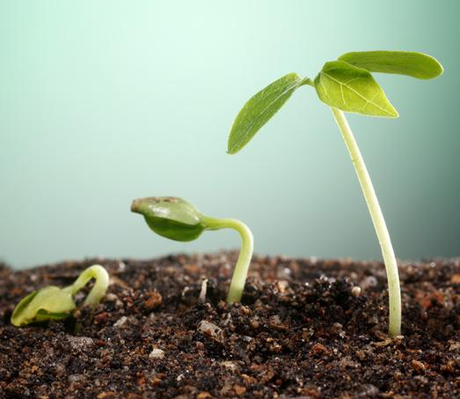
Nutrient cycles
Materials are continually exchanged between living organisms, the soil and the atmosphere.
Different stages are involved in the cycling of carbon, nitrogen, oxygen and hydrogen.
We can study their behavior
in separate nutrient cycles:
the carbon cycle
the nitrogen cycle
the water cycle.
Atoms are conserved at each stage in all nutrient cycles.
Notes:
Photo credit: © focal point, Shutterstock.com 2018

Slide 7

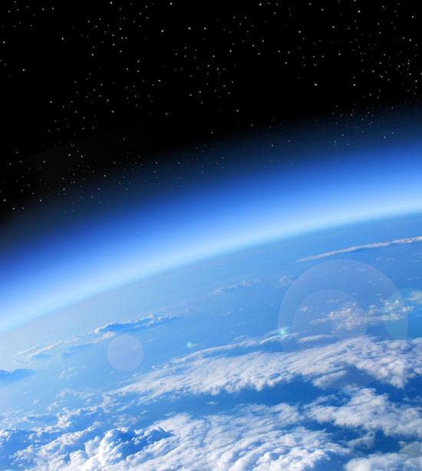
The atmosphere
The atmosphere forms an important part of all nutrient cycles.
Carbon is present in the atmosphere, combined with oxygen
in the gas carbon dioxide, CO₂.
Nitrogen is present in the atmosphere as a gaseous diatomic molecule, N₂.
Water is present in the atmosphere as water vapor, H₂O.
Each gas is added to and removed from the atmosphere as part of each nutrient cycle.
How much of Earth’s atmosphere does each gas make up?
Notes:
Teacher notes
The atmosphere is currently made of 78% nitrogen, 20% oxygen, 0.93% argon, 0.004% carbon dioxide and small amounts of other gases including water vapor. The amount of water vapor in the atmosphere is very variable, but is typically around 1%. The composition of Earth’s atmosphere has changed over geological time.
Photo credit: © Studio23, Shutterstock.com 2018

Slide 8
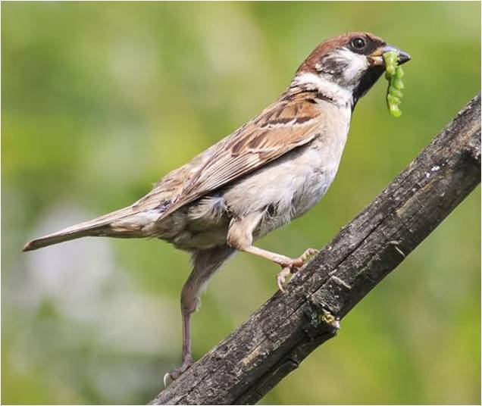
Cycling in living things
Matter cycles through living organisms in food chains.
Carbon, nitrogen, hydrogen and oxygen (as well as small amounts of other elements) are used to build the biomass that makes up all living things.
When an organism is eaten by a consumer, its biomass is transferred to the consumer.
Notes:
Teacher notes
For more information on biomass transfers, please refer to the Biomass Transfers presentation.
Photo credit: © Bachkova Natalia, Shutterstock.com 2018

Slide 9
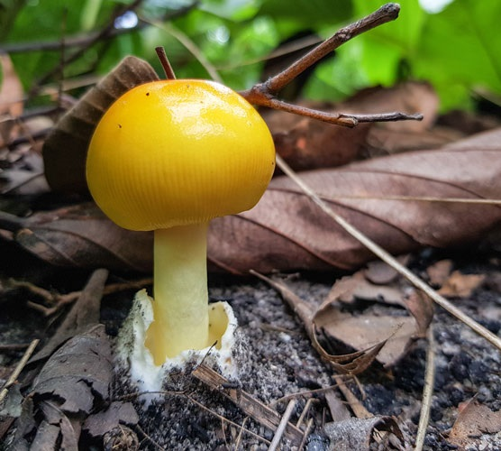
Soil
When organisms die or produce waste, the biomass is broken down by organisms that can feed on it.
The process of breaking
down dead matter is called
decay or decomposition.
This process happens
in soil, which contains
decaying biological matter
as well as the organisms
that carry out decay.
Notes:
Photo credit: © ppopla, Shutterstock.com 2018

Slide 10
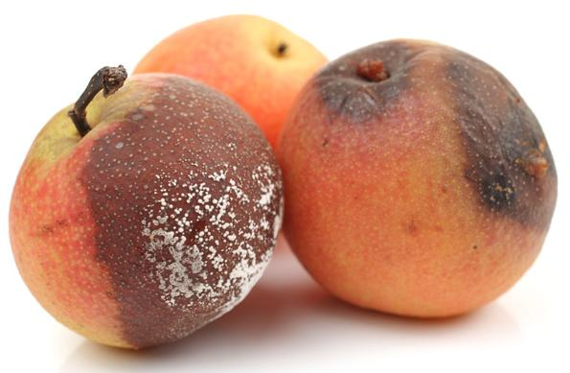
Decay
Fungi and some types of bacteria can digest dead or waste matter. These organisms are known as decomposers.
Some types of animals, such as earthworms, can also feed on dead matter. These are known as detritivores.
Both types of organism live in soil.
By breaking down dead matter, decomposers and detritivores cycle materials from biomass to the atmosphere, soil, or food chains.
Can you explain how?
Notes:
Teacher notes
Help students to explain how matter is cycled to each system by the organisms that carry out decay. Respiration carried out by decomposers and detritivores moves matter into the atmosphere. Nutrients are released into the soil. Some of these nutrients are taken up by plants and enter the food chain.
This slide covers the Science and Engineering Practices:
Constructing Explanations and Designing Solutions: Apply scientific ideas, principles, and/or evidence to provide an explanation of phenomena and solve design problems, taking into account possible unanticipated effects.
Obtaining, Evaluating, and Communicating Information: Communicate scientific and/or technical information or ideas (e.g. about phenomena and/or the process of development and the design and performance of a proposed process or system) in multiple formats (including orally, graphically, textually, and mathematically).
Photo credit: © jiangdi, Shutterstock.com 2018

Slide 11
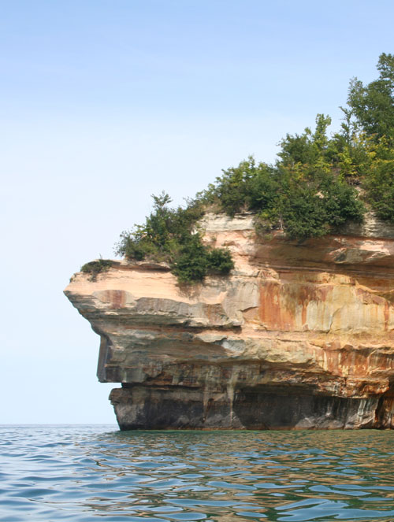
The carbon cycle
The carbon cycle describes the movement of carbon through Earth’s systems.
Carbon exists in different forms in each system.
Can you name the forms of carbon
in the biosphere and atmosphere?
Different processes move carbon between each system.
For example, photosynthesis moves carbon from the atmosphere to the biosphere.
Can you name any other processes that move carbon?
Notes:
Teacher notes
The carbon cycle is covered in more detail in the Carbon Cycle presentation. Students should be able to name forms of carbon mentioned earlier in the presentation. In the biosphere, carbon is found in living tissues. It is a building block in biological molecules, such as carbohydrates, fats and proteins. In the atmosphere, carbon is found combined with oxygen in the compound carbon dioxide, CO₂, which is a gas. You may also wish to discuss forms of carbon in Earth’s other systems. In the hydrosphere, carbon is found as dissolved carbon dioxide and other compounds such as carbonic acid. In the geosphere, carbon is found in fossil fuels and rocks such as limestone and chalk.
Other processes that move carbon include cellular respiration (biosphere to atmosphere), combustion (biosphere to atmosphere), sedimentation (biosphere to geosphere), volcanic activity (geosphere to atmosphere) and diffusion (both directions between atmosphere and hydrosphere).
For more information about the carbon cycle, please refer to the Carbon Cycle presentation.
This slide covers the Science and Engineering Practices:
Constructing Explanations and Designing Solutions: Apply scientific ideas, principles, and/or evidence to provide an explanation of phenomena and solve design problems, taking into account possible unanticipated effects.
Obtaining, Evaluating, and Communicating Information: Communicate scientific and/or technical information or ideas (e.g. about phenomena and/or the process of development and the design and performance of a proposed process or system) in multiple formats (including orally, graphically, textually, and mathematically).
Photo credit: © Lindsey Moore, Shutterstock.com 2018

Slide 12

The nitrogen cycle
The nitrogen cycle describes the movement of nitrogen through Earth’s systems.
Nitrogen gas (N₂) forms the majority (78%) of Earth’s atmosphere.
However, atmospheric nitrogen cannot be used directly by plants. It first needs converting into other forms. This process is called nitrogen fixing.
Nitrate ions (NO₃–) and ammonium ions (NH₄⁺) are important types of useable nitrogen.
Notes:
Photo credit: © kosmooss, Shutterstock 2018

Slide 13
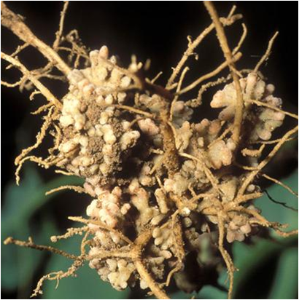
Making nitrogen available (1)
There are several different processes involved in making nitrogen available.
Microbes are important to many of these processes.
Nitrogen-fixing bacteria live in the soil and the roots of some plants. They convert nitrogen gas into nitrate ions.
Decomposers release ammonia from dead matter during the process of decay. Bacteria can then convert this into nitrate ions.
Notes:
Teacher notes
Nitrogen-fixing bacteria live in the root nodules of a class of plants called legumes which include beans, peas and clover. They convert nitrogen gas into nitrates. Legumes are often planted to improve the fertility of poor-quality soils by raising the nitrate content of the soil. The image shows nitrogen-fixing nodules on the roots of a pea plant (Pisum sativum).
Photo credit: © John Kaprielian, Science Photo Library 2018

Slide 14
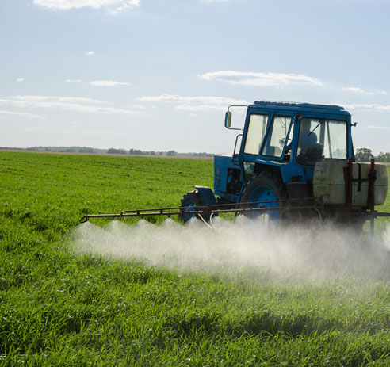
Making nitrogen available (2)
Lightning can fix atmospheric nitrogen. It contains enough energy to cause nitrogen in the atmosphere to react and form available nitrogen compounds.
Humans fix atmospheric
nitrogen using the Haber process.
In this common industrial process, nitrogen from the atmosphere reacts with hydrogen to produce ammonia.
The ammonia is added to
soils as an artificial fertilizer.
Notes:
Photo credit: © sauletas, Shutterstock.com 2018

Slide 15
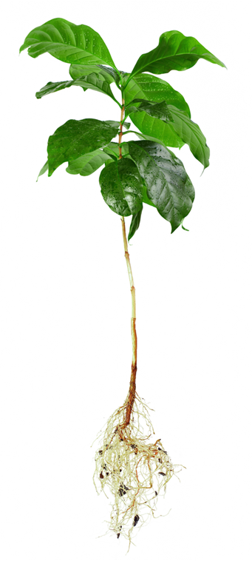
Using available nitrogen
Plants take up ammonium ions or nitrate ions from the soil through their roots.
Plants use these compounds to make amino acids, which they build into proteins.
The nitrogen compounds are also used to make DNA.
Can you suggest the next stage of the nitrogen cycle?
Plant biomass is eaten by consumers, passing the nitrogen compounds through the food chain.
Notes:
Teacher notes
Help students to apply their understanding of biomass transfers to explain that plant biomass is consumed by other organisms, causing nitrogen compounds to move through the food chain.
This slide covers the Science and Engineering Practices:
Constructing Explanations and Designing Solutions: Apply scientific ideas, principles, and/or evidence to provide an explanation of phenomena and solve design problems, taking into account possible unanticipated effects.
Obtaining, Evaluating, and Communicating Information: Communicate scientific and/or technical information or ideas (e.g. about phenomena and/or the process of development and the design and performance of a proposed process or system) in multiple formats (including orally, graphically, textually, and mathematically).
Photo credit: © Olesia Bilkei, Shutterstock.com 2018

Slide 16
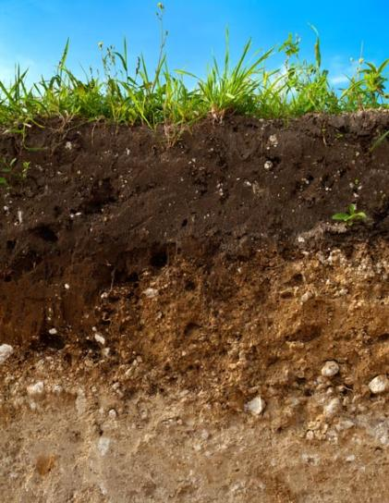
Denitrification
Denitrification is a process that reduces the level of nitrates in the soil by converting them back into nitrogen gas.
This is carried out by a special type
of bacteria living in the soil called
denitrifying bacteria.
The bacteria rely on anaerobic conditions. As a result, denitrification can only happen when there is a very low concentration of oxygen.
Can you think of some habitats where the soil is likely to have a
low concentration of oxygen?
Notes:
Teacher notes
Soil is often low in oxygen in habitats such as wetlands, bogs, marshes and areas with waterlogged soils.
This slide covers the Science and Engineering Practices:
Constructing Explanations and Designing Solutions: Apply scientific ideas, principles, and/or evidence to provide an explanation of phenomena and solve design problems, taking into account possible unanticipated effects.
Obtaining, Evaluating, and Communicating Information: Communicate scientific and/or technical information or ideas (e.g. about phenomena and/or the process of development and the design and performance of a proposed process or system) in multiple formats (including orally, graphically, textually, and mathematically).
Photo credit: © Igor Stramyyk, Shutterstock.com 2018

Slide 17
What happens in the nitrogen cycle?
Notes:
Teacher notes
This ten-stage animation provides an illustrated guide to the nitrogen cycle. It could be used to introduce the topic or as a summary. While viewing the animation, students could be asked to identify the microorganisms that are involved in the different processes of the nitrogen cycle.
Ammonia is a nitrogen compound with the chemical formula, NH₃.
This slide covers the Science and Engineering Practice:
Developing and Using Models: Develop, revise, and/or use a model based on evidence to illustrate and/or predict the relationships between systems or between components of a systems.

Slide 18
Labeling the nitrogen cycle
Notes:
Teacher notes
This labeling activity could be used as a summary exercise to check students’ ability to identify the components and sequence of the nitrogen cycle. The activity could be extended by asking students to write the chemical formulae for the nitrogen-containing compounds in the cycle.
This slide covers the Science and Engineering Practice:
Developing and Using Models: Develop, revise, and/or use a model based on evidence to illustrate and/or predict the relationships between systems or between components of a systems.

Slide 19
Components of the nitrogen cycle
Notes:
Teacher notes
This matching activity could be used as an introductory or summary activity on the nitrogen cycle.

Slide 20
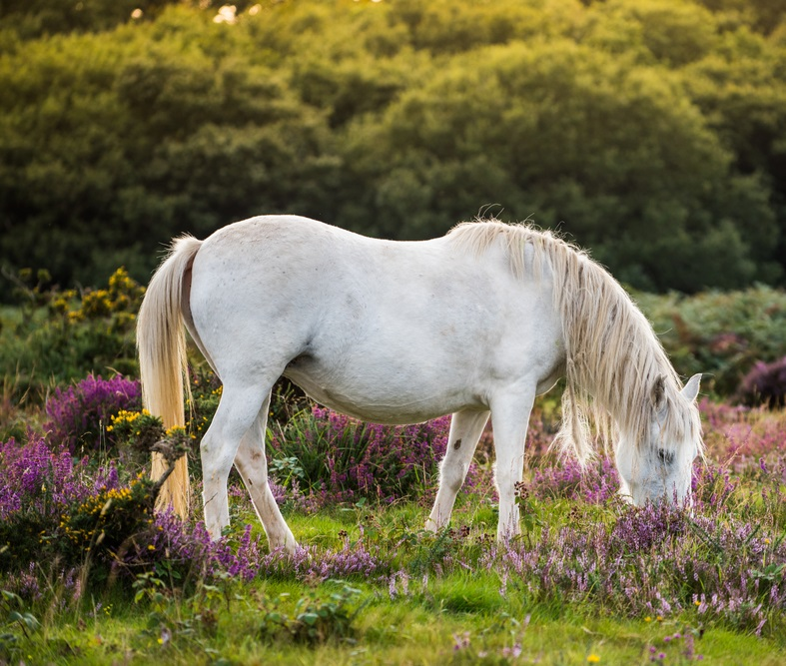
The water cycle (1)
The water cycle describes the movement of water through Earth’s systems.
Water exists in different physical states in the water cycle: solid, liquid or gas.
Water is very important to
living organisms.
How do living organisms
obtain water?
What happens to the water
in living organisms?
Notes:
Teacher notes
Discuss students’ ideas for the questions. All living organisms need water to survive, and all living organisms contain water. However, there are a variety of methods used to obtain it. Examples include drinking (land based animals, marine fish), osmosis (land based plants, freshwater fish) and food (land based animals and aquatic species). You could ask students to carry out their own research on the topic.
Water has many uses in living organisms. Excess water is lost to the environment as urine. Some of it passes through the food chain when organisms are consumed. The water in dead tissues is released into the environment during decomposition.
This slide covers the Science and Engineering Practices:
Constructing Explanations and Designing Solutions: Apply scientific ideas, principles, and/or evidence to provide an explanation of phenomena and solve design problems, taking into account possible unanticipated effects.
Obtaining, Evaluating, and Communicating Information: Communicate scientific and/or technical information or ideas (e.g. about phenomena and/or the process of development and the design and performance of a proposed process or system) in multiple formats (including orally, graphically, textually, and mathematically).
Photo credit: © merc67, Shutterstock.com 2018

Slide 21
The water cycle (2)
Notes:
This slide covers the Science and Engineering Practice:
Developing and Using Models: Develop, revise, and/or use a model based on evidence to illustrate and/or predict the relationships between systems or between components of a systems.

