Slide 1
Charles Darwin

Slide 2
Information
Constructing Explanations and Designing Solutions
Engaging in Argument from Evidence
Obtaining, Evaluating and Communicating Information
1. Patterns
2. Cause and Effect
6. Structure and Function
7. Stability and Change

Slide 3
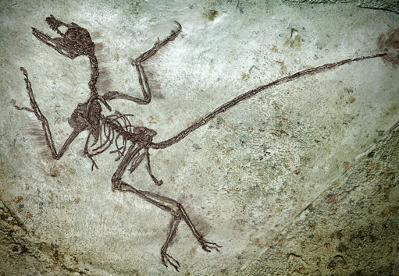
Life on Earth
Life on Earth began at least 3,500 million years ago.
What do you think the earliest life forms were like?
All life on Earth evolved from very simple organisms. Dinosaurs only appeared 3,325 million years later!
There are many theories of how life first appeared on Earth, but lack of evidence has made it difficult to know which theory is correct.
Notes:
Teacher notes
Discuss students’ ideas for the question before moving on to the answer.
Photo credit: © Marcio Jose Bastos Silva, Shutterstock.com 2018

Slide 4
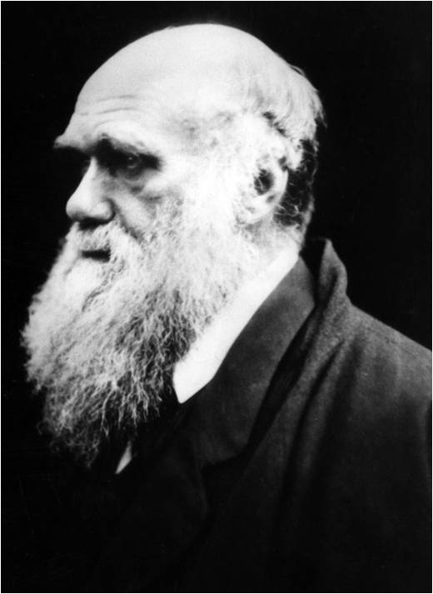
Darwin’s theory of evolution
In the mid-1800s, the British naturalist Charles Darwin (1809–1882) proposed a new theory for evolution.
Darwin proposed that evolution took place through a process called natural selection.
He developed his theory based on observations he made on a round-the-world trip on the ship HMS Beagle. He also carried out many experiments, had discussions with fellow scientists and used evidence from fossils.
Notes:
Teacher notes
For more information about the theory of evolution by natural selection, please refer to the Evolution presentation.
For more information about fossils, please refer to the Earth and Space Sciences: Fossils presentation.
Photo credit: © Everett Historical, Shutterstock.com 2018

Slide 5
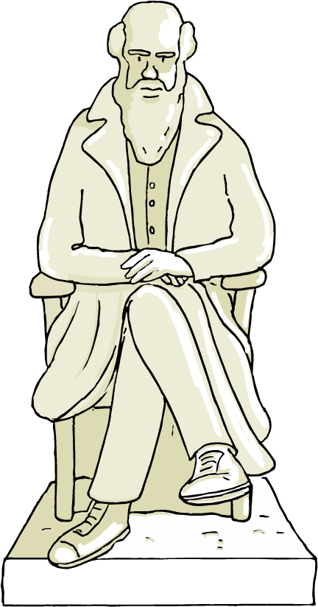
Darwin and natural selection
Natural selection is a scientific theory. This is an explanation proposed by scientists following scientific investigation.
Darwin carried out over 30 years of research on fossils and living plant and animal species. This led to his theory of evolution by natural selection.
He used natural selection to explain how different species are related to each other, as well as how species become adapted to their environment.
Notes:
Teacher notes
For more information about how species adapt to their environment, please refer to the Adaptations presentation.

Slide 6
The life of Charles Darwin

Slide 7
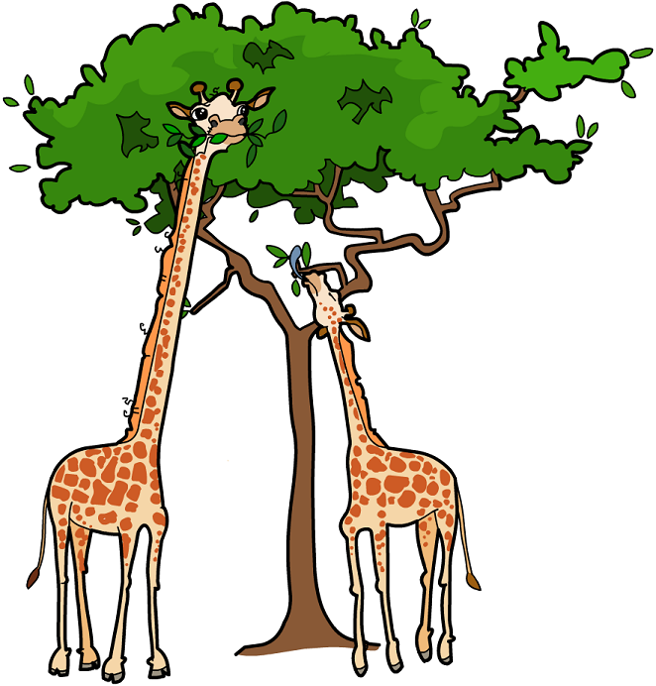
Lamarck’s theory of evolution
Jean-Baptiste Lamarck (1744–1829) was a French scientist. He believed that species evolved because they inherited characteristics acquired through the over- or under-use of body parts.
How would this theory explain a giraffe’s long neck?
The short-necked ancestors of modern giraffes needed to reach the leaves on tall trees when food was scarce.
Over their lifetime, the giraffes
stretched their necks, making them longer. This characteristic was then passed on to their offspring.
Notes:
Teacher notes
Discuss students’ ideas for the question before moving on to the explanation.
This slide covers the Science and Engineering Practices:
Constructing Explanations and Designing Solutions: Apply scientific ideas, principles, and/or evidence to provide an explanation of phenomena and solve design problems, taking into account possible unanticipated effects.
Obtaining, Evaluating, and Communicating Information: Communicate scientific and/or technical information or ideas (e.g. about phenomena and/or the process of development and the design and performance of a proposed process or system) in multiple formats (including orally, graphically, textually, and mathematically).

Slide 8
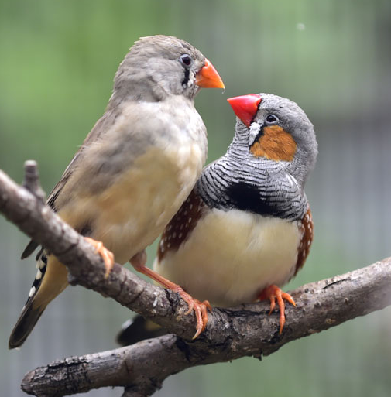
Darwin’s theory of natural selection
Darwin found that individual organisms within a species showed variation in their characteristics.
Darwin observed that organisms have to compete with each other in order to survive. He found that organisms with characteristics that made them better suited to their environment would be better competitors.
Darwin concluded that individuals with an advantageous characteristic were more likely to survive and pass on the characteristic to the next generation. This is natural selection.
Notes:
Teacher notes
Darwin believed that natural selection favors a characteristic that is advantageous to survival. Individuals with this characteristic were therefore more likely to survive and breed successfully.
For more information about evolution by natural selection, please refer to the Evolution presentation.
For more information about variation between individuals, please refer to the Variation presentation.
Photo credit: © Wang LiQiang, Shutterstock.com 2018

Slide 9
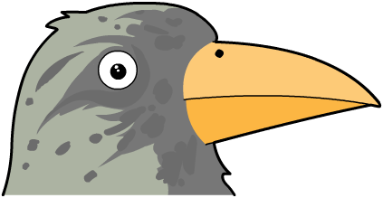
Galápagos finches
In the Galápagos Islands, Darwin noticed that finches with different types of beak lived on each island.
Some finches had large and strong beaks, suitable for crushing seeds.
Others had thin, delicate beaks, suitable for picking insects from holes in the ground.
Darwin observed that the type of beak a particular finch had was adapted to the environment that particular finch was found in.
This gave the finch a better chance to survive and breed.
Notes:
Teacher notes
The Galápagos Islands are a group of islands found in the Pacific Ocean.

Slide 10
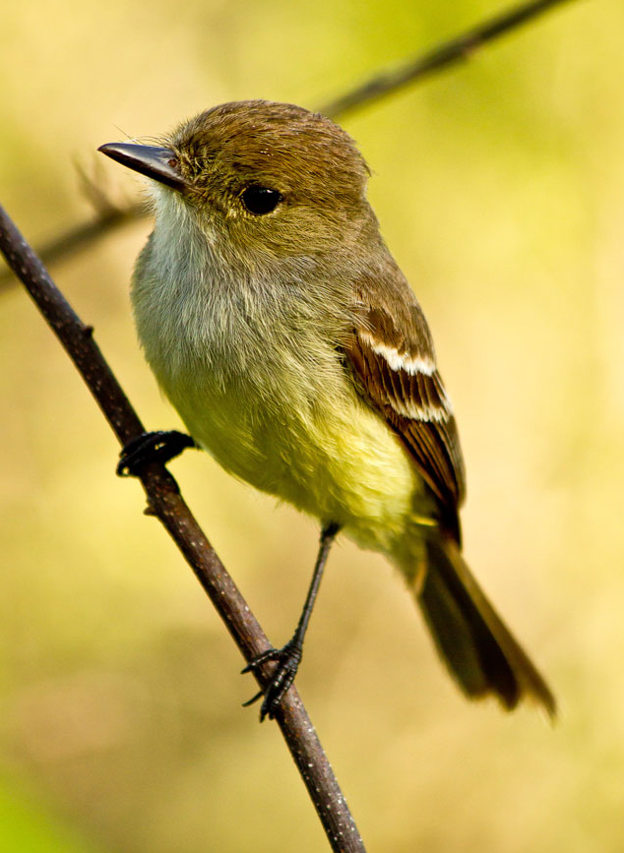
Galápagos finches and natural selection
Darwin believed that all the finches had evolved from a common ancestor on the mainland.
Natural variation meant that some finches developed slightly different beaks.
These finches were able to eat alternative types of food and avoid competition, making them more likely to survive and pass on their characteristics.
Notes:
Photo credit: © Wang LiQiang, Shutterstock.com 2018

Slide 11
Darwin’s evidence for evolution
Notes:
Teacher notes
Fossil evidence: there are a number of problems with fossil evidence. Firstly soft tissue preservation is very rare, meaning that only organisms with hard skeletons have a good fossil record, and this lacks any detail on their soft tissue. Secondly, the conditions for fossilization are very rare, making the fossil record very incomplete even for organisms with hard tissues. Finally, dating fossils is based on the stratum in which they are found, and is an approximation at best.
Acanthostega gunnari is a specimen from the Devonian period, roughly 365 million years ago. It is one of the first vertebrates known with four distinct limbs, rather than fins. Despite its tetrapod-like features, Acanthostega was almost certainly aquatic. It has gills within its mouth, a large tail fin for swimming and a weak vertebral column, which is unlikely to have supported its body weight on the land.

Slide 12
Lamarck vs. Darwin
Notes:
Photo credits: both images have been released into the public domain.

Slide 13
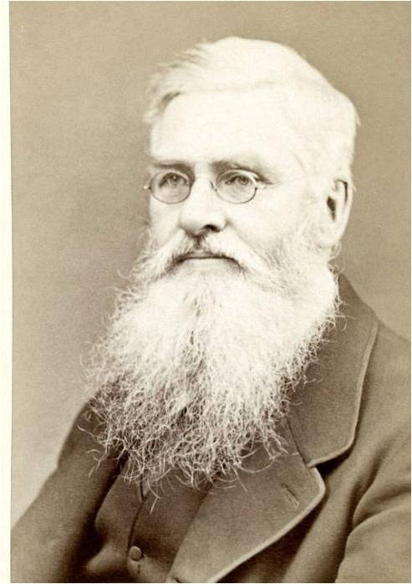
Wallace and Darwin
Darwin was at first unwilling to publish his findings.
Then, British naturalist Alfred Russel Wallace proposed an almost identical theory of natural selection to Darwin.
In 1858, Wallace and Darwin published a joint scientific paper on natural selection as the driving force for evolution.
This prompted Darwin to publish his
book On the Origin of Species in 1859.
Notes:
Teacher notes
Wallace initially wrote to Darwin with his findings and ideas about natural selection. Darwin was surprised to find these ideas to be almost identical to his own and, so that both scientists could be given credit, they published a joint paper on the theory of evolution by natural selection.
Photo credit: This image is in the public domain.

Slide 14
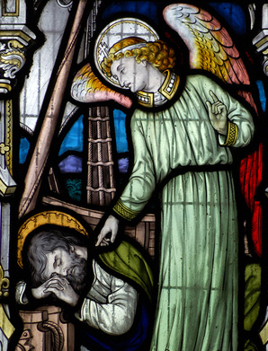
Controversial research
On the Origin of Species attracted widespread interest.
This is because it was written for a non-specialist audience, so it was accessible for lots of people.
British Victorian society was shocked by Darwin’s theory, as it challenged the common belief that God made all animals and plants on Earth.
Darwin’s theory conflicted with Christian beliefs. There was also insufficient evidence to convince many scientists of the time. As a result, his theory was only gradually accepted.
Notes:
Teacher notes
Ask students to discuss why they think that On the Origin of Species attracted a wider audience than the joint scientific paper published the previous year.
A handful of influential scientists were convinced by Darwin's work and spoke out in public to promote his ideas. Despite this, many Victorian scientists were unconvinced by Darwin’s theory as it was difficult to test. For his theory to work, the Earth needed to be millions of years old, but its age was not known at that time. You could ask students to research British Victorian society to learn more about why Darwin’s ideas were so shocking at the time.
Photo credit: © BasPhoto, Shutterstock.com 2018

Slide 15
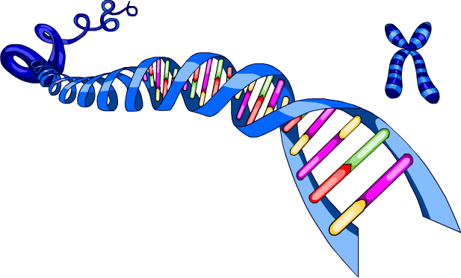
Could Darwin explain everything?
At the time Darwin proposed his theory of evolution, DNA and genes had not yet been discovered. This meant he was unable to explain why characteristics varied between individuals of the same species or how they were inherited.
It was not until 50 years after Darwin’s theory was first published that the mechanism of inheritance and variation was discovered.
We now have evidence to support Darwin’s theory. This means it is now accepted by modern scientists as the best explanation for how species evolve over time.
Notes:
Teacher notes
At the time, little was known about the process of fossilization or how to explain gaps in the fossil record.

Slide 16
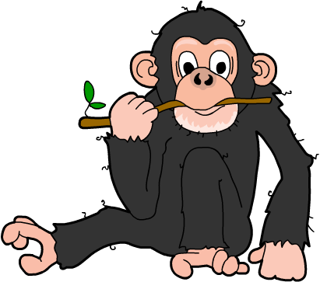
DNA evidence for evolution
The discovery of genes has helped scientists to build on Darwin’s theory. For example, DNA from different organisms can now be compared. The fewer the differences, the less time since they shared a common ancestor.
98% of a human and a chimpanzee’s genes are the same. What does this tell you about their evolution?
It is a relatively short time since they both evolved from a shared common ancestor.
Notes:
Teacher notes
Discuss students’ ideas for the question before moving on to the answer.
For more information on common ancestors, please refer to the Evolution presentation.
For more information on evolutionary relationships, please refer to the Evolutionary Relationships presentation.
This slide covers the Science and Engineering Practices:
Constructing Explanations and Designing Solutions: Apply scientific ideas, principles, and/or evidence to provide an explanation of phenomena and solve design problems, taking into account possible unanticipated effects.
Engaging in Argument from Evidence: Construct, use, and/or present an oral and written argument or counter-arguments based on data and evidence.
Obtaining, Evaluating, and Communicating Information: Communicate scientific and/or technical information or ideas (e.g. about phenomena and/or the process of development and the design and performance of a proposed process or system) in multiple formats (including orally, graphically, textually, and mathematically).

