Slide 1
Cell Transport

Slide 2
Information
Developing and Using Models
Planning and Carrying Out Investigations
Using Mathematics and Computational Thinking
Constructing Explanations and Designing Solutions
Obtaining, Evaluating and Communicating Information
1. Patterns
2. Cause and Effect
3. Scale, Proportion, and Quantity
4. Systems and System Models
5. Energy and Matter

Slide 3
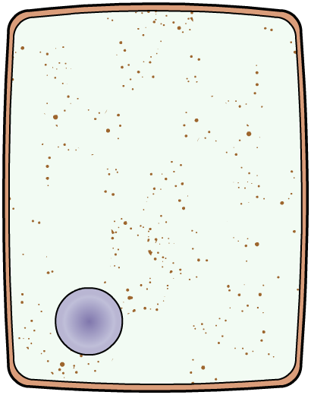
Transport across the cell membrane
All cells need to be able to access the substances they need to survive, and be able to remove waste materials.
Substances enter and leave cells across the cell membrane.
Cell membranes are partially permeable, which means they let some substances through, but not others.
Substances can cross the cell membrane through:
the cell membrane surrounds the entire cell
diffusion
osmosis
active transport.

Slide 4
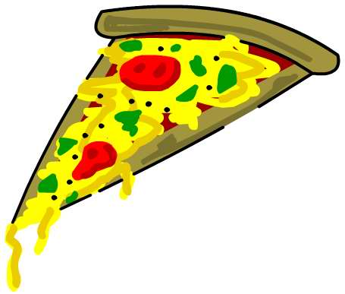
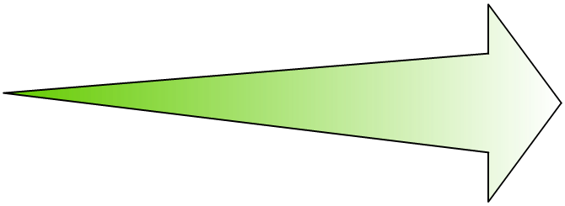
Diffusion
Why can the student smell the pizza from a distance?
The pizza can be smelled because molecules are moving away from it and spreading out in the air. This process is called diffusion.
Where is the smell strongest?
The smell is strongest near the pizza and gets weaker further away. This is because the concentration of molecules from the pizza is highest in the air closest to it.
Notes:
Teacher notes
Discuss students’ ideas for the questions before revealing the answers. Help them to identify that the student detects molecules that have traveled from the pizza.
This slide covers the Science and Engineering Practices:
Constructing Explanations and Designing Solutions: Apply scientific ideas, principles, and/or evidence to provide an explanation of phenomena and solve design problems, taking into account possible unanticipated effects.
Obtaining, Evaluating, and Communicating Information: Communicate scientific and/or technical information or ideas (e.g. about phenomena and/or the process of development and the design and performance of a proposed process or system) in multiple formats (including orally, graphically, textually, and mathematically).

Slide 5
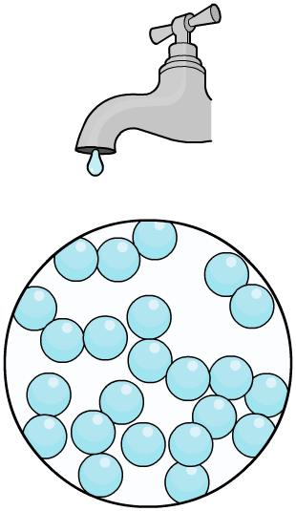
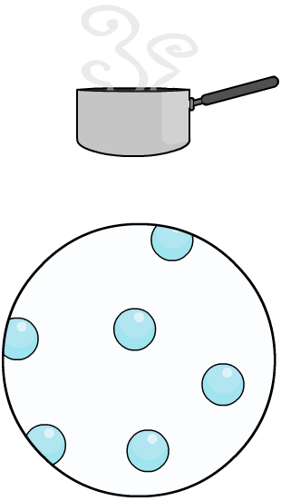
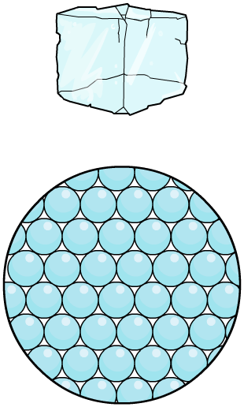
Moving molecules
In which states are molecules able to diffuse?
solid (e.g. ice)
liquid (e.g. water)
gas (e.g. steam)
Particles in liquids and gases are constantly moving and bumping into each other at random. This means that they tend to spread out. By contrast, particles in solids cannot move freely. Solids are therefore unable to diffuse.
Notes:
Teacher notes
Help students to apply their existing knowledge of the states of matter to answer the question. Encourage them to remember that particles in solids cannot move freely, and help them to identify the impact that this will have on diffusion.
This slide covers the Science and Engineering Practices:
Constructing Explanations and Designing Solutions: Apply scientific ideas, principles, and/or evidence to provide an explanation of phenomena and solve design problems, taking into account possible unanticipated effects.
Obtaining, Evaluating, and Communicating Information: Communicate scientific and/or technical information or ideas (e.g. about phenomena and/or the process of development and the design and performance of a proposed process or system) in multiple formats (including orally, graphically, textually, and mathematically).

Slide 6
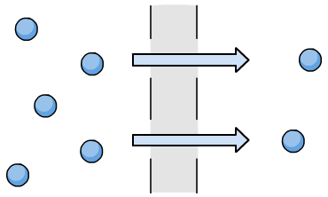
How do molecules move during diffusion?
Diffusion is the net movement of molecules in a liquid or gas moving from an area of high concentration to an area of lower concentration.
high concentration of particles
low concentration of particles
In gases and liquids, molecules are constantly moving randomly in all directions.
Net movement describes the overall direction molecules are moving in.

Slide 7
Diffusion in action
Notes:
Teacher notes
This activity could be used as an introductory exercise to work on diffusion.
This slide covers the Science and Engineering Practice:
Developing and Using Models: Develop, revise, and/or use a model based on evidence to illustrate and/or predict the relationships between systems or between components of a system.

Slide 8
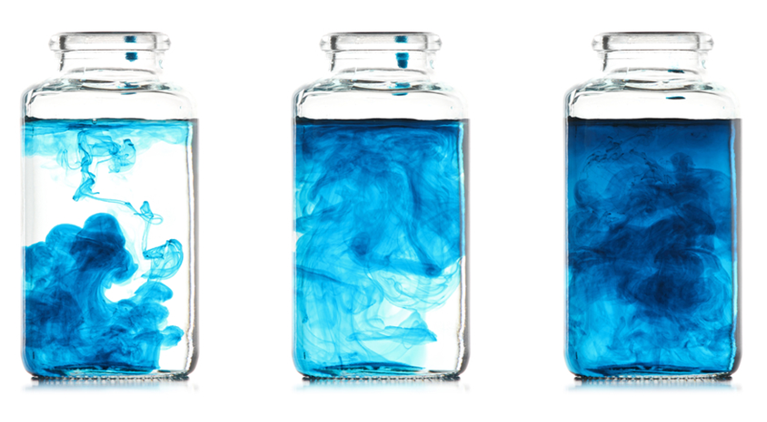
Diffusion, energy and concentration
Diffusion does not require any energy to occur – it is said to be a passive process.
This is possible because, during diffusion, molecules move down their concentration gradient. The concentration gradient describes the difference in concentration of molecules between two regions.
Diffusion can continue until the molecules are evenly spread out.
When this happens, there is no longer a concentration gradient.
Notes:
Photo credit: © Wahoo, Shutterstock.com 2018

Slide 9
Diffusion: true or false?
Notes:
Teacher notes
This true-or-false activity could be used as an introductory or summary activity on diffusion, or at the start of the lesson to gauge students’ existing knowledge of the subject matter. Colored traffic light cards (red = false, yellow = don’t know, green = true) could be used to make this a whole-class exercise.

Slide 10
Temperature and the rate of diffusion
Temperature influences how fast the molecules in a gas or liquid are able to move.
An increase in temperature increases
the speed at which molecules can diffuse down their concentration gradient.
surface area × concentration difference
rate of diffusion =
This means that molecules diffuse faster from an area of higher concentration to an area of lower concentration.
As a result, increasing temperature
increases the rate of diffusion.

Slide 11
What factors affect diffusion?
Notes:
Teacher notes
This simulation enables students to see how the rate of diffusion of particles across an exchange surface (membrane) is affected by surface area, thickness and concentration gradient. The orange strip across the centre of the box containing the particles represents the exchange surface. For each factor there are two simulations, each differing in just one way:
Surface area
large: the exchange surface spans the full height of the box
small: the exchange surface spans half the height of the box
Thickness
thin: the exchange surface is normal thickness
thick: the exchange surface is much thicker (the particles move more slowly through this)
Concentration gradient
large: particles are removed away rapidly from the exchange surface once they have moved across the membrane, maintaining a large concentration gradient
small: particles disappear much more slowly once they have moved across the membrane, leading to a smaller concentration gradient
It may be worth mentioning Fick’s law, as students could come across this term in further reading. Fick’s law holds that the rate of diffusion is directly proportional to the concentration gradient and inversely related to the thickness of the membrane.
This slide covers the Science and Engineering Practices:
Developing and Using Models: Develop, revise, and/or use a model based on evidence to illustrate and/or predict the relationships between systems or between components of a system.
Using Mathematics and Computational Thinking: Use mathematical, computational, and/or algorithmic representations of phenomena or design solutions to describe and/or support claims and/or explanations.

Slide 12
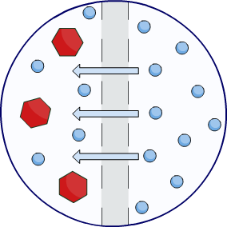
What is osmosis?
Osmosis is the diffusion of water from a solution with a high concentration of water molecules to a solution with a lower concentration of water molecules across a partially permeable membrane.
A partially permeable membrane is selective over what molecules are able to pass through. Cell membranes are partially permeable.
Here, the blue water molecules are able to pass across the partially permeable membrane by osmosis, but the red solute molecules are too large to cross.
Notes:
This slide covers the Science and Engineering Practice:
Developing and Using Models: Develop, revise, and/or use a model based on evidence to illustrate and/or predict the relationships between systems or between components of a system.

Slide 13
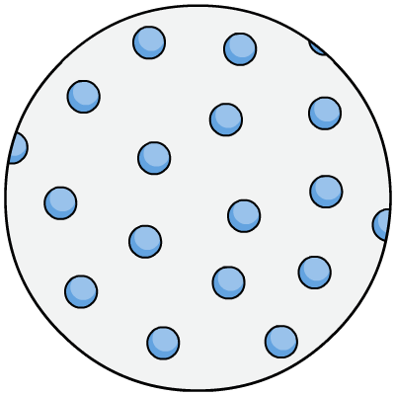
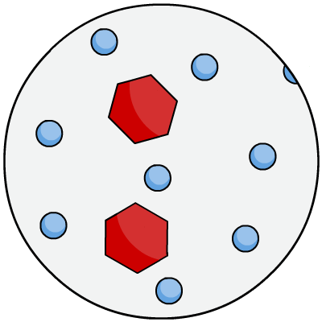
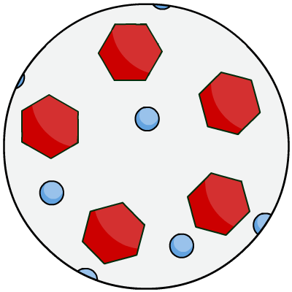
Dilute vs. concentrated
During osmosis, water molecules diffuse from pure water or a dilute solution to a more concentrated solution.
Dilute solutions have a high concentration of water molecules.
Concentrated solutions have a low concentration of water molecules.
concentrated
solution
pure water
dilute solution

Slide 14
Osmosis in action
Notes:
Teacher notes
This activity could be used as an introductory exercise to work on osmosis.

Slide 15
Predicting osmosis
Notes:
Teacher notes
This drag and drop activity provides the opportunity for informal assessment of students’ understanding of osmosis.

Slide 16
Practical: Investigating osmosis
Notes:
Teacher notes
Potato cells (plant cells) have a cell wall for additional support against changes in cell volume.
Consider asking students how different sugar solutions would affect red blood cells, which do not have a cell wall.
This slide covers the Science and Engineering Practices:
Planning and Carrying Out Investigations: Plan and conduct an investigation individually and collaboratively to produce data to serve as the basis for evidence, and in the design: decide on types, how much, and accuracy of data needed to produce reliable measurements and consider limitations on the precision of the data (e.g., number of trials, cost, risk, time), and refine the design accordingly.
Constructing Explanations and Designing Solutions: Make a quantitative and/or qualitative claim regarding the relationship between dependent and independent variables.
Developing and Using Models: Develop, revise, and/or use a model based on evidence to illustrate and/or predict the relationships between systems or between components of a system.

Slide 17
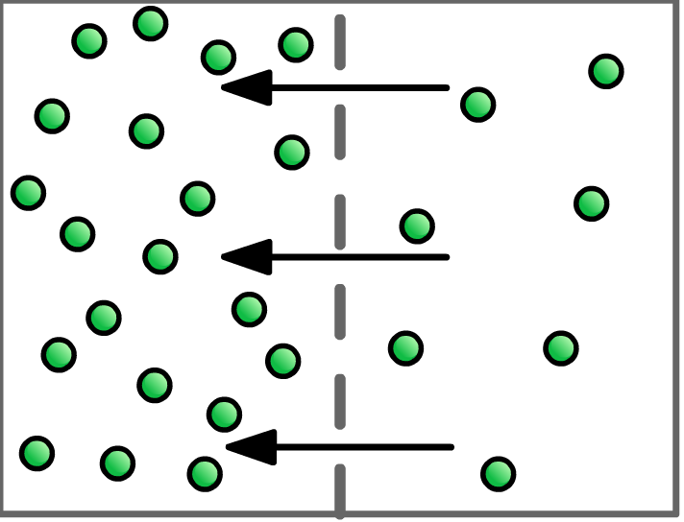
What is active transport?
Active transport is the movement of a substance from an area of lower concentration to an area of higher concentration.
Active transport enables a substance to move against its concentration gradient.
This requires energy to take place, which is provided by cellular respiration.
high
concentration
low
concentration
Notes:
This slide covers the Science and Engineering Practice:
Developing and Using Models: Develop, revise, and/or use a model based on evidence to illustrate and/or predict the relationships between systems or between components of a system.

