Slide 1
Stars

Slide 2
Information
Developing and Using Models
Using Mathematics and Computational Thinking
Obtaining, Evaluating and Communicating Information
3. Scale, Proportion, and Quantity
5. Energy and Matter
7. Stability and Change

Slide 3
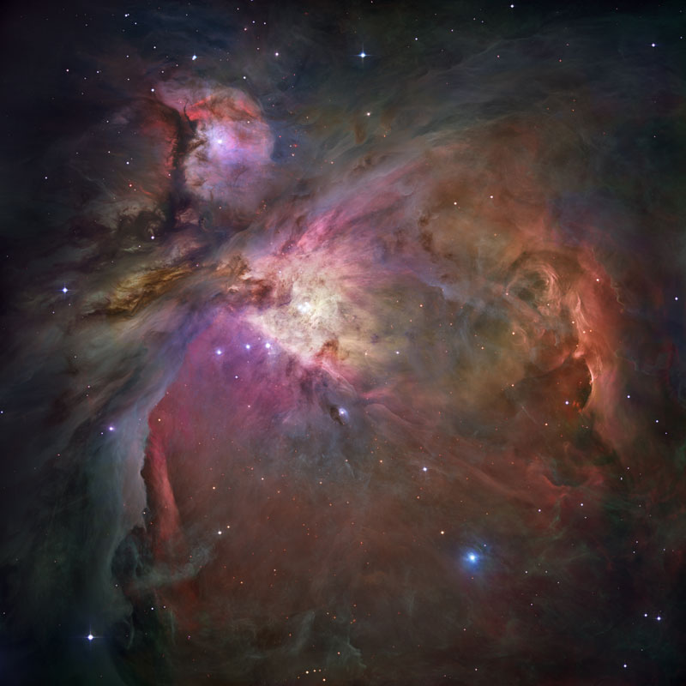
The formation of a star (1)
A star is formed when dust and gas is drawn together by gravity. The cloud of dust and gas, called a nebula, becomes hotter and denser, collapsing in on itself to form a protostar.
When the center of a protostar is hot and dense enough, nuclear fusion reactions begin. The star begins to shine.
The hydrogen nuclei in the star’s core fuse together to form helium nuclei.
Notes:
This presentation is accompanied by the worksheet Stars.
Photo credit: Orion Nebula © NASA,ESA, M. Robberto (Space Telescope Science Institute/ESA) and the Hubble Space Telescope Orion Treasury Project Team
The Orion Nebula is a picture book of star formation, from the massive, young stars that are shaping the nebula to the pillars of dense gas that may be the homes of budding stars. More than 3,000 stars of various sizes appear in this image.

Slide 4
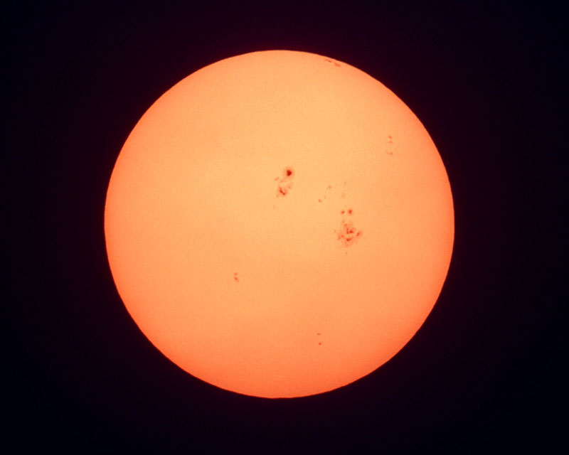
The formation of a star (2)
Fusion releases a huge amount of energy. This keeps the center of a star hot enough for fusion to continue, and heats the gases in the star.
The hot gases in the star expand, creating an outward force that balances the inward force of gravity and stops the star collapsing.
The star remains stable as long as these forces are in equilibrium. It is in the main sequence period of its life cycle.
Notes:
Teacher notes
For more information about nuclear fusion, please refer to the Physical Science: Nuclear Fusion presentation.
Photo credit: sun © Tom Tschida/NASA

Slide 5
How do stars begin and end?
Notes:
Teacher notes
This animation introduces how stars are formed, and how small, massive and really massive stars die. It can be used as an introduction to the topics within this presentation.
This slide covers the Science and Engineering Practice:
Developing and Using Models: Develop, revise, and/or use a model based on evidence to illustrate and/or predict the relationships between systems or between components of a system.

Slide 6
Structure of a stable star
Notes:
Teacher notes
This interactive click-and-reveal activity explains the structure of a main sequence star and how energy is created and transported through the star. There are five layers to reveal.
6

Slide 7
Terms about the life cycle of stars
Notes:
Teacher notes
This matching activity could be used as an introductory or summary activity on the lifecycle of stars.

Slide 8
The death of a small star
Notes:
Teacher notes
This five-stage interactive animation explains what happens to a low-mass star (similar to the Sun) when the hydrogen is depleted. Students could be prompted to explain why different elements are formed at different stages in the star’s life cycle.
This slide covers the Science and Engineering Practice:
Developing and Using Models: Develop, revise, and/or use a model based on evidence to illustrate and/or predict the relationships between systems or between components of a system.
8

Slide 9
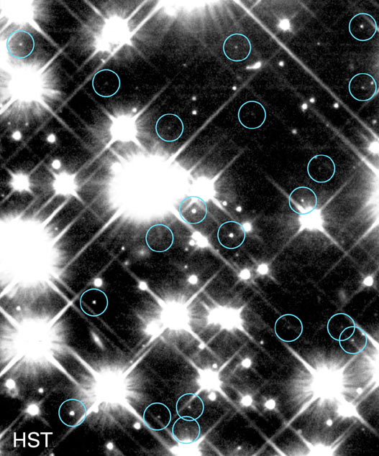
What is a white dwarf?
A white dwarf is formed at the end of the life cycle of a star that is about the same size as the Sun.
This photograph was taken using the Hubble Space Telescope. It shows ancient white dwarf stars in the Milky Way galaxy.
The white dwarf stars are shown ringed in blue.
Notes:
Photo credit: NASA and H. Richer (University of British Columbia)

Slide 10
Life cycle of small stars
Notes:
10
Teacher notes
This ordering activity could be used as an introductory or summary activity on the lifecycle of small stars, and the difference between small stars and large stars in the following chapter. Mini-whiteboards could be used to make this a whole-class exercise.

Slide 11
The death of a large star
Notes:
Teacher notes
This five-stage interactive animation explains what happens to a high-mass star (many times larger than the Sun) when the hydrogen is depleted. Students could be prompted to explain why different elements are formed at different stages in the star’s life cycle, and why a massive star behaves differently from a low-mass star.
This slide covers the Science and Engineering Practice:
Developing and Using Models: Develop, revise, and/or use a model based on evidence to illustrate and/or predict the relationships between systems or between components of a system.
11

Slide 12
Life cycle of large stars
Notes:
12
Teacher notes
This ordering activity could be used as an introductory or summary activity on the lifecycle of large stars, and the difference between large stars and small stars in the previous chapter. Mini-whiteboards could be used to make this a whole-class exercise.

Slide 13
What is a supernova?
Notes:
Teacher notes
This seven-stage animation explains what a supernova is and the stages in its formation.

Slide 14
Neutron stars
After a 1.4–2 solar mass star has exploded in a supernova, only the inner core of the star remains.
This core will have a radius of only 10 km, and a density more than 14 orders of magnitude higher than that of the Sun, and close to the density of an atomic nucleus.
This is a neutron star.
The outer shell is thought to be composed of a solid crust of atomic nuclei. Inside this crust is a liquid interior composed almost entirely of neutrons, increasing in density towards the center to reach nearly 10¹⁸ kg m^{–3}.
liquid core
up to
8 × 10¹⁷ kg m^{–3}
solid crust ~1 km
Notes:
Teacher notes
Some neutron stars rotate, emitting two beams of radiation in opposite directions. If the path of these beams crosses the Earth, the star can be observed as a regular pulse of radiation. When the first of these regular pulses was observed in 1967, its origin was unknown, and it was dubbed “LGM-1” (“little green man”). Shortly afterwards, it was established that the pulses came from a type of star, and the phenomenon was called a pulsar (“pulsating star”).
Pulsars rotate at speeds ranging from one rotation every few seconds to hundreds of rotations a second, and each rotation causes two pulses of radiation as the two beams pass over the Earth.

Slide 15
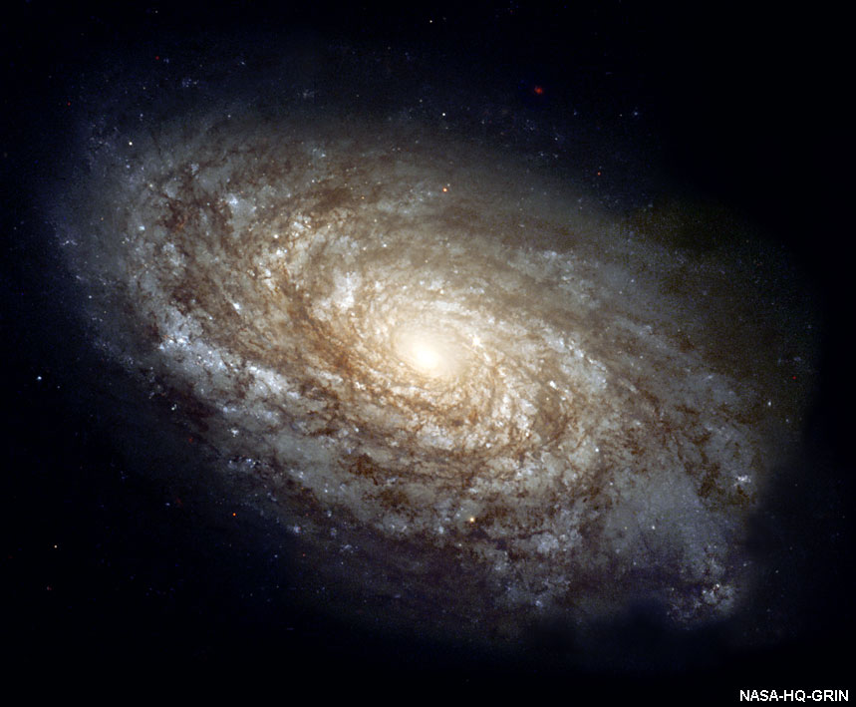
How are black holes formed?
The end of the life cycle of really massive stars is different to that of massive stars.
After a really massive red giant collapses in a supernova explosion, it leaves an object so dense that nothing, not even light, can escape its gravitational pull.
This is called a black hole.
Some scientists believe that there are black holes at the center of galaxies.
If light cannot escape from a black hole, then how can a black hole be observed?
Notes:
Photo credit: NASA Headquarters - Greatest Images of NASA (NASA-HQ-GRIN)
The spiral galaxy NGC 4414 as imaged by the Hubble Space Telescope. The core of the galaxy contains mainly older yellow and red stars. The outer spiral arms contain young, blue stars. The outward spiralling arms of the galaxy are very rich in interstellar dust.

Slide 16
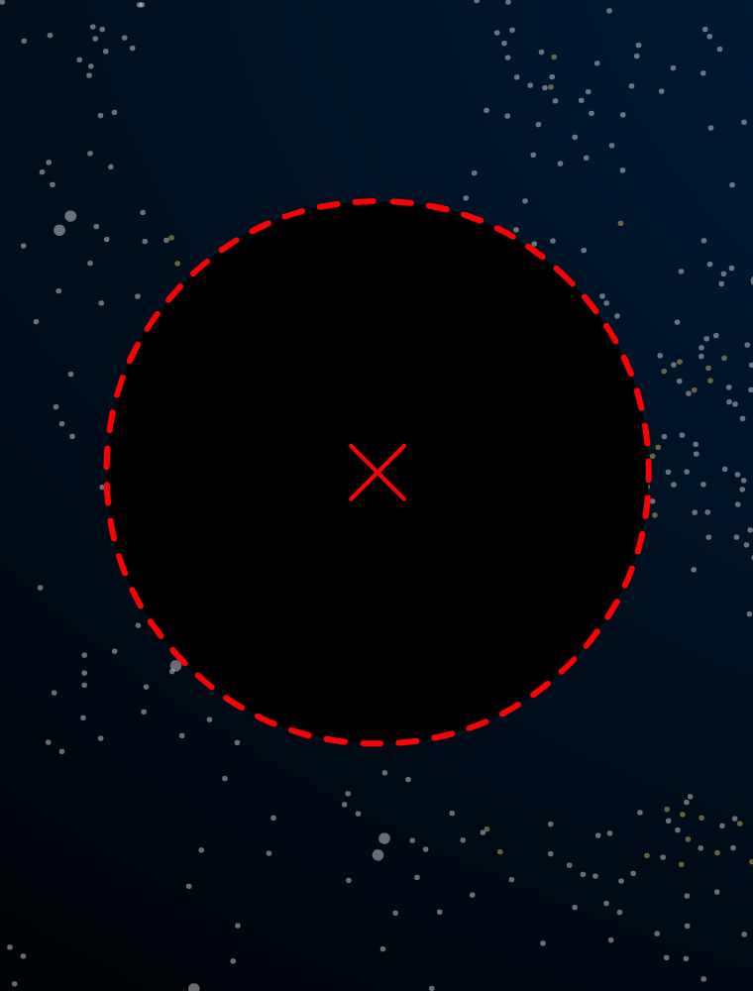
Event horizons
Every black hole is surrounded by an event horizon. Nothing that occurs within this boundary can ever affect the Universe outside it, and anything that crosses this horizon will fall into the black hole.
event horizon
To an outside observer, an object falling into the black hole slows down as it approaches the event horizon, never quite crossing it.
From the object’s point of view, it crosses the event horizon and falls towards the singularity.
singularity
Notes:
Teacher notes
The study of these strange effects, in which time and space are different depending on the observer, is known as relativity. The event horizon is not a physical boundary, and cannot be seen. It is only a theoretical boundary that separates the black hole from the rest of space.

Slide 17
How can a black hole be ‘seen’?
Notes:
Teacher notes
This three-stage animation explains how we know black holes exist, and where, even though they cannot be seen.
Photo credit: © R. Kraft (SAO) et al., CXO, NASA
This image, from the Chandra X-ray Observatory, shows the giant elliptical galaxy Centaurus A. The jet, approximately 30,000 light-years long, seems to arise from the galaxy's bright central x-ray source -- suspected of harboring a black hole with a million or so times the mass of the Sun.

Slide 18
Elements on the Earth
Notes:
Photo credit: © gary718, Shutterstock.com 2018

Slide 19
Making large atoms
Notes:
Teacher notes
This completing sentences activity could be used as an introductory or summary activity on element formation in stars. In point 5, all the elements heavier than iron came from a supernova. Use this point to provoke a discussion about where this supernova actually was.
19

Slide 20
Making elements summary
Notes:
Teacher notes
This matching activity could be used as an introductory or summary activity on the elements produced in stars. It should be noted that these are not the only elements produced by stars in each of these stages. For example, hydrogen is still fused to helium in the outer layers of a red giant, until all the hydrogen is used up. There are also elements formed by stars which are not listed here.
20

Slide 21
How are elements formed?
Design a poster to communicate information about how different elements are formed in the Universe.
Your poster should answer the following questions:
How were hydrogen and helium formed in the early universe?
How are elements heavier than helium but lighter than iron produced?
How are elements heavier than iron produced?
How can scientists tell which elements are present in stars?
Notes:
This slide covers the Science and Engineering Practices:
Obtaining, Evaluating, and Communicating Information: Critically read scientific literature adapted for classroom use to determine the central ideas or conclusions and/or to obtain scientific and/or technical information to summarize complex evidence, concepts, processes, or information presented in a text by paraphrasing them in simpler but still accurate terms.
Obtaining, Evaluating, and Communicating Information: Communicate scientific and/or technical information or ideas (e.g. about phenomena and/or the process of development and the design and performance of a proposed process or system) in multiple formats (including orally, graphically, textually, and mathematically).

Slide 22
Power output of a star
The amount of energy a star radiates per second, in all directions, is its luminosity. This is its power output.
Stefan’s law states that the luminosity of a star is directly proportional to its surface area, and to the fourth power of its temperature:
P = σAT⁴
(σ = 5.7 × 10^{–8} J K^{–4} m^{–2} s^{–1})
Where σ is known as the Stefan-Boltzmann constant. So a cool red giant can have the same power output as a smaller but hotter star.
A₁ = 6 × 10¹⁸ m²
A₂ = 3 × 10¹⁹ m²
red giant
Sun
T₁ = 6,000 K
T₂ = 4,000 K
P₁ = 4 × 10²⁶ W
P₂ = 4 × 10²⁶ W
Notes:
Teacher notes
This formula assumes black body radiation.
This slide covers the Science and Engineering Practices:
Using Mathematics and Computational Thinking: Use mathematical, computational, and/or algorithmic representations of phenomena or design solutions to describe and/or support claims and/or explanations.
Using Mathematics and Computational Thinking: Apply techniques of algebra and functions to represent and solve scientific and engineering problems.

Slide 23
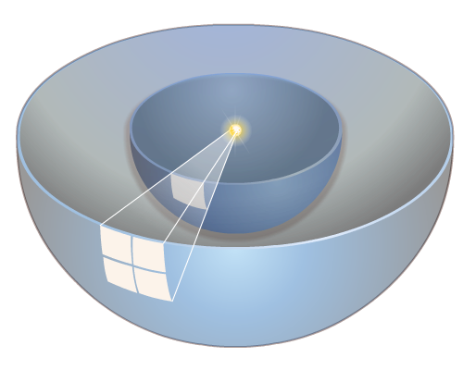
Flux and the inverse square law
The more distant a star, the dimmer it appears. Why is this?
The vacuum of space does not absorb light, so the total amount of light is not reduced as you get further away from the star. But the further away you are, the larger the sphere the light is spread over, so the lower the intensity of the light.
This intensity is called flux. It measures the power per square meter by dividing the total power (luminosity) by the area of the sphere at that distance:
P
F =
4πd²
d
Flux is inversely proportional to the square of the distance from a source.
2d
a
4a
This is an inverse square law.
Notes:
This slide covers the Science and Engineering Practice:
Using Mathematics and Computational Thinking: Use mathematical, computational, and/or algorithmic representations of phenomena or design solutions to describe and/or support claims and/or explanations.

Slide 24
Apparent magnitude
The apparent brightness of a star when viewed from Earth depends on the luminosity of the star, and how far away it is. Flux depends on both of these, but varies over a huge scale.
Apparent magnitude (m) uses a logarithmic scale to give an idea of the order of magnitude of the star’s brightness:
m = –2.5 log F + constant
The constant is based on the brightness of a comparison star, usually Vega, one of the brightest stars in the night sky.
Apparent magnitude makes it possible to put all celestial objects on a scale from roughly –30 (the Sun) to +30 (the faintest objects visible in the Hubble Space Telescope).
Notes:
This slide covers the Science and Engineering Practice:
Using Mathematics and Computational Thinking: Use mathematical, computational, and/or algorithmic representations of phenomena or design solutions to describe and/or support claims and/or explanations.

Slide 25
Absolute magnitude
Related to apparent magnitude is absolute magnitude (M). This removes the effect of distance by giving the apparent magnitude of a star if it were at a standard distance of 10 pc.
If d is the distance to the star, then M is given by:
m – M = 5 log (d / 10)
Q. If apparent magnitude is a logarithmic scale describing flux,
then absolute magnitude is a logarithmic scale describing
what other variable?
Luminosity.
Q. Some objects, such as certain types of supernova, always
have the same absolute magnitude. If m and M are known
for a particular supernova, what can you calculate using
the formula above?
How far away it is.
Notes:
This slide covers the Science and Engineering Practice:
Using Mathematics and Computational Thinking: Use mathematical, computational, and/or algorithmic representations of phenomena or design solutions to describe and/or support claims and/or explanations.

Slide 26
Brightness – questions
Notes:
This slide covers the Science and Engineering Practice:
Using Mathematics and Computational Thinking: Apply techniques of algebra and functions to represent and solve scientific and engineering problems.

Slide 27
The Hertzsprung-Russell diagram
Notes:
Teacher notes
The example stars featured in this animation are:
Proxima Centauri: the Sun’s nearest neighboring star
Bellatrix, Betelgeuse and Rigel: three of the four corners of the constellation Orion; Betelgeuse and Rigel are supergiants, while Bellatrix is a massive main sequence star
Sirius B: the white dwarf that forms a binary system with Sirius, the brightest star in the night sky
This slide covers the Science and Engineering Practice:
Developing and Using Models: Develop, revise, and/or use a model based on evidence to illustrate and/or predict the relationships between systems or between components of a system.

