Slide 1
Pollution

Slide 2
Information
Developing and Using Models
Planning and Carrying Out Investigations
2. Cause and Effect

Slide 3
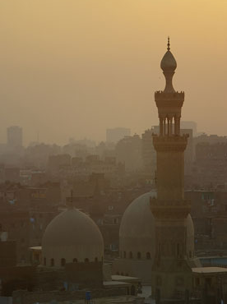
What is air pollution?
Air is made up of a mixture of gases – about 78% nitrogen, 21% oxygen and 1% other gases, including carbon dioxide.
Air pollution is the presence of substances in the air (pollutants). These are usually caused by human activities and are harmful to health or the environment.
It can be easy to spot air pollution in cities. However, its effects are not limited to urban areas because air circulates freely all over the world.
The effects of air pollution can destroy forests, poison fish in lakes and rivers, and even cause premature death in humans.
Notes:
Teacher notes
For more information on the composition of the atmosphere, please refer to the Earth’s Atmosphere presentation.
Photo credit: © andesign101, Shutterstock.com 2018

Slide 4
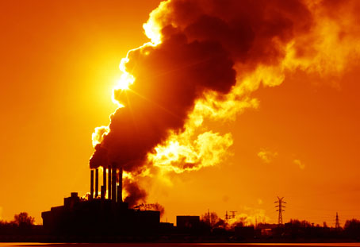
Fuels and the environment
Most fuels contain hydrogen and carbon, but many also contain some sulfur. When a fuel burns, several substances may be released into the Earth’s atmosphere, including:
carbon dioxide (CO₂)
water vapor (H₂O)
carbon monoxide (CO)
sulfur dioxide (SO₂)
oxides of nitrogen (NO)
particulates.
The conservation of atoms during chemical reactions means that any impurities in the fuel will also end up as a product.
Notes:
Photo credit: © Dudarev Mikhail, Shutterstock.com 2018

Slide 5
Causes and effects of air pollutants
Notes:
Teacher notes
This activity provides an introduction to the five major air pollutants. It could be used either as a starting point for the topic or as a summary activity.

Slide 6
Carbon dioxide in nature
Carbon dioxide (CO₂) is an important atmospheric gas as it prevents heat radiation produced by the Earth from escaping into space – the greenhouse effect. Without CO₂, the Earth would not be warm enough for life.
Plants and trees use CO₂ during photosynthesis. This is a chemical reaction that takes place in the chloroplasts of green plant cells, where light energy is used to convert carbon dioxide and water into glucose and oxygen. CO₂ also dissolves in rain and sea water.
Notes:
Teacher notes
Carbon dioxide forms carbonic acid when dissolved in water and is responsible for rain having a pH of 5.6.
For more information on the greenhouse effect and the role of photosynthesis in removing carbon dioxide from the atmosphere, please refer to the Earth’s Atmosphere and The Greenhouse Effect presentations.

Slide 7
Carbon dioxide from fuels
CO₂ is produced during the complete combustion of hydrocarbon fuels, such as crude oil or natural gas.
+
carbon dioxide
+
hydrocarbon
oxygen
→
water
Increased levels of CO₂ in the atmosphere can cause dramatic changes to the Earth’s climate, known as global warming.
Countries across the world are trying to reduce their CO₂ emissions.

Slide 8
The products of combustion
Notes:
Teacher notes
This virtual experiment illustrates how the products of the combustion of a hydrocarbon can be determined. It should be made clear to students that air is sucked through the apparatus while the candle is burning.
Anhydrous means without water. Anhydrous cobalt chloride paper will detect any moisture created by combustion.
This slide covers the Science and Engineering Practice:
Planning and Carrying Out Investigations: Select appropriate tools to collect, record, analyze and evaluate data.

Slide 9
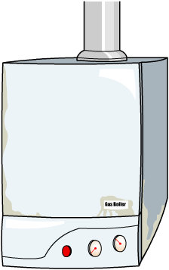
Incomplete combustion
If there is a shortage of oxygen when a hydrocarbon fuel is burned, incomplete combustion takes place.
+
carbon monoxide
+
+
hydrocarbon
oxygen
→
carbon
water
Carbon monoxide (CO) gas is very harmful to human health because it stops the blood from carrying oxygen.
CO is produced in internal combustion engines, but can also be released from faulty gas appliances.

Slide 10
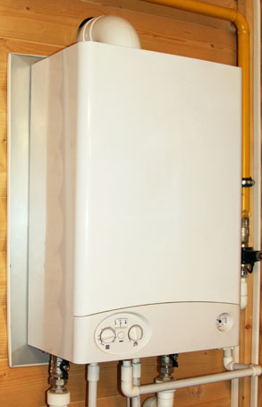
Carbon monoxide
Carbon monoxide (CO) is a colorless, odorless and very toxic gas that reduces the ability of the blood to carry oxygen. Carbon monoxide poisoning kills about 370 people in the US on average each year.
CO can be released by gas appliances and flues in the home that have not been properly installed or are poorly maintained.
CO is also produced during the combustion of petrol or diesel inside internal combustion engines. Catalytic converters are now fitted to vehicles to convert the CO into CO₂.
Notes:
Data credit: QuickStats: Number of Deaths Resulting from Unintentional Carbon Monoxide Poisoning, by Month and Year — National Vital Statistics System, United States, 2010–2015. Available at: https://www.cdc.gov/mmwr/volumes/66/wr/mm6608a9.htm
This weblink was working correctly at the time of publication. Boardworks takes no responsibility for the content of external websites.
Photo credit: © sommthink, Shutterstock.com 2018

Slide 11
Nitrogen oxides
As hydrocarbons burn in internal combustion engines, high temperatures are created. At these temperatures, nitrogen in the air, which is normally unreactive, combines with oxygen to form nitrogen monoxide (NO):
nitrogen
+
oxygen
→
nitrogen monoxide
NO can react with oxygen to give nitrogen dioxide (NO₂):
nitrogen monoxide
+
nitrogen dioxide
oxygen
→
Together, NO and NO₂ are referred to as NO_{x}.

Slide 12
Soot
When the amount of oxygen available is very limited, incomplete combustion can also produce carbon particulates, often referred to as soot.
+
carbon monoxide
+
+
hydrocarbon
oxygen
carbon
water
Carbon particles are produced in the combustion of long chain hydrocarbons, such as in the wax in candles. The carbon particles glow in the heat of the flame and give it a yellow color.
Carbon particles in the air can cause respiratory problems for some people.
Notes:
Teacher notes
For more information on hydrocarbons, please refer to the Physical Science: Alkanes and Hydrocarbons presentations.

Slide 13
Pollutants
Notes:
Teacher notes
This activity provides an introduction to the five major air pollutants. It could be used either as a starting point for the topic or as a summary activity.
The following color code is used for molecules:
red = oxygen
black = carbon
yellow = sulfur
blue = nitrogen.

Slide 14
Common pollutants

Slide 15
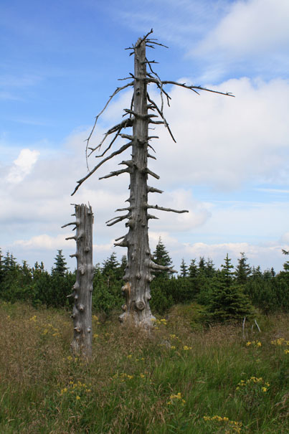
Sulfur dioxide
Sulfur is found naturally in all fossil fuels – fuel oil and coal contain about 2% sulfur.
When a hydrocarbon fuel containing sulfur impurities is burned, the sulfur reacts with oxygen and sulfur dioxide (SO₂) is produced. SO₂ dissolves in rain water to produce acid rain.
Nitrogen dioxide (NO₂) can also react with water to produce acid rain.
Notes:
Photo credit: © apple1, Shutterstock.com 2018

Slide 16
Acid rain

Slide 17
The effects of acid rain
Notes:
Teacher notes
Sodium metabisulfite can aggravate asthma.
In a natural environment, acid rain can slow or stop new plant growth because hydrogen ions from the acid displace calcium, magnesium and potassium ions needed by the plants, leaching them from the soil. Aluminum ions (from aluminum hydroxide) can also react with the acid in acid rain, again stopping plants from absorbing calcium from the soil.
This slide covers the Science and Engineering Practice:
Planning and Carrying Out Investigations: Plan an investigation or test a design individually and collaboratively to produce data to serve as the basis for evidence as part of building and revising models, supporting explanations for phenomena, or testing solutions to problems. Consider possible variables or effects and evaluate the confounding investigation’s design to ensure variables are controlled.

Slide 18
Decreasing sulfur dioxide
Many fuels contain sulfur which is released as sulfur dioxide (SO₂) into the atmosphere. This results in the formation of acid rain.
Current methods to reduce sulfur dioxide emissions include:
removing sulfur from natural gas and fuel – this is an expensive technique that increases fuel prices
using gas scrubbers – spraying the gas with alkaline sea water that neutralizes the sulfur dioxide
using calcium oxide – this reacts with SO₂ to form the solid compound calcium sulfate. This can be used for construction materials.

Slide 19
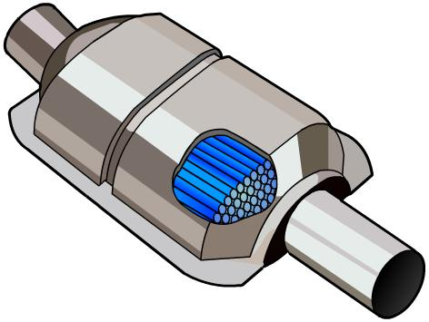
Reducing pollution from vehicles
Harmful gases produced during the combustion of fuels are released into the atmosphere.
Insufficient oxygen, for example when a car is started, results in incomplete combustion and the production of the toxic chemicals carbon monoxide and nitrogen monoxide.
Catalytic converters treat car exhaust before it is released into the atmosphere.
They convert carbon monoxide into the less harmful carbon dioxide, and convert nitrogen monoxide into nitrogen and oxygen.
Notes:
Teacher notes
Platinum or rhodium act as a catalyst in the catalytic converters to increase the rate of conversion of CO to CO₂ and NO to N₂ +O₂.
Although catalytic converters prevent poisonous gases being emitted, they do not prevent the release of carbon dioxide, a contributor to climate change.

Slide 20
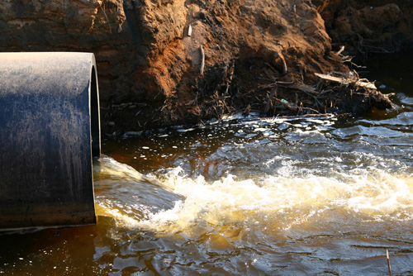
What causes water pollution?
Rivers and oceans are often used to dispose of waste. This can cause extensive damage to aquatic life.
Substances dumped at sea include sewage, oil, industrial chemicals, fuels, plastics and disused ships.
Substances used on land, such as pesticides and fertilizers, can be washed into rivers and oceans, causing damage to ecosystems.
Notes:
Photo credit: © Yellowj, Shutterstock.com 2018

Slide 21
The effects of sewage and fertilizer

Slide 22
Eutrophication

Slide 23
Pollutants in the food chain
Notes:
Teacher notes
The number at the bottom right of each stage represents example values of the concentration in the tissues of DDT and its derivatives (in parts per million, ppm).

Slide 24
Types of pollutant
Some pollutants can build up in food chains, causing harm to aquatic organisms. These chemicals tend to be very stable compounds that are not easily broken down in the natural environment.
PCBs are chemicals used in coolants and insulating fluids in electrical equipment. Their use was banned in 1979.
DDT is a chemical that was widely used as an insecticide, helping to control populations of disease-carrying insects. It was banned in 1972.
It is thought that these chemicals can cause a variety of problems in higher animals, affecting the immune system, growth and reproduction.

Slide 25
Which concentration?
Notes:
This slide covers the Science and Engineering Practice:
Developing and Using Models: Develop, revise, and/or use a model based on evidence to illustrate and/or predict the relationships between systems or between components of a system.

Slide 26
Biological indicators

Slide 27
Using indicator species

