Slide 1
Climate Change

Slide 2
Information
Developing and Using Models
Analyzing and Interpreting Data
Using Mathematics and Computational Thinking
Engaging in Argument from Evidence
Obtaining, Evaluating and Communicating Information
1. Patterns
2. Cause and Effect
4. Systems and System Models
7. Stability and Change

Slide 3
What is climate?
Climate is not the same as weather. What is the difference?
Weather is the state of the atmosphere at a given time and place. It is measured in terms of factors such as temperature, rainfall, humidity and cloudiness.
Climate is the average weather for a region over a long period of time, usually 30 years.
Weather can change several times a day; the climate normally takes a long time to change. What would happen if the climate changed quickly?

Slide 4
What is climate change?
The changing climate is a natural phenomenon and normally takes place over several centuries.
The term “climate change” is used to refer to current changes in the climate. This is because recent scientific records show that the global climate is warming up more rapidly than usual.
The average global temperature has increased by 0.6 °C in 140 years.
The ten hottest years for the last 100 years have occurred since 1990.
Scientists have predicted that the climate could increase by up to 6 °C in the next 150 years.

Slide 5
Impacts of climate change
Notes:
Teacher notes
This activity could be used as a stimulus for a discussion on the effects of global warming
Photo credits: polar bears © US Fish and Wildlife Service (http://www.fws.gov/), Hurricane Katrina satellite © NASA, USA (http://www.nasa.gov/vision/earth/lookingatearth/h2005_katrina.html), cracked mud © Chad Gore, mosquito © Gabor Bibor, Great Barrier Reef, Australia © Rhett A Butler / mongabay.com (http://mongabay.com)

Slide 6
What is global warming?
The term “global warming” is often used in connection with climate change, but what does it mean?
Global warming refers to the increase in the Earth’s temperature due to the greenhouse effect, which can cause changes in climate.
However, the term “global warming” is now being used to refer to the warming predicted to occur as a result of increased emissions of greenhouse gases and other human activities. This enhanced greenhouse effect may lead to significant climate change.
Remember, global warming and climate change are not the same thing and should not be used interchangeably.

Slide 7
Evidence for climate change
As well as temperature change, other evidence for climate change has also been collected:
changes in the organization of ecosystems
increase in ocean temperatures
retreating glaciers
a decrease in the amount of Arctic sea ice
a rise in sea levels of around 17 cm.
Notes:
Teacher notes
For more information about evidence for climate change, please refer to: http://climate.nasa.gov/causes/
This website was working at the time of publication. Boardworks is not responsible for the content of third party sites.

Slide 8
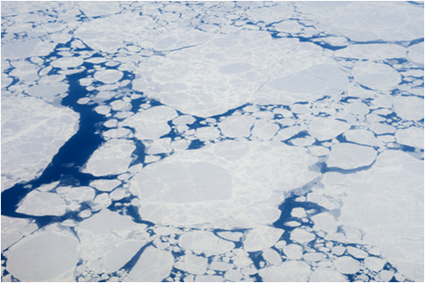
How is evidence collected?
Different techniques are used to collect evidence for climate change:
weather recordings using thermometers
measure small changes in temperature from trapped air and other molecules using ice core extractions
plant analysis – changes in climate can alter plant distribution in an ecosystem
rocks and fossils – to measure the Earth’s previous climate
studying images of glaciers
measuring ice cover.
Notes:
Photo credit: © MarcelClemens, Shutterstock.com 2018

Slide 9
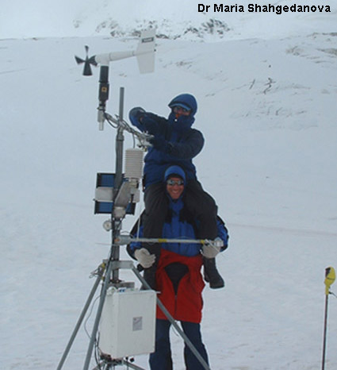
What is the evidence for climate change?
Data collected by climate scientists can be used to answer two key questions:
Is the climate really changing rapidly?
Is human activity causing this climate change?
These scientists are setting up an Automatic Weather Station on the Djankuat glacier in Russia.
Monitoring glaciers has produced startling evidence about the rate at which some glaciers are melting.
Notes:
Teacher notes
Djankuat Glacier is in the Caucasus mountains, between Georgia and Russia. The mass of the glacier has been recorded since 1964. This is one of the longest records for recording and is therefore considered a “reference glacier” by UNESCO.
Photo credit: Dr Maria Shahgedanova, Department of Geography, University of Reading (www.shes.rdg.ac.uk/Research/LCRG.asp)

Slide 10
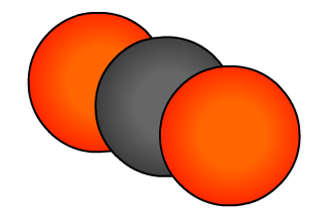
Why is carbon dioxide so important?
Carbon dioxide is considered the most significant greenhouse gas.
This is because carbon dioxide can remain in the environment over a long time, from 50 to 200 years.
Any process producing carbon dioxide today could affect
the climate for hundreds of years.
Carbon is present in all living things and moves through the environment in a chain of reactions called the carbon cycle.
Levels of carbon dioxide in the atmosphere have increased since the Industrial Revolution in the 19th century.
How might human activities have contributed to this?
Notes:
Teacher notes
For more information about the carbon cycle, please refer to the Life Science: Carbon Cycle presentation.

Slide 11
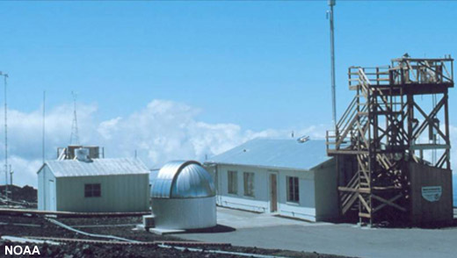
How are carbon dioxide levels measured?
Atmospheric carbon dioxide levels are measured around the world to detect global trends in this greenhouse gas.
The standard measurement used is parts per million (ppm). In 2005, levels were around 370 ppm. This means for every million parts of air, 370 parts were carbon dioxide.
Research stations for monitoring atmospheric gases are usually sited in remote places.
The Mauna Loa Observatory in Hawaii, is located at an altitude of 4,170 meters.
Notes:
Photo credit: National Oceanic and Atmospheric Administration, USA, Mauna Loa observatory, Hawaii

Slide 12
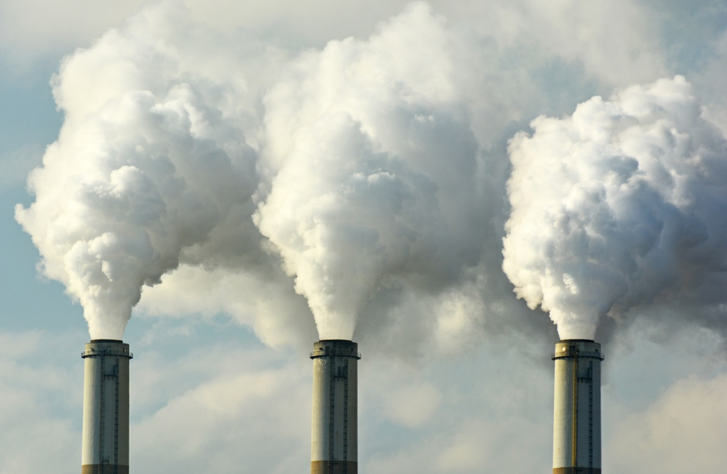
Climate change and human activity
An increase in the amount of greenhouse gases in the Earth’s atmosphere has been seen over the last 200 years.
This coincides with the start of the industrial revolution, when fossil fuels started to be used on a large scale.
The burning of fossil fuels has resulted in large amounts of carbon dioxide being released into the atmosphere.
This has overlapped with an increase in global temperatures.
Notes:
Teacher notes
Normally, a steady level of carbon dioxide is maintained in the air by the carbon cycle.
Photo credit: coal fossil fuel plant © Jeff Zehnder, Shutterstock 2018

Slide 13
What affects greenhouse gas levels?
Greater use of fossil fuels is thought to be the main source of the increase in atmospheric carbon dioxide.
Burning wood also releases carbon dioxide.
Living trees also have a major impact on the atmosphere, as they produce oxygen and absorb the greenhouse gas carbon dioxide. Deforestation reduces the amount of photosynthesis taking place and so increases carbon dioxide levels.
Rice farming and cattle farming produce the greenhouse gas methane.
Methane is 7.5 times more effective as a greenhouse gas than carbon dioxide but is currently in the atmosphere at much lower levels.
Notes:
Teacher notes
Fossil fuels are carbon-based materials that formed over millions of years from the remains of ancient plants and animals. Fossil fuels and oxygen are burned to produce carbon dioxide and water.
For more information about greenhouse gases, please refer to The Greenhouse Effect presentation.

Slide 14
Atmospheric carbon dioxide levels
Notes:
Teacher notes
This animated graph could be used to illustrate the current increase in atmospheric carbon dioxide levels. Data from the Mauna Loa observatory, Hawaii, courtesy of NOAA.
The key points about the data are:
Carbon dioxide levels have risen annually.
Within each year, there are seasonal changes in the level of carbon dioxide in the atmosphere. Dips in carbon dioxide levels correspond to spring and summer months, when plants are growing and photosynthesising more rapidly.
Students should be aware that CO₂ levels are increasing. Within this increase, there is a yearly variation in CO₂ levels.
More information about atmospheric gases is available at www.esrl.noaa.gov/gmd
This weblink was working correctly at the time of publication. Boardworks takes no responsibility for the content of external sites.
This slide covers the Science and Engineering Practice:
Analyzing and Interpreting Data: Analyze data using tools, technologies, and/or models (e.g., computational, mathematical) in order to make valid and reliable scientific claims or determine an optimal design solution.

Slide 15
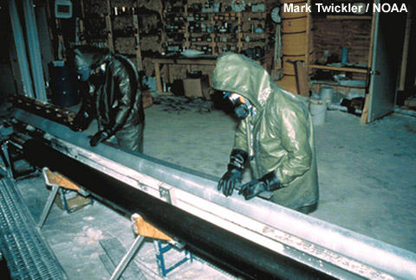
What are ice cores?
Ice cores are long columns of ice that are drilled out of glaciers.
Ice cores are studied to increase understanding of the history of climate as they provide data about the distant past.
Air bubbles trapped in the ice are used to estimate carbon dioxide levels thousands of years ago.
This is called a proxy record. These are indirect climate measures of the climate that have not been recorded using instruments. Tree rings are another type of proxy record.
Notes:
Photo credit: Mark Twickler, University of New Hampshire and NOAA

Slide 16
Data from ice cores
Notes:
Teacher notes
This animated graph could be used as a stimulus for either small group or whole class discussion on the long term trends in atmospheric carbon dioxide level. Data from the Vostok ice core, courtesy of NOAA and WDC Paleo (www.ncdc.noaa.gov/paleo/icecore/antarctica/vostok/vostok_co2.html).
Petit, JR et al. 1999. Climate and atmospheric history of the past 420,000 years from the Vostok ice core, Antarctica. Nature 399: 429-436.
This slide covers the Science and Engineering Practice:
Analyzing and Interpreting Data: Analyze data using tools, technologies, and/or models (e.g., computational, mathematical) in order to make valid and reliable scientific claims or determine an optimal design solution.

Slide 17
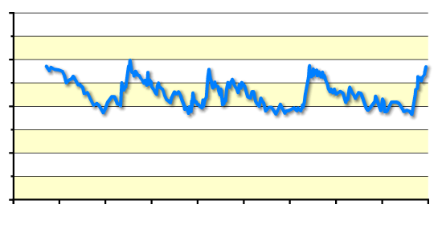
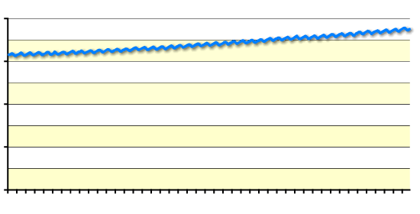
How have CO₂ levels changed?
400
These graphs show how carbon dioxide concentrations have changed over time.
300
200
100
Around 200 years ago, CO₂ levels were about 280 ppm and are now about 380 ppm.
0
400
300
200
100
0
years before present (thousands)
400
According to records, this is about 27% more than at any time in the last 400,000 years.
300
200
100
How might this affect the climate?
0
1960
1980
2000
year
Notes:
Teacher notes
These graphs can be used to compare current trends in atmospheric carbon dioxide levels with historic records.
Top graph data (proxy records) from the Vostok ice core, courtesy of NOAA and WDC Paleo. Bottom graph data (instrumental records) from the Mauna Loa observatory, Hawaii, courtesy of NOAA.
Petit, JR et al. 1999. Climate and atmospheric history of the past 420,000 years from the Vostok ice core, Antarctica. Nature 399: 429-436.
The key points about the data are:
Carbon dioxide levels have naturally varied over time (top graph)
Carbon dioxide levels vary seasonally (bottom graph)
Current carbon dioxide levels are significantly higher than at any time in the last 400,000 years, according to the ice core records.
Discussion points could include:
How reliable are different data sources?
Which methods can be used to help scientists understand atmospheric conditions over a long time period?
This slide covers the Science and Engineering Practice:
Analyzing and Interpreting Data: Analyze data using tools, technologies, and/or models (e.g., computational, mathematical) in order to make valid and reliable scientific claims or determine an optimal design solution.

Slide 18
Temperature change
Notes:
Teacher notes
This animated graph could be used to stimulate discussion about recent temperature variations. Data from the UK Metrological Office (www.met.gov.uk). This website was working correctly at the time of publication. Boardworks takes no responsibility for the content of external sites.
When talking about climate change, temperature changes are normally recorded as the difference between the average temperature compared to a stated mean temperature. The mean temperature is usually worked out by averaging temperature data for a 30-year period (this is consistent with how ‘climate’ is defined).
These types of graphs are show how the climate is changing, compared to a previous climate pattern.
This slide covers the Science and Engineering Practice:
Analyzing and Interpreting Data: Analyze data using tools, technologies, and/or models (e.g., computational, mathematical) in order to make valid and reliable scientific claims or determine an optimal design solution.

Slide 19
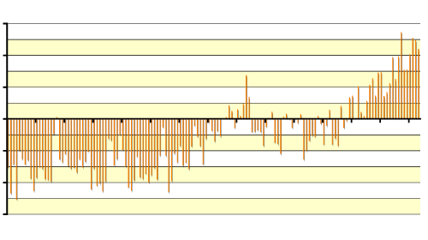
Are temperature and CO₂ related? (1)
0.6
The global average temperature has increased at the same time as the levels of carbon dioxide have risen.
0.4
0.2
0
–0.2
–0.4
–0.6
1861
1941
2001
However, it is not correct to say that carbon dioxide levels have caused this temperature change, because there are other factors involved.
year
400
300
200
100
0
How should the data
1960
1980
2000
year
be discussed?
Notes:
Teacher notes
These graphs can be used as a stimulus for discussion about the relationship between temperature and atmospheric carbon dioxide levels. Top graph data from the UK Metrological Office (www.met.gov.uk). Bottom graph data from the Mauna Loa observatory, Hawaii, courtesy of NOAA.
Key points about the data are:
Temperature and carbon dioxide levels have both increased over the last 40 years.
Students should be aware that this does not necessarily mean that carbon dioxide levels have caused the increase in temperature, because other factors may be involved.
This slide covers the Science and Engineering Practice:
Analyzing and Interpreting Data: Analyze data using tools, technologies, and/or models (e.g., computational, mathematical) in order to make valid and reliable scientific claims or determine an optimal design solution.

Slide 20
Are temperature and CO₂ related? (2)
Does the data show that increases in atmospheric carbon dioxide cause an increase in Earth’s temperature?
The data shows that there is a correlation between increasing carbon dioxide levels and temperature. However, it cannot tell us that one causes the other.
Carbon dioxide is a greenhouse gas, which means it can trap the Sun’s radiation. This is a causal mechanism for carbon dioxide to increase Earth’s temperature. However, we cannot say for certain that this is the only reason behind the temperature increase, as other factors may be involved.
Notes:
This slide covers the Science and Engineering Practices:
Analyzing and Interpreting Data: Analyze data using tools, technologies, and/or models (e.g., computational, mathematical) in order to make valid and reliable scientific claims or determine an optimal design solution.
Analyzing and Interpreting Data: Consider limitations of data analysis (e.g., measurement error, sample selection) when analyzing and interpreting data.

Slide 21
How should I talk about the climate data?
It is important to be very careful about the words used to discuss scientific data.
Collected data shows that temperature and carbon dioxide levels in the atmosphere have increased at the same time. It might seem to make sense to say that the rise in carbon dioxide is causing the temperature rise but this is incorrect.
How do you know that it is not the temperature increase that is causing carbon dioxide levels to rise?
Can you say for certain that carbon dioxide is the only factor in the change of temperature?
It is more correct to say that there appears to be a positive relationship between carbon dioxide levels and temperature.
Notes:
This slide covers the Science and Engineering Practices:
Analyzing and Interpreting Data: Analyze data using tools, technologies, and/or models (e.g., computational, mathematical) in order to make valid and reliable scientific claims or determine an optimal design solution.
Analyzing and Interpreting Data: Consider limitations of data analysis (e.g., measurement error, sample selection) when analyzing and interpreting data.

Slide 22
Peer review
Research in science produces vast amounts of data, sometimes conflicting. How do you know which research to believe?
Peer review involves the independent evaluation of scientific research by experts in the field. They decide which results are published in science journals.
A recent study of peer reviewed research showed 97% of climate scientists agree that human activities have led to climate change.
Notes:
This slide covers the Science and Engineering Practice:
Obtaining, Evaluating, and Communicating Information: Evaluate the validity and reliability of and/or synthesize multiple claims, methods, and/or designs that appear in scientific and technical texts or media reports, verifying the data when possible.

Slide 23
Communicating climate change
It is important for data to be presented in an accurate and accessible way, for both scientists and the public.
Misrepresentation of data can lead to inaccurate opinions presented in the media that are only based on part of the evidence.
This information may be biased to suit an individuals needs.
Think about where you hear about current information on climate change. How is it portrayed, and what impact may this have on a person?
Notes:
This slide covers the Science and Engineering Practice:
Obtaining, Evaluating, and Communicating Information: Evaluate the validity and reliability of and/or synthesize multiple claims, methods, and/or designs that appear in scientific and technical texts or media reports, verifying the data when possible.

Slide 24
Effects of climate change
The changing climate and increasing greenhouse gas emissions affect not just the environment, but also human lifestyle.
The main effects of global climate change include:
extreme weather
disrupted agriculture
decreasing ice cover
changing sea level
spreading disease.
Notes:
Teacher notes
Divide students into five groups and assign each group an effect from the bullet points above. Ask them to do some more research on the effect they’ve been given and how climate change could be responsible for that effect. Ask them to create a model of this interaction using drawings, a demonstration, or other method.

Slide 25
How do we predict climate change?
Climate models are used to predict how Earth’s climate is changing.
These are computer models which represent the interactions between the Earth’s atmosphere, land surface, oceans, and sun.
This results in a huge amount of information, which makes it difficult to accurately model Earth’s climate.
We therefore use multiple simplified models to understand changes in climate.
Notes:
This slide covers the Science and Engineering Practice:
Using Mathematics and Computational Thinking: Use mathematical, computational, and/or algorithmic representations of phenomena or design solutions to describe and/or support claims and/or explanations.

Slide 26
Modeling climate change
Using climate models, climate change scientists take several steps to make predictions about Earth’s climate:
Data from previous climates is entered into the model to test its ability to reproduce known climates.
Scientists report a range of projections. For example, these can show how the climate might change if CO₂ production stays the same, if it decreases or if it increases.
The International Panel on Climate Change (IPCC) is a UN organization responsible for assessing climate change data. They use information from different computer models and research to write reports about climate change.
Notes:
Teacher notes
When talking about climate change, climate scientists often use the term “projections,” instead of “predictions.”
A projection is developed by using the available scientific evidence to assess what is likely to occur. It cannot be tested by experimentation in the same way as a prediction, which is usually a more specific statement.
This slide covers the Science and Engineering Practice:
Using Mathematics and Computational Thinking: Use mathematical, computational, and/or algorithmic representations of phenomena or design solutions to describe and/or support claims and/or explanations.

Slide 27
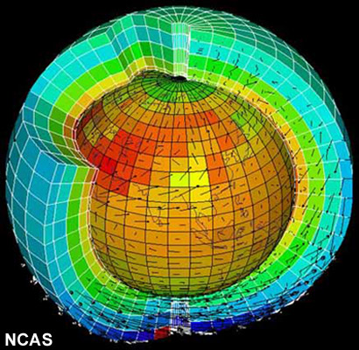
How is climate change predicted?
Scientists use experiments to explore how things work and to test predictions. However, the climate is far too large and too complicated to be reproduced in a laboratory.
Instead, computer models are used to represent the climate and explore the possible effects of human actions.
Mathematical formulae are used to represent the separate parts of the climate system and how they interact.
In models, the Earth is divided into grid squares. Using smaller squares increases the detail.
Notes:
Teacher notes
Complex climate models are very difficult to model and require a lot of computing power. The Earth Simulator center in Japan has one of the largest computers used for climate modeling. It can work at a speed of 35,000,000,000 calculations per second! Powerful computers like this make it possible to model the complexity of the climate system.
This slide covers the Science and Engineering Practice:
Using Mathematics and Computational Thinking: Use mathematical, computational, and/or algorithmic representations of phenomena or design solutions to describe and/or support claims and/or explanations.
Photo credit: NCAS. (The Natural Environment Research Council Centres for Atmospheric Science) (http://ncas.nerc.ac.uk).
The image shows the division of the globe by vertical and horizontal grids for the purpose of computer modeling.

Slide 28
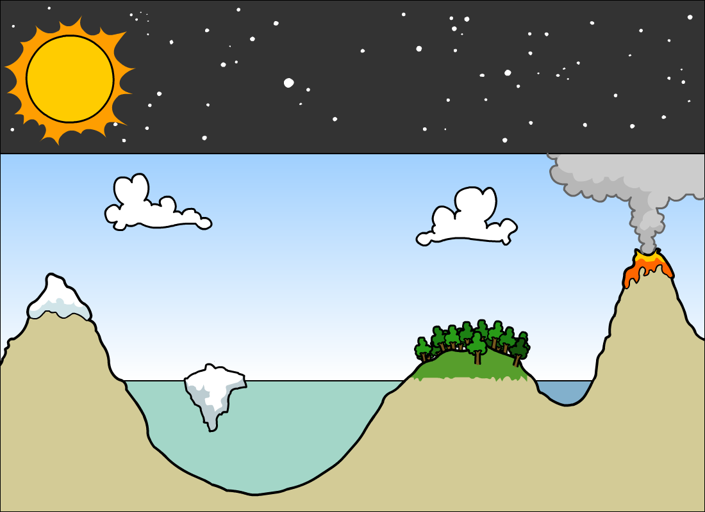
How is the climate modeled?
There are many factors that can affect the climate. All these interactions need to be included in climate models.
radiation from the Sun
radiation from the Earth
volcanoes
atmosphere
precipitation
evaporation transpiration
ice in the sea
ice on land
seas and oceans
land
rivers and lakes
Notes:
Teacher notes
The illustration is a simplified diagram of the interactions that are included in climate models.
To produce accurate predictions about climate change, models need to represent the interactions between the elements that have been shown to affect the climate. These methods are similar to those used in weather forecasting, but the time scale of climate models is much larger.
Key factors are:
The balance between radiation from the Sun entering the atmosphere and the amount of radiation from the Earth escaping into space.
Interactions of the water cycle – evaporation, transpiration, precipitation, seas and oceans, rivers and lakes.
Levels of ice on land and sea affect the sea levels and also the amount of water available for precipitation.
The net effect on the temperature of volcanic eruptions is complicated. Carbon dioxide from eruptions adds to the greenhouse effect. However, dust from volcanoes decreases the amount of solar radiation coming into the Earth’s atmosphere. This is why volcanic activity can decrease the temperature.
This slide covers the Science and Engineering Practice:
Developing and Using Models: Develop, revise, and/or use a model based on evidence to illustrate and/or predict the relationships between systems or between components of a system.

Slide 29
How accurate are climate models?
Within a small section of the scientific community there is still some scepticism about the accuracy of the predictions produced using climate models.
Arguments against using climate models include:
climate models do not measure local variability well.
it is difficult to model aspects of the climate like clouds. Cloud cover greatly influences surface temperature. Not including clouds in models could reduce their accuracy.
to predict the contribution of humans to climate change, the models have to make assumptions about population and economic growth. This could cause prediction errors.
How are climate researchers trying to solve these problems?
Notes:
Teacher notes
Using the predictions generated by climate models to determine political policy is still a contentious issue. There are several websites and books that take a sceptical viewpoint of climate change predictions. However, within the scientific community there is a growing consensus that climate change is at least partially due to human activities and that climate models are an essential tool in understanding possible future change.
This could be a useful area to use as an introduction to using computer technology for research. Points for students to consider when using websites include:
When was the site written? This will indicate how up to date the information is.
Is this an academic piece of research? University websites and journals like Nature are usually reliable sources of information.
Who writes the site? Is it the work of one person, a team of people or a larger institute?
Who funds the site? This could indicate a possible bias in writing about an issue.
This slide covers the Science and Engineering Practices:
Analyzing and Interpreting Data: Consider limitations of data analysis (e.g., measurement error, sample selection) when analyzing and interpreting data.
Engaging in Argument from Evidence: Compare and evaluate competing arguments or design solutions in light of currently accepted explanations, new evidence, limitations (e.g., trade-offs), constraints, and ethical issues.
Engaging in Argument from Evidence: Evaluate the claims, evidence, and/or reasoning behind currently accepted explanations or solutions to determine the merits of arguments.
Obtaining, Evaluating, and Communicating Information: Evaluate the validity and reliability of and/or synthesize multiple claims, methods, and/or designs that appear in scientific and technical texts or media reports, verifying the data when possible.

Slide 30
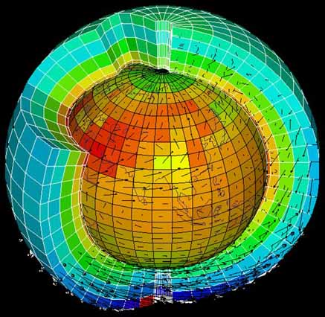
How are climate models tested?
Climate change researchers take several steps to make model predictions more reliable.
Data from previous climates is entered into the model. This tests the ability of the model to reproduce known climates.
Scientists usually report a range of projections or scenarios. These can show, for example, how the climate might change if human carbon dioxide production stays the same, if it decreases, or if it increases.
The International Panel on Climate Change (IPCC) is a UN organization that is responsible for assessing climate change data. They use information from different computer models to write reports for governments about the science of climate change.
Notes:
Teacher notes
When talking about climate change, climate scientists often use the term “projections,” instead of “predictions.”
A projection is developed by using the available scientific evidence to assess what is likely to occur. It cannot be tested by experimentation in the same way as a prediction, which is usually a more specific statement.
In climate change, the term “scenario” is also used, to mean an even broader group of possibilities.
This slide covers the Science and Engineering Practice:
Using Mathematics and Computational Thinking: Use mathematical, computational, and/or algorithmic representations of phenomena or design solutions to describe and/or support claims and/or explanations.
Photo credit: NCAS. (The Natural Environment Research Council Centres for Atmospheric Science) (http://ncas.nerc.ac.uk).
The image shows the division of the globe by vertical and horizontal grids for the purpose of computer modeling.

