Slide 1
Shadows

Slide 2
Information
Planning and Carrying Out Investigations
Analyzing and Interpreting Data
1. Patterns
2. Cause and Effect
7. Stability and Change

Slide 3
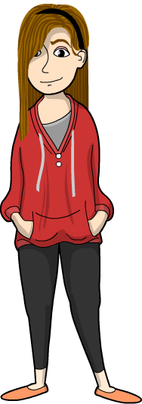
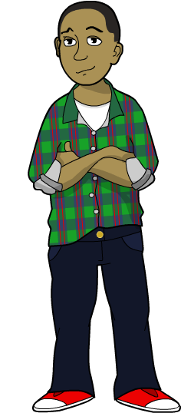
Forming a shadow (1)
James and Alexis are outside having fun.
The Sun comes out and shines brightly on them, causing shadows to form.

Slide 4
Forming a shadow (2)
Along comes a cloud again.
What will happen to the shadows now?
When the Sun is covered, shadows disappear.

Slide 5
The Sun and shadows (1)
When the Sun is shining, James and Alexis feel hot.
The colors they see are bright.
The shadows they cast are dark.

Slide 6
The Sun and shadows (2)
When the Sun is hidden behind a cloud, James and Alexis feel cooler.
The colors are not so bright.
Their shadows are gone.
Notes:
Teacher notes
Ask: “Why do these changes happen?” (because the cloud blocks out some of the light and heat of the Sun).

Slide 7
The danger of looking at the Sun
You can tell if a cloud covers the Sun without even looking at it!
And that’s good, because you should NEVER look right at the Sun!
Notes:
Teacher notes
Make sure students understand that looking directly at the Sun can permanently damage their eyesight.

Slide 8
Why are shadows formed?
Notes:
Teacher notes
Ask students what they notice about the shape of the shadow. Is the shape of the shadow always similar to the shape of the object forming it?
This slide covers the Science and Engineering Practice:
Analyzing and Interpreting Data: Use observations (firsthand or from media) to describe patterns and/or relationships in the natural and designed world(s) in order to answer scientific questions and solve problems.

Slide 9
What do you know about shadows?
Notes:
Teacher notes
Explain that when light shines on an object from directly above, the object will not cast a shadow (because the light source is not blocked). To illustrate this principle, shine a beam of light directly down on an object from above. Then shine the light on the object from the side. Where the object is blocking the light, a shadow will appear behind the object.
Let children explore shadow formation using flashlights and objects of different shapes and sizes. Introduce children to the idea of light traveling from a source by shining a powerful flashlight beam through a comb with widely spaced teeth and showing that the beam is blocked and does not bend around corners. Ask students to record what they see in drawings and writing.

Slide 10
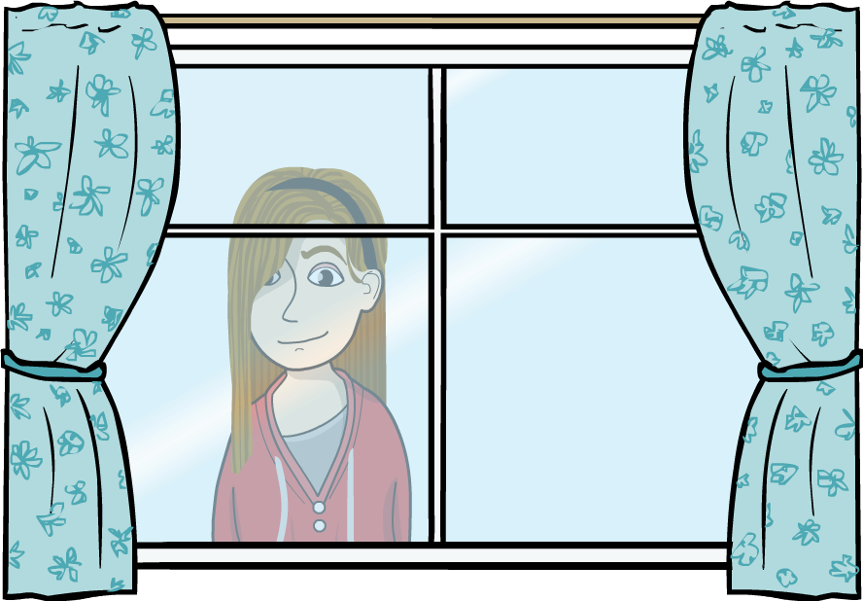
What materials let light through? (1)
Some materials let light pass through them.
Can you think of any?
Some materials only let some light pass through them.
Can you think of any?
Materials that let light pass through them have different shadows to materials that do not.

Slide 11
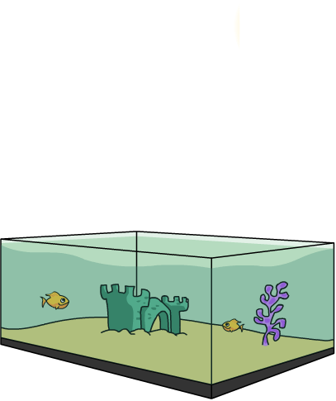
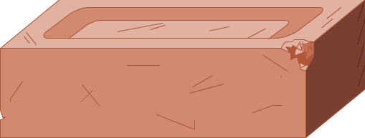
What materials let light through? (2)
Look closely at the objects below.
What material is each object made from?
If we shine a flashlight on each object, which ones will let the light travel through them and which ones will not?
brick
lampshade
fish tank
Think about how much light each material would let through.

Slide 12
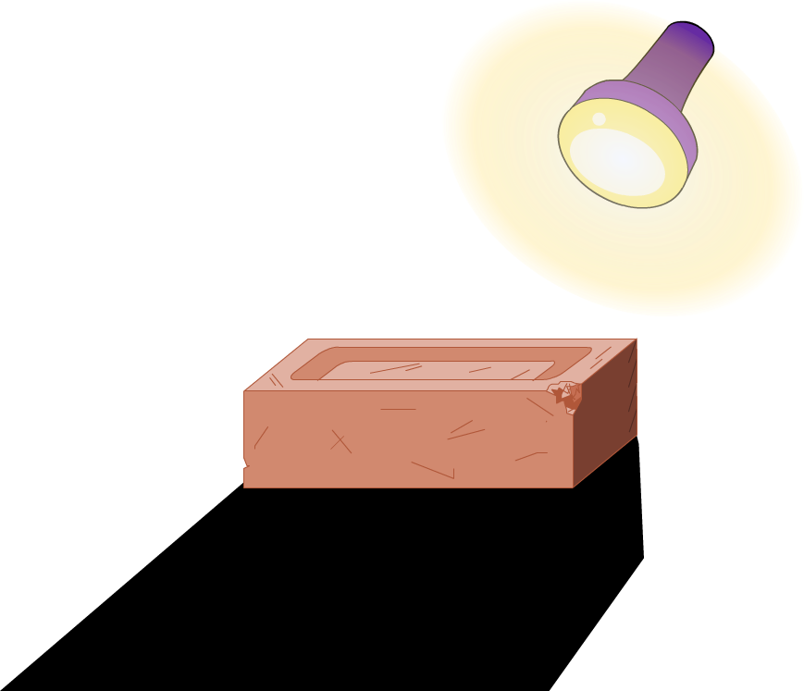
What does opaque mean?
Materials that do not let any light pass through them are called opaque.
The brick is opaque. You cannot see through it and it blocks out all light.

Slide 13
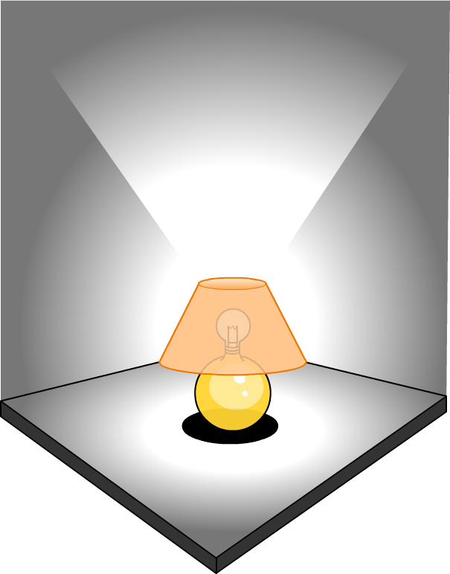
What does translucent mean?
Materials that let some light pass through them but are not see-through are called translucent.
Translucent materials block out some light, but not all of it.
This lampshade is made of a translucent material so that the room is lit, but not too brightly.

Slide 14
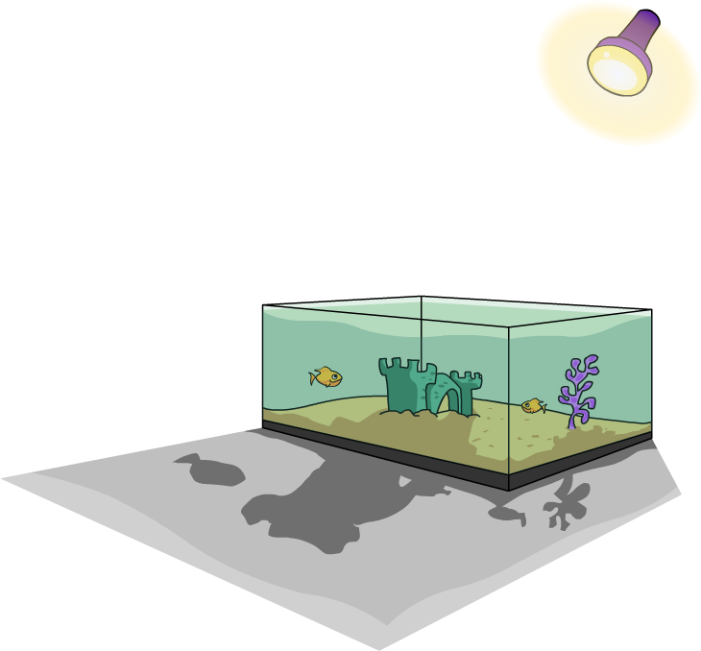
What does transparent mean?
Materials that are see-through and let almost all light pass through them are called transparent.
The glass in this fish tank is transparent because it is clear, colorless and you can see straight through it.
Light passes through transparent materials very easily.

Slide 15
Understanding shadows
Notes:
Teacher notes
Encourage students to make clear and descriptive predictions about whether an object will cast a shadow and what the shadow will look like (shape and darkness). After all the objects’ shadows have been revealed, ask students to make generalizations, e.g. opaque materials form dark shadows because they do not let any light through, and even transparent materials can make a faint shadow because they block some light.
This slide covers the Science and Engineering Practice:
Planning and Carrying Out Investigations: Make predictions based on prior experiences.

