Slide 1
Particles

Slide 2
Information
Developing and Using Models
Planning and Carrying Out Investigations
Constructing Explanations and Designing Solutions
2. Cause and Effect
3. Scale, Proportion and Quantity
5. Energy and Matter

Slide 3
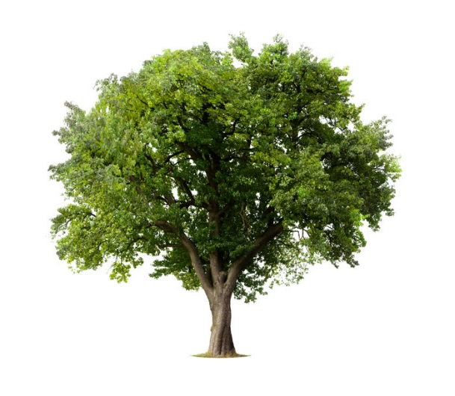
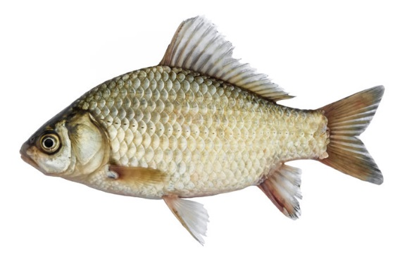
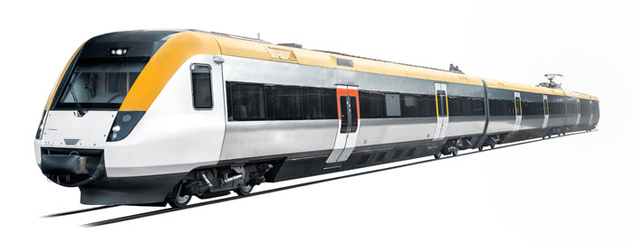
What is matter?
What is matter?
Every object in the Universe is made of matter.
Matter is anything that takes up space and has mass and weight.
Notes:
Teacher notes
You might need to remind students of the meanings of the terms mass and weight.
Photo credits: Water © CK Foto; Carp © Nosyrevy; Apple Tree © Jan Martin Will; Rose © nadezhda F; Train © Tommy Alven; Book © Pakhnyushchy, all at Shutterstock.com 2018
3

Slide 4
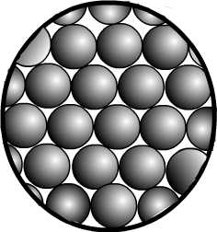
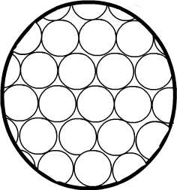
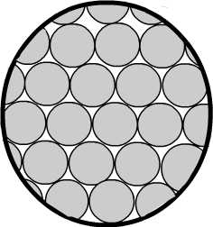
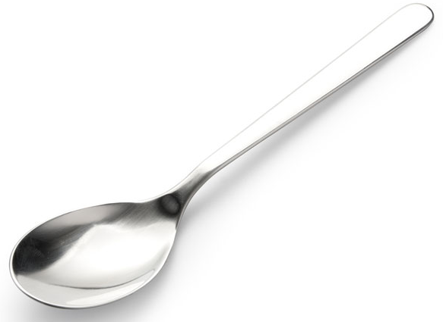
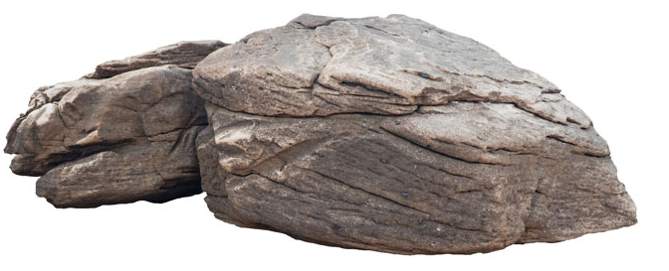
What are particles?
Matter is made up of particles.
Particles are very small objects that are too small to see.
They are the building blocks of all matter.
Notes:
Photo credits: Rock © nasidastudio; Dog © Csanad Kiss; Spoon © onair, all at Shutterstock.com 2018

Slide 5
Diamonds
Notes:
This slide covers the Science and Engineering Practices:
Developing and Using Models: Develop and/or use models to describe and/or predict phenomena.

Slide 6
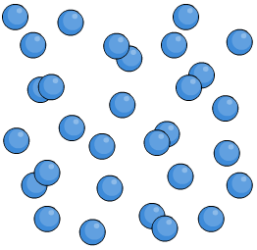
Invisible particles
Most objects that are made up of particles can be seen. However, some are invisible to us.
Particles that make up the air around us cannot be seen.
Even though they are invisible to us, we know that the particles are there.
How can we prove that they are there?

Slide 7
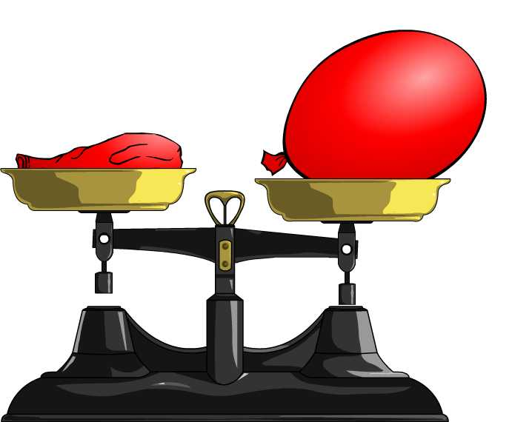
Do air particles have weight?
We can see the effect that air particles have on a balloon when we blow it up – the balloon changes shape.
Do air particles have weight? How could we test this?
All matter has weight. This proves that there is matter inside the balloon.
Notes:
Teacher notes
You can set this investigation up in the classroom. Make sure you use a balloon pump rather than blowing these up yourself. This avoids adding moisture from your lungs to the balloon, which could add to the weight. You could discuss with students how this might not make the results reliable.
You will need to use two balloons – one inside the other, for this experiment. The compression force from two balloons causes the air particles to move closer together, which will help tip the scales. You will need to ensure that a double balloon is used on the other side of the scales too.
This slide covers the Science and Engineering Practices:
Planning and Carrying Out Investigations: Make observations and/or measurements to produce data to serve as the basis for evidence for an explanation of a phenomenon or to test a design solution.
Constructing Explanations and Designing Solutions: Use evidence (e.g., measurements, observations, patterns) to construct or support an explanation or to design a solution to a problem.

Slide 8
The movement of particles (1)
Notes:
This slide covers the Science and Engineering Practices:
Planning and Carrying Out Investigations: Make observations and/or measurements to produce data to serve as the basis for evidence for an explanation of a phenomenon or test a design solution.
Constructing Explanations and Designing Solutions: Use evidence (e.g., measurements, observations, patterns) to construct or support an explanation or design a solution to a problem.

Slide 9
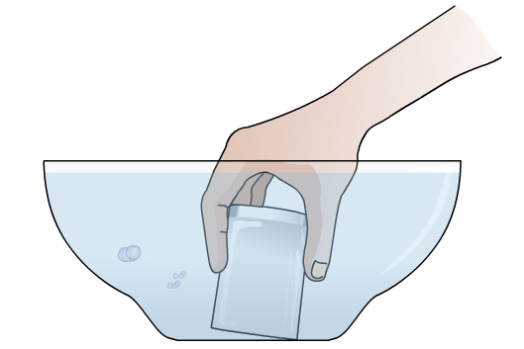
The movement of particles (2)
If we tip the glass, we will see air moving out of the bottle in the form of bubbles.
Water can now fill the space left by the air.

Slide 10
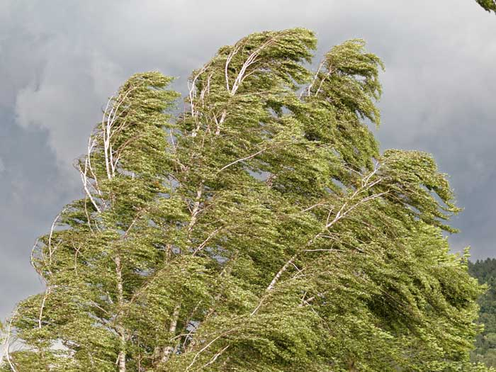
The movement of particles (3)
We can also see the effects of air on larger objects.
Can you explain how the movement of particles is shown in this image?
The wind is blowing against the leaves and branches of the tree, causing them to move.
This is caused by the movement of air particles.
Notes:
This slide covers the Science and Engineering Practices:
Constructing Explanations and Designing Solutions: Use evidence (e.g., measurements, observations, patterns) to construct or support an explanation or to design a solution to a problem.
Photo credit: © fgwim, Shutterstock.com 2018

