Slide 1
Marvellous Matter

Slide 2
Information
Planning and Carrying Out Investigations
Analyzing and Interpreting Data
Obtaining, Evaluating and Communicating Information
1. Patterns
6. Structure and Function

Slide 3
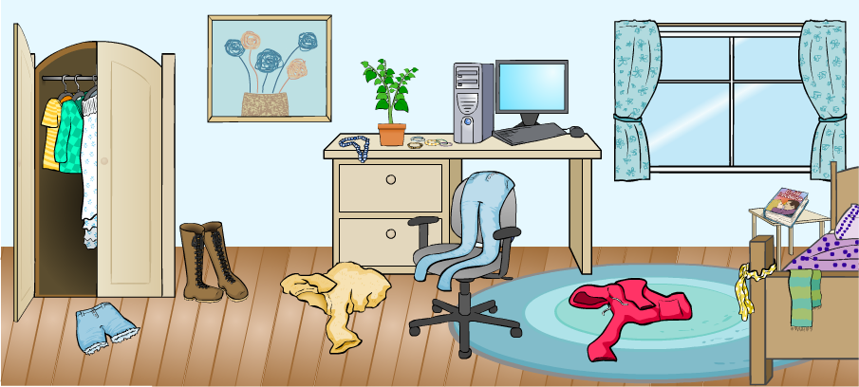
Types of matter
Look at the things around you. Do they all look the same?
No, they don’t!
There are many different types of matter.

Slide 4
Differences in objects
Notes:
Teacher notes
Ask students to name all the objects displayed on the screen. How do they think each object was made? Can they find an object in the classroom made from the same material? Students will be challenged to identify the materials used to make each object and then to suggest some properties of these materials. Students could take turns to answer, or vote on the answers given.
Students could work in pairs asking each other similar questions about a group of objects in the classroom (e.g. the contents of a shelf, drawer or pencil case), e.g. “Touch three things that are rough / smooth.” Encourage students to use different senses to explore the objects, asking: "What does it look like? How does it feel? How does it smell? Does it make a noise?”, etc.

Slide 5
Sorting materials (1)
Notes:
Teacher notes
Once students have completed the activity, you could ask them to suggest other items that could be added to each group.

Slide 6
Sorting materials (2)

Slide 7
Grouping objects by material (1)
Notes:
Teacher notes
Discuss why each material was used to make the different objects (e.g. wood because it is strong, hard, easy to cut and carve, and can be painted; metal because it is hard, strong, does not burn, can be shiny and can be made to be sharp; plastic because it is waterproof, can be made in any color, and can be shaped easily).
Students often have difficulty distinguishing the material from the object made from that material. It may be helpful to show them some pieces of raw material that are not made into particular objects (for example, a block of wood or metal).
Photo credits: Rubber duck © easyshoot; Plastic pail © Jonathan Vasata; Plastic crate © Ivonne Wierink; Chair © Atiketta Sangasaeng; Drawers © John Kasawa; Hanger © Ljesic; Key © mihalec; Ring © Skyline; Pots © margouillat photo, all Shutterstock.com 2018

Slide 8
Grouping objects by material (2)
Walk around your house and make a list of different objects that are made from the same materials.
Notes:
This slide covers the Science and Engineering Practice:
Planning and Carrying Out Investigations: Make observations (firsthand or from media) to collect data that can be used to make comparisons.

Slide 9
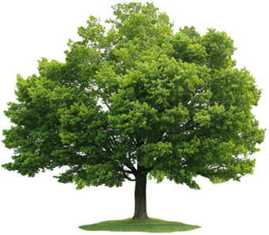
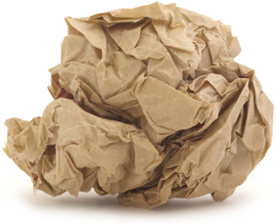
Natural materials
Some materials we use occur naturally. You can find them in the natural world.
Other materials have to be made by humans.
Notes:
Photo credit: Tree © Le Do; Paper: © vesna cvorovic, both Shutterstock.com 2018

Slide 10
Natural and human-made materials
Notes:
Teacher notes
Can the class think of other natural or human-made materials they could add to the two groups shown on-screen? Students could write or sketch their ideas on sticky notes and add them to the board.

Slide 11
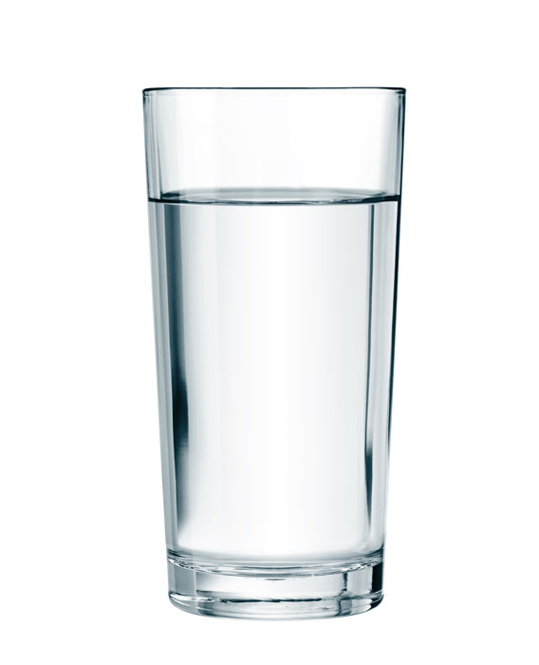
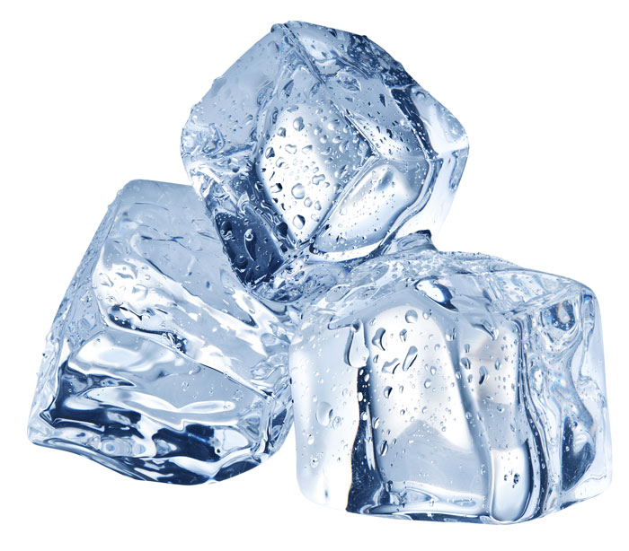
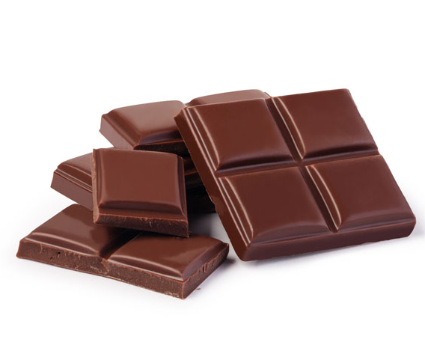
Solid and liquid materials
Some types of matter are solid and some types are liquid.
Can you think of any examples?
What are the differences between them?
Notes:
Teacher notes
Help students to describe differences between solid and liquid matter they can see around them. Encourage students to think about differences between ice and water, and between liquid and solid chocolate. Help them to identify that temperature causes a change between the two states.
Photo credits: Ice © Valentyn Volkov; Glass of water © Andrey_Kuzmin; Chocolate © gresei, all Shutterstock.com 2018

Slide 12
Identifying materials (1)

Slide 13
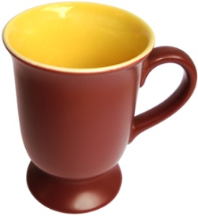
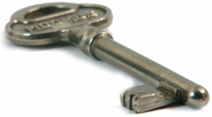
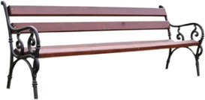
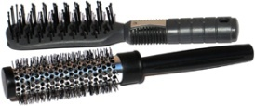
Identifying materials (2)
Can you finish the sentences to describe these objects?
The ________ is made of ___________.
It is _________, _________ and ________.
word bank
wool
metal
smooth
soft
paper
shiny
hard
dull
wood
transparent
rough
glass
plastic
bendy
strong
clay
Notes:
Teacher notes
Ask students to fill in the blanks in these sentences using words from the word bank. Many arrangements of words may be appropriate. Students take turns to describe the objects. After each attempt, ask the class: “Do you think that’s the right description?” Give students plenty of practice in reading the descriptions so that they become familiar with the meanings of the various terms. Students could go on to write descriptions of objects in the classroom, using the format given here.
This slide covers the Science and Engineering Practices:
Analyzing and Interpreting Data: Record information (observations, thoughts, and ideas).
Obtaining, Evaluating, and Communicating Information: Communicate information or design ideas and/or solutions with others in oral and/or written forms using models, drawings, writing, or numbers that provide detail about scientific ideas, practices, and/or design ideas
Photo credit: Pencil: © Zeth Lorenzo; Hair brush and newspaper: © Sanja Gjenero; Key: © Vangelis Thomaidis; Scarf: © Irum Shahid; Bench: © Michal Zacharzewski; Mug: © Alessandro Paiva

Slide 14
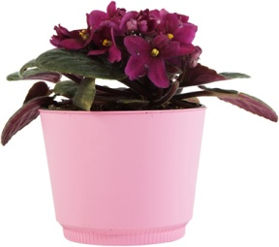
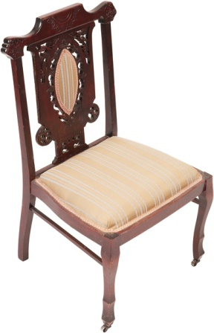
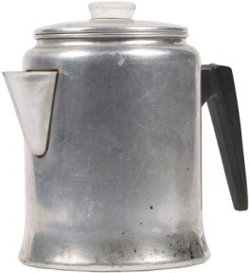
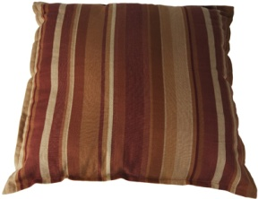
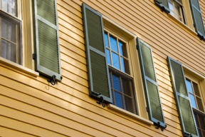
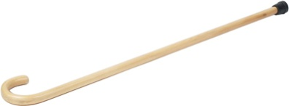
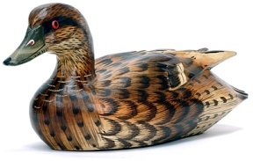
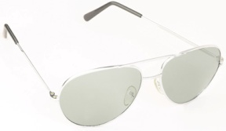
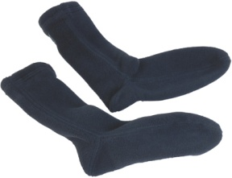
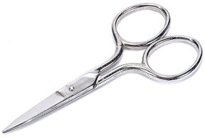
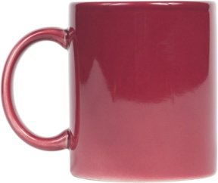
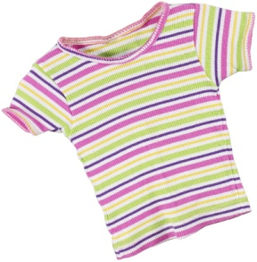
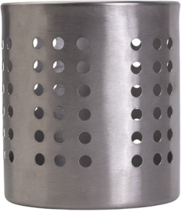
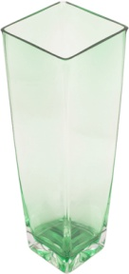
Shiny and dull objects
Are each of these items shiny or dull?
Notes:
Photo credits: all © 2018 Jupiterimages Corporation

Slide 15
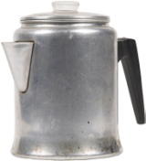
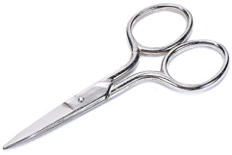
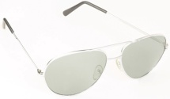
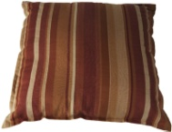
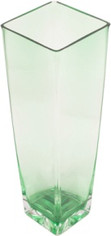
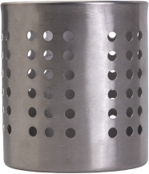
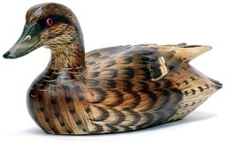
Deciding how to sort items
Decide on another way to sort these items into two lists:
..............................things
..............................things
Notes:
Teacher notes
Ask students to decide on how to group the materials (e.g. into hard things / soft things, transparent / not transparent, bendy / not bendy, etc.) Write the appropriate titles into the boxes (or use sticky notes as labels). Encourage students to sort the pictures following the model they have already practiced. This activity can be reset and repeated using as many categories as you wish.
This slide covers the Science and Engineering Practice:
Analyzing and Interpreting Data: Record information (observations, thoughts, and ideas).
Photo credits: all © 2018 Jupiterimages Corporation

