Slide 1
Magnets
Notes:
Begin with the content from Mysterious Magnets. Follow with the existing Magnets content. Move the last slide earlier on so the investigation is last. Check for flow and consistency, and add some keywords from the spec

Slide 2
Information
Asking Questions and Defining Problems
Planning and Carrying Out Investigations
Analyzing and Interpreting Data
Constructing Explanations and Designing Solutions
1. Patterns
2. Cause and Effect
6. Structure and Function

Slide 3
Examples of magnets
Notes:
Teacher notes
Ask: “Where have you seen a magnet?”, “Are all magnets the same shape, size, or color?”, and “What special power do you think a magnet has?” Allow students to share their experiences.
Photo credits:
Horseshoe magnet: © MilanB, Shutterstock.com 2018
Refrigerator magnets: © Myotis, Shutterstock.com 2018

Slide 4
What types of objects do magnets attract?
Notes:
Teacher notes
Encourage students to speculate and comment about what will happen. Ask: “Which things will stick to the magnet?” Ask the children to explain why they think the objects were picked up by the magnet.

Slide 5
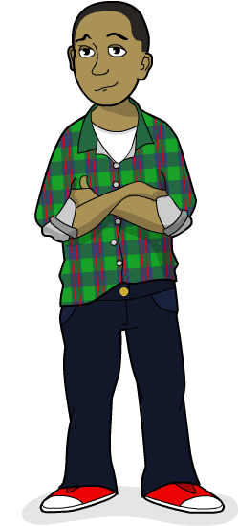
Magnets and metals
Metal things stick to magnets!
But are there some metals that don’t stick to them?

Slide 6
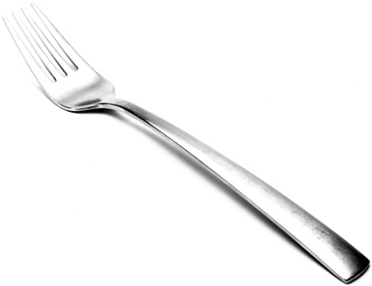
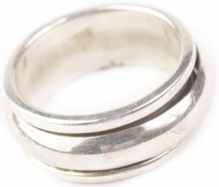
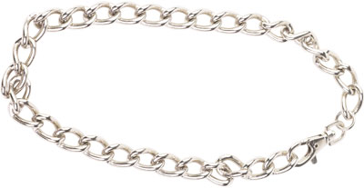
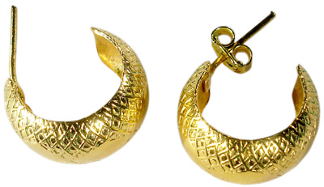
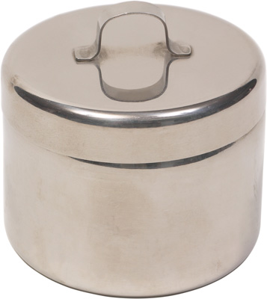
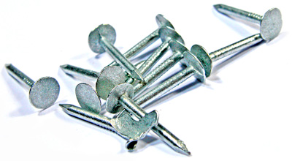
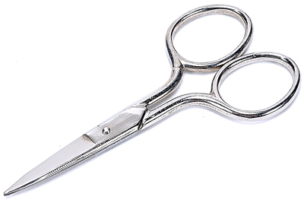
Magnetic attraction
What will happen when a magnet is put next to each of these things?
Notes:
Teacher notes
Ask: “Do all the different metal things stick to the magnet?” Students could go on to test items in the classroom using magnets.
This slide covers the Science and Engineering Practices:
Asking Questions and Defining Problems: Ask questions that can be investigated and predict reasonable outcomes based on patterns such as cause and effect relationships.
Photo credits:
Paperclip: © Josep Altarriba
Ring, bracelet, scissors, metal tin: © 2008 Jupiterimages Corporation
Fork: © Frank Hermers
Earrings: © Afonso Lima
Nails: © Tijmen van Dobbenburgh

Slide 7
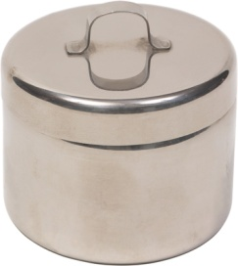
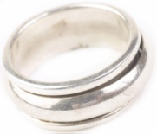
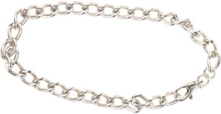
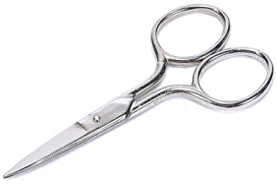
Iron
Only these things stuck to the magnet:
They are all made of a metal called iron.
Only iron sticks to magnets.
Notes:
Photo credits:
Paperclip: © Josep Altarriba
Ring, bracelet, scissors, metal tin: © 2008 Jupiterimages Corporation
Fork: © Frank Hermers
Earrings: © Afonso Lima
Nails: © Tijmen van Dobbenburgh

Slide 8
What is magnetism? (1)
Magnetism is a force. You can feel it if you have two magnets like these!
You can’t see forces, but you can feel them!
All magnets have a north pole and a south pole. However, they are not all labeled like these.
What happens when two magnets are placed next to each other?

Slide 9
What is magnetism? (2)

Slide 10
Investigating magnetism
Notes:
Teacher notes
If you have magnets available in the classroom, give students time to carry out the instructions.

Slide 11
Does magnetic force work over distance?
When an object is placed near a magnet, it experiences a magnetic force.
Does an object need to touch a magnet to experience a magnetic force?
No, magnetic forces can act over a distance.
Objects do not need to touch a magnet to feel a magnetic force from it.
Notes:
Photo credits:
Scissors: © 2018 Jupiterimages Corporation
Nails: © Tijmen van Dobbenburgh

Slide 12
Testing the strength of magnets
Notes:
Teacher notes
Ask: “Can you think of another way of testing the strength of the magnets?” Give students time to discuss their ideas with a partner (e.g. How many paperclips can the magnet hold?) before reporting back to the whole class. Students could develop their own fill-in-the-blank puzzles to express their ideas.
This slide covers the Science and Engineering Practices:
Planning and Carrying Out Investigations: Plan and conduct an investigation collaboratively to produce data to serve as the basis for evidence, using fair tests in which variables are controlled and the number of trials considered.

Slide 13
The magnet strength investigation (1)
Notes:
Teacher notes
Ask students to commentate as the animated test unfolds. Make sure they note that the distance being measured is the empty space between the magnet and the yellow square.
This slide covers the Science and Engineering Practices:
Planning and Carrying Out Investigations: Make observations and/or measurements to produce data to serve as the basis for evidence for an explanation of a phenomenon or test a design solution.

Slide 14
The magnet strength investigation (2)
Notes:
This slide covers the Science and Engineering Practices:
Analyzing and Interpreting Data: Represent data in tables and/or various graphical displays (bar graphs, pictographs, and/or pie charts) to reveal patterns that indicate relationships.

Slide 15
What can we conclude?
Notes:
This slide covers the Science and Engineering Practices:
Analyzing and Interpreting Data: Analyze and interpret data to make sense of phenomena, using logical reasoning, mathematics, and/or computation.

Slide 16
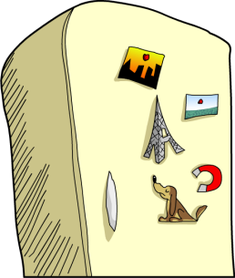
Everyday uses of magnets
Think of some everyday uses of magnets.
Make a list in words and drawings.
Used in electrical switches.
2.

