Slide 1
Gravity

Slide 2
Information
Asking Questions and Defining Problems
Planning and Carrying Out Investigations
Analyzing and Interpreting Data
Using Mathematics and Computational Thinking
2. Cause and Effect
3. Scale, Proportion, and Quantity
5. Energy and Matter
7. Stability and Change

Slide 3
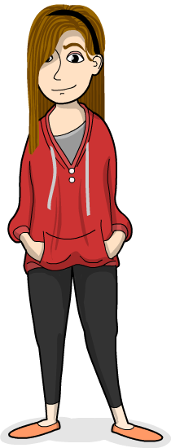
What is gravity?
Gravity is a force. What can you remember about forces?
All forces have a size and act in one direction.
Forces act on objects.
The force of gravity attracts all objects towards each other.
Every object has a force of gravity. The larger an object is, the larger its force of gravity.
Notes:
Teacher notes
Explain that every object in the Universe attracts every other object with a pulling force called gravity. Gravity is the force of attraction that pulls all objects (matter) together. The more mass an object has, the more gravity it has, so things with a lot of mass (such as the Earth) exert a stronger pull. This is why objects do not float away from the Earth and into space.

Slide 4
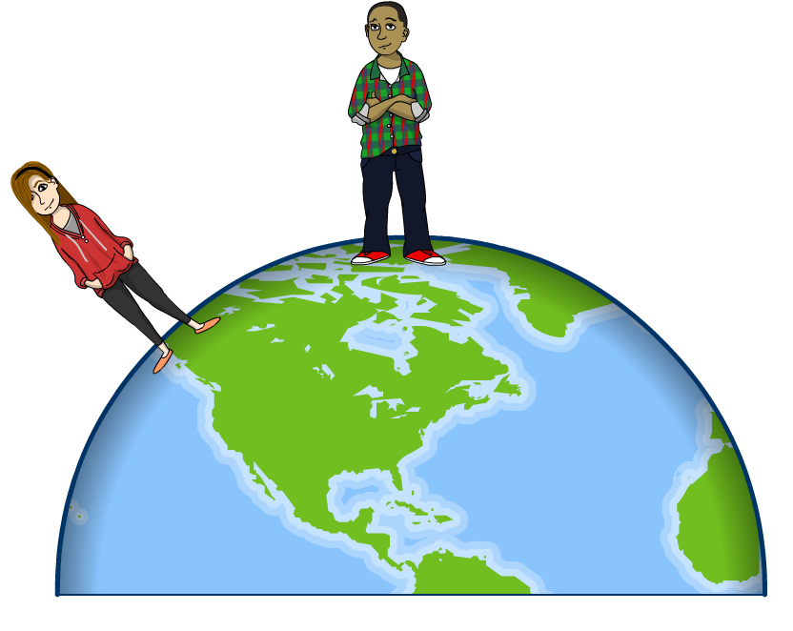
Gravitational force
Earth’s gravitational force acts on all objects that are close to Earth’s surface.
It pulls all nearby objects towards the center of Earth.
If it wasn’t for gravity,
we’d all float into space!
Notes:
The gravitational force of Earth acting on an object near Earth’s surface pulls that object toward the planet’s center.

Slide 5
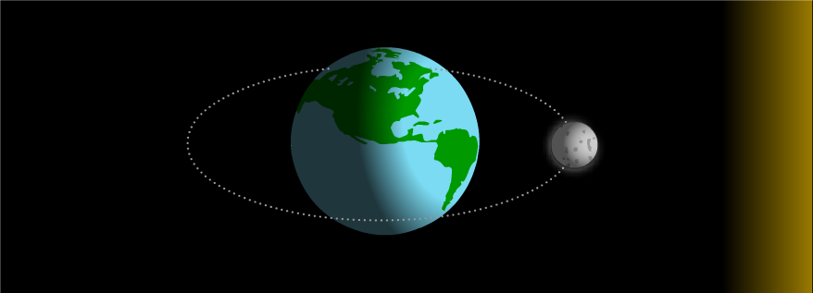
The Earth and the Moon
Objects do not need to be touching Earth to be affected by its gravitational force.
The Moon is close enough to Earth to be affected by its gravity. Earth’s gravity keeps the Moon close to us!
Notes:
Teacher notes
Explain that the Sun also has its own gravitational force, and this affects all objects in the solar system, including Earth.

Slide 6
What is a forcemeter?
This is a forcemeter. It is used to measure the size of
a force, including gravity. The units for measuring force are newtons.
pointer
spring
measuring
scale
hook

Slide 7
How does a forcemeter work?
Notes:
This slide covers the Science and Engineering Practices:
Planning and Carrying Out Investigations: Evaluate appropriate methods and/or tools for collecting data.

Slide 8
Using a forcemeter

Slide 9
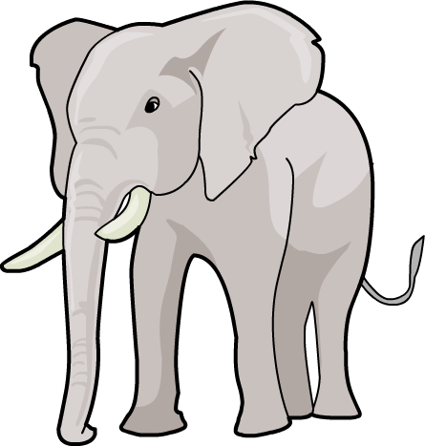
Mass and weight
Weight is sometimes confused with mass.
Mass measures the amount of material an object contains.
The mass of an object always stays the same.
Weight measures the pull of gravity on an object.
The bigger an object’s mass, the bigger the force due to gravity, and so the more it weighs!
BIG MASS
SMALL MASS
BIG WEIGHT
SMALL WEIGHT

Slide 10
Mass and weight on the Moon

Slide 11
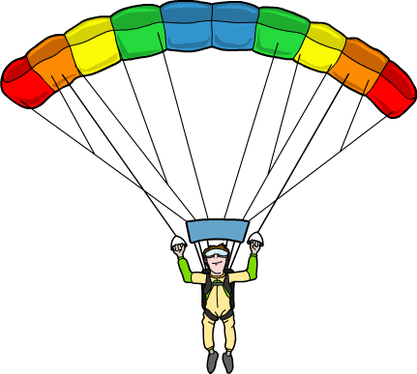
Air resistance
How are the forces acting in this picture?
air
resistance
Are they balanced?
As this skydiver falls toward the Earth, air resistance pushes in the opposite direction to his weight
and slows his fall.
weight

Slide 12
Investigating air resistance (1)
Notes:
This slide covers the Science and Engineering Practices:
Planning and Carrying Out Investigations: Plan and conduct an investigation collaboratively to produce data to serve as the basis for evidence, using fair tests in which variables are controlled and the number of trials considered.

Slide 13
Investigating air resistance (2)
Notes:
This slide covers the Science and Engineering Practices:
Planning and Carrying Out Investigations: Plan and conduct an investigation collaboratively to produce data to serve as the basis for evidence, using fair tests in which variables are controlled and the number of trials considered.

Slide 14
What can we conclude? (1)
Notes:
This slide covers the Science and Engineering Practices:
Asking Questions and Defining Problems: Ask questions that can be investigated and predict reasonable outcomes based on patterns such as cause and effect relationships.

Slide 15
What can we conclude? (2)
Notes:
Teacher Notes
Ask students whether the data they collected agrees with the graph shown here.
This slide covers the Science and Engineering Practices:
Analyzing and Interpreting Data: Analyze and interpret data to make sense of phenomena, using logical reasoning, mathematics, and/or computation.
Using Mathematics and Computational Thinking: Describe, measure, estimate, and/or graph quantities such as area, volume, weight, and time to address scientific and engineering questions and problems.

Slide 16
What happened during the investigation?
Notes:
This slide covers the Science and Engineering Practices:
Planning and Carrying Out Investigations: Evaluate appropriate methods and/or tools for collecting data.
Planning and Carrying Out Investigations: Make predictions about what would happen if a variable changes.

Slide 17
What have you learned about gravity?

