Slide 1
Feel the Force

Slide 2
Information
Asking Questions and Defining Problems
Developing and Using Models
Planning and Carrying Out Investigations
Engaging in Argument from Evidence
2. Cause and Effect
3. Scale, Proportion, and Quantity
5. Energy and Matter
7. Stability and Change

Slide 3
What are forces? (1)
Notes:
Teacher notes
Encourage students to describe how each of the animated objects moves. Ask them to identify the force that makes each object move, and whether it is a push or a pull. For example, the ball pushes off the ground as it bounces. Wind pushes the kite. The skateboarder pushes against his skateboard to jump. Gravity pulls the brick to the ground.
If students have difficulty with these answers (particularly the concept of gravity), go through the rest of the presentation with them and revisit this activity at the end.
Students could make a table showing objects that are moved by a push or pull, e.g. a bike (a push on the pedals).
This slide covers the Science and Engineering Practices:
Developing and Using Models: Develop and/or use models to describe and/or predict phenomena.
Engaging in Argument from Evidence: Construct an argument with evidence to support a claim.

Slide 4
What are forces? (2)
Notes:
Teacher notes
Ask students to list other examples of a push changing the shape of an object.

Slide 5
What happens when something is pulled?
Pulls can make things change direction and shape too:
A cat and a dog pull in different directions.
The string of sausages will get longer and longer until it snaps!
What will happen to the cat and dog?
Notes:
This slide covers the Science and Engineering Practices:
Planning and Carrying Out Investigations: Make predictions based on prior experiences.
Engaging in Argument from Evidence: Construct an argument with evidence to support a claim.

Slide 6
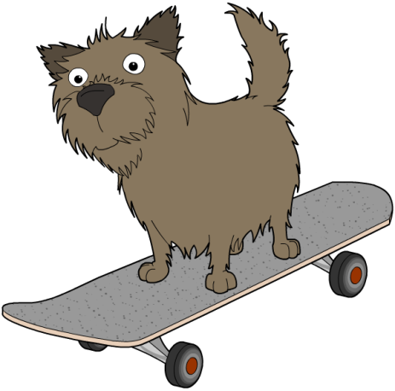
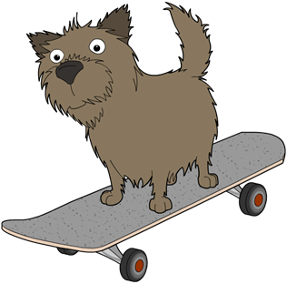
Pushing and pulling (1)
Speed up, slow down, or change direction…
What happens if you push Fuzz?
Notes:
This slide covers the Science and Engineering Practices:
Planning and Carrying Out Investigations: Make predictions based on prior experiences.
Engaging in Argument from Evidence: Construct an argument with evidence to support a claim.

Slide 7
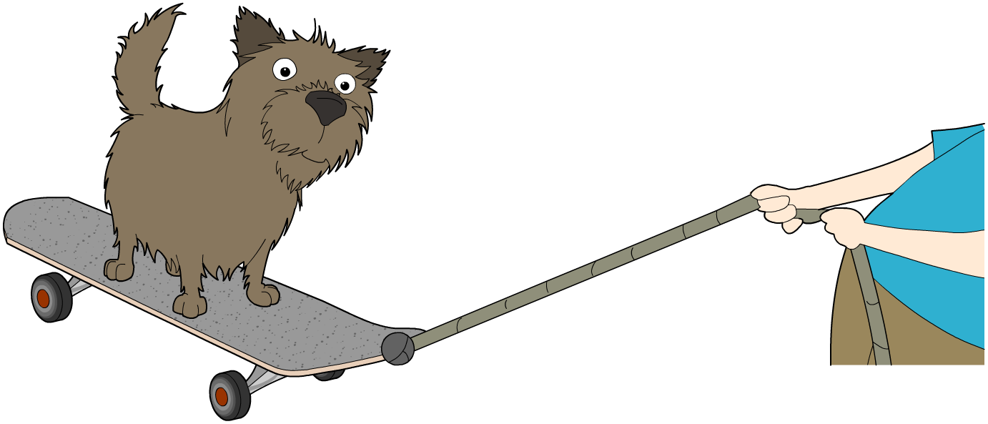
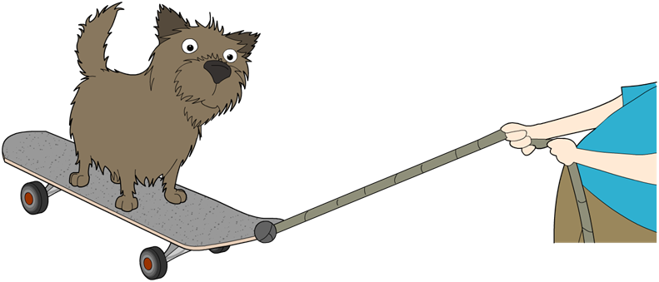
Pushing and pulling (2)
Speed up, slow down, or change direction…
What happens if you pull Fuzz?
Notes:
This slide covers the Science and Engineering Practices:
Planning and Carrying Out Investigations: Make predictions based on prior experiences.
Engaging in Argument from Evidence: Construct an argument with evidence to support a claim.

Slide 8
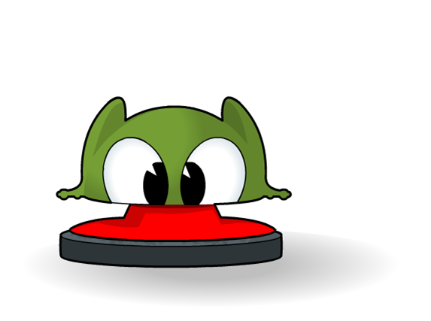
What happens when you push? (1)
What happens when you push the frog down?
small push
Notes:
This slide covers the Science and Engineering Practices:
Planning and Carrying Out Investigations: Make predictions based on prior experiences.
Engaging in Argument from Evidence: Construct an argument with evidence to support a claim.

Slide 9
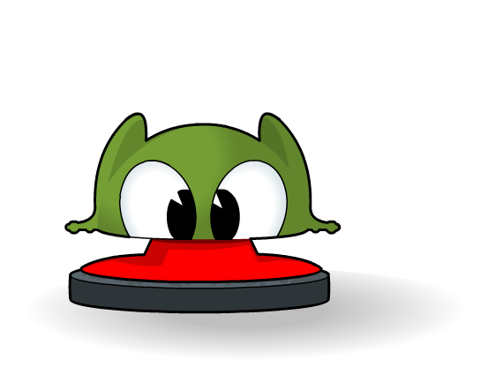
What happens when you push? (2)
It springs back up again!
small push
A bigger push down would cause a bigger push back up.

Slide 10
Movement
Pushes and pulls can make things start or stop moving.
How could you make this toy car move?
You could push it.
Or, you could pull it.
Notes:
This slide covers the Science and Engineering Practices:
Planning and Carrying Out Investigations: Make predictions based on prior experiences.
Engaging in Argument from Evidence: Construct an argument with evidence to support a claim.

Slide 11
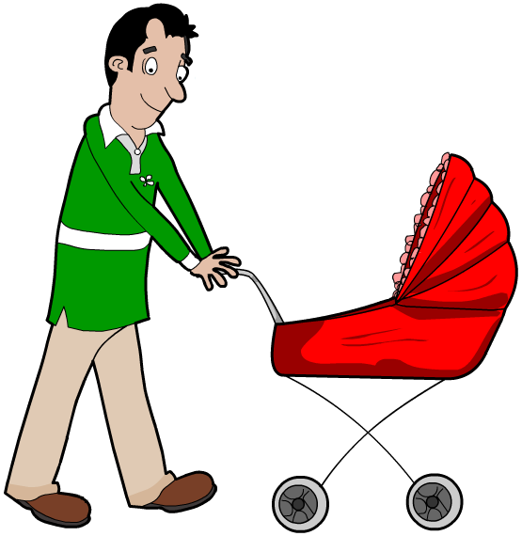
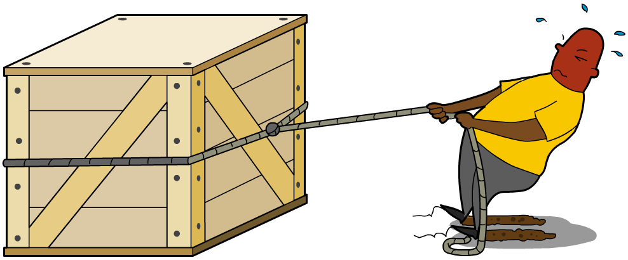
What are pushes and pulls?
Pushes and pulls are both forces.
We see evidence of them acting when we see things change direction, change shape, or change speed.
pushing a stroller
pulling a crate
Notes:
Teacher notes
Encourage children to jump and feel the force of gravity pulling them back to the ground. Ask them to describe what they have done using the words push, pull and force, e.g. “I pushed against the ground with my legs. The force of my push shot me up into the air. Then the force of gravity pulled me back down to the ground again.”

