Slide 1
Digital Information

Slide 2
Information
Developing and Using Models
Using Mathematics and Computational Thinking
1. Patterns
4. Systems and System Models
5. Energy and Matter

Slide 3
Digital information
Technology can help us send and receive information over long distances.
High-tech devices, such as computers and cell phones, can convert the information we give them into digital information.
This information is then sent to a new location where it is decoded back into a form that we can understand.
Notes:
Photo credit: © Monkey Business Images, Shutterstock.com 2018
3

Slide 4
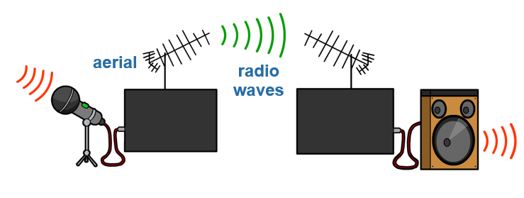
Radio and television
Signals for radio and television are transmitted using radio waves.
In a transmitter, sound waves made by a person, are turned into electric current. This then produces radio waves in an anntenna.
Radio waves are picked up by a receiver, which produces an electric current. The energy from this produces sound waves.
antenna

Slide 5
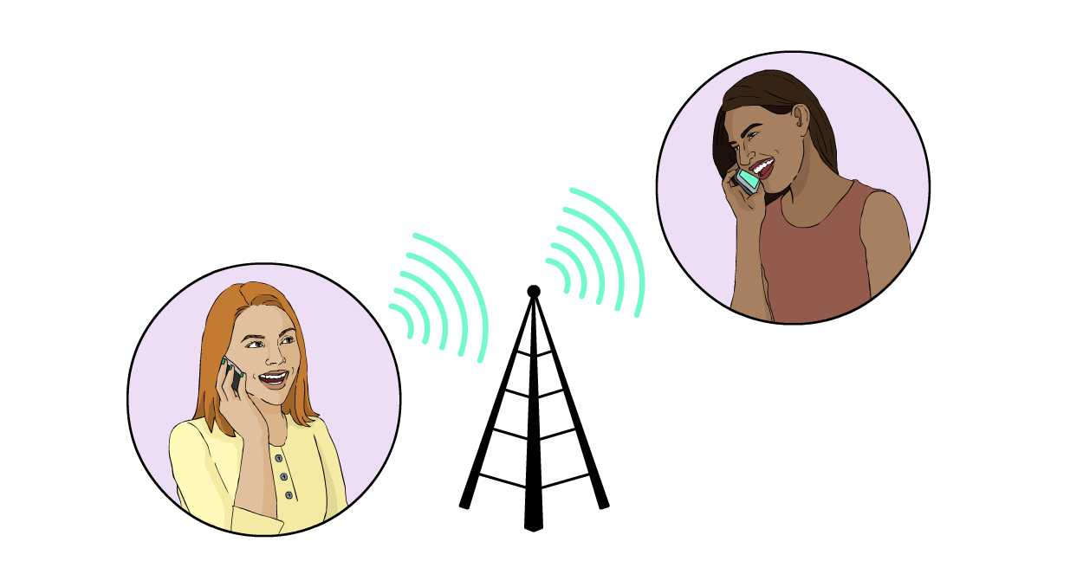
Cell phones
We can transmit data over long distances using cell phones.
A cell phone converts sound waves into digital information in the form of a wave. These waves are transmitted to a cell tower.
The waves are then transmitted to another cell phone, which converts the information back into sound waves again.
Notes:
Teacher notes
This shows the basics of what happens during a local call. A long distance call would involve more than one cell tower. It’s a common misconception that when you talk on a cell phone that sound waves travel through the air. Make sure students understand that a cell phone converts the sound wave into digital information to transmit it.

Slide 6
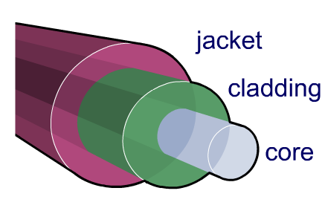
Fiber optics
Internet data can be sent through fiber optic cables.
The information we give is converted into digital information by a computer.
This is sent down the optical fiber in the form of pulses of visible light.
This pattern is decoded at the receiver to reform the original data.

Slide 7
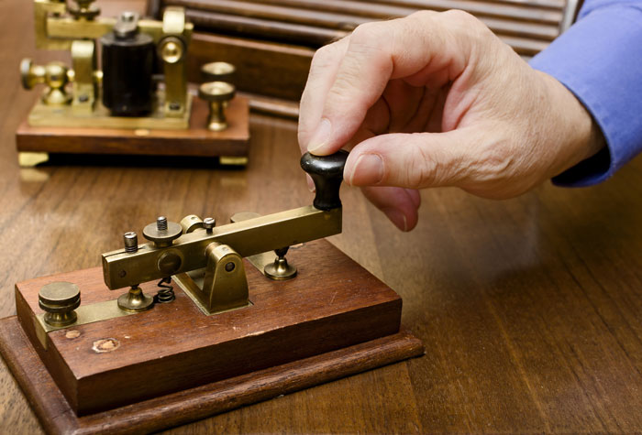
Using patterns
Digital information is in the form of a pattern or code.
How is it possible to communicate using just a pattern?
Morse code is a good example of a way to share information using patterns.
It is made up of a series of short and long signals. Electric pulses were used to send these signals long distances.
Notes:
Photo credit: © villorejo, Shutterstock.com 2018

Slide 8
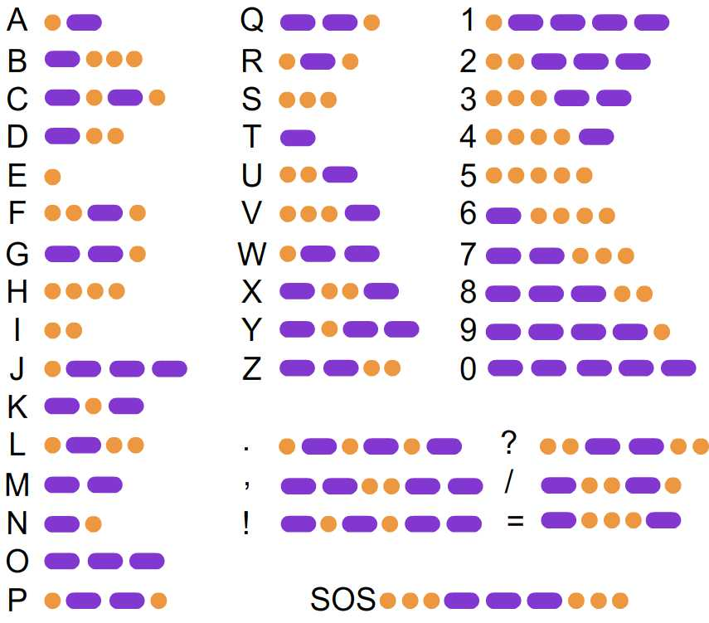
Morse code
In Morse code, each letter of the alphabet is represented by a different combination of long and short signals, shown as dots and dashes.
A dash is twice as long as a dot.
This way we can communicate a complicated message using only electrical pulses, taps or flashes of light.
Notes:
Teacher notes
Students could make up their own messages to communicate to each other using tapping or a by flashing a light.
The gap between letters is three time the duration of a dot and the gap between two words is seven times longer than a dot.

Slide 9
Binary
Computers use a code called binary to send information and receive about a picture. Instead of using words, this language uses 1s and 0s.
Imagine that a computer receives a set of numbers, for example 100100110. It could place this on a grid, using white for 0 and black for 1. The image would look like this:
Notes:
This slide covers the Science and Engineering Practices:
Developing and Using Models: Develop a model using an analogy, example, or abstract representation to describe a scientific principle or design solution.
Using Mathematics and Computational Thinking: Organize simple data sets to reveal patterns that suggest relationships.

Slide 10
Binary
Can you form the picture that would be made using the following code, in this grid below?
0000000000100100000000000000000001000010001001000001100000000000
Notes:
Teacher notes
You might need to remind students that the table is read row by row from left to right.
This slide covers the Science and Engineering Practices:
Developing and Using Models: Develop a model using an analogy, example, or abstract representation to describe a scientific principle or design solution.
Using Mathematics and Computational Thinking: Organize simple data sets to reveal patterns that suggest relationships.

