Slide 1
Changing Materials

Slide 2
Information
Asking Questions and Defining Problems
Planning and Carrying Out Investigations
Engaging in Argument from Evidence
2. Cause and Effect

Slide 3
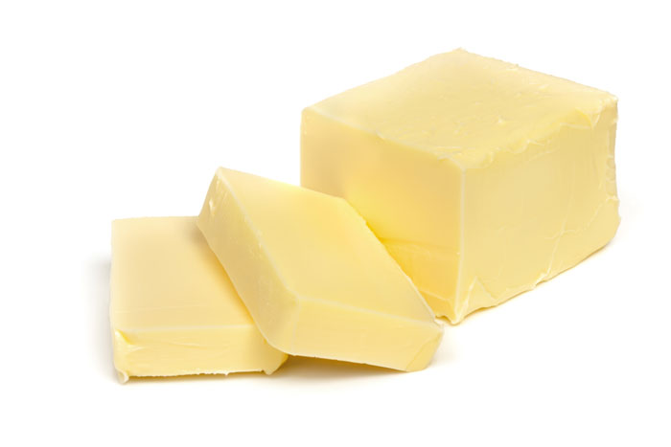
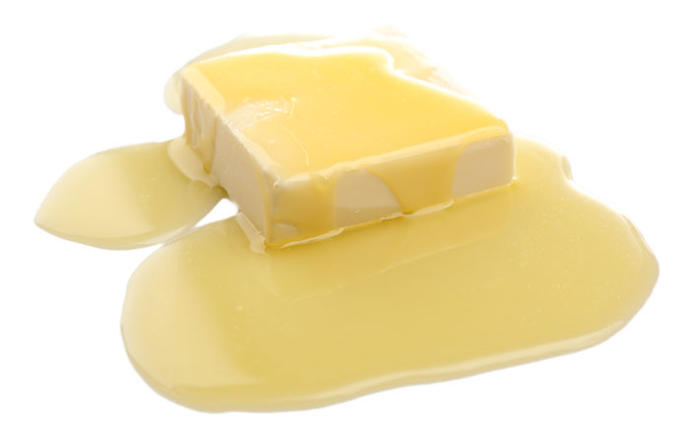
Heating and cooling
Heating or cooling a material can cause it to change.
What changes do you see when butter is heated?
It will start to melt, and will eventually turn to liquid.
Notes:
Teacher notes
Students could list materials that change when they are heated. They could do “before” and “after” drawings of these materials to display around the board.
Photo credits: solid butter © Robyn Mackenzie; melting butter © Africa Studio, both Shutterstock.com 2018

Slide 4
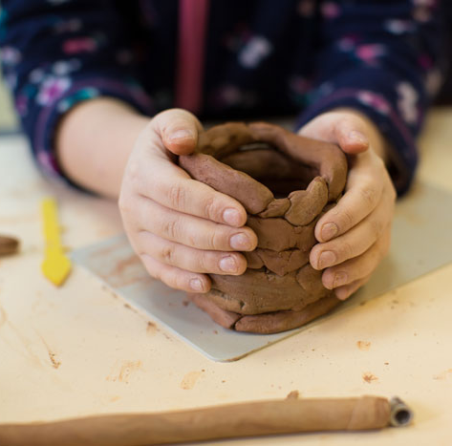
Changing clay
Take a look at how the material called clay can be changed.
A group of students made pots from clay.
The clay was soft and easy to squash, bend, stretch and twist.
Notes:
Teacher notes
Ask: “What do you think clay is?” (A kind of soft, sticky earth dug from the ground).
Photo credit: © Kristina Bessolova, Shutterstock.com 2018

Slide 5
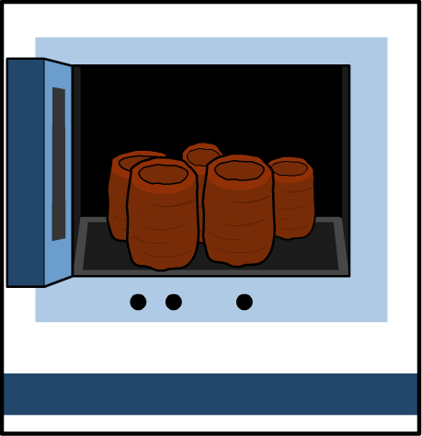
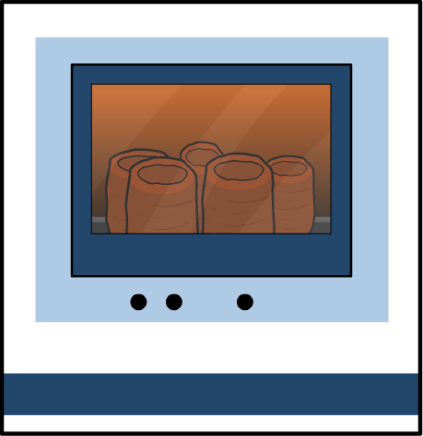
What happens to clay when it is heated?
The clay pots are put in a kiln. The kiln gets very hot and the clay pots are baked.
When they come out, they have changed.
What questions should the students ask to find out how the baked clay is different from the wet clay?
Notes:
Teacher notes
You could show students a wet pot and a baked pot and ask them to describe the differences that they see and feel. You could ask students to design their own investigation to test the pots (if you don’t mind them being broken!)
This slide covers the Science and Engineering Practice:
Asking Questions and Defining Problems: Ask and/or identify questions that can be answered by an investigation.

Slide 6
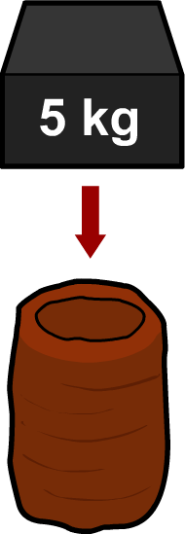
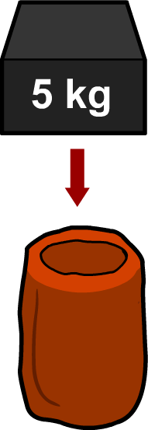
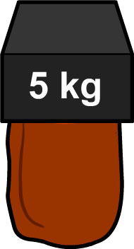
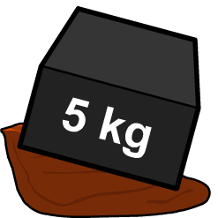
Testing clay – weight
Clay changes when it is baked at a hot temperature.
What will happen when a heavy weight is placed on…
wet clay?
baked clay?
Notes:
Teacher notes
Students could describe the changes they can see between the baked and unbaked clay pots shown onscreen.

Slide 7
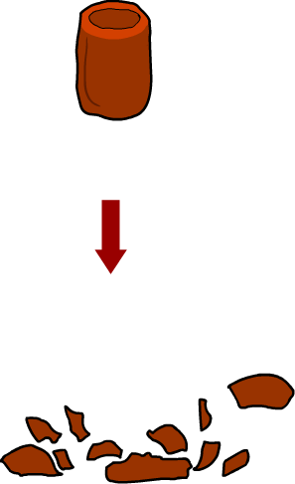
Testing clay – dropping
Clay changes when it is baked at a hot temperature.
What will happen if we drop…
wet clay?
baked clay?
Notes:
Teacher notes
Students could describe the changes they can see between the baked and unbaked clay pots shown onscreen.

Slide 8
Differences between wet and baked clay

Slide 9
The process of heating
Notes:
Teacher notes
Encourage students to describe the process of baking a cake. Can we get the eggs back out of the cake once it has been baked? Students could make a table describing the cake mix before and after it goes into the oven.

Slide 10
How do ice cubes change?

Slide 11
Why do ice cubes change?

Slide 12
Reversable changes
Heating and cooling can change the properties of some materials.
Some of these changes can be reversed, and some cannot.
Let’s think about the clay and ice cubes.
Can baked clay be returned to wet clay?
Can melted ice cube be returned to a solid again?
How can we collect evidence to prove this?
Notes:
Teacher notes
Encourage students to suggest ideas of how to test the clay and ice cubes. You could carry out a practical investigation with different materials, such as ice cubes, an uncooked egg, and a piece of butter. Students could heat and cool the ingredients to see how they change and whether the changes are reversible or irreversible. They can use the evidence from their investigation to construct an argument that some changes are caused by heating or cooling can be reversed and some cannot. If it’s not possible to carry out a practical investigation then the animations on the next two slides provide a good summary.
This slide covers the Science and Engineering Practices:
Planning and Carrying Out Investigations: With guidance, plan and conduct an investigation in collaboration with peers.
Engaging in Argument from Evidence: Construct an argument with evidence to support a claim.

Slide 13
Baking soft clay

Slide 14
The changing state of water
Notes:
Teacher notes
At each stage of the animation, ask students what words they would use to describe what is happening. Appropriate words could include: solid, liquid, gas, melt, freeze, change, cool, warm, flow, change shape, volume, powder, vapor, condensation.
Explain the difference between degrees Celsius and degrees Fahrenheit. Celsius is the metric scale for temperature. Although most countries use Celsius for all temperature measurement, people in the United States usually only use Celsius in scientific contexts. Ask students to give examples of situations in which they might use Celsius or Fahrenheit (in a science classroom, when talking about the weather, etc.).

Slide 15
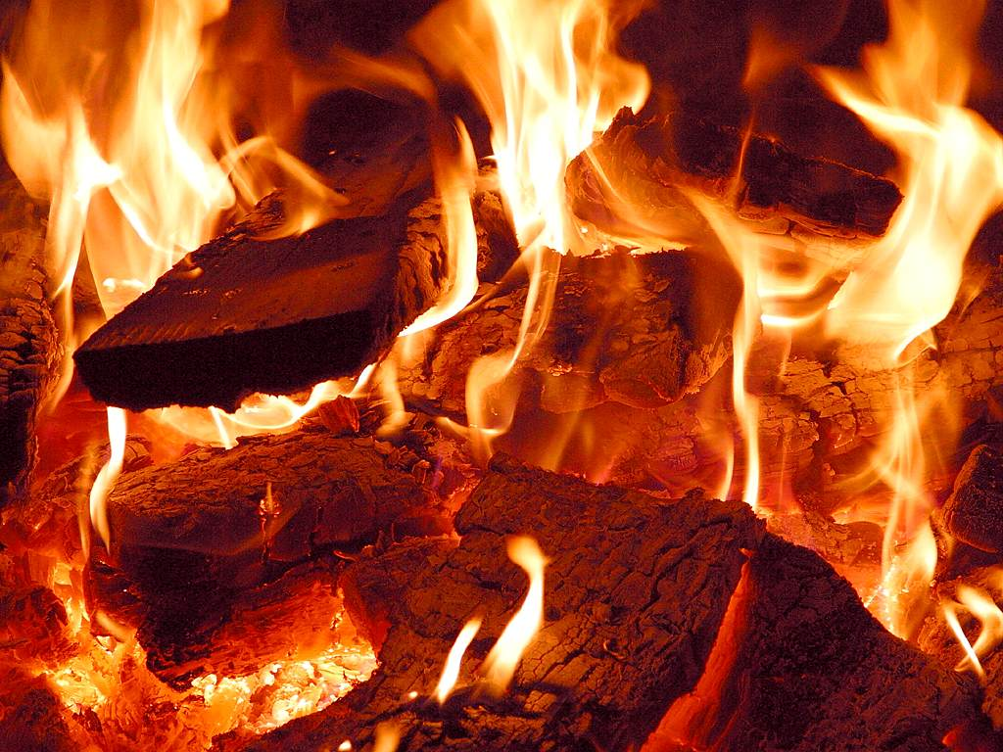
Burning
Burning a material is very different from heating it. When most materials are burned, new materials are made and the change is irreversible.
Burning usually produces smoke and ash.
Smoke contains lots of different things, including some things that we can’t see, called gases.
Notes:
Teacher notes
It may be helpful to tell students that burning is a chemical reaction.
Photo credit: Courtesy of PDPhoto.org

Slide 16
What changes are reversible?

Slide 17
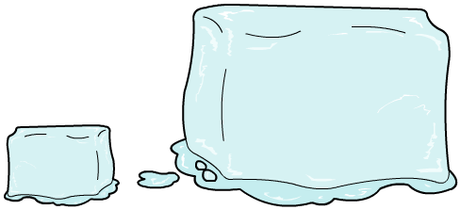
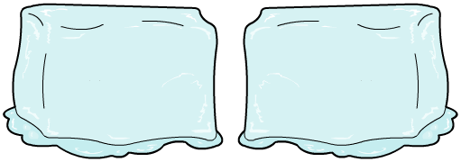
Melting
We can put ice cubes in different places and see which cube melts first.
Which ice cubes should we use to make our test fair?
or
All the cubes need to start out the same size, otherwise the small cubes will melt faster than the big ones.
Notes:
Teacher notes
Allow the class time to discuss which set of ice cubes to use for the onscreen test. Ask: “Does it matter if the ice cubes are all different sizes?”

Slide 18
A melting investigation
Notes:
Teacher notes
Ask students to predict which ice cube will melt first and to give their reasons.
As students watch the animation, ask: “Which ice cube is melting fastest? Is that what you expected?” Students may have expected the outside of the fridge to be cold. Ask: “Is it cold outside of the fridge as well as inside of it?” If possible, students should be taken to a fridge to find out.

Slide 19
The investigation results
Here’s the information from the kitchen experiment.
Place in the kitchen | How long ice cube took to melt
top of fridge | 4 minutes
shelf | 6 minutes
sink | 8 minutes
counter | 10 minutes
stovetop | 2 minutes
Why did the ice cube on the stovetop melt the quickest?

Slide 20
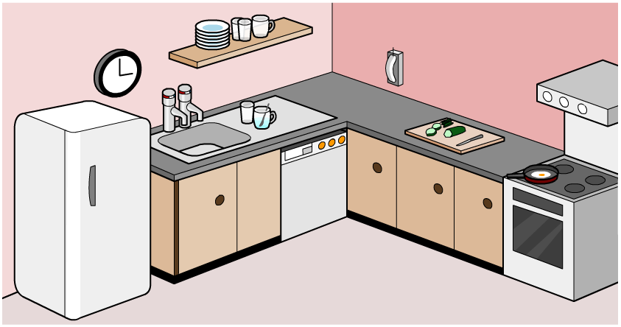
Where was the hottest place in the kitchen?
The stovetop was the hottest place in the kitchen!

