Slide 1
Pollination and Seeds

Slide 2
Information
Asking Questions and Defining Problems
Engaging in Argument from Evidence
1. Patterns
2. Cause and Effect
6. Structure and Function
7. Stability and Change

Slide 3
How do plants reproduce?

Slide 4
Pollination and fertilization
Before flowers can produce seeds, they must be pollinated.
Pollination happens when pollen from one flower is carried to another flower.
Once a flower has been pollinated, fertilization happens.
This produces seeds.

Slide 5
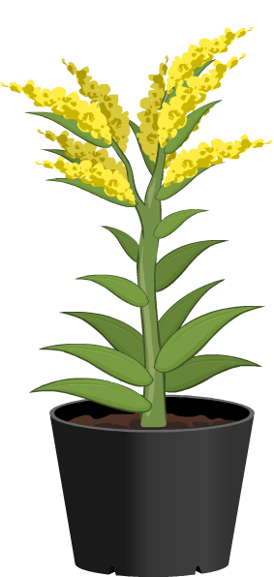
Pollinators
How do you think pollen is carried between flowers in pollination?
Animals can pick up pollen
from one flower and carry it
to another one.
Lots of plants depend on
animals to do this job for them.
However, some plants are pollinated in a different way, such as by the wind.

Slide 6
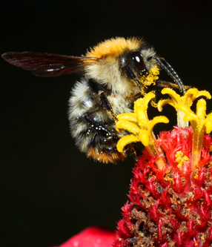
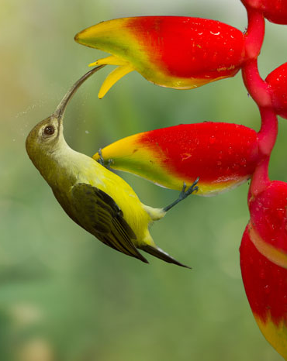
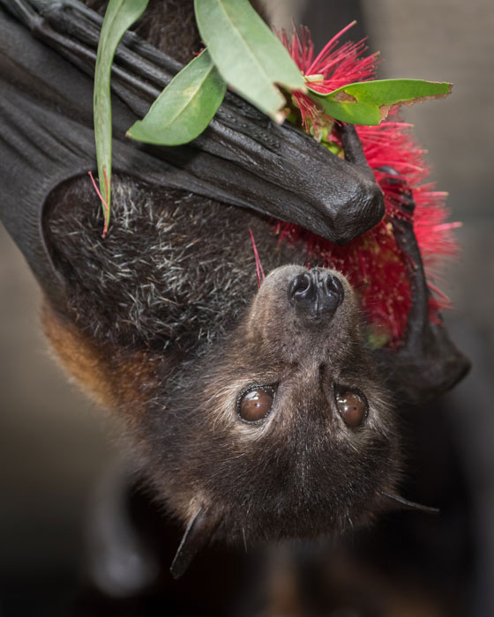
What types of animals help pollination?
Can you name any types of animal that pollinate plants?
insects
birds
bats
Notes:
Photo credit: Bee © Kletr; Bird © noicherrybeans; Bat © Puffin's Pictures; all Shutterstock.com 2018

Slide 7
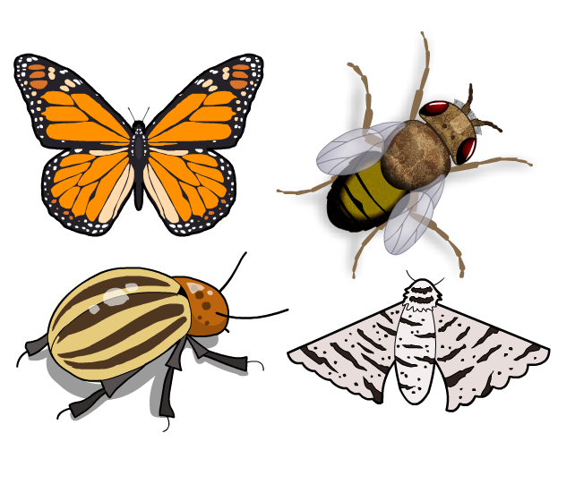
Pollination and insects
Insects are very important pollinators.
Thousands of different types of plants are pollinated by insects all over the world!
Many types of insects pollinate plants:
bees and wasps
beetles
butterflies and moths
flies.

Slide 8
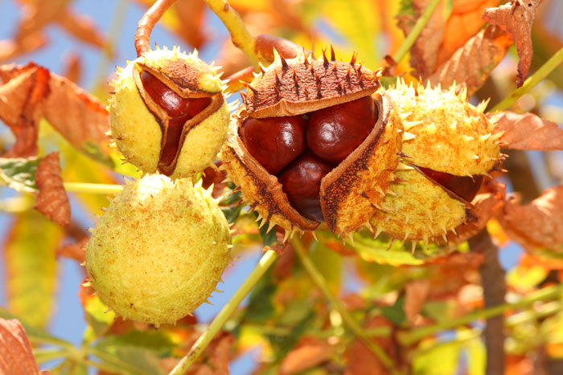
Seeds
Once a flower has been pollinated, fertilization happens and a seed is produced.
A seed can grow into a new plant.
Before this can happen, the seed needs to be carried away so it has its own space to grow.
How do you think this can happen?
Notes:
Teacher notes
Collect students’ ideas about mechanisms of seed dispersal before moving on to the next slide.
This slide covers the Science and Engineering Practice:
Asking Questions and Defining Problems: Ask questions based on observations to find more information about the natural and/or designed world(s).
Photo credit: © Akos Zambori, Shutterstock.com 2018

Slide 9
How are plant seeds spread? (1)
Notes:
Teacher notes
Emphasize that seeds are dispersed so that they have the best chance of survival. Plants must compete for light, water and nutrients. Therefore, it is best for the seeds to grow as far as possible from the parent plant.

Slide 10
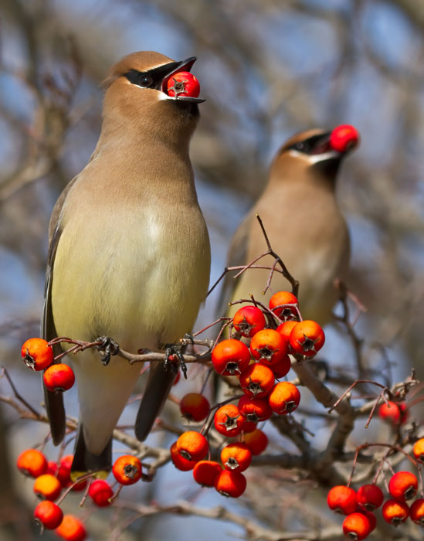
How are plant seeds spread? (2)
Many types of plant depend on animals to carry their seeds to new places so they can grow.
Some plants make their seeds attractive to animals by putting them inside tasty fruit.
Animals eat the fruit and carry the seeds off with them!
Notes:
Photo credit: © LorraineHudgins, Shutterstock.com 2018

Slide 11
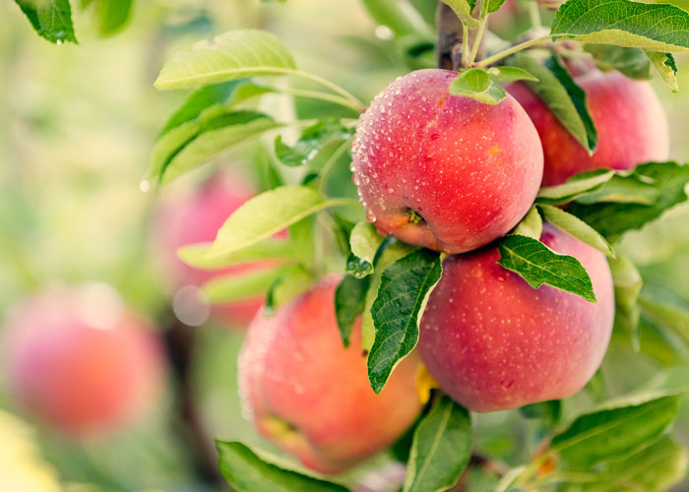
The importance of pollination
Why do you think pollination and seed growth is important to humans?
Fruit and seeds make up an important part of our diet.
Many of the plants used to grow food for humans are pollinated by bees!
What do you think would happen if bees stopped pollinating plants?
Notes:
This slide covers the Science and Engineering Practice:
Engaging in Argument from Evidence: Construct an argument with evidence to support a claim.
Photo credit: © topseller, Shutterstock.com 2018

